Slide 1
CHE 112 Fall 2020
Lecture 1fg – Conversion Factors
Overview/Topics
Units (Imperial and Metric)
Conversions
US ↔ US
US ↔ Metric
Metric ↔ Metric
Multistep Conversions
Compound Units
Squares and Cubes
Word Problems
Use of SN, SF, Rounding
Skills to Master
HW 1 f,g
Additional Useful Links
www.chemhaven.org/che111
Khan Academy
Google/You Tube
Read
OER – Chapter 1.6

Slide 2
Conversion – Compound Units
Example: Convert 65 mi/hr to km/sec
Example: Convert 5.0 gallons/sec to mL/day
Can you:
Solve Compound Units Problems
HW 1 f

Slide 3
Conversion – Squares and Cubes
Example: Convert 120 m² to cm²
Example: Convert 35,000 in³ to ft³
Can you:
Solve Squares and Cube Problems
HW 1 f

Slide 4
Conversion – Word Problems
Example: A horse can haul 50.0 lbs of gear up a mountain. If you need to move 1200 kg of gear up a mountain how many horses will you need?
Can you:
Solve Word Problems
HW 1 g

Slide 5
Conversion – Word Problems
Example: You work for a zoo and have decided you want to trade an elephant for some kangaroo’s but will need to do several trades to do this. You can trade 12 apes for 5 snakes, 1 elephant for 9 emu’s, 2 emu’s for 5 koala’s, 3 koala’s for 7 apes and 5 snakes for a kangaroo. How many kangaroo’s can you get if you trade 2 elephants.
Can you:
Solve Word Problems
HW 1 g

Slide 6
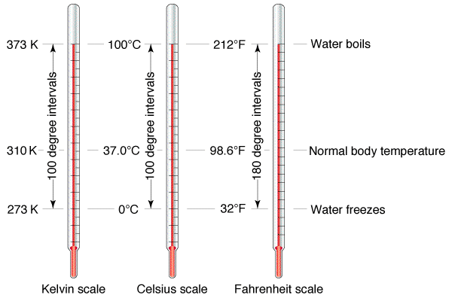
Conversion – Temperature
Slightly different than other units because °F and °C define zero differently and the size of a degree is different.
Linear relationship so we can use an equation to convert between them.
°C and K same sized unit, zero is defined differently
°F = 1.8(°C) + 32
Can you:
Solve Temperature Problems
Lab 1 b

Slide 7
Conversion – Density and Specific Heat
Can you:
Solve Density Problems (Lab 1e)
Solve Specific Heat Problems (Lab 3 and Chapter 9

Slide 8
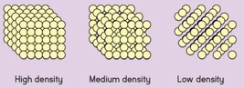
Conversions – Density
Ratio of the mass of an object to its volume
Measure of how closely packed the atoms are in a substance
$$D=\frac{M}{V}$$
M = Mass (g)
V = Volume (mL)
D = Density (g/mL)

Slide 9
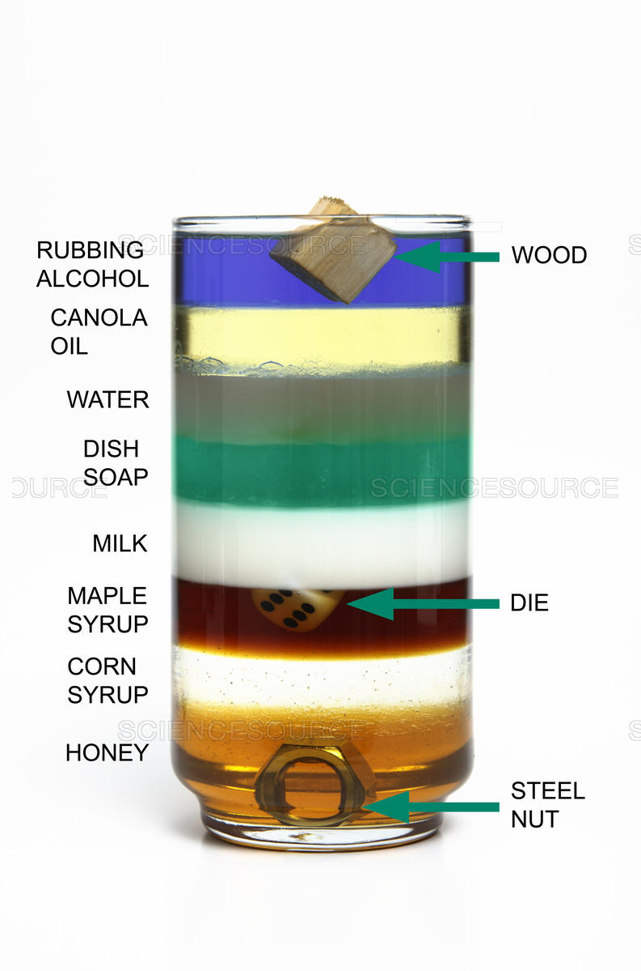
Conversion – Density Columns
Lowest Density
Highest Density

Slide 10
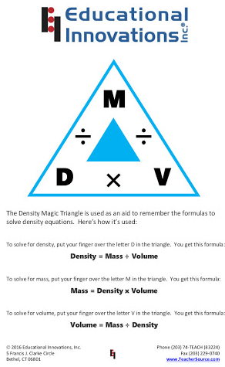
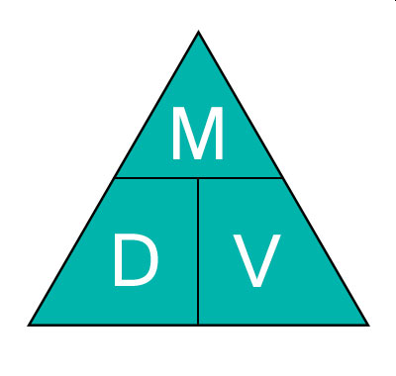
Solving Density Problems

Slide 11
Solving Density Problems (CF Method!)
Density has 2 units (g/ml OR ml/g) therefore it is just a CF like 1 ft = 12 in
Example: What is the mass of 100. mL of gold (Au)?
Example: What is the volume (in L) of 25.0 kg of gold (Au)?
Can you:
Solve for D, M or V
Order Liquids
What are some other CF?
KISSS: Density is Just a Conversion Factor!

Slide 12
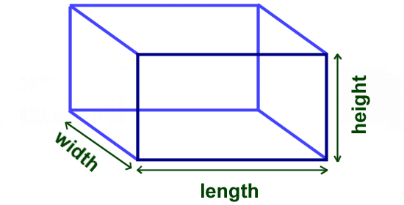
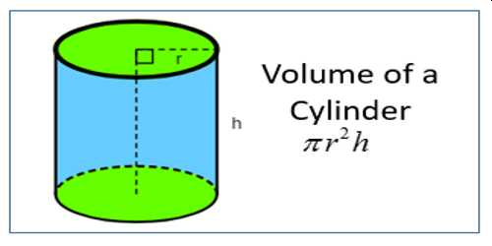
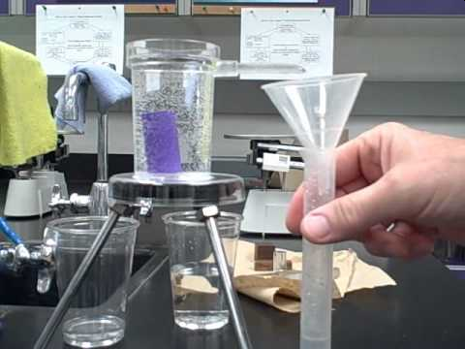
Experimentally Determining Density (2 Methods)
Use a scale
$$D=\frac{M}{V}$$
V = L x W x H
or
Archimedes Principle
Water Displacement

Slide 13
Example: You are given a gold necklace by your significant other. Being the chemist that you are (or may become) you decide to test if its real gold. You go into your chemistry lab and the necklace weighs 150 grams and when placed in a graduated cylinder the level of water changes from 55.0 mL to 66.6 mL. Is the necklace pure gold?

Slide 14
Conversion – Energy and Pressure
Can you:
Remember it for the Future!
Chapter 3 Electromagnetic Energy
Chapter 8 Gases
Chapter 9 Thermodynamics

Slide 15
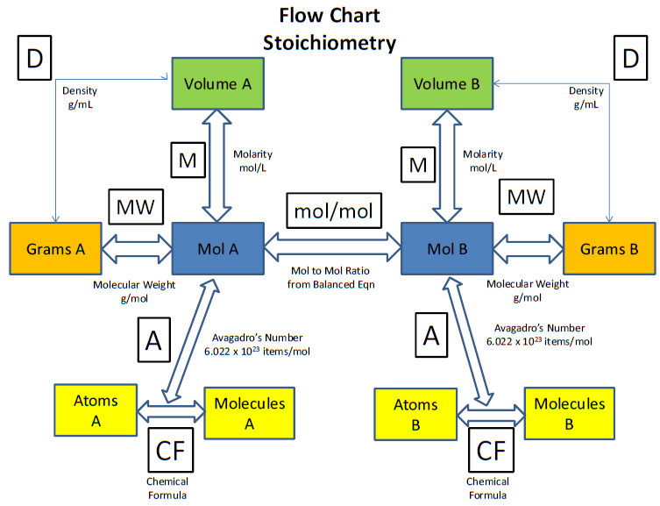
Conversion – Stoichiometry
Can you:
Chapter 2, 6, 7

