Slide 1
CHE 111 Fall 2020
Lecture 1 cde – Units and Conversion Factors
Overview/Topics
Units (Imperial and Metric)
Conversions
US ↔ US
US ↔ Metric
Metric ↔ Metric
Multistep Conversions
Compound Units
Squares and Cubes
Word Problems
Use of SN, SF, Rounding
Skills to Master
HW 1 c-e
Additional Useful Links
www.chemhaven.org/che111
Khan Academy
Google/You Tube
Read
OER – Chapter 1.6
Read Lab 1 a,b

Slide 2
Cheat Sheet: You will have Table 28.1 on all exams

Slide 3
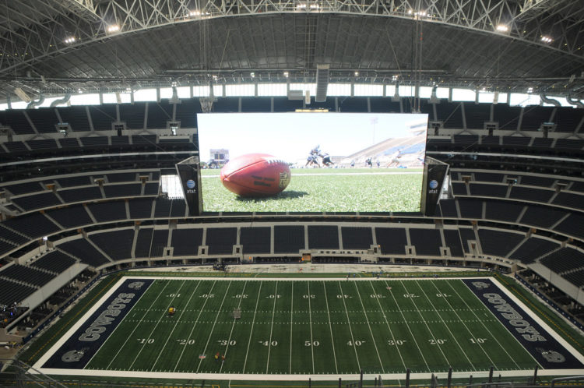
Review
Why are Units Important?
96 cm TV
Lecture 1a
HW 1 a,b
Uncertainty (or Error)
96 inch TV
150.0 ± 0.1 lb
Magnitude
Units
Lab 1 a-e
Today’s Lecture
HW 1 c-f
96 foot TV?

Slide 4
Units – General Information
Numbers w/o units are meaningless
SI System
Base Units vs Derived Units
Imperial (USA) vs Metric
Common Units and Abbreviations
What Unit should I use?
Cheat Sheet: Learn it, use it, love it!

Slide 5
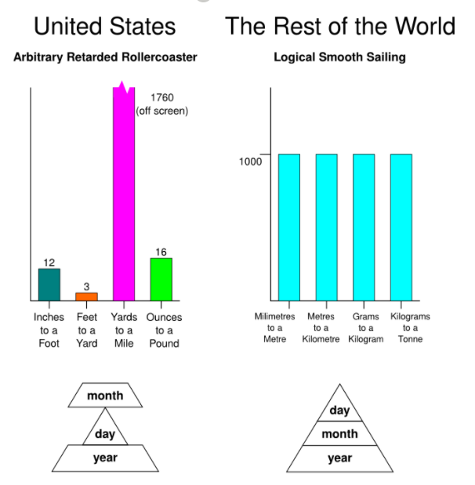
Units – General Information
Numbers w/o units are meaningless
SI System
Base Units vs Derived Units
Imperial (USA) vs Metric
Common Units and Abbreviations
What Unit should I use?
The Good – Metric System
The Bad – whatever system the problem is in
The Ugly – HW 1 c-g

Slide 7
Typical Units and Abbreviations
Units of Mass
Units of Volume
Units of Length
Units of Time
Units of Temperature
Can you:
Recognize standard units of measurement?
Cheat Sheet: Learn it, use it, love it!

Slide 8
Units – General Information
Numbers w/o units are meaningless
SI System
Base Units vs Derived Units
Imperial (USA) vs Metric
Common Units and Abbreviations
What Unit should I use?
The Good – Metric System
The Bad – whatever system the problem is in
The Ugly – HW 1 c-g

Slide 9
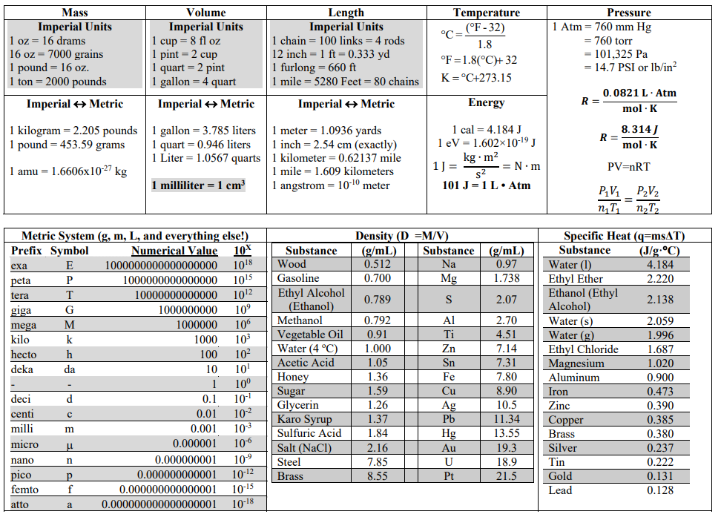

Slide 10
Dimensional Analysis
aka Unit Conversion, Rail and Fence, Conversion Factor Analysis etc.
the process of converting from one set of units to another
Ex: My friend in Canada weighs 75 kg, how many pounds does he weigh?
Google (not allowed on tests) – 165.347 lbs
Memorize 1 kg = 2.205 lb
Cheat Sheet 1 kg = 2.205 lbs
75 kg x 2.205 lbs = 165.347 lbs
How do I know if I should multiply or divide (50/50)?

Slide 11
Dimensional Analysis
$\frac{75 kg}{1} × \frac{2.205 lbs}{1 kg}$ = 165.375 lb
Starting
Value
Conversion Factor
(Cheat Sheet)
Why this works:
The fundamental law of fractions states that the value of a fraction does not change when its numerator and denominator are both multiplied by the same non-zero number
$$\frac{25}{50}=\frac{1×5×5}{1×2×5×5}=\frac{1}{2}$$
$$\frac{1}{2}×\frac{3}{3}=\frac{3}{6}$$
This is just the number 1 “disguised”
Cancel top/bottoms if they are the same

Slide 12
General Process
Types of Problems
Start with the given value
Pick CF, tops/bottoms cancel
May need multiple step
Do the math
Multiply Tops
Divide by Bottoms
Keep track of SF
US ↔ US
US ↔ Metric
Metric ↔ Metric
Multiple Steps
Compound Units
Squares and Cubes
Word Problems
Hints
Be familiar with the many different types of units
Mass vs Length vs Volume
US vs Metric
1 mL = 1 cm³
Try, if you get stuck try something different
Double check that units cancel
Double check SF
Can you:
Use CF to solve problems

Slide 13
Conversion – Single Step / US Units
Example: Convert 53 ft to in
Example: Convert 100. in to ft
Can you:
Solve Single Step Problems
HW 1 c

Slide 14
Conversion – Multiple Steps
Example: Convert 2.50 tons to oz.
Example: Convert 118.5 cups to gallons
Can you:
Solve Multi-Step Problems
HW 1 c

Slide 15
Conversion – US ↔ Metric
Example: 8.5 oz to grams
Example: Convert 7.00 L to pints
Can you:
Solve US-Metric Problems
HW 1 c

Slide 16
Conversion – Metric ↔ Metric
Only 1 table for ALL conversions!
Use table on the CS (don’t move the decimal)
Table reads 1 cm = 0.01 m (1 goes with the prefix)

Slide 17
Conversion – Metric ↔ Metric
Example: 9.5 mL to L
Example: Convert 150 g to Tg
Can you:
Solve Metric-Metric Problems
HW 1 d

Slide 18
Conversion – Metric ↔ Metric
Example: 25,000 μm Mm
Example: Convert 8.50 x 10-⁷ GL to pL
Can you:
Solve Metric-Metric Problems
HW 1 d

