Slide 1
CHE 102 Spring 2021
Lecture 19 h– Review of IMFs
Overview/Topics
IMF vs Chemical Bonds
4 IMF’s
LDF
DD
HB
ID
IMF and BP/MP
IMF and Solubility
Skills to Master
HW 20 d
Read
Chapter 11, 14
Review Chapter on www.chemhaven.org/che102

Slide 2
Chemical Bonds
Intermolecular Forces
Attractive force between atoms
Strong
2 Types
Ionic Bond (IB)
Covalent or Molecular
Determine Chemical Properties
Represented by:
Attractive force between molecules
Weak
4 Types
London Dispersion Forces (LDF)
Dipole-Dipole (DD)
Hydrogen Bond (HB)
Ion-Dipole (ID)
Determine *Physical Properties
Represented by:
Can you:
Differentiate between
$$F=k\frac{q_{1}q_{2}}{r^{2}}$$
*melting point, boiling point, vapor pressure, evaporation, viscosity, surface tension, and solubility

Slide 3
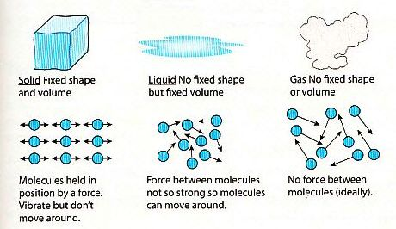
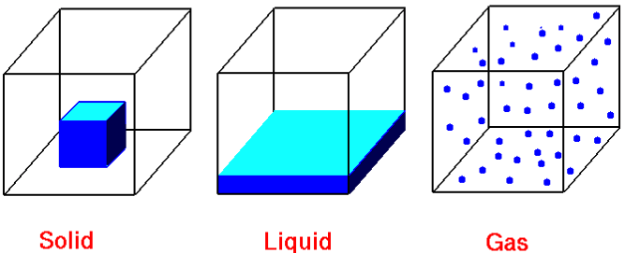
Review Ch. 1
States of Matter
State | Shape | Volume | Particles | Compressibility | IMF/Energy
Solid | Def. | Def. | Ridged, clinging, tightly packed | Very Low | IMF >> Energy
Liquid | Indef. | Def. | Mobile, adhering | Low | IMF ≈ Energy
Gas | Indef. | Indef. | Independent, far apart | High | IMF << Energy
Can you:
Complete the table

Slide 4
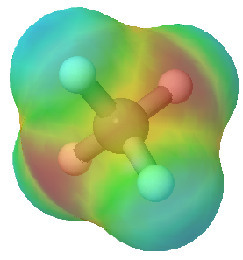
London Dispersion Forces (LDF)
aka – Dispersion forces, van Der Waals Forces
Attractive force between non-polar molecules due to temporary instantaneous dipoles
Occurs in all molecules
Weakest IMF
Proportional to size/# electrons/MW
NP molecules generally are symmetrical
LDF
H
H
LDF
H C H
H C H
Can you:
Define the IMF
Draw an example (not given in class or book)
H
Symmetrical
Nonpolar
H

Slide 5
London Dispersion Forces (LDF)
aka – Dispersion forces, van Der Waals Forces
Attractive force between non-polar molecules due to temporary instantaneous dipoles
Occurs in all molecules
Weakest IMF
Proportional to size/# electrons/MW
NP molecules generally are symmetrical
Normal distribution
of electrons
Normal distribution
of electrons
e⁻
e⁻
e⁻
e⁻
e⁻
e⁻
No Attractive Force
e⁻
e⁻
e⁻
e⁻
e⁻
e⁻
e⁻
e⁻
e⁻
e⁻
e⁻
e⁻
e⁻
e⁻
e⁻
LDF
e⁻
e⁻
e⁻
e⁻
e⁻
e⁻
e⁻
e⁻
e⁻
e⁻
e⁻
δ⁻
δ⁺
δ⁻
δ⁺
Can you:
Define the IMF
Draw an example (not given in class or book)
Temporary
Instantaneous
Dipole
Induced Dipole
Neighboring Atom

Slide 6
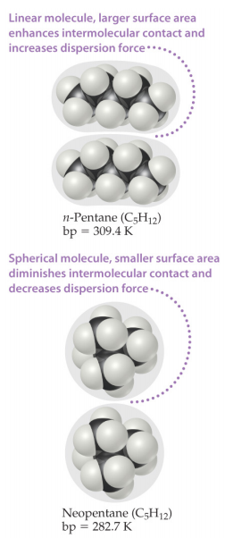
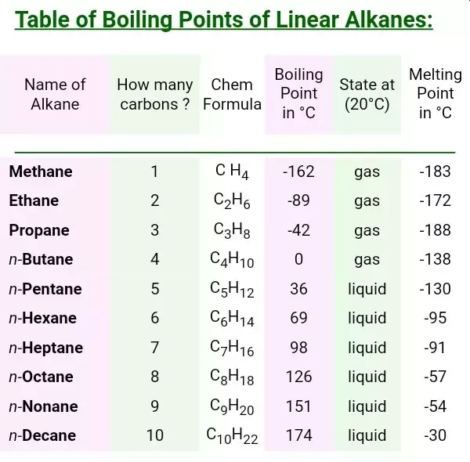
Shape/Size Matters
$$F=k\frac{q_{1}q_{2}}{r^{2}}$$
v.s.

Slide 7
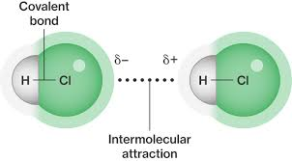
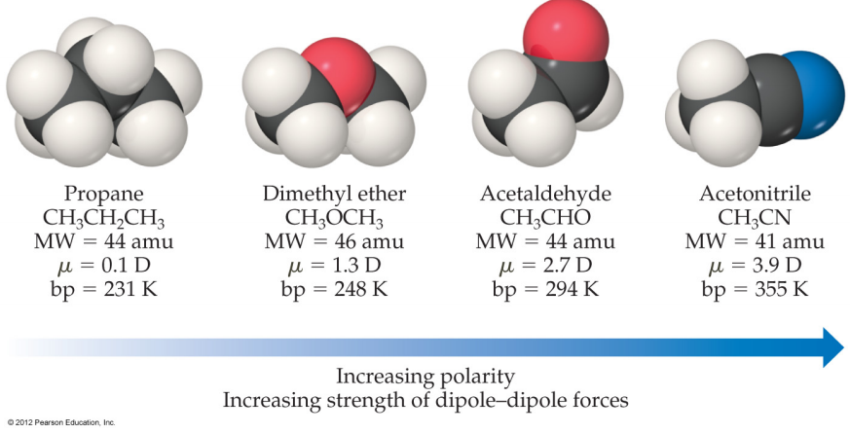
Dipole-Dipole Forces (DD)
Attractive force between polar molecules due to asymmetric distribution of electrons producing partial charges (δ⁺--- δ⁻) that attract two molecules together
Electrostatic Attraction (opposites attract)
2nd Weakest IMF
Proportional to size of the dipole (ΔEN)
DP molecules generally are unsymmetrical
$$F=k\frac{q_{1}q_{2}}{r^{2}}$$
Can you:
Define the IMF
Draw an example (not given in class or book)

Slide 8
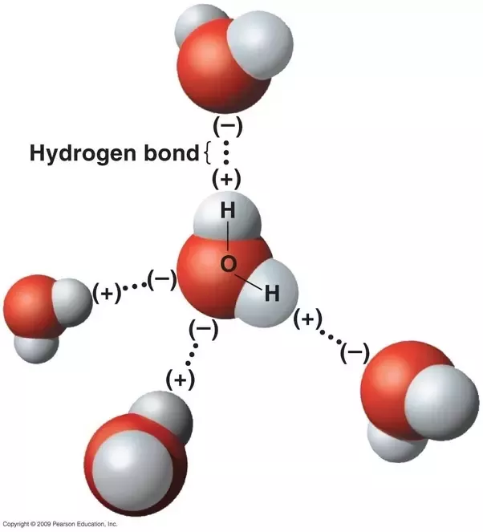
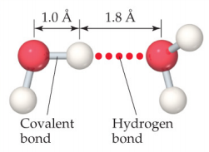
Hydrogen Bond (HB)
Special (stronger) case of DD interactions
H bonded to a small highly electronegative element (O,N,F) is attracted to a lone-pair of electrons or a δ⁻ charge on another molecule.
Hydrogen acts as δ⁺⁺ (stronger than normal partial charge)
Electrostatic Attraction (opposites attract)
2nd Strongest IMF
HB are IMF despite the poor word choice of “Bond”
Can you:
Define the IMF
Draw an example (not given in class or book)

Slide 9
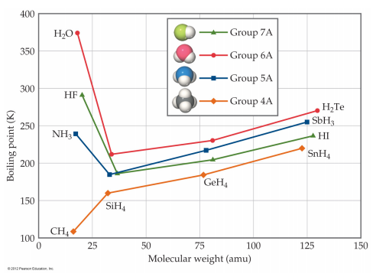
Table 13.2
Importance of HB
w/o HB water would boil at -100 °C
Exceptionally large Heat of Fusion and Vaporization
Second Semester
Solubility
DNA structure
Protein Structure

Slide 10
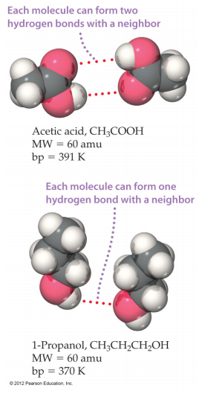
Shape/Size Matters
v.s.

Slide 11
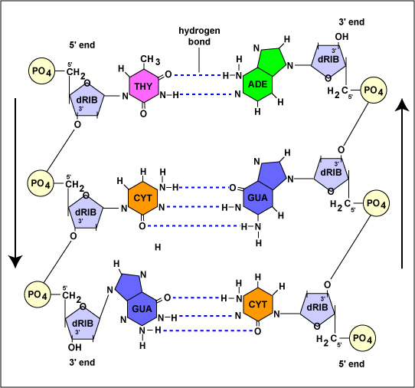
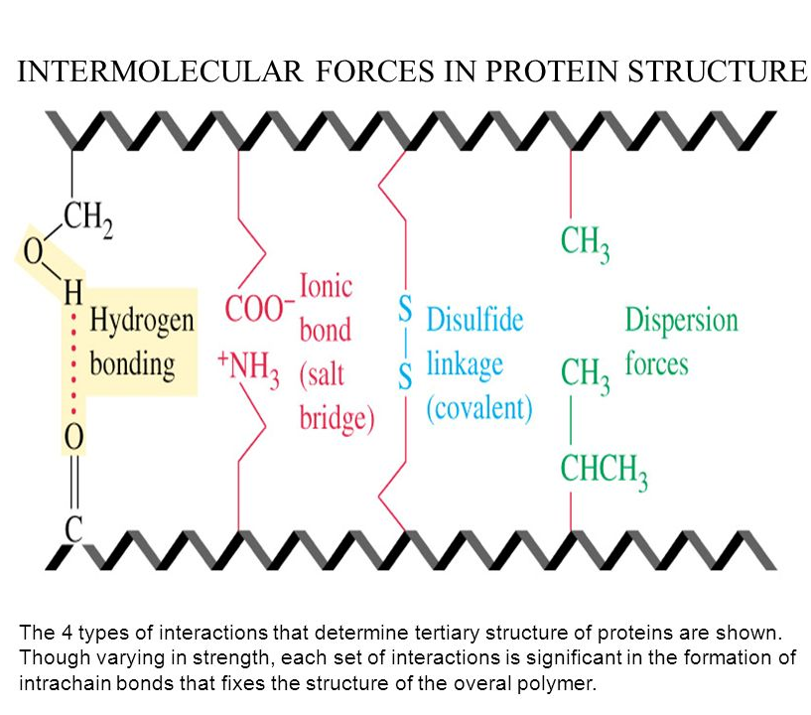
Structure of DNA
Structure of Proteins

Slide 12
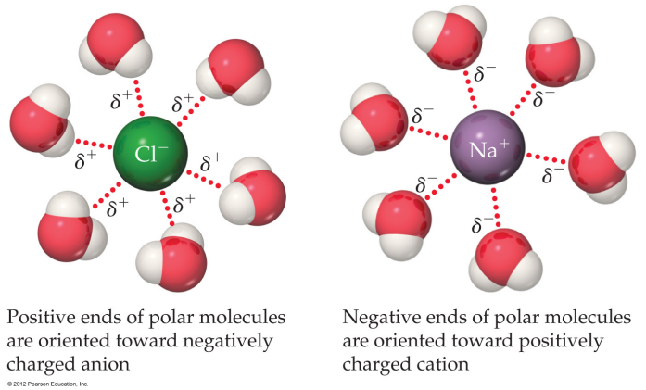
Can you:
Define the IMF
Draw an example (not given in class or book)
Ion Dipole (ID)
Attractive force between ions (full +/-) charges and a dipolar molecule (δ⁺/δ⁻ )
Electrostatic Attraction (opposites attract)
Strongest IMF
“Solvation Shell or Hydration Shell”

Slide 13
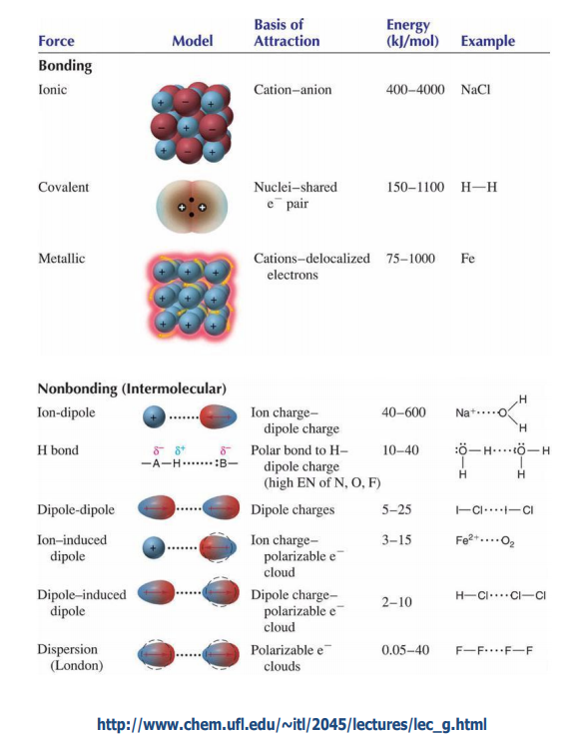
Relative Strength of Different Forces
Don’t memorize value, know relative strengths
Size Dependent

Slide 14
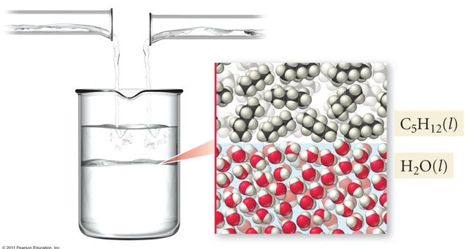
2 General Rules for Solutions
Like Dissolves Like
Oil and Water Don’t Mix
Substances with similar IMF will form solutions
Substances with different IMF will not form solutions
Phase Boundary
ID
HB
DD
LDF
Polar
Nonpolar
Substances are usually soluble +/- one category

Slide 15
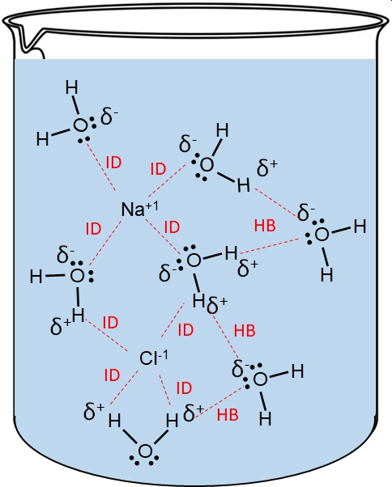
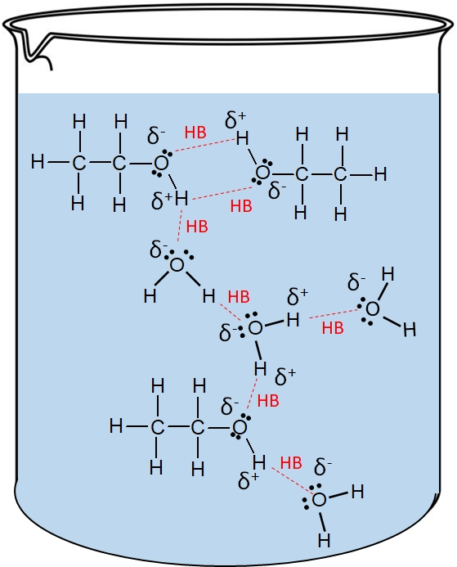
Ionic Compounds dissolve in water
Substances with HB’s dissolve in water

Slide 16
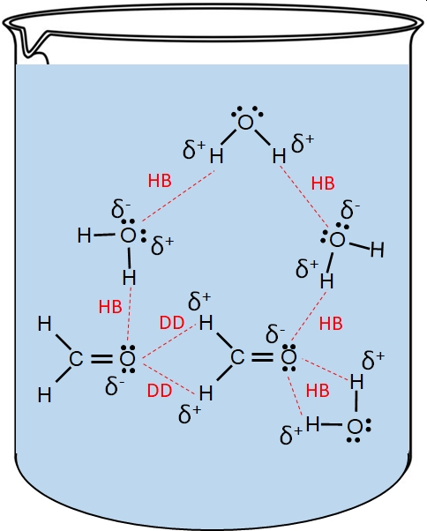
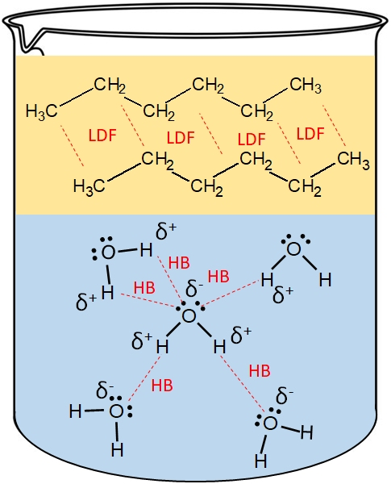
Compounds with LDF will
NOT dissolve in water
Compounds with DD will dissolve in water

Slide 17
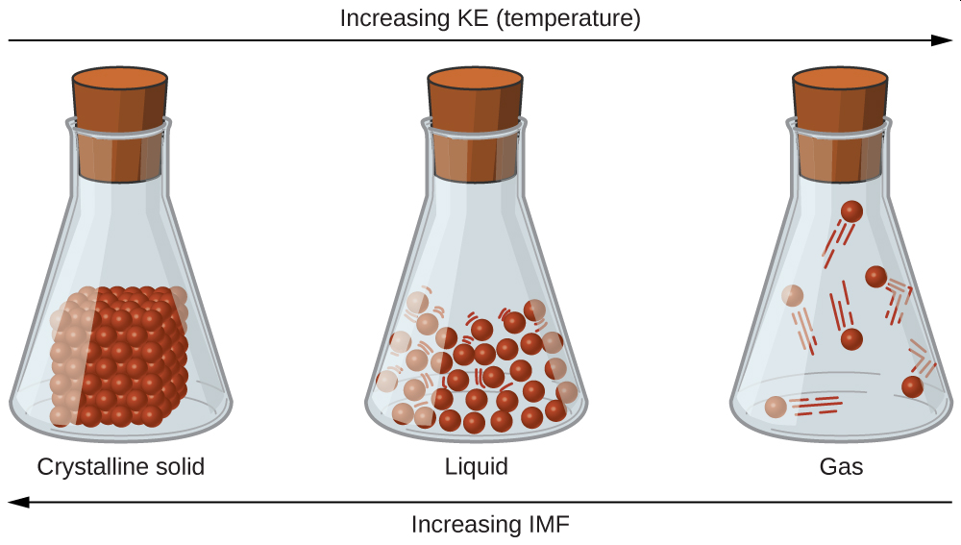
Effect on Physical Properties
Melting Point is Directly Proportional (DP) to IMF
Boiling Point is Directly Proportional (DP) to IMF
Can you:
Identify IMF in molec.
Determine which has the higher/lower Mp/Bp

Slide 18
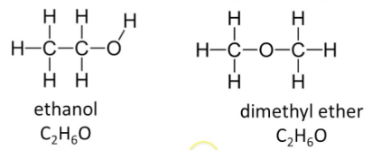
You Try It:
For each molecule indicate what IMF are present:
Which molecule will have the higher boiling point?
Which molecule will dissolve in water better?
Can you:
Identify IMF in molec.
Determine which has the higher/lower Mp/Bp or solubility

Slide 19
You Try It:
For each molecule indicate what IMF are present:
Which molecule will have the higher boiling point?

Slide 20
You Try It:
For each molecule indicate what IMF are present:
Order the molecules from Lowest BP to Highest BP
(a)
(b)
(c)
(d)
(e)

Slide 22
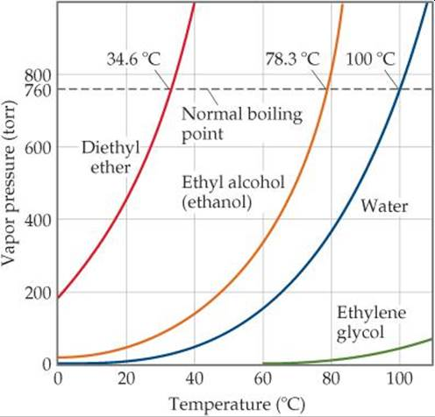
Vapor Pressure
Boiling Point
Intermolecular Forces
Boiling Point is DP IMF
Vapor Pressure is IP IMF
Similar Graph on CS

Slide 23
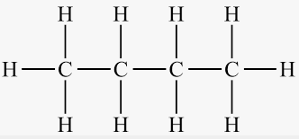
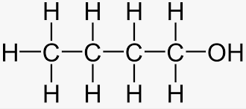
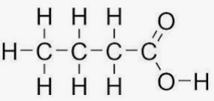
Example
Label all IMF in the following molecules
Order them from Lowest P_{v} to Highest P_{v}
(a)
(b)
(c)
(d)

