Slide 1
CHE 102 Spring 2020
Lecture 35b – Amino Acid Metabolism
Overview/Topics
Big Picture
Nitrogen Fixation
Nitrogen Balance
Transamination
Urea Cycle
Acetyl-CoA “Central Molecule”
Skills to Master
Reactions
What changed/Type of Reaction
Energy – gain/loss/neutral
Oxidation/Reduction
Miscellaneous
Read
Hein 10th Edition
Pages 970-982
Sections 35.5-35.11
Additional Useful Links

Slide 2
Can you:
Identify and/or Draw a Saturated or Unsaturated FA?
Structure -> Physical Properties -> Biological Property
Cheat Sheet: You will have Table 28.1 on all exams

Slide 3
Protein Metabolism (Overview)
Metabolically “Unique”
Nitrogen is problematic (can’t use Elemental N₂)
No common structure (separate pathways for each AA)
3 Main Roles
Building blocks for proteins
Nitrogen source – AA, Nucleic Acids, Hemoglobin, Vitamins etc
Energy
Can you:
Big Picture

Slide 4
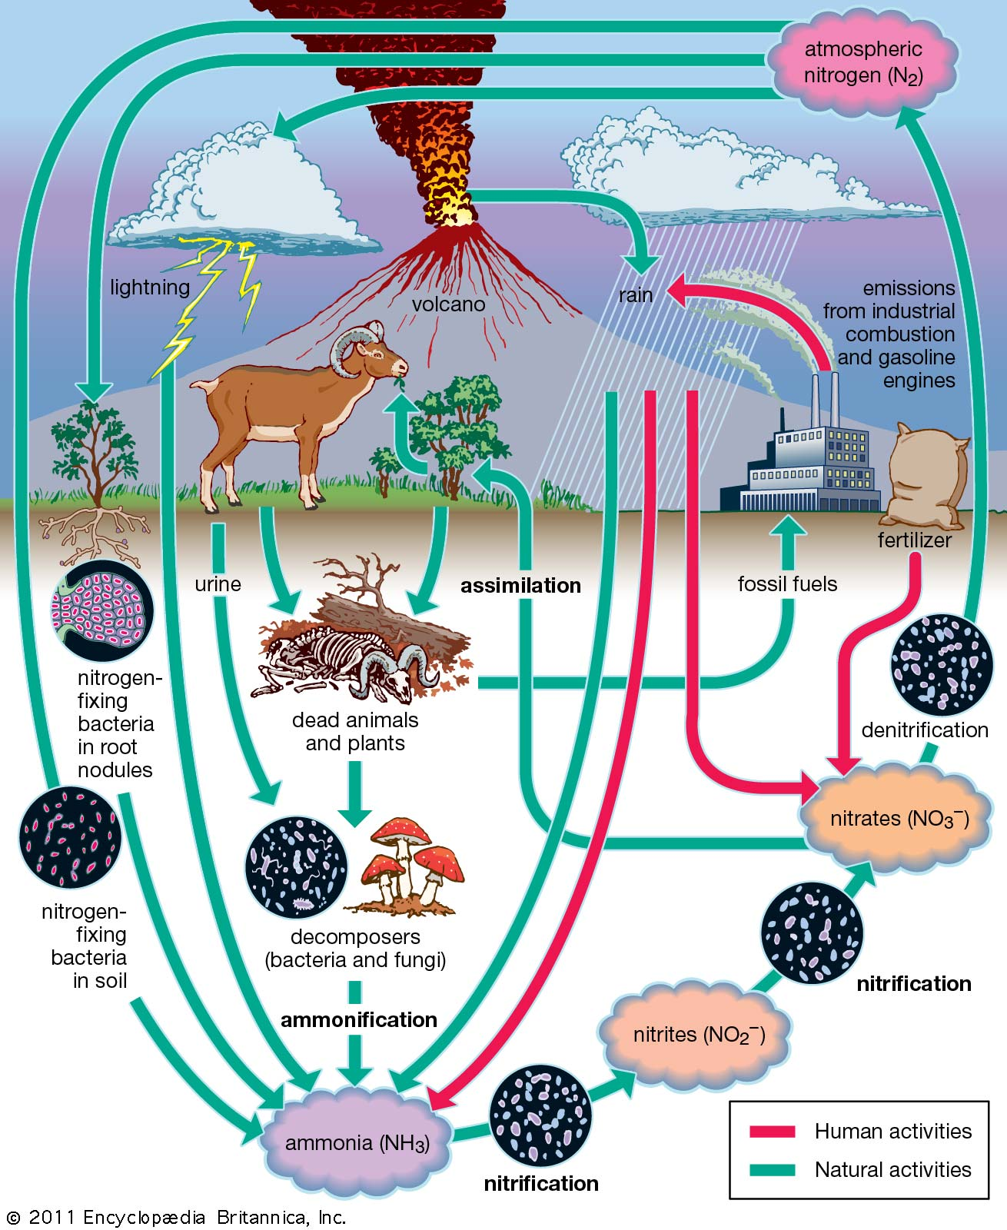
Nitrogen Fixation
N₂= 78% of atmosphere
Cells can’t use b/c
3 Methods of Nitrogen Fixation
N N
Lightning
N₂ NO (dissolved in rain water)
Chemically
400-500 °c
N₂ (g) + 3 H₂ (g) 2 NH₃ (g)
Bacteria
N₂ NH₄⁺ or NO₂⁻
Nitrogen “Cycle” – fixed, circulated, recirculated, returned to atmosphere
Must be obtained in our Diet
Can you:
Why is N₂ complex?
3 methods of fixation

Slide 5
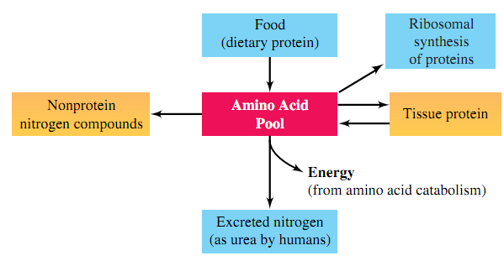
Nitrogen – 3 Main Uses
Protein/Tissue Pool
AA Tissue Proteins
Liver t_{1/2} = 1 week
Muscle t_{1/2} = 6 months
Other Nitrogen Compounds
DNA/RNA
Lipids – Sphingolipids
Nicotinamide Ring (NAD⁺/NADH)
Heme groups
Energy
Deamination or transamination
Form Keto Acids
Synthesize other compounds
Can you:
3 Main Uses

Slide 6
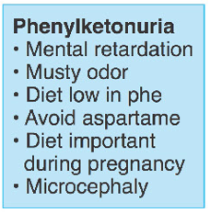
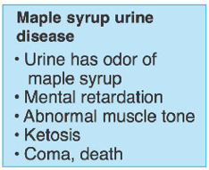
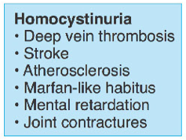
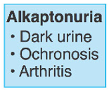
Metabolic Nitrogen Balance
Most AA from Diet
Nitrogen “Balance”
Nitrogen “Pool” = constant (in = out)
Positive Balance – growth (in > out)
Negative Balance– fasting/starving (in < out)
Metabolic Breakdown = many “diseases” (1 example)
Diets and Diet Supplements
Good/Bad/Ugly?
PHE
LEU
Cys
Tyr
Can you:
Nitrogen “Balance”

Slide 7
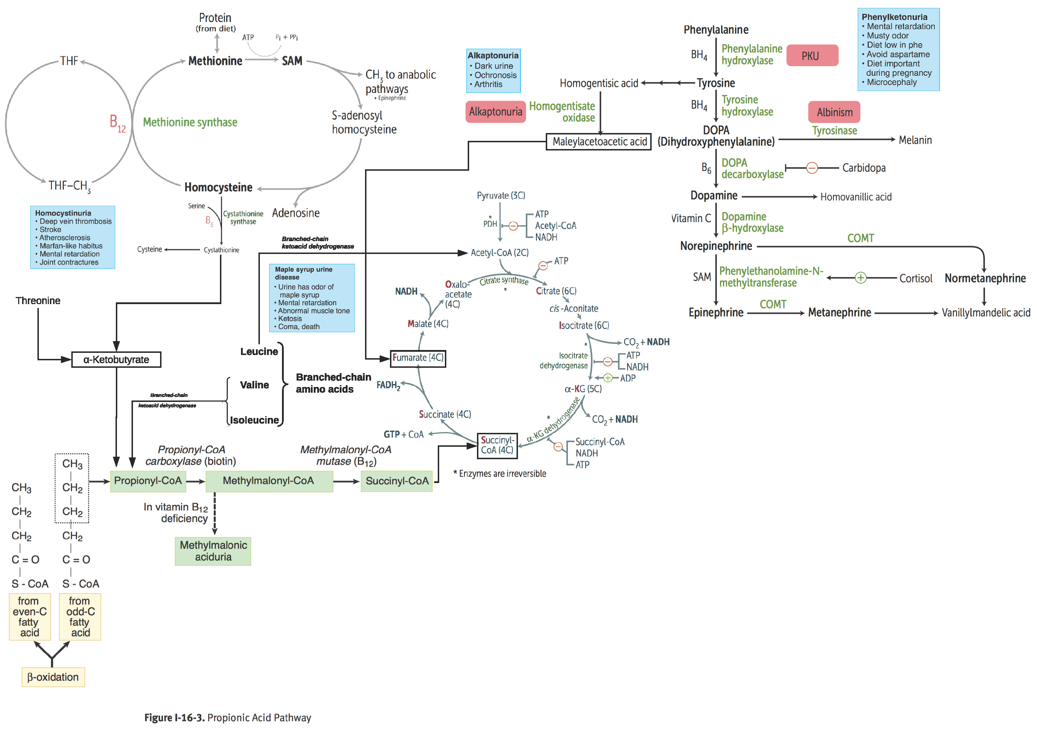
Different Pathways for Different AA
Complicate – Lets skip it!
Can you:
Metabolic Diseases
AA Metabolic Pathways

Slide 8
Nitrogen Transfer (Transamination)
Transamination – removal/transfer of N from AA
α–amino acid → α-keto acid
Unique Enzyme for each Unique AA
Almost
Always L-Glu
Can you:
Structure of AA
Structure of α-keto acid
Complete the Reaction

Slide 9
Transamination Example
Pyruvic Acid → L-Ala
α-carbon
α-carbon
Hint 1: The NH₂ just moves from one alpha carbon to the other
Can you:
Structure of AA
Structure of α-keto acid
Complete the Reaction
Hint 2: Swap the Ketone and the Amine

Slide 10
Transamination – You Try it!
Write out the reaction showing:
Oxaloacetic acid + L-glutamic acid →
Hint: You will always be given the Reactants Side
Can you:
Complete the Reaction

Slide 11
Transamination – Answer
Write out the reaction showing:
Oxaloacetic acid + L-glutamic acid →

Slide 12
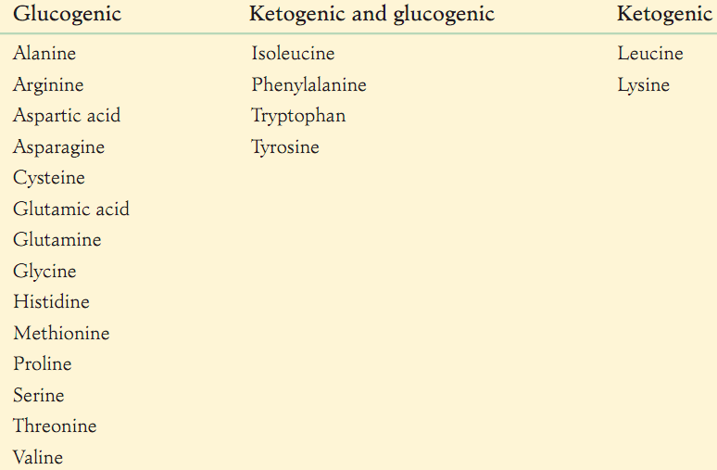
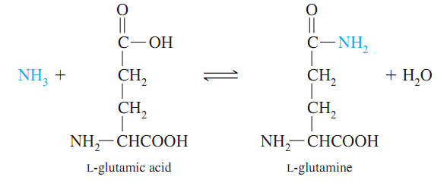
Converting AA to Energy
Transamination 1st step
AA belong to 3 categories
Glucogenic AA (make glucose)
Ketogenic AA (make acetyl-CoA)
L-Glutamine (Central Molecule)
All AA can add/remove amine group
Transfer of “N” around body
Reacts with toxic ammonia (NH₃) to neutralize it
Can you:
Difference between Glucogenic/Ketogenic
Central role of L-Glu

Slide 13
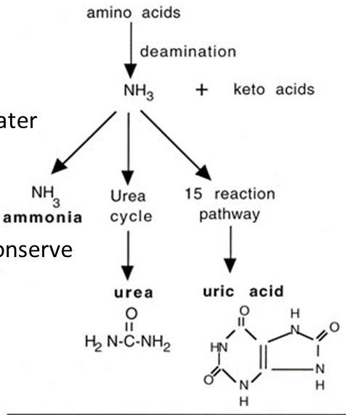
Nitrogen Excretion
Nitrogen is conserved (reused) unless
Excess available (high protein diet)
C-skeleton is used for other purposes (starvation
Ammonia/NH₃ dissolved in water is toxic
Fish piss in the ocean
Birds/Lizards uric acid
Mammals - Excrete in water
Urea
Produced by AA catabolism
50% reused/50% excreted
More on next slide(s)
Uric Acid
Produced by Nucleic Acid metabolism
90% reabsorbed/10% excreted
Skip!!
Requires water
Requires Energy

Slide 14
CAC or Pyruvate or L-Ala
Step 1
Step 2
Can you:
Type of Reaction
Energy gain/lose/neutral
Oxid/Red
Urea Cycle

Slide 15
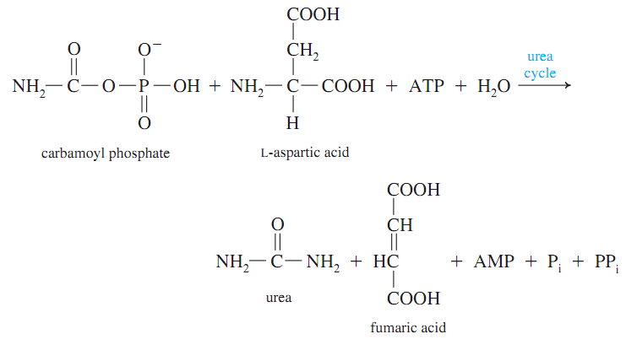
Urea Cycle (Net Reaction)
Can you:
Theoretically the “easy” reactions could be on exam

Slide 16
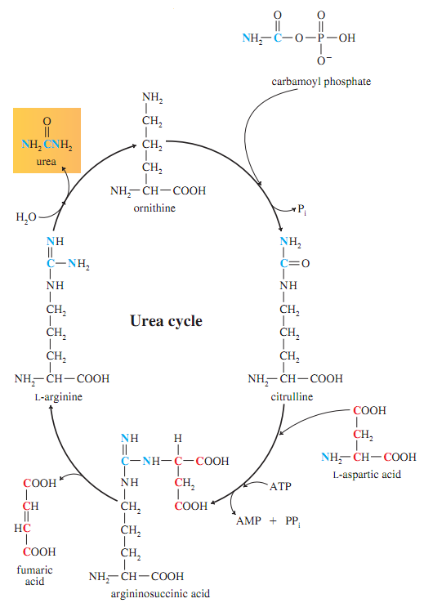
Urea Cycle
Urea cycle intermediates = AA but not used in proteins
Reactions are “complicated” (Skip!!)
Can you:
Theoretically the “easy” reactions could be on exam

Slide 17
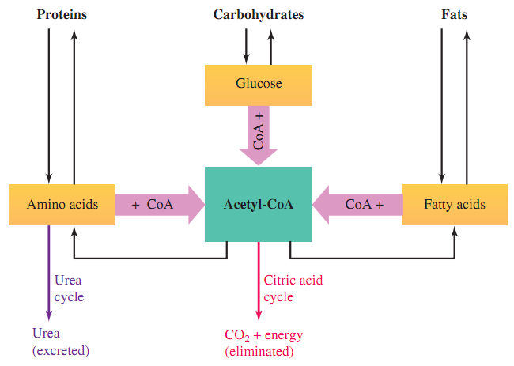
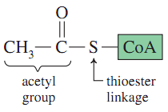
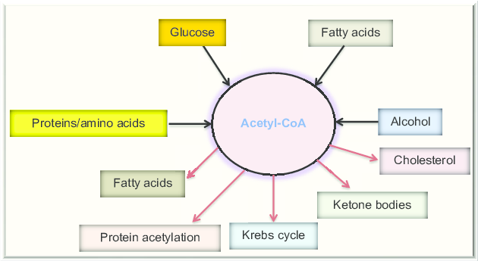
Acetyl-CoA “Central Molecule”
Required to enter CAC
3 Main Reason
2 C = small/simple molecule ideal starting point to build many different molecules
Thioester = Highly reactive
CoA = “handle” = easy for enzymes to bind too
Handle
Simple Building Block
Reactive
Bond

Slide 18
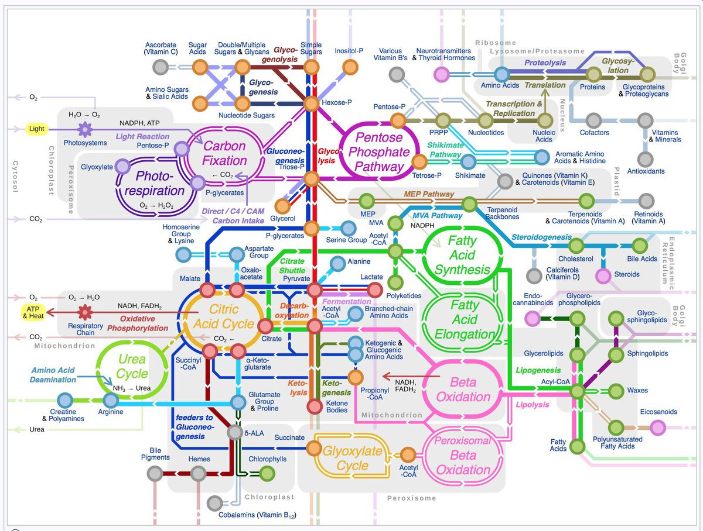
“Central Molecules”
Many Central Molecules
Carbohydrate – Glucose
Proteins – L-Glu
Energy – ATP / Acetyl-CoA
3 Main Advantages
Links many cycles
Efficiency (avoids redundancy)
Simplifies metabolic control

