Slide 1
CHE 102 Spring 2020
Lecture 35a – Lipid and Protein Metabolism
Overview/Topics
Energy storage/locations
β-oxidation
Lipogenesis
Carbohydrates vs FA
Skills to Master
Reactions
What changed/Type of Reaction
Energy – gain/loss/neutral
Oxidation/Reduction
Miscellaneous
Read
Hein 10th Edition
Pages 963-970
Sections 35.1-35.4
Additional Useful Links

Slide 2
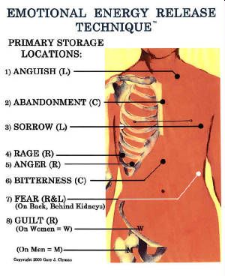
Energy Storage/Distribution
3 Major Energy Sources
Carbohydrates (brain, anaerobic)
Fatty Acids (most dense)
Amino Acids (versatile, N-source)
Amount of Energy storage
Glucose/Glycogen – 1,800 kcal (1%)
FA– 136,000 kcal (84%)
AA/Protein– 24,000 kcal (15%)
Location of Energy storage
Liver – glucose/glycogen
Adipose Tissue – FA
Muscle - protein
Can you:
Relative amounts of Energy
Energy storage locations

Slide 3
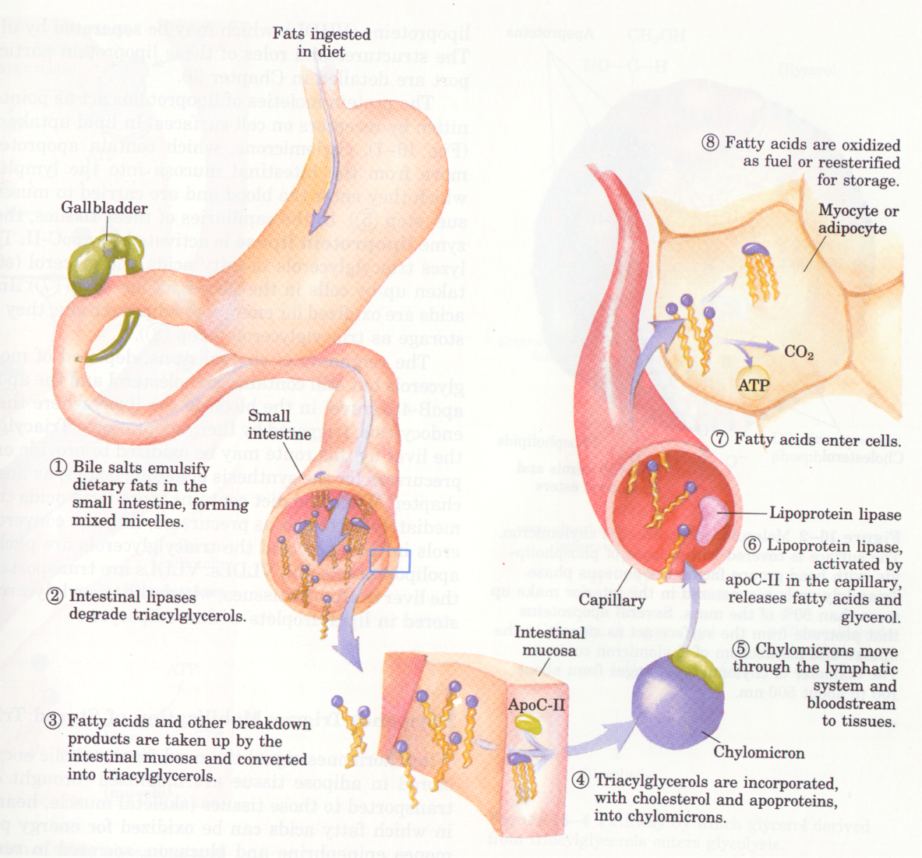
Can you:
See the Big Picture (Ch. 32)
Fatty Acid “Big Picture”

Slide 4
Fatty Acid Metabolism
Occurs in Mitochondria
Aerobic
No ATP formed (only redox coenzymes)
Franz Knoop (1904) - Determined FA are broken up into 2 Carbon Chunks
Pee experiments “Tagged Molecules”
Added Benzene ring to FA with even or odd numbers of C atoms
Collected “Pee”
Concluded broken up 2 C at a time
Took 50 years to “confirm”
β-oxidation (2 Carbon Chop)
Can you:
Concept – “tagged molecules”
3 Basic Facts

Slide 5
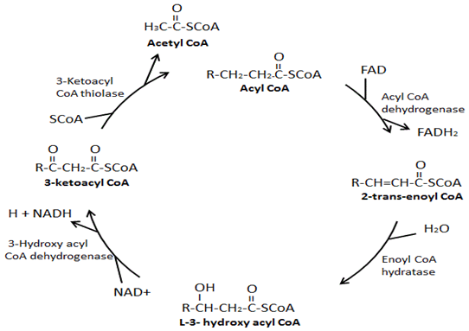
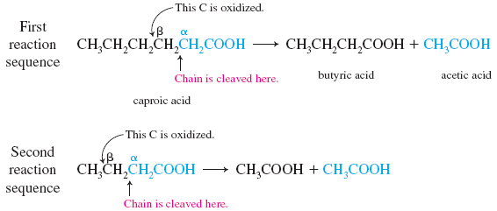
Β-oxidation/2 C Chop Cycle
Initial Step + 4 Repeated Steps
Breaks off 2 Carbon at a time
6 C → 4C → 2C
Final products → CAC
Can you:
Why is it a “Cycle”

Slide 6
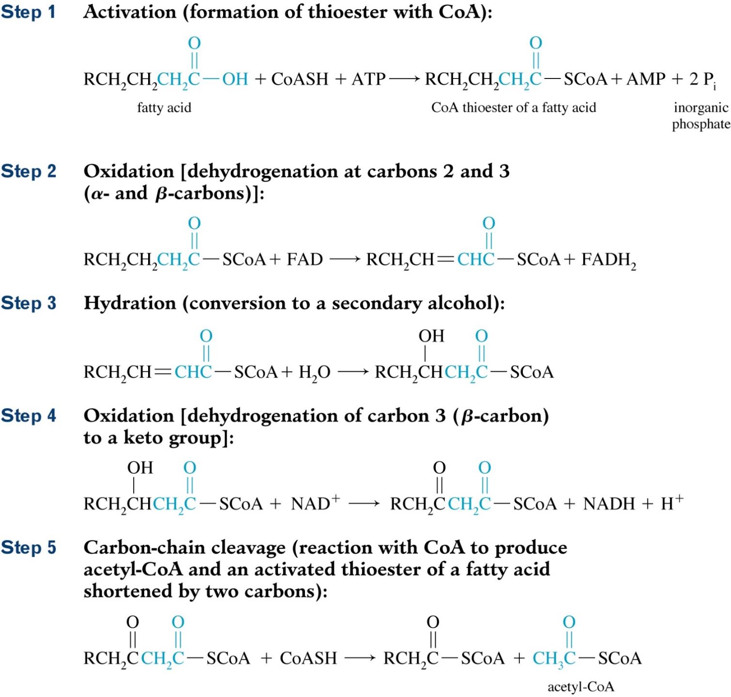
β-oxidation/2 C Chop Cycle
Can you:
Type of Reactions
Changes in FG
Energy Gain/Loss/Neutral
Oxid/Red

Slide 7
Step 1 (Activation)
Step 2 (Oxidation)

Slide 8
Step 3 (Hydration)
Step 4 (Oxidation)

Slide 9
Step 5 (2 C Chop / Cleavage)
Go to Step 2

Slide 10
Example – Decanoic Acid
How many cycles of β-oxidation will occur?
How many NADH are made?
How many FADH₂ are made?
How many ATP are used?
How many ATP are produced?
How many molecules of Acetyl-CoA are transported to the CAC?
How many molecules of ATP can be made in the CAC?
Can you:
Calculate # Cycles
Determine 3 ATP

Slide 11
Example – Decanoic Acid
How many cycles of β-oxidation will occur?
How many NADH are made?
How many FADH₂ are made?
How many ATP are used?
How many ATP are produced?
How many molecules of Acetyl-CoA are transported to the CAC?
How many molecules of ATP can be made in the CAC?
1
2
3
4
10 C → 8 C → 6 C → 4 C → 2 C + 2 C
4 Cycles
1 NADH/cycle = 4 total
1 FADH₂/cycle = 4 total
1 ATP used to start the cycle
Technically no ATP are produced but you can convert the NADH and FADH₂ into 5 ATP/cycle = 20 ATP (-1 to start)
5 molecules
CAC = 12 ATP/cycle = 60 ATP
Can you:
Calculate # Cycles
Determine 3 ATP

Slide 12
Fatty Acids vs Carbohydrates
Glucose (C₆H₁₂O₆)
Hexanoic acid
(C₆H₁₂O₂)
Hexanoic acid
Glucose
2 pyruvates
2 ATP
Hexanoyl-CoA
-1 ATP
2 NADH + H⁺
5 ATP
Hexanoyl-CoA
2 pyruvates
3 Acetyl-CoA
30 ATP
2 Acetyl-CoA
20 ATP
2 FADH₂
3 ATP
2 NADH + H⁺
5 ATP
2 NADH + H⁺
5 ATP
32 ATP
37 ATP
Mwt = 180
Mwt = 116
ATP per Gram = 0.32
ATP per Gram = 0.17

Slide 13
Fatty Acids vs Carbohydrates
Figure 35.1

Slide 14
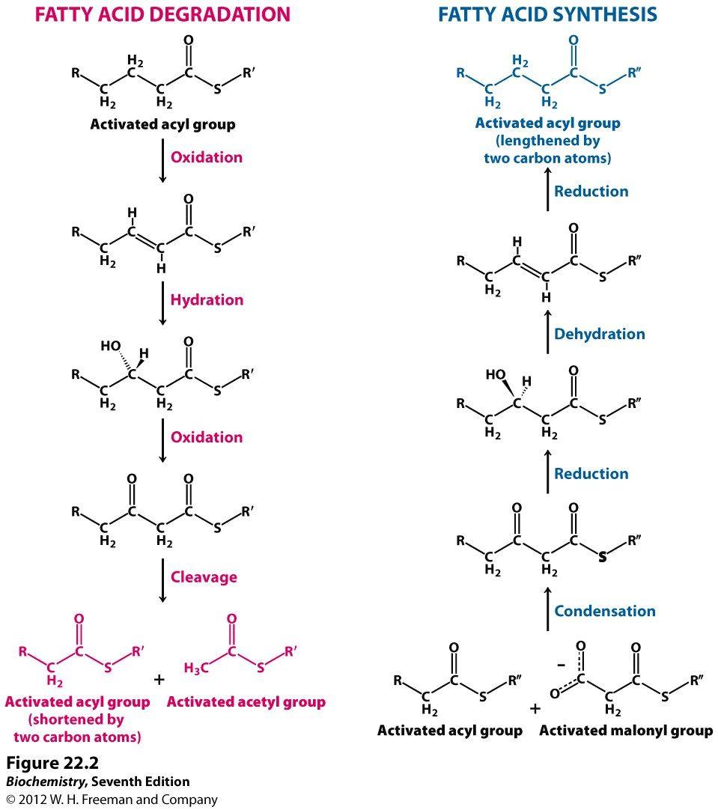
Lipogenesis
Biosynthesis of FA molecules from acetyl-CoA
Not the reverse of β-oxidation
Occurs in Cyctoplasm
Different Enzymes used
Uses different Co-enzyme “Handle” (CoA vs ACP)
Can you:
3 differences between cycles

Slide 15
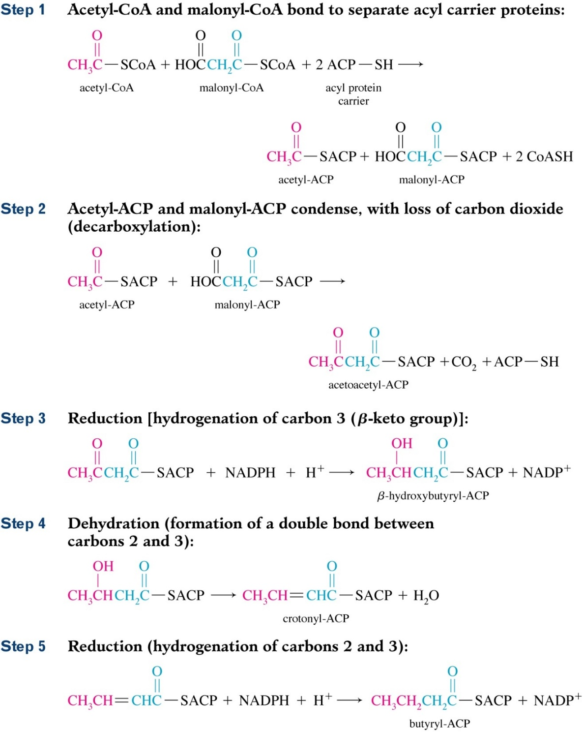
Lipogenesis – All steps
Can you:
Type of Reactions
Changes in FG
Energy Gain/Loss/Neutral
Oxid/Red

Slide 16
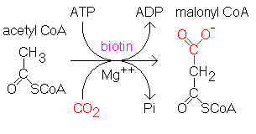
Step 0
Step 0 (Formation of Malonyl-CoA)

Slide 17
Step 1 (Handles Added - ACP)
Step 2 (Condensation/Decarboxylation)

Slide 18
Step 3 (Reduction)
Step 4 (Dehydration)

Slide 19
Step 5 (Reduction)
Go to Step 1

