Slide 1
CHE 102 Spring 2020
Lecture 34abc – Carbohydrate Metabolism
Overview/Topics
Metabolism Basics + Advanced
Cooperation
EMP/Glycolysis
CAC
Hormones
Blood Glucose
Skills to Master
Big Pictures Concepts
Metabolism
Cooperation
Blood Glucose
Reactions
Identify Type
Gain and loss of energy
Catabolic/Anabolic
Oxid/Reduction
Read
Hein 10th Edition
Pages 939-959
Sections 34.1-34.9
Additional Useful Links

Slide 2
Overview
Photosynthesis (Anabolic)
Carbon is Reduced (+4 → 0)
Energy is stored
Many small steps
6 CO₂ + 6 H₂O + 2820 kJ → C₆H₁₂O₆ + 6 O₂
Chemistry (Catabolic)
Carbon is Oxidized (0 → +4)
Energy is released (exothermic)
Single Step
C₆H₁₂O₆ + 6 O₂ → 6 CO₂ + 6 H₂O + 2820 kJ
Biology (Catabolic)
Carbon is Oxidized (0 → +4)
Energy is released (exothermic)
Many, many, many steps (20+)
EMP/CAC
Efficiently extract energy
Can you:
Compare Chemistry vs Biology

Slide 3
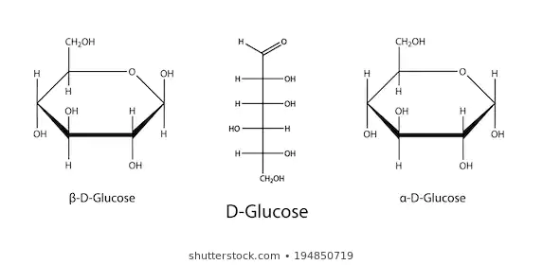
Energy Metabolism “Big Picture”
Basal Metabolic Rate
Man (150 lbs/middle aged) =1800 kcal/day
Women (130 lbs/middle aged) = 1300 kcal/day
3 Types of Storage/Use
Quick use – muscles/ATP (few seconds)
Intermediate – stored glycogen → Glucose → ATP
(2 minutes + lactic acid)
Longer – Liver produces glucose → muscles
75 watt light bulb
Can you:
Definitions
3 Type of Energy use/supply
Tell me why glucose is so important?
Energy Metabolism “Why Glucose”
67% carbon by mass
Easiest to metabolize
Can be aerobic or anaerobic
Brain
100% dependent on glucose
Uses 60% of body supply

Slide 4
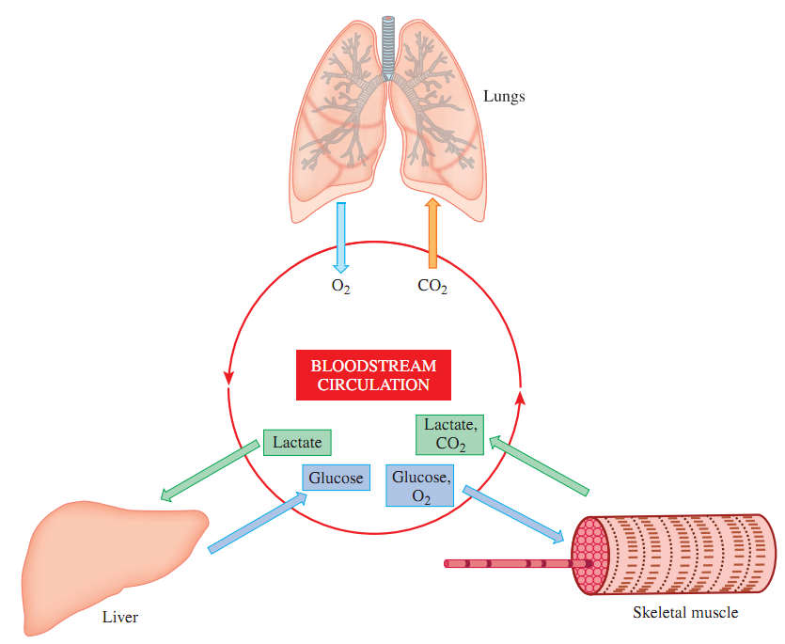
Energy Metabolism “Cooperation”
Lungs
O₂ inhaled
CO₂ exhaled
Blood Acidity ↓
Complicated process
100’s reactions
Many different cell types
Many different organs
Muscles
Use O₂
Produce CO₂
Blood Acidity ↑
Muscles
Use Glucose
Produce Lactate
Blood Acidity ↑
Liver
Release Glucose
Remove Lactate
Blood Acidity ↓
Can you:
Cooperation
Role of each organ
Book: Fig 34.2

Slide 5
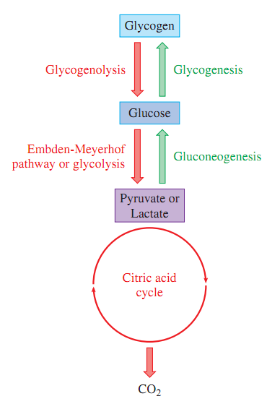
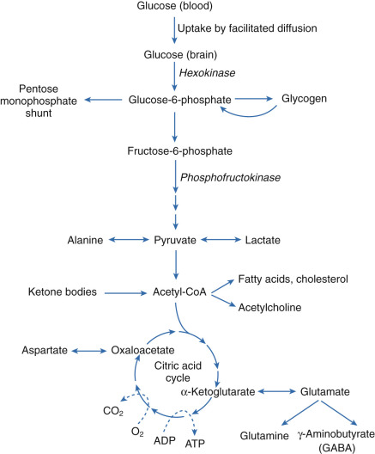
Energy Metabolism “Cooperation”
Storage polysaccharide (Ch. 26)
Energy Storage
(restore blood sugar balance)
(storage after meals)
(Liver)
Energy Production
Can you:
Big Picture
“Definitions”

Slide 6
Metabolic Diseases
What happens when 1 of 1000’s of things goes wrong
Diabetes Mellitus/Hyperglycemia (34.9)
Hypoglycemia (34.3)
Von Gierke Disease (34.3)
McArdle Disease (34.3)
Cancer (Blue box p. 947)
“Skip”: Too much biology, not enough chemistry
Can you:
Know 1 example

Slide 7
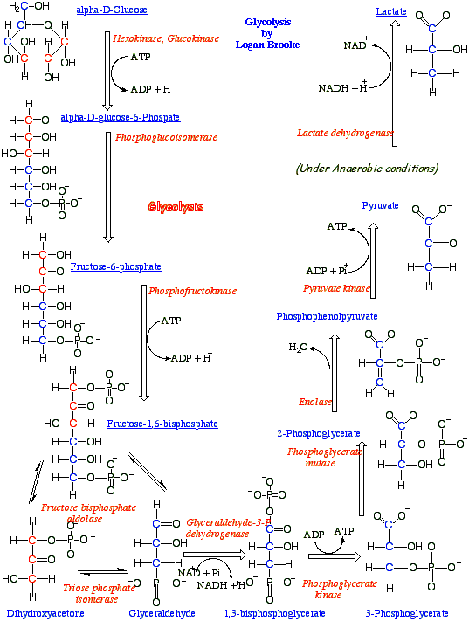
Mastering Metabolism
Learn don’t memorize
Lots of steps
Lots of different pictures
Identify what occurs (reaction type)
Energy gained/lost
Redox Coenzymes/ATP
Can you:
What occurred
Reaction Type
FG gained/lost
Gain/Lose Energy
Oxid/Red
Catabolic/Anabolic

Slide 8
EMP and Glycolysis - Overview
Anaerobic
Cytoplasm
Inefficient (2 ATP made)
Carbon is Oxidized (0 → +4)
Energy is released (exothermic)
Many, many, many steps (10+)
Chemistry/Combustion:
C₆H₁₂O₆ + O₂ → 6 CO₂ + 6 H₂O + 2820 kJ
O
O
=
=
Waste Energy
EMP:
C₆H₁₂O₆ + 2 NAD⁺ + 2H⁺ + 2 ADP + 2 P_{i} 2 CH₃-C-C-O⁻ + 2 NADH + 2 ATP + 150 kJ
Glucose
Pyruvate
30.5 kJ each
*COOH vs COO⁻
O
O
O
=
=
=
Glycolysis:
2 CH₃-C-C-O⁻ + 2 NADH CH₃-C-C-O⁻ + 2 NAD⁺
(EMP + 1 more step)
OH
Citric Acid Cycle
CAC
Net Gain:
2 ATP
61 kJ
Inefficient (61/2820 = 2%)
Waste = 150 kJ
Can you:
Why so many steps?
Start/End Products
Energy Produced vs Wasted

Slide 9
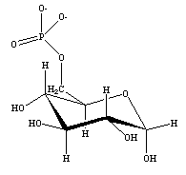
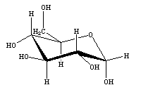
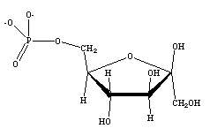
Step 1
Can you:
What occurred
Gain/Lose Energy
Oxid/Red
Catabolic/Anabolic
α-D-Glucose
α-D-Glucose-6-phosphate
ATP
ADP
Hexokinase
Step 2
α-D-Glucose-6-phosphate
β-D-Fructose-6-phosphate
Phosphoglucoisomerase

Slide 10
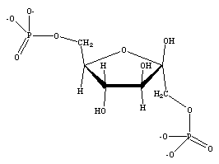
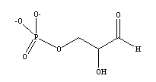
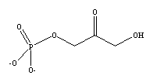
Step 3
β-D-Fructose-6-phosphate
β-D-Fructose-1,6-bisphosphate
ATP
ADP
Phosphofructokinase
Step 4
Glyceraldehyde-3-phosphate
β-D-Fructose-1,6-bisphosphate
+
Aldolase
Dihydroxyacetone phosphate

Slide 11
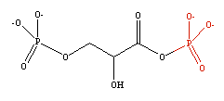
Step 5
Glyceraldehyde-3-phosphate
+
Glyceraldehyde-3-phosphate
Triose phosphate isomerase
Dihydroxyacetone phosphate
Step 6
Glyceraldehyde-3-phosphate
1,3-Bisphosphoglycerate
2 NAD⁺
2 NADH
x2
x2
Glyceraldehyde-3-
phosphate dehydrogenase

Slide 12
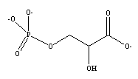
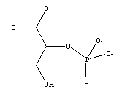
Step 7
1,3-Bisphosphoglycerate
3-Phosphoglycerate
2 ADP
2 ATP
x2
x2
Phosphoglycerate kinase
Step 8
3-Phosphoglycerate
2-Phosphoglycerate
x2
x2
Phosphoglycerate mutase

Slide 13
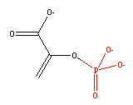
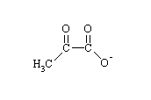
Step 9
2-Phosphoglycerate
Phosphoenolpyruvate
x2
x2
Enolase
Step 10
Phosphoenolpyruvate
2 ADP
2 ATP
Pyruvate
x2
x2
Pyruvate kinase

Slide 14
Net Result - EMP
α-D-Glucose
+
2 ADP
Embden-Meyerhof Pathway
Pyruvate
+
+
2 ATP
Pyruvate

Slide 15
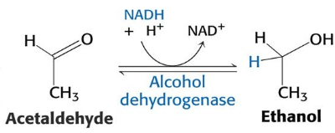
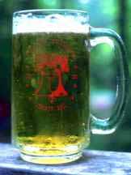
Finishing Glycolysis
w/o oxygen need to recycle NADH to continue cycle
2 mechanisms (human vs yeast)
*COOH vs COO⁻
Lactic Acid
NADH
NAD⁺
Pyruvate
muscles
Acetaldehyde
NADH
NAD⁺
yeast
Can you:
Why recycle?
Yeast > Humans
+ CO₂

Slide 16
Citric Acid Cycle (CAC)
Aerobic Cycle
Mitochondria
Efficient
Net result = 4 NADH, 1 FADH₂ +1 GTP
No ATP, but 15 ATP “equivalent”/pyruvate
Produces 1260 kJ (1260/2820 = 45%)
O
O
=
=
1 CH₃-C-C-O⁻ + 4 NAD⁺ + 1 FAD + GDP + P_{i} + 10 H⁺ + 10 e⁻
3 CO₂ + 4 NADH + 1 FADH₂ + 1 GTP
15 ATP
Can you:
Aerobic
Net Reaction (30 ATP)

Slide 17
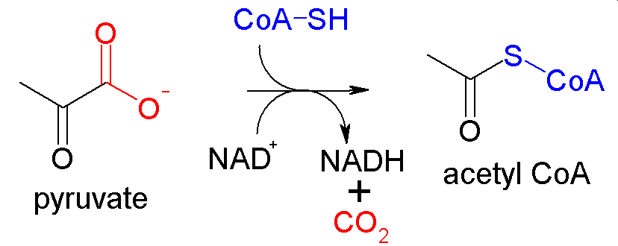
Preparatory Steps (EMP → CAC)
Can you:
ID Link between EMP/CAC
Importance of CoASH
Step a
Lactic Acid
Pyruvate
+ NAD⁺
+ NADH + H⁺
Step b
*requires Niacin, riboflavin, thiamin pantothenic acid

Slide 18
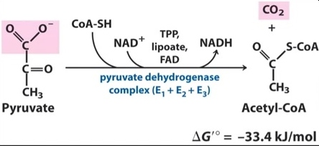
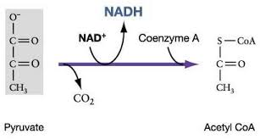
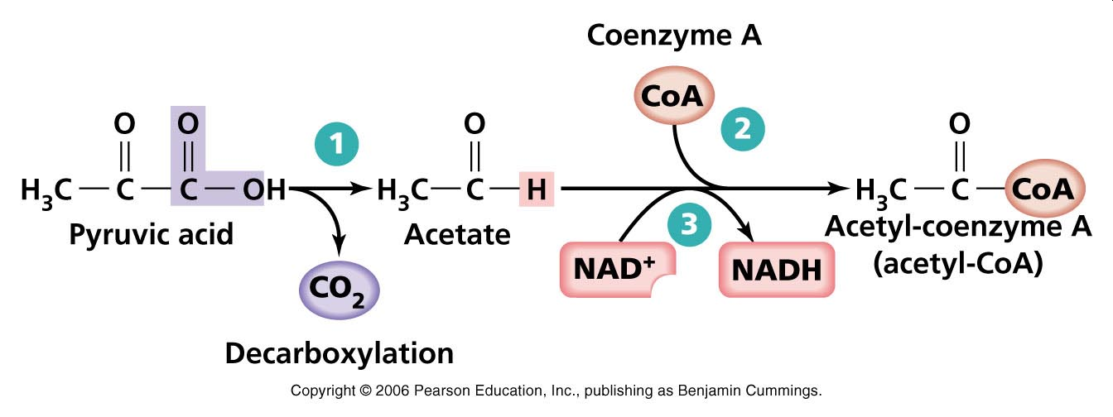
3 Alternative “Views”
Can you:
Understand/Don’t Memorize!

Slide 19
Coenzyme A (CoASH)
Can you:
Just recognize it and why its important
Lots of ways to write it
Coenzyme-A
CoASH
CoA-SH
Big ugly structure we don’t need to know except for the S-H
Used as an enzyme “handle” to bring a molecule to the CAC
The only important
part!

Slide 20
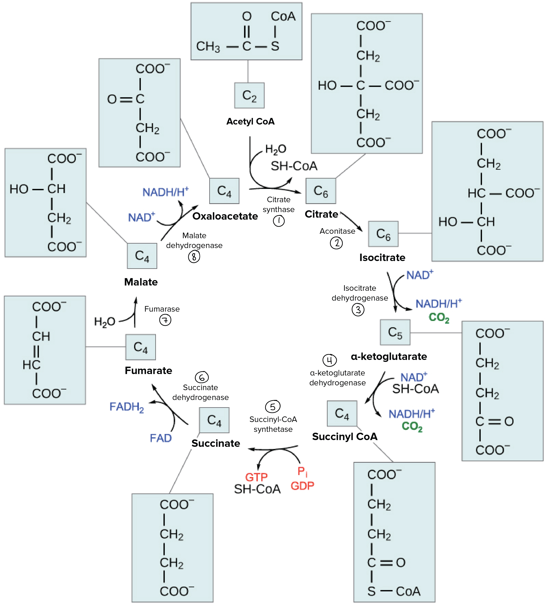
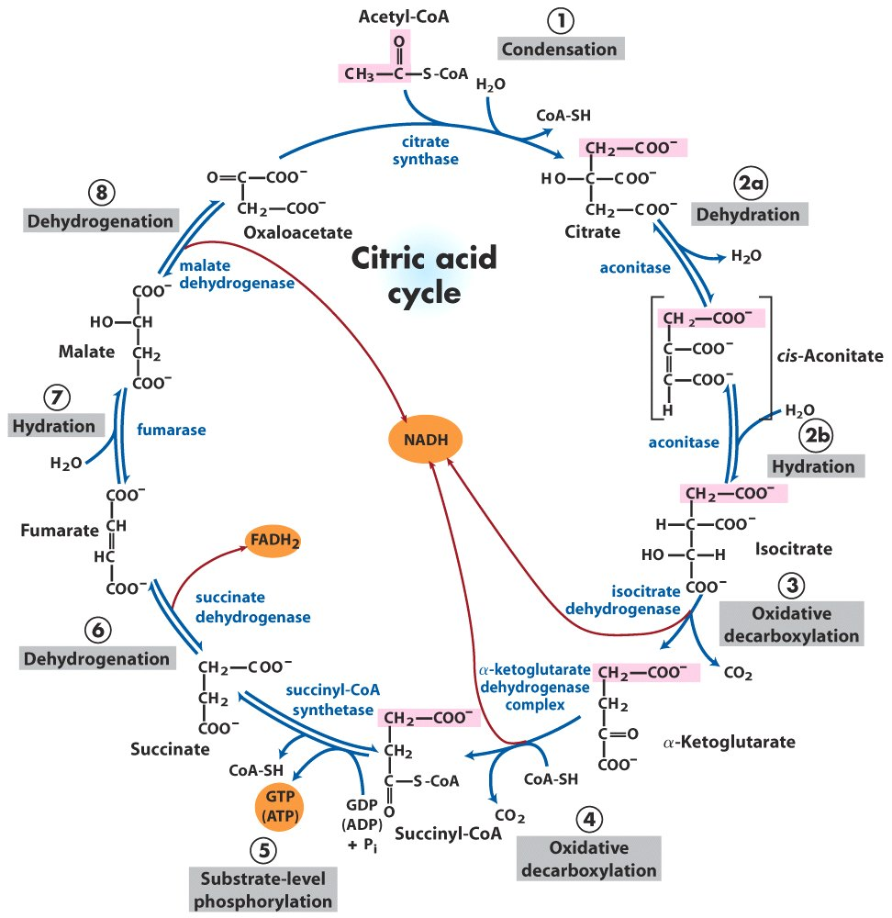
Citric Acid Cycle (CAC)
Many different representations
Don’t memorize it, Understand it!

Slide 21
Can you:
Changes in Structure/FG
Type of Reaction
Energy Gain/Loss
Oxid/Reduction

Slide 22
Can you:
Changes in Structure/FG
Type of Reaction
Energy Gain/Loss
Oxid/Reduction

Slide 23
Can you:
Changes in Structure/FG
Type of Reaction
Energy Gain/Loss
Oxid/Reduction

Slide 24
Can you:
Changes in Structure/FG
Type of Reaction
Energy Gain/Loss
Oxid/Reduction

Slide 25
Can you:
Changes in Structure/FG
Type of Reaction
Energy Gain/Loss
Oxid/Reduction

Slide 26
Can you:
Changes in Structure/FG
Type of Reaction
Energy Gain/Loss
Oxid/Reduction

Slide 27
Can you:
Changes in Structure/FG
Type of Reaction
Energy Gain/Loss
Oxid/Reduction

Slide 28
Can you:
Changes in Structure/FG
Type of Reaction
Energy Gain/Loss
Oxid/Reduction

Slide 29
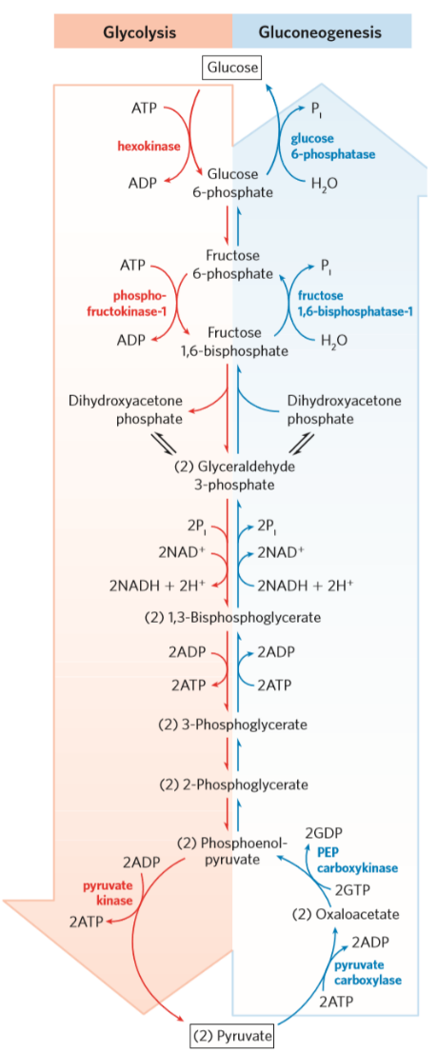
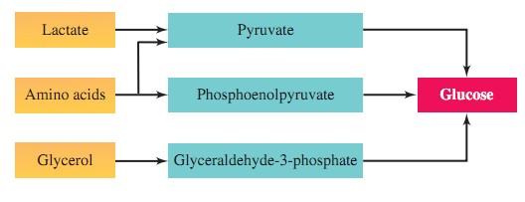
Gluconeogenesis (GNG)
Reverse of glycolysis
Converts many molecules back to glucose
Lactate
Amino Acids (Alanine, Glutamine)
Glycerol (from Triacylglycerides)
Occurs primarily in liver, kidneys (other places also)
Example of a “Complex Metabolic Pathway”
Don’t memorize any reactions, but could appear on exam
Can you:
Define it
Why its important
https://en.wikipedia.org/wiki/Gluconeogenesis

Slide 30
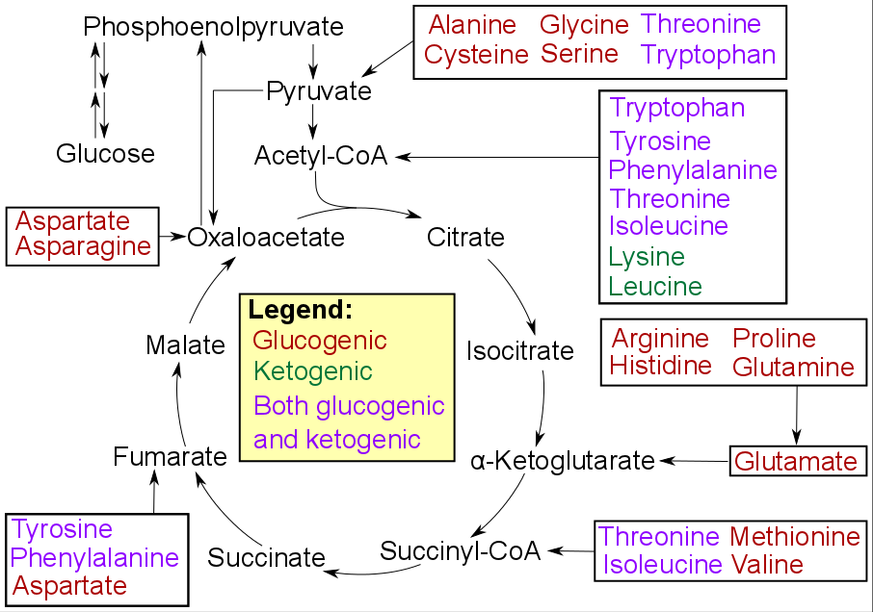
Can you:
Recognize key molecules
Don’t memorize it, use it

Slide 31
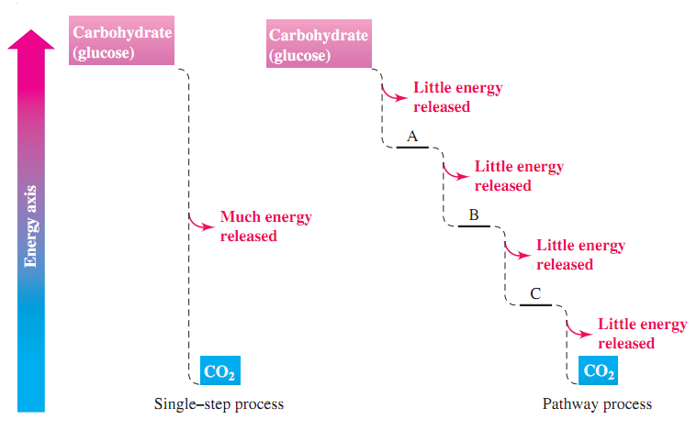
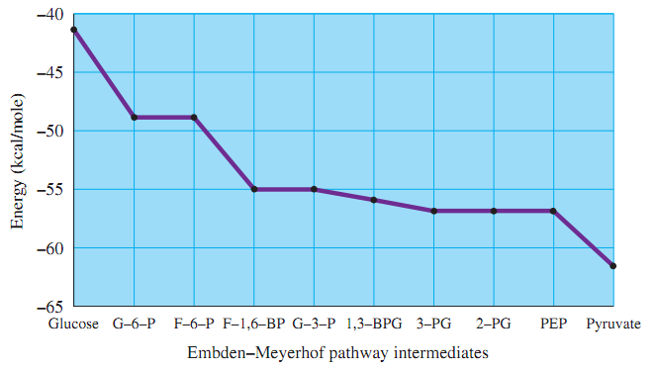
Complex Metabolic Pathways (34.7)
Pathway intermediates (link multiple pathways)
Easier to capture small amounts of energy (safer)
Many points of control
Redundancy – many steps used in multiple pathways
Can you:
What is a metabolic pathway
Why so many steps

Slide 32
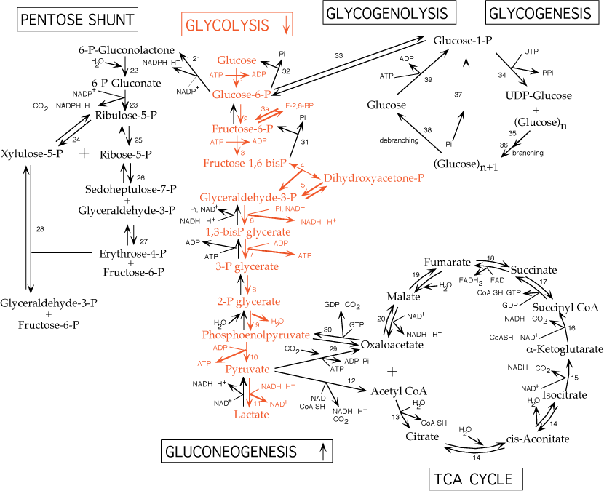
Can you:
Isn’t it beautiful
Why so many steps

Slide 33
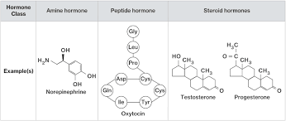
Hormones
Can you:
Big picture/why are they important
Chemical structure
Dfn – chemical substances that act as control agents (regulate metabolic pathways)
Produced by endocrine glands, thyroid, parathyroid, pancreas, adrenal, pituitary, ovaries, testes, placenta
Many hormones function in many species
No single chemical structure/classification
Proteins/Polypeptides
Steroids
AA derivatives
Only small amounts needed (10⁻⁶-10⁻¹² M)
Produced in the body (not acquired via diet)

Slide 34
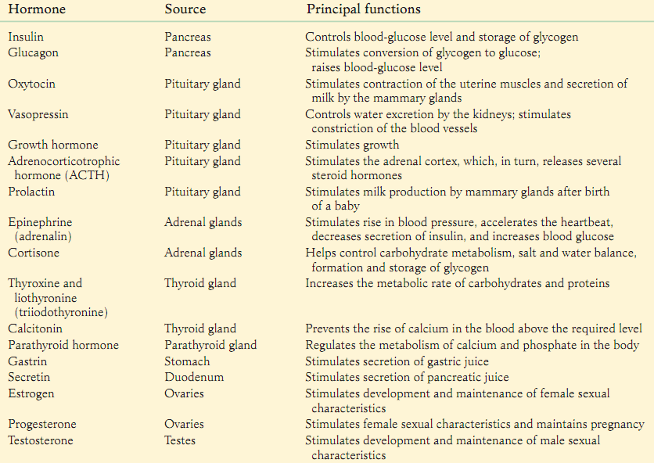
Hormones
Can you:
1 Example (Table 34.1)

