Slide 1
CHE 102 Spring 2020
Lecture 33 – Bioenergetics Basics
Overview/Topics
Dfn - Bioenergetics
Term
Anabolism/Catabolism
Oxidation/Reduction
Redox coenzymes
HEPB
Substrate Level Phosphorylation (SLP)
Oxidative Phosphorylation (OP)
Photosynthesis
Energy Level Diagrams
Skills to Master
Determine what is oxid/red
Complete energy level diagrams
Follow energy in a reaction
Differences between SLP/OP
Additional Useful Links
https://www.khanacademy.org/science/biology/cellular-respiration-and-fermentation/intro-to-cellular-respiration/a/intro-to-cellular-respiration-and-redox
Read
Hein 10th Edition
Pages 919-935
Sections 33.1-33.6

Slide 2
Can you:
Identify and/or Draw a Saturated or Unsaturated FA?
Structure -> Physical Properties -> Biological Property
Cheat Sheet: You will have Table 28.1 on all exams

Slide 3
Bioenergetics
study of the transformation, distribution and utilization of energy by living organisms
Photosynthesis
Embden-Meyerhof Pathway (EMP)/Glycolysis
Citric Acid Cycle (CAC)
β-oxidation and Lipogenesis
Can you:
Definition
Table 33.1
Big Picture

Slide 4
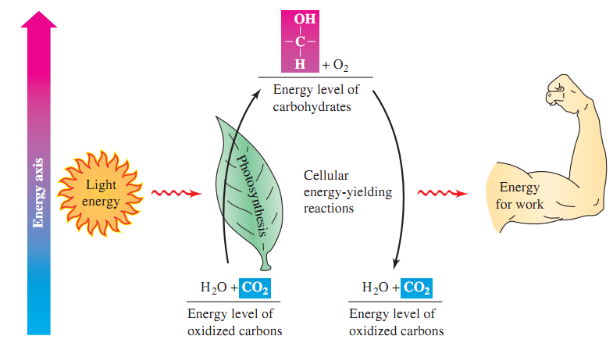
Metabolism
sum of all the chemical reactions within a living organism
Anabolism
Simple → Complex
Reduce Carbon
Consumes/Requires Energy
Examples
Photosynthesis (Ch. 33)
Gluconeogenesis (Ch. 34)
Lipogenesis (Ch. 35)
Catabolism
Complex → Simple
Oxidize Carbon
Produces Energy
Examples
EMP/Glycolysis (Ch. 34)
CAC (Ch. 34)
β-oxidation (Ch. 35)
Can you:
Definitions
Recognize Anabolism and Catabolism
Energy Level Diagrams

Slide 5
Review – Oxidation and Reduction (Redox)
*They are always paired
Reduction
GER
Gain e⁻
Lose bonds to Oxygen
Gains bonds to Hydrogen
Store Energy
Oxidation
LEO
Lose e⁻
Gain bonds to Oxygen
Lose bonds to Hydrogen
Release Energy
Can you:
Definitions
Recognize Oxid. and Red.
Energy Level Diagramsv

Slide 6
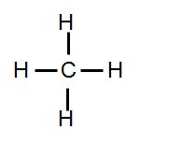
Can you:
Calculate Ox # of atom
Calculate average Ox # molecule
Recognize Low/High Energy
Oxidation Number (Ox #:)
Charge an atom would have it all the electrons in covalent bonds were instead treated like ionic bonds (gain/lost not shared)
More Reduced (more negative Ox #) – High Energy
More Oxidized (more + Ox #) – Low Energy
4 Basic Rules
Hydrogen always +1
Oxygen always -2
Like atoms bonds treated as 0
Molecules are neutral (ie sum Ox #’s = 0
“Fatty Acid”
“Carbohydrate”
H
H
C
C
C
C
C
C
O
C
O
H
OH
Ox #: -4
Ox #: -2
Ox #: +0
Ox #: +4
High Energy
Low Energy

Slide 7
Can you:
Calculate Ox # of atom
Calculate average Ox # molecule
Recognize Low/High Energy
A couple more examples…
Which has more energy? Explain.
1-butanol
2-butanone
Butanoic acid

Slide 8
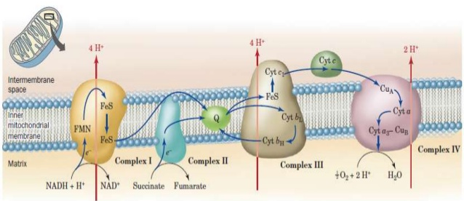
Redox Coenzymes
Enzymes used to move electrons/energy around (and store)
3 Main Redox Coenzymers
NADH/NAD⁺
NADPH/NADP⁺
FADH₂/FAD
Synthesized from vitamins (niacin and riboflavin)
Carry electrons to mitochondrial electron transport system
85% of a cells energy from redox process’s
Generally converted to and stored in HEPB (ATP)
Can you:
Importance of Redox Coenzymes
Recognize them in reactions
Recognize Low/High Energy

Slide 9
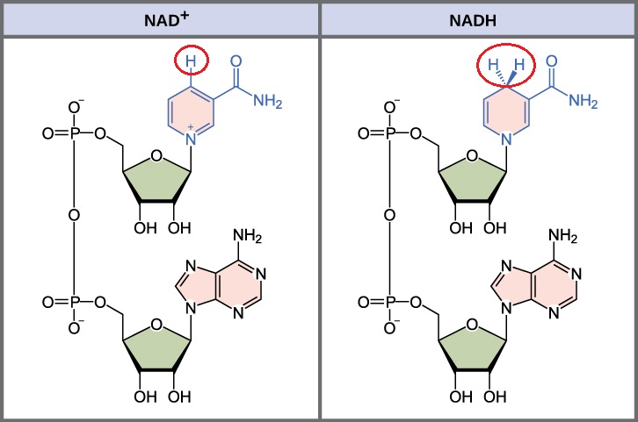
NAD - Nicotinamide Adenosine Dinucleotide
FAD – Flavin Adenine Dinucleotide
Low Energy
Low Energy
High Energy
High Energy
NADP: has PO₄⁻² group instead of OH
Can you:
Recognize Low/High energy

Slide 10
“Close up” on what changes
NAD/NADPH
FAD
Oxidized
Low Energy
Reduced
High Energy

Slide 11
Just Abbreviations
Reduction
NAD⁺ NAD
Oxidation
Reduction
FAD FADH₂
Oxidation

Slide 12
Can you:
Recognize Low/High energy
Determine Oxid/Red
Complete AND Explain the problems
You Try It!
Add FAD and FADH₂ to the reaction below.
What is wrong with the following equation?

Slide 13
You Try It! - Answers
Add FAD and FADH₂ to the reaction below.
Explanation – The molecule is being oxidized (it lost two bonds to H) therefore the redox coenzyme must be reduced (go from low energy to high energy)

Slide 14
You Try It! - Answers
What is wrong with the following equation?
Explanation – In a redox reaction one molecule is oxidezed and one molecule must be reduced (they are paired). In this example, both the molecule (lost bond to oxygen/gained bond to H) and the redox coenzyme are being reduced (went from low energy to high energy, or gained a bond to H).

Slide 15
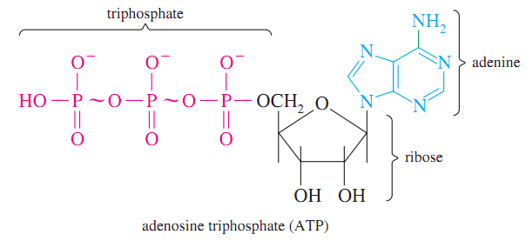
Review – HEPB/ATP
Dehydration
-H₂O
Formation Reaction
+H₂O
Hydrolysis
Easily accessible – Dehydration/Hydrolysis
Universal – all plants/animals use it
Can you:
Importance of HEPB and ATP
ID Type of Reactions

Slide 16
Can you:
Compare and Contrast SLP vs OP
Energy Conversion
Energy from nutrients with reduced carbons (energy-yielding nutrients) is converted to high-energy phosphate bonds that are used to do work in the body
Two methods for storing energy in HEPB/phosphate anhydride bonds
Substrate Level Phosphorylation (SLP)
Oxidative Phosphorylation (OP)

Slide 17
Substrate Level Phosphorylation (SLP)
Anaerobic (No O₂)
Occurs in Cytoplasm
Inefficient
Examples – Glycolysis
Often transferred to ATP in a latter step
Dehydration
-H₂O
Can you:
Complete the reaction
ID HEPB

Slide 18
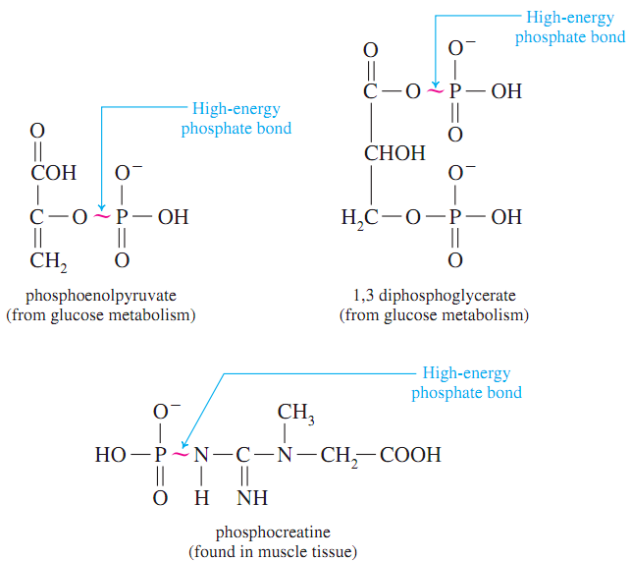
SLP - Examples

Slide 19
Oxidative Phosphorylation (OP)
Can you:
Complete the reaction
Understand Energy Level Diagrams
Aerobic (O₂)
Occurs in Mitochondria
Efficient
Examples – CAC/β-oxidation
Redox Coenzymes converted to ATP

Slide 20
Photosynthesis
Can you:
Calculate Oxid #’s
Anabolic or Catabolic?
1961 Noble Prize – Melvin Calvin
Converting Sunlight to Reduced Carbons
Light Reactions
Dark Reactions
6 CO₂ + 6 H₂O + 2820 kJ C₆H₁₂O₆ + 6 O₂

Slide 21
Photosynthesis
Figure 33.9

