Slide 1
CHE 102 Spring 2020
Lecture 31a – Nucleic Acid Basics
Overview/Topics
Structure of DNA/RNA
Purpose of DNA/RNA
Terminology/Abbreviations
ATP/High Energy Phosphate Bond (HEPB)
DNA → RNA
Biosynthesis of Proteins
Skills to Master
Draw Examples
DNA
RNA
Understand role of IMF
Role of DNA/RNA
ID HEPB and importance of ATP
Steps in synthesis of proteins
Read
Hein 10th Edition
Pages 851-862 and 874-876
Sections 31.1-31.6 and 31.11
Additional Useful Links
https://xaktly.com/NucleicAcids.html

Slide 2
Can you:
Identify and/or Draw a Saturated or Unsaturated FA?
Structure -> Physical Properties -> Biological Property
Cheat Sheet: You will have Table 28.1 on all exams

Slide 3
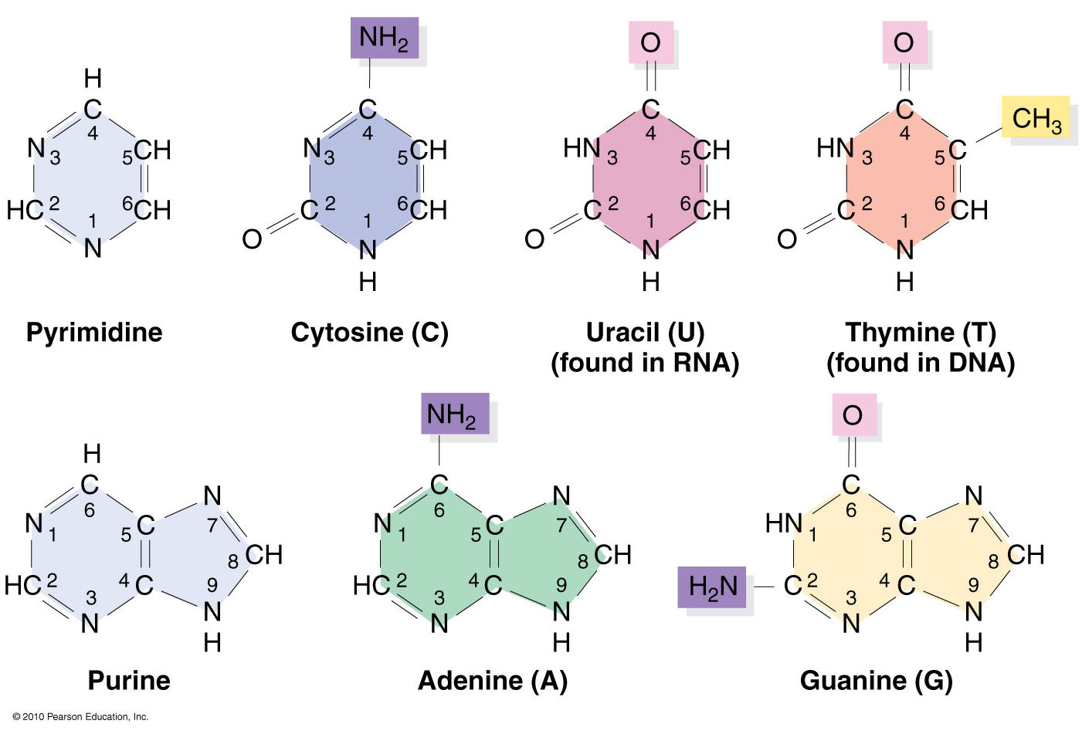
Pyrimidines and Purines Bases
Sugars
Cheat Sheet: You will have all structures here
Can you:
Difference between DNA/RNA
Which Hydrogens React

Slide 4
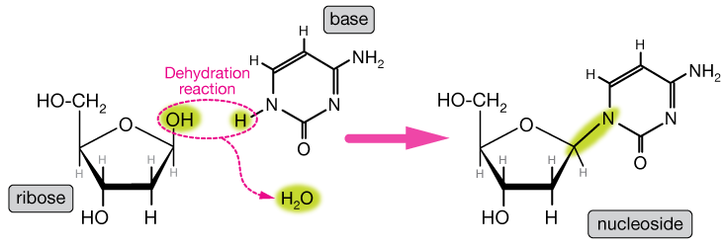
Nucleosides
Base + Sugar → Nucleoside
2° Amine + Alcohol → 3° Amine
Dehydration Reaction
Cytidine (C)
Cytosine (C)
Can you:
Given the parts, can you draw the reaction?
Cheat Sheet: You will have Table 31.1

Slide 5
Nucleoside – You try it!
Draw deoxyribose + adenine → Deoxyadenosine (dA)

Slide 6
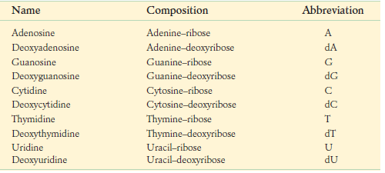
Naming
Nucleoside
s
n
d
s
n

Slide 7
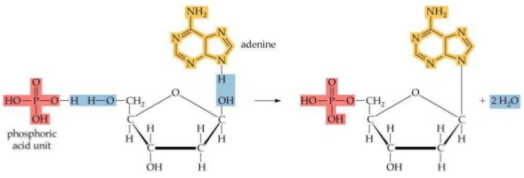
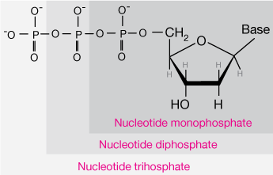
Nucleotide
Given Table 31.1 on cheat sheet
Base + Sugar + Phosphate
Phosphate Anhydride Bonds
High Energy Phosphate Bonds (HEPB)
Draw and Name them
Dehydration Reaction
Naming/Abbreviations
Phosphates can connect to Ribose 2’,3’,5’, Deoxyribose 3’,5’
deoxyadenosine-5’-monophosphate
5’-dAMP
Can you:
Given the parts, can you draw the reaction?
Name and Abbreviation

Slide 8
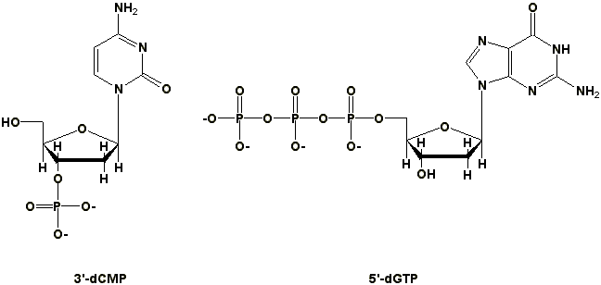
Nucleotide (more examples)
Deoxycytidine-3’-monophosphate
Deoxyguonosine-5’-triphosphate
Can you:
Given the parts, can you draw the reaction?
Name and Abbreviation

Slide 9
Nucleotide – You try it!
Draw ribose + cytosine + 2 Phosphate on the 3’ carbon and Name/Abbreviation

Slide 10
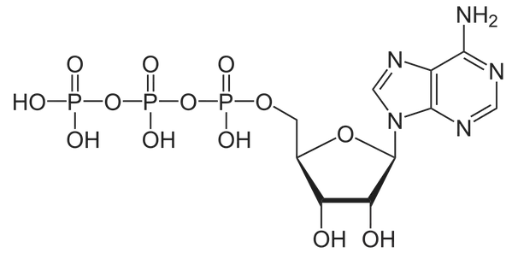
Adenosine 5’-triphosphate (ATP)
*Key Molecule
HEPB
use energy
ATP + H₂O
ADP + P_{i} + 35kJ
store energy
Hydrolysis/Dehydration Reaction
Can you:
Recognize HEPB
Recognize when a reaction gains/loses energy (Ch. 33)
Why is ATP a “key” molecule?

Slide 11
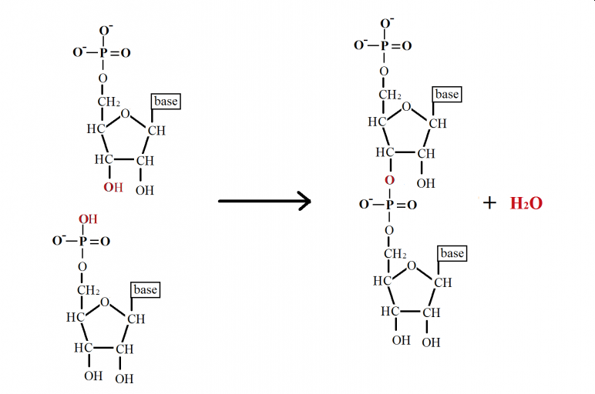
Making DNA/RNA
5’
3’
-H₂O
5’
3’
Can you:
Given the parts, can you draw the reaction?
Type of Reaction
Type of Bonds

Slide 12
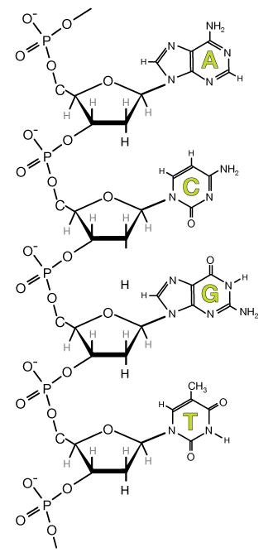
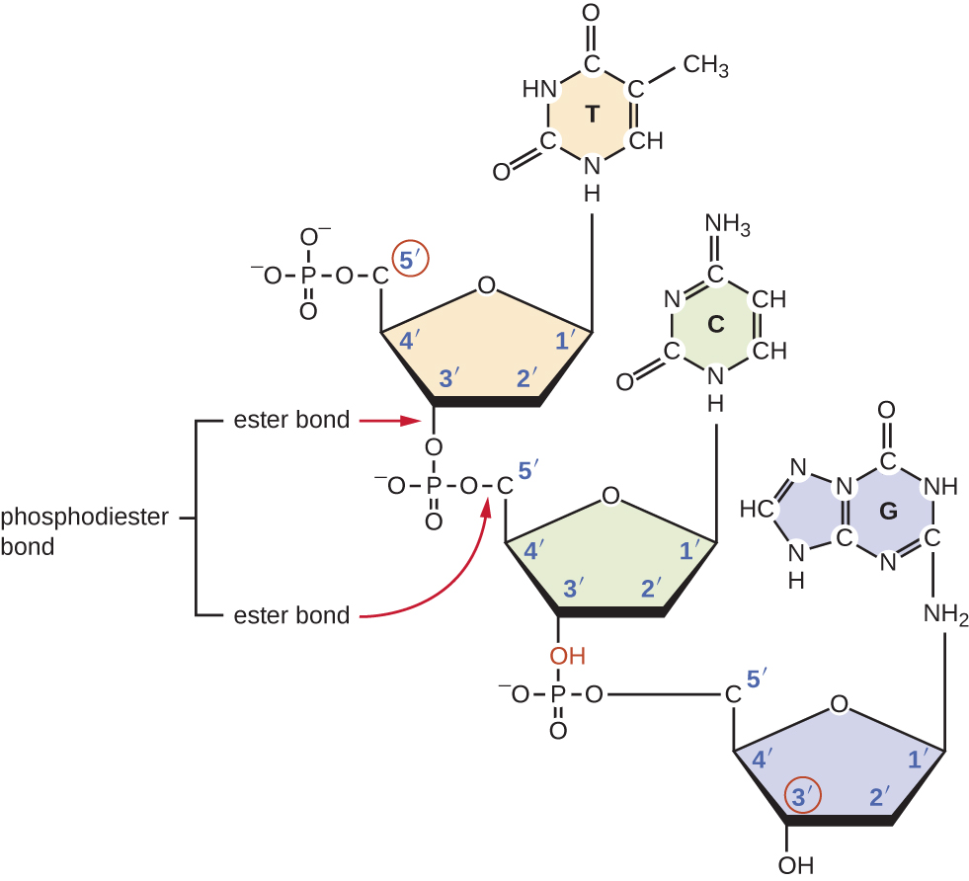
Bigger Picture DNA/RNA
Can you:
Understand many different ways of representing DNA/RNA

Slide 13
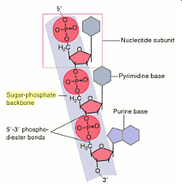
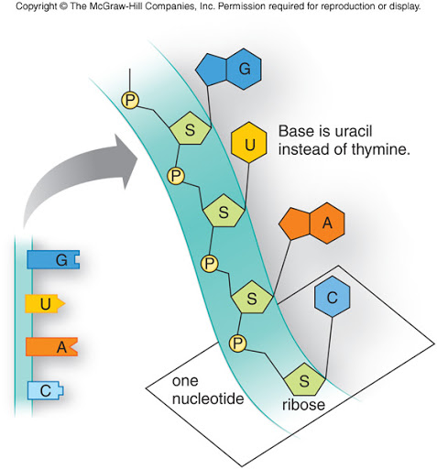
More Representations - DNA/RNA

Slide 14
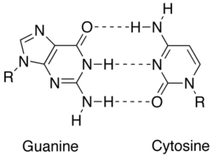
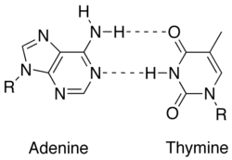
Complementary Base Pairs
IMF - Hydrogen Bonds
G/C and T/A
Built in Error Checking
Can you:
Definition – Complementary
IMF/HB

Slide 15
DNA – Double Helix
Can you:
Why DNA forms a double helix

Slide 16
Can you:
It just keeps getting bigger!
DNA – Big Picture

Slide 17
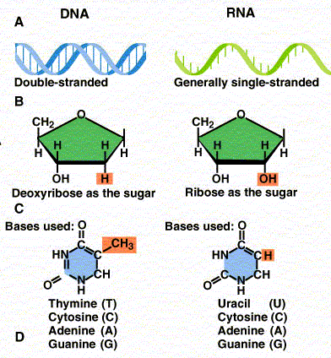
Differences between DNA and RNA
DNA | RNA
Double Strand | 1. Single Strand
Dexoyribose | 2. Ribose
3. T | 3. U
Store Information | 4. mRNA/rRNA/tRNA Blueprint/Machinery/Dump Truck
5. Unmodified | 5. Heavily Modified
Can you:
5 difference between DNA/RNA

Slide 18
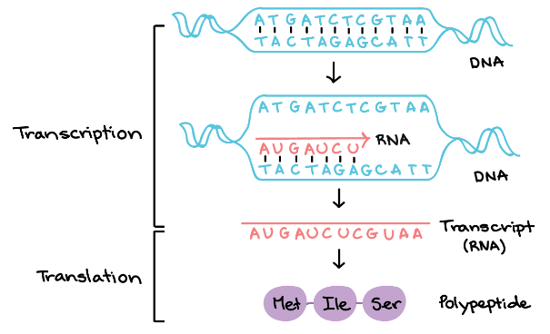
DNA to RNA (Transcription)
Coding Strand
Template Strand
Template Strand
https://www.khanacademy.org/science/biology/gene-expression-central-dogma/transcription-of-dna-into-rna/a/overview-of-transcription
Can you:
Outline (basics)
Translate DNA → RNA → AA
Note: Covered in much more detail in BIO 204

Slide 19
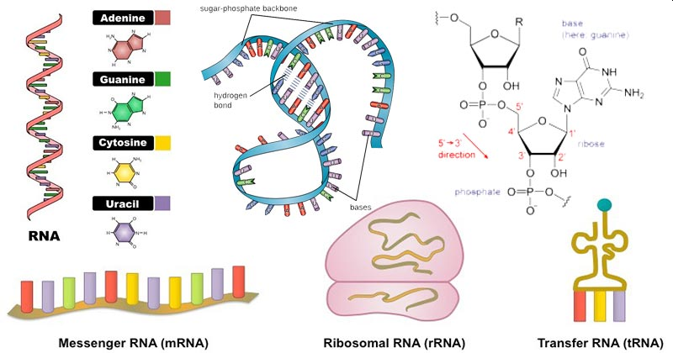
RNA Basics
Can you:
Role of each type of RNA
3 main types
rRNA = ribosomal → machinery (80%)
mRNA = messenger → blueprint
tRNA = transfer → dump truck
Single Strand
U instead of T
Complimentary to DNA (HB)
Heavily Modified
Methylation (add CH₃)
Saturation of C=C
Isomerization of ribose

Slide 20
mRNA
Can you:
Role of each type of RNA
Carries information from DNA to Ribosome
Blueprint
Undergoes some modification
More than just Blueprint
Includes 5’ cap group
Untranslated regions – where ribosome can interact
Coding region
3’ tail

Slide 21
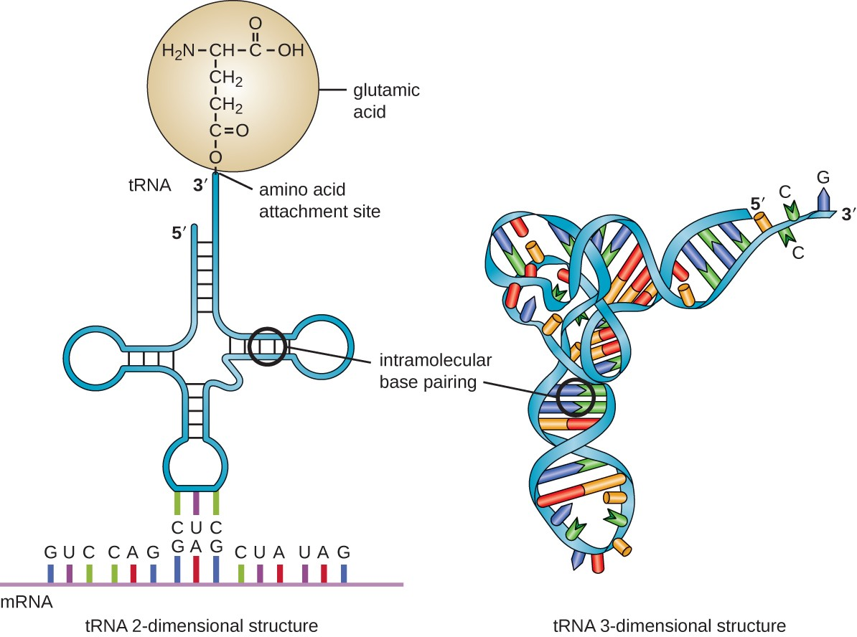
tRNA
1 - Acceptor Region – binds to AA
2,4 – Ribosome handles – interact with ribosome
3 - Anticodon region – binds to mRNA
Transfer
Dump truck
Bring AA to Ribosome – Interacts with ribosome, AA and mRNA
Unique cloverleaf shape – 3 important regions
1
4
2
3
Can you:
Role of each type of RNA

Slide 22
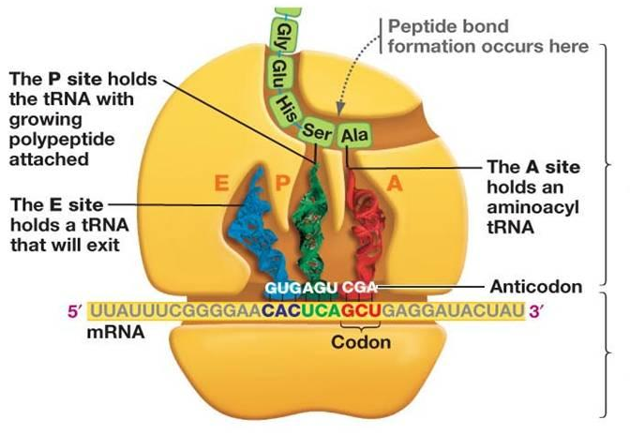
rRNA
Can you:
Role of each type of RNA
80% of RNA
Combines with proteins to make ribosomes
Machinery to synthesis proteins (30-35% rRNA, 60-65% protein)
Complicated structure (skip)
Small Subunit:
21 different proteins
+ rRNA
Large Subunit:
34 different proteins + rRNA

Slide 23
ncRNA (Noncoding RNA)
Type | Size | Location | Purpose
Micro (miRNA) | 20-25 | Cytoplasm | Stop translation by blocking ribosomes
Small Nuclear (snRNA) | 60-200 | Nucleus | Control post transcription modification
Small Nucleolar (snoRNA) | 70-100 | Nucleolus | Control modification of rRNA
Small Interfering (siRNA) | 20-25 | Cytoplasm | Stop translation by triggering mRNA destruction
Control flow of genetic information
Know 1 example
Hot new area to research for curing genetic diseases
Can you:
Just know it exists
https://www.biologyexams4u.com/2014/12/different-types-of-rna-in-cell.html#.XpMyOchKi70

Slide 24
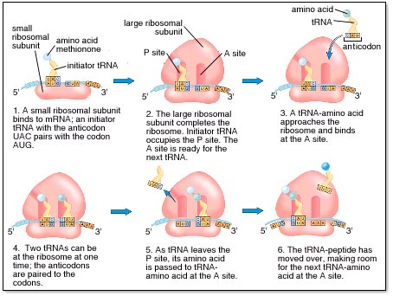
Translation
Can you:
Understand process
Understand individual steps
Dfn: Biosynthesis of Proteins (DNA → RNA → Protein)
Step 0: Preparation
Step 1: Initialization
Step 2: Elongation
Step 3: Termination
Know the roles of:
DNA
mRNA, tRNA, rRNA
Ribosomes – 2 subunits, 3 binding sites (1 mRNA, 2-tRNA)
AA
ATP
https://www.khanacademy.org/science/biology/gene-expression-central-dogma/translation-polypeptides/a/the-stages-of-translation

Slide 25
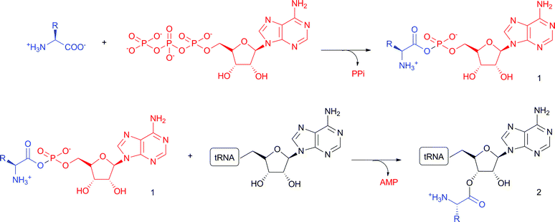
Translation – Step 0 – Preparation
Can you:
Understand reaction
Understand role of AA, tRNA, ATP
DNA transcribed to mRNA
mRNA moves from nucleous to cytoplasm
mRNA binds to 5+ ribosomes
tRNA binds to AA (requires an enzyme)
AA + tRNA + ATP → AA-tRNA + AMP + 2 P_{i}

Slide 26
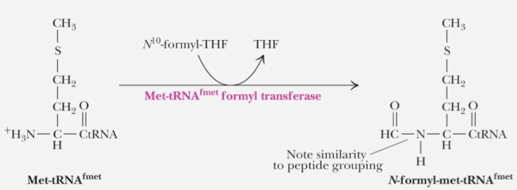
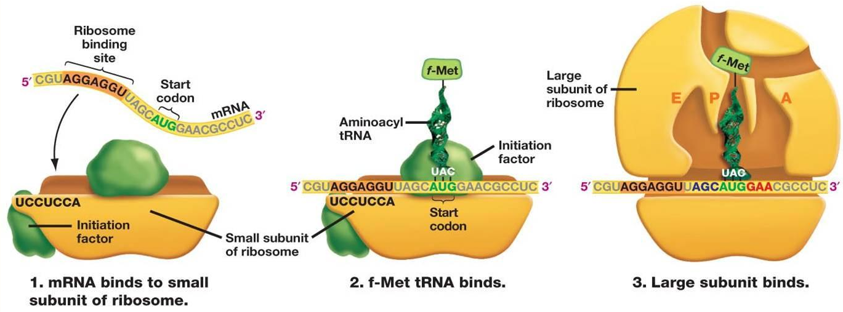
Can you:
Understand reaction
Understand role blocking group
Translation – Step 1 – Initiation
AUG (Met) = start codon, capped to prevent reaction on amine end
Ribosome binds to mRNA at/near the initiator/start codon

Slide 27
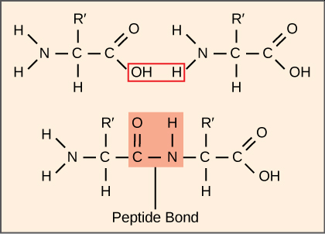
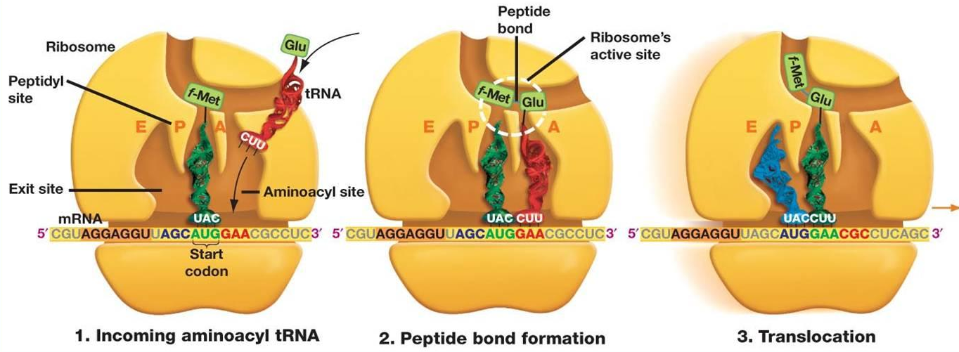
Translation – Step 2 – Elongation
tRNA HB to mRNA anticodon
Ribosome makes peptide bond between AA
tRNA breaks off (to be reused)
Process repeats….
Can you:
Understand reaction
Understand process

Slide 28
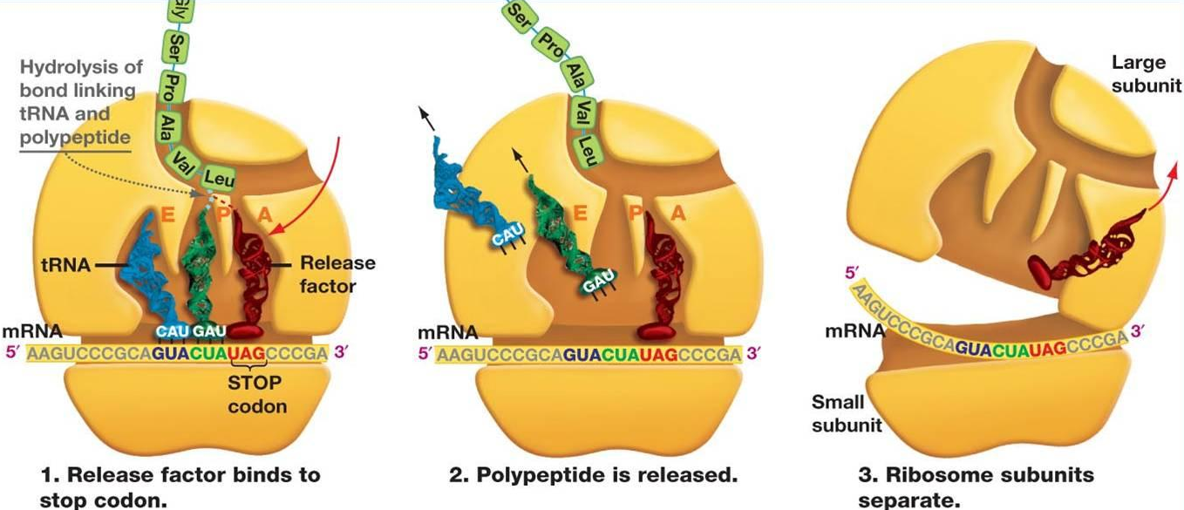
Translation – Step 3 – Termination
Can you:
Understand reaction
Understand process
Elongation stops when a TC/nonsense codon is reached
Last tRNA is hydrolyzed
Ribosomes separate and release mRNA and finished protein

Slide 29
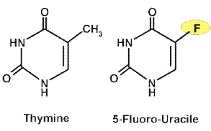
Special Topic - Cancer
Can you:
Apply what you have learned to specific topics
Role of “artificial bases”
Why different treatments “work”
Oncogenes: proteins that code for cell growth
Cancer: uncontrolled/unregulated cell growth/reproduction
caused by loss of oncogene regulation
Tumor-Suppressor Genes: block/reduce cancer by causing apoptosis if cell is damaged
20+discovered for rare cancers
Example p53 is inactive in about 50% of cancers
Suppression of gene allows cancer to develop
Apoptosis: cause cell destruction, release of cytochrome C from mitochondria activates caspases (digestive enzyme) → breaks apart cell machinery
Treatments:
Radiation → kills fast growing cells
Chemotherapy → kills fast growing cells
Genetics → activate tumor-suppressing genes
Example: 5-fluoro-uracile inhibits production of thymine

Slide 30
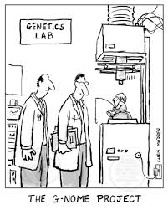
Human Genome Project:
Can you:
Apply what you have learned to specific topics
Heredity is controlled by DNA
Genetic Diseases effect 8% humans
Started 1998 → Map 3 billion base pairs
Finished 2001!
Results:
Codes for 23,000 enzymes but potentially could
code for 100,000+ (junk DNA)
98% of Genome ≠ code proteins
Unknown or no function
Junk DNA
Regulation
Unused/Abandoned genes
1000 of genetic tests developed
Goal:
Scientific understanding
Cure Genetic Diseases – easier said than done, but some successes

Slide 31
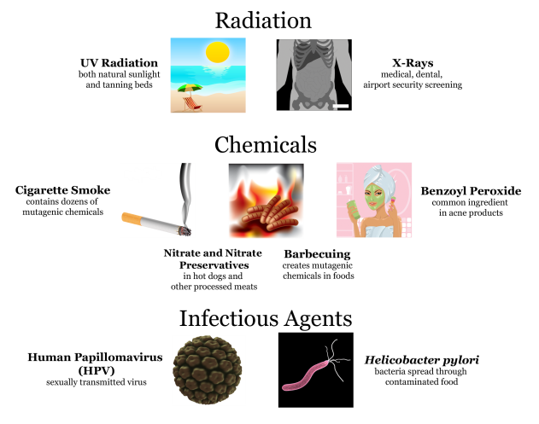
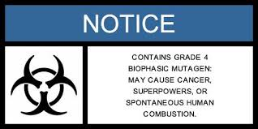
Mutation
Can you:
Apply what you have learned to specific topics
Mutation: alteration to DNA that changes genome in child but not parent
Good (Superpowers) or Bad (Cancer, diseases)
Evolution
Mutagens: cause genetic damage
Ionizing Radiation – UV, x-rays, cosmic rays
Chemicals
Radioactive decay
Heavy Metals
Viruses
Anti-oxidants: decrease/limit damage

Slide 32
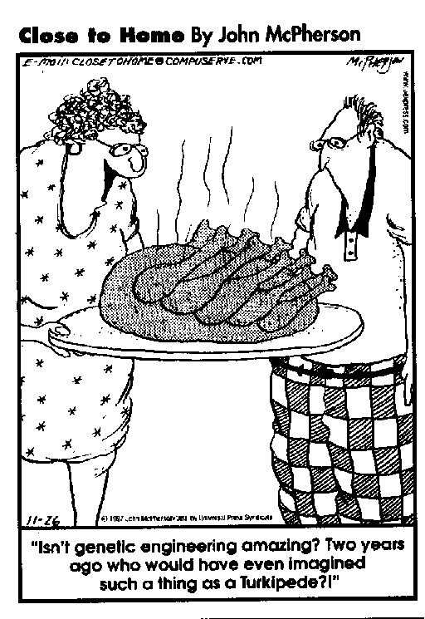
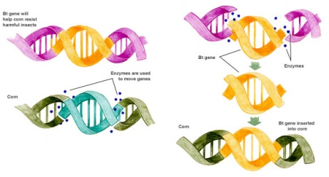
Genetic Engineering
Can you:
Apply what you have learned to specific topics
Laboratory technique for controlling/causing genetic change
DNA polymerase chain reaction: copies specific genes over and over
Restriction Endonucleases: split DNA at very specific points
Insertion: Ability to insert genetic material
Ligases: covalently bond DNA back together
Recombinant DNA: DNA whose base pairs have been rearranged to contain new information
Examples:
Yeast/Bacteria → Insulin, Anemia drugs, Interferon
Agriculture → GMO crops, pesticide resistance

