Slide 1
CHE 102 Spring 2020
Lecture 30a – Enzymes
Overview/Topics
Ways to speed up a reaction
6 Types of Enzymes
Reaction Energy Profiles
Enzyme Kinetics – basics
Vocabulary and Models
Active Site
Lock and Key
Induced-fit
Proximity Catalysis
Productive Binding
Strain Hypothesis
Effect or Temp/pH on Enzymes
Enzyme Regulation
Feedback Inhibition
Feedforward Activation
Skills to Master
Vocabulary (Lots of BOLD words in chapter)
Energy Profiles (Fig. 30.1/30.3
Temp/pH (Figure 30.9/30.10)
Different Models discussed
Additional Useful Links
Read
Hein 10th Edition
Pages 833-846
Sections 30.1-30.7

Slide 2
General Information
Enzymes:
Proteins that catalyze biochemical reactions (speed up reactions)
↑ rate 1 million – 100 million times
Allow reactions to occur at “room temp” and “body” pH
Life w/o enzymes not “likely”
1000’s of different enzymes exist
Enzyme Specificity (1 Enzyme catalyzes 1 Reaction or Substrate)
Sequence of AA → Specific Shape → Specific Biological Function
“-ase” ending
4 Common Features
Speed up reactions
Enzyme not altered in the reaction (reusable)
Highly specific
Reversible – One direction usually highly favored
Can you:
General properties of enzymes
Read: 30.1

Slide 3
Can you:
Given a reaction identify what class of enzyme was used (Ch. 33-35)
6 Main Classes of Enzymes
Class | Function
Oxidoreductases | Oxidation-Reduction reactions between 2 substrates
2. Transferases | Transfer of functional group between 2 substrates
3. Hydrolases | Hydrolysis of esters, carbohydrates and proteins
4. Lysases | Removal of functional groups (not by hydrolysis)
5. Isomerases | Interconversion of stereoisomers and structural isomers
6. Ligases | Linkage of 2 compounds via breaking a phosphate anhydride bond in ATP

Slide 4
Speeding Up Reactions
Molecules react when they “bump” together with enough “energy”
Molecules go through a “transition state” ½ way between that of the R and P
A + B → AB → C
Activation Energy (AE or E_{A}) – Minimum energy required for a reaction to occur
The larger the value the slower the reaction
Transition State (TS) – State ½ way between the R and P
3 Ways to Increase Reaction rate
Increase Conc. of Reactants (more collisions)
Increase Temp. (more molecules have energy to react)
Add a Catalyst (lower Activation Energy)
Can you:
Terminology (AE, TS, CAE)
3 ways to increase rate
Read: 30.2

Slide 5
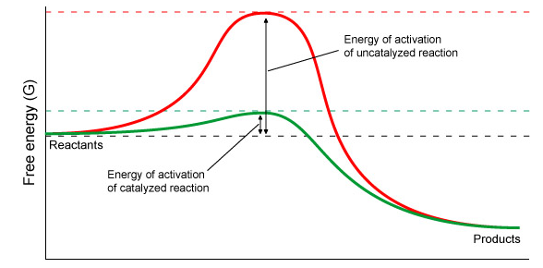
Energy Diagram (Review Ch. 4)
A + B → AB → C
AB
TS
AE
A
CAE
C
Can you:
Draw/Label/Complete an Energy Diagram
Endothermic or Exothermic

Slide 6
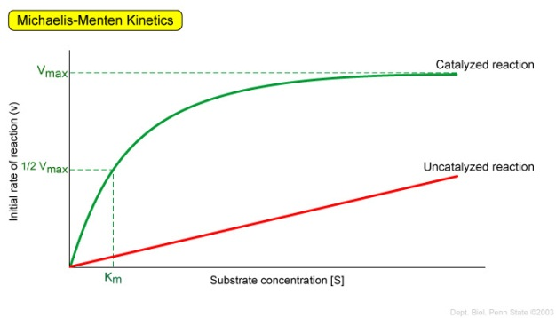
Enzymes – “Maximum” Rate
Enzyme Catalyzed = Maximum rate limited by number of catalyst molecules
Uncatalyzed = linear response
Can you:
Enzymes have a maximum rate
Read: 30.3

Slide 7
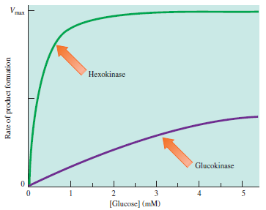
Enzymes – Rate is determines by process or “need”
Enzymes tailored to meet specific metabolic needs
Level of substrate concentration
Hexokinase = low [conc] = energy
Glucokinase = high [conc] = storage
Glucose → Energy
Glucose → Storage
Another Example:
Rate of reaction (turnover number)
○ Catalase = fast – destroys toxins
○ Chrymotrypsin = slow - digestion
Can you:
Enzymes rate depends on purpose

Slide 8
Overview – Why are enzymes so specific?
Active Site
Lock and Key Hypothesis
Induced Fit Model
Overview – How do enzyme speed up a reaction?
Proximity Catalysis
Productive Binding Hypothesis
Strain Hypothesis
Can you:
What does each theory contribute to our understanding of how enzymes catalyze reactions.
Read: 30.5

Slide 9
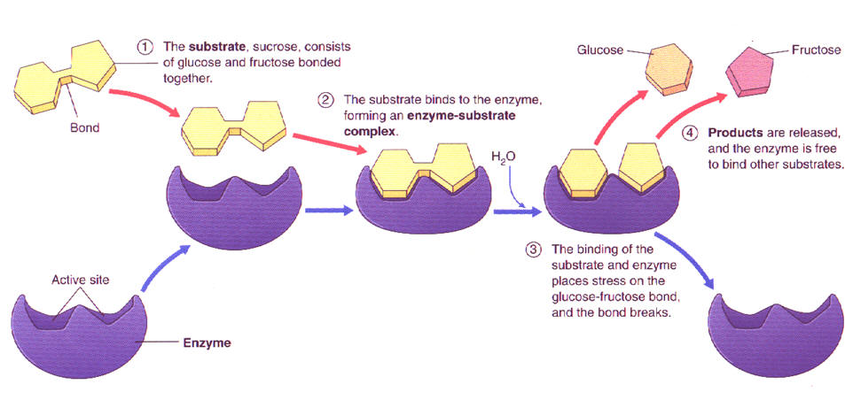
General Process
S → P
Enzyme Binds Substrate
Forms Enzyme/Substrate Complex (TS)
Enzyme Catalyzes Reaction
Enzyme Release Product
Enzyme free to start another reaction
1
2
3
4
E + S → E-S →E + P
Binding
Catalysis
Can you:
Understand the 5 steps
5. Enzyme free to catalyze another reaction

Slide 10
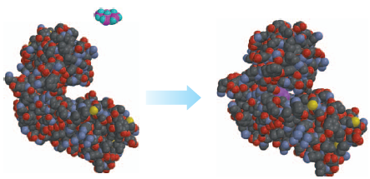
Enzyme Active Site (AS)
Area where catalysis occurs
Small (1-5%) of total surface area
Very Specific: 1 enzyme = 1 reaction (Specificity)
AA Sequence → Structure → Specific Function
Substrate
AS
Can you:
Why is the AS important?

Slide 11
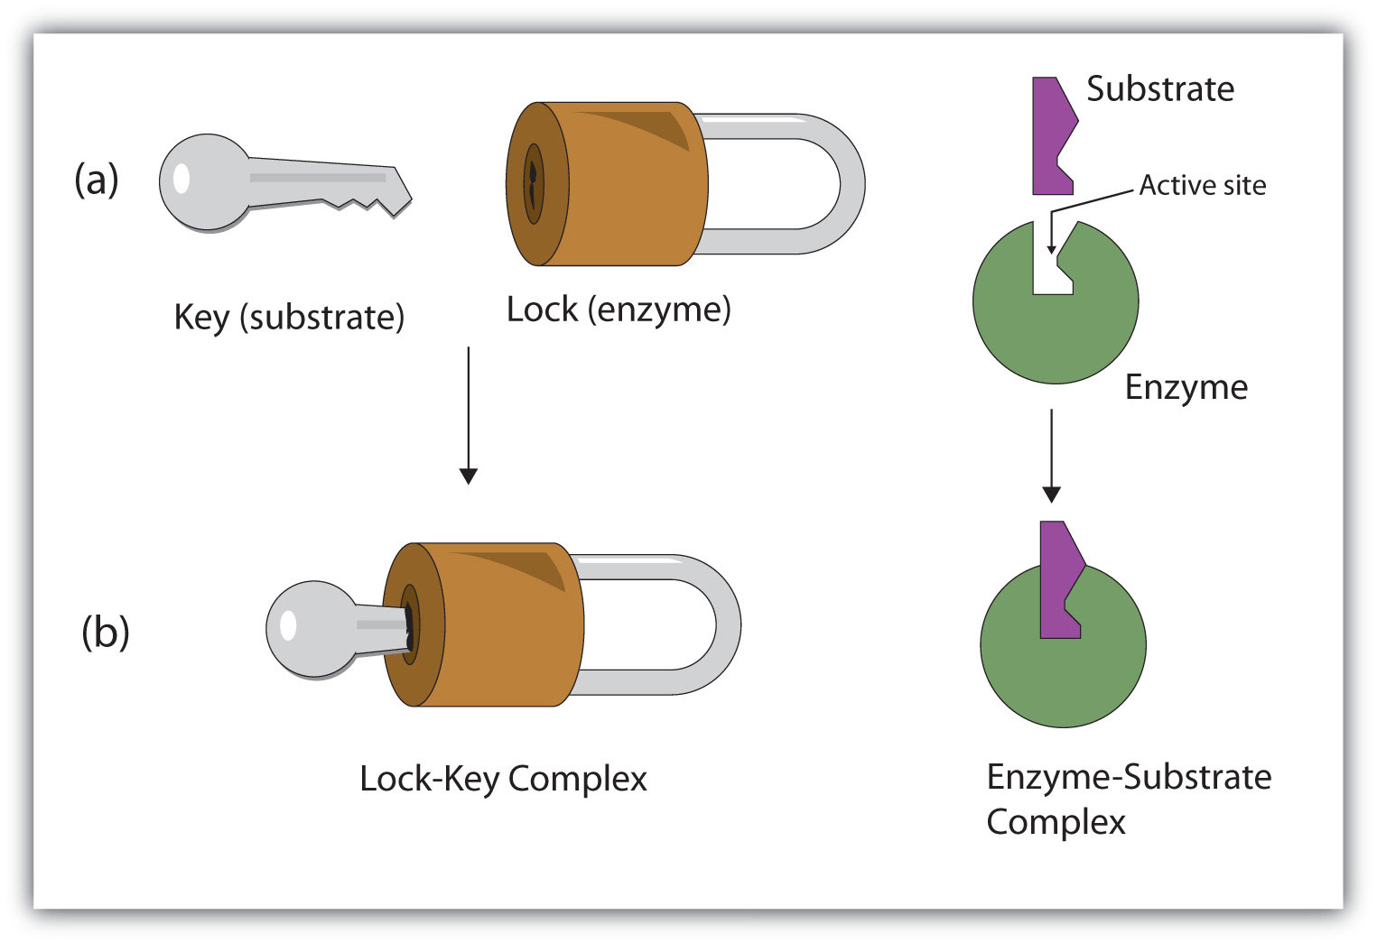
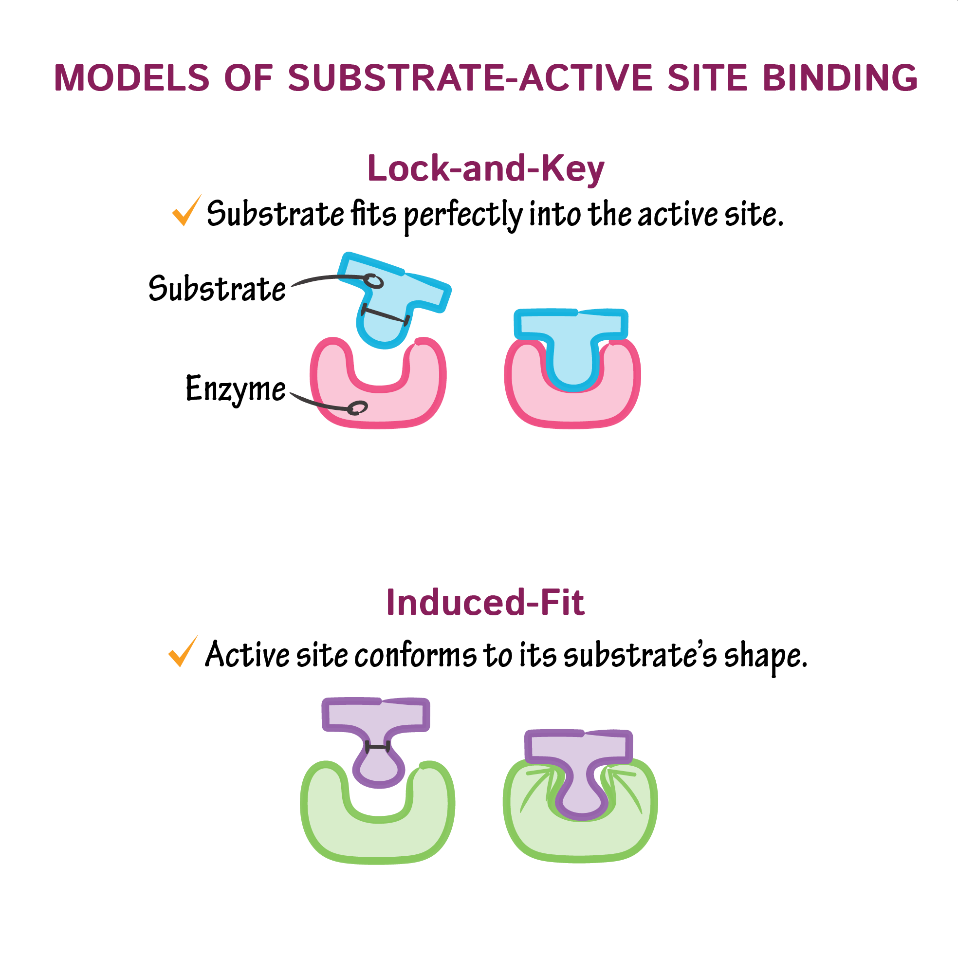
Lock and Key Model
Substrate (Key) fits into the Enzyme (Lock)
One key, One lock
Flaw: not rigid → Induced Fit Model
Can you:
Why is each model important
What is different about them?
Induced Fit Model
Active site is flexible (can move)
Enzyme can change state/shape to bind/catalyze a reaction
“Key slides in and out easily,
But now the lock binds the key
so it can’t be pulled out”

Slide 12
How do enzyme speed up a reaction?
Proximity Catalysis - Enzyme holds the reactants in close proximity
Productive Binding - Enzyme holds reactants in proper orientation for only the desired reaction to occur
Strain Hypothesis – Enzyme forces substrate to react by changing shape
Can you:
What are 3 ways that enzymes speed up reaction?
Can you explain how each would speed up reaction?

Slide 13
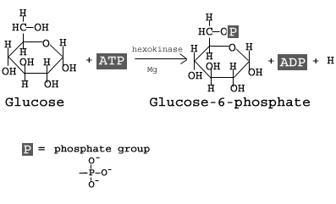
Example of all 3!
Example: Glucose → Glucose-6-Phosphate
Many parts required (Substrate + ATP + Mg⁺² ion. (Proximity Catalysis)
Phosphate only added to #6 carbon (Productive Binding)
Enzyme strains the O-H bond on Carbon #6 forcing it to break (Strain Hypothesis)

Slide 14
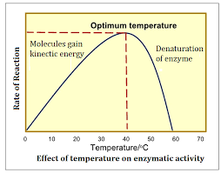
Effect of Temperature on Catalysts
Any change that effects protein structure effects an enzymes catalytic ability
Temperature can change the shape of the enzyme
Structure/Function Relationship
Low Temp
Few molecules have AE required to react (+ denaturation)
High Temp
Enzymes denature
Ch. 29.10
Can you:
Why does Temp. effect catalysts
How does low/high temp. effect the rate
Read: 30.6

Slide 15
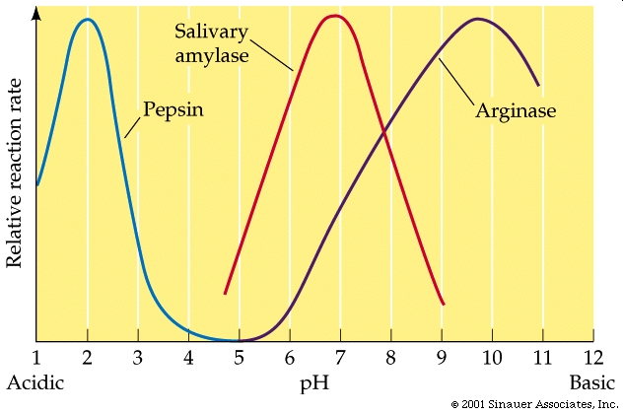
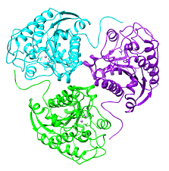
Effect of pH on Catalysts
Any change that effects protein structure effects an enzymes catalytic ability
Charge of –COOH and –NH₂ effected by pH → change in 2°/3°/4° structure
Most Enzymes have an “optimal” pH depending on function
Stomach
Mouth
Can you:
Why does pH effect catalysts
Why do different enzymes have different optional pH’s?
Read: 30.6

Slide 16
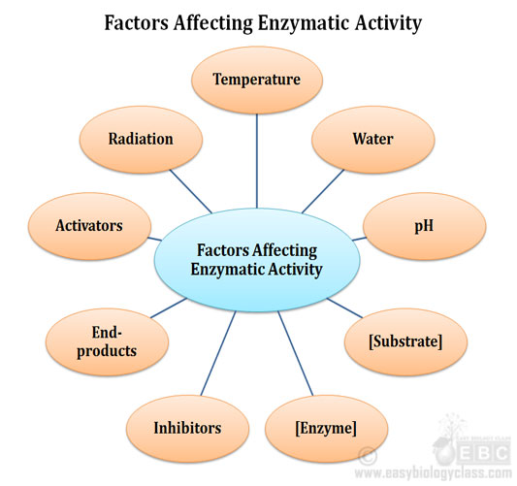
Read: 30.7
Enzyme Regulation
Control the rate at which process occur in the body
Hexokinase vs Glucokinase
Enzyme Inhibition – make it slower
Enzyme Activation – make it faster
Many many many different mechanisms
Covalent Modification
Allosteric Regulation
Etc…
2 ways to control biological pathways
Feedback Inhibition
Feedforward Activation
Can you:
Vocabulary
Big picture – why do you need to control enzyme rates?

Slide 17
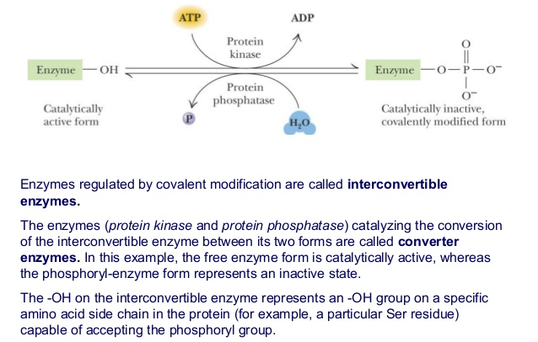
Lots of different types of modification
Phosphate Group
Adenyl Group (Ch. 31)
Uridine (Ch. 31)
ADP (Ch. 33)
Methylation (Ch. 31
Covalent Modification
Functional groups bonded to enzyme
Changes ability of Enzyme to catalyze a reaction
Can you:
Give 1 example of modification
Don’t memorize all 5

Slide 18
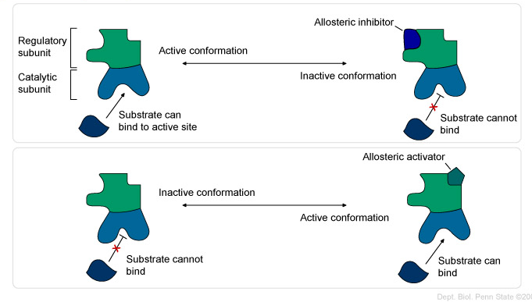
Can you:
Active vs Regulatory parts of Enzyme
Allosteric Regulation
Enzymes have multiple parts that have different functions
Active domain (AS) – catalyzes the reaction
Regulatory domain – modulates activity (inhibits or activates)
Activator/inhibitors bind to Regulatory domain and changes the catalytic ability of enzyme

Slide 19
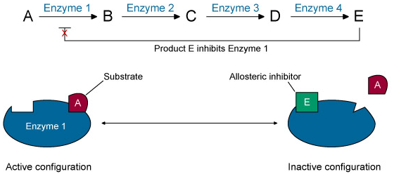
Regulation of Biochemical Pathways
Feedforward Activation
Excess of beginning R/P
Increases the reaction rate of a later step
Feedback Inhibition
Excess of later or final product
Decreases the reaction rate of an earlier step

Slide 20
Another Example
Can you:
Define each method
Draw an example
Given an example determine which method of control is used

Slide 21
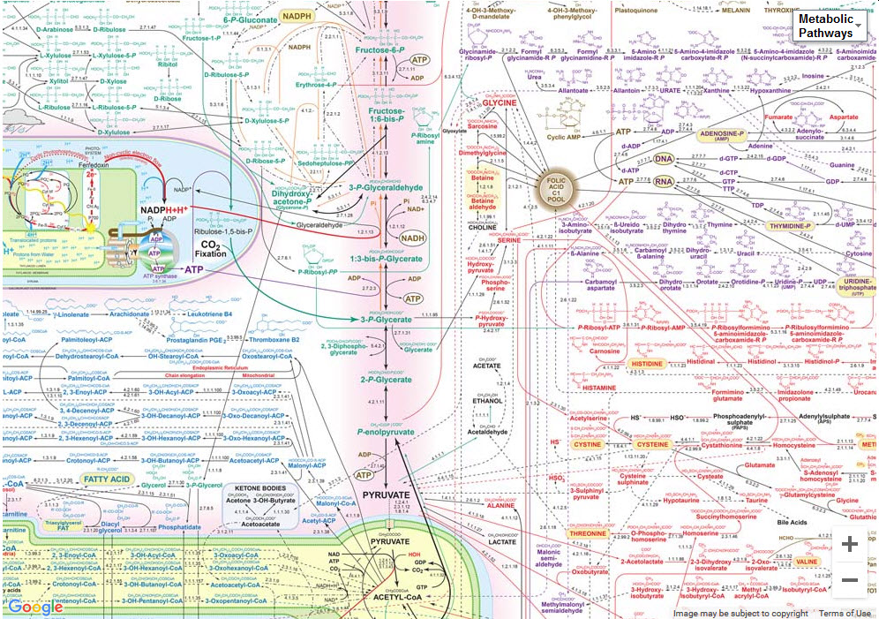
Other Examples in your Book
Eicosanoids (Ch. 28.3)
Drug treatments for Atherosclerosis (Ch. 28.7)
Hemoglobin (Ch. 29.9)
Metabolism (Ch. 34 and 35)
Diabetes (Ch. 34.9)
Can you:
See the “Big” Picture
Apply information about Enzymes to previous chapters

