Slide 1
CHE 102 Spring 2020
Lecture 29c – Chemical Reactions (Lab)
Overview/Topics
Sanger Experiment
Chromatography
Electrophoresis
Diagnostic Tests
Xanthoproteic Test
Biuret Test
Ninhydrin Test
Skills to Master
Given Sanger fragments construct an AA chain.
Describe the basis for chromatography and electrophoresis
Given AA, predict the outcome of chromatography and electrophoresis experiments
Predict result of Diagnostic tests
Read
Hein 10th Edition
Pages 819-824
Sections 29.11-29.12
Additional Useful Links
Chromatography: https://slideplayer.com/slide/4701883/
Electrophoresis:
https://www.youtube.com/watch?v=bzR-uu-cIyg

Slide 2
Sanger Experiment
Fredrick Sanger (1958 Nobel Prize) Beef Insulin
Used to determine Primary Structure (#, kind, type, and sequence of AA)
Several years of work to sequence 51 AA
Hydrolyzed (+H₂O) proteins into smaller fragments to analyze
O
O
O
NH₂-CH-C-NH-CH-C-NH-CH-C-OH
R₁
R₂
R₃
+H₂O
O
O
O
NH₂-CH-C-OH
+
NH₂-CH-C-OH
+
NH₂-CH-C-OH
R₁
R₂
R₃
Can you:
Given AA Chain, hydrolyze it
Read: 29.12

Slide 3
Original Fragment
AA 1
AA 2
AA 3
AA 4
AA 5
AA 6
AA 7
AA 8
Frag 1:
AA 1
AA 2
AA 3
Frag 2:
AA 3
AA 4
AA 5
AA 6
Frag 3:
AA 4
AA 5
AA 6
AA 7
AA 8
AA 1
AA 2
AA 3
AA 4
AA 5
AA 6
AA 7
AA 8
Reconstructed Fragment
Can you:
Given AA Fragments, construct the original AA chain

Slide 4
You Try It!
Given the following fragments, combine them together to forma strand that is 8 AA long
Frag 1:
Ala
Tyr
Gly
Frag 2:
Tyr
Lys
Ala
Ala
Frag 3:
Gly
Asp
Cys
Can you:
Given AA Fragments, construct the original AA chain

Slide 5
Did you get it right?
Given the following fragments, combine them together to forma strand that is 8 AA long
Frag 1:
Ala
Tyr
Gly
Can you:
Given AA Fragments, construct the original AA chain
Frag 2:
Tyr
Lys
Ala
Ala
Frag 3:
Gly
Asp
Cys
Frag 1:
Ala
Tyr
Gly
Frag 2:
Tyr
Lys
Ala
Ala
Frag 3:
Gly
Asp
Cys
Correct
Answer:
Tyr
Lys
Ala
Ala
Tyr
Gly
Asp
Cys

Slide 6
Chromatography
Method to separate compounds (AA) based on differences in
Solubility
Size
Charge
Stationary/Solid Phase – chromatography paper
Mobile/Liquid Phase – water or ethanol
Liquid moves up the solid phase, different compounds travel at different rates depending based on chemical properties
Can you:
How are AA separated
Terminology
Describe a Chromatography experiment
Read: 29.12
https://slideplayer.com/slide/4701883/

Slide 7
Chromatography - Example
Stationary Phase = Nonpolar
Mobile Phase = Polar
AA 1 (Least Polar)
AA 2
AA 3
AA 4 (Most Polar)
Unknown Mixture
Can you:
Show how the AA are separated

Slide 8
Chromatography - Example
Stationary Phase = Nonpolar
Mobile Phase = Polar
Asp – CH₂-COOH
Leu - CH₂CH(CH₃)₂
Ala – CH₃
Gly - H
Can you:
Complete the experiment

Slide 9
Chromatography – You Try It!
Separation based on size
Small = fast
Large = slow
Val
Lys
Ala
Phe
Can you:
Complete the experiment

Slide 10
Chromatography – Answer!
Separation based on size
Small = fast
Large = slow
Val
smallest
Lys
Ala
largest
Phe
Can you:
Complete the experiment

Slide 11
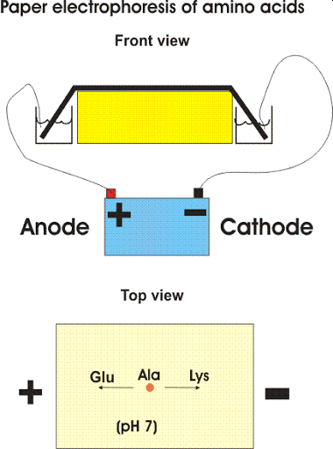
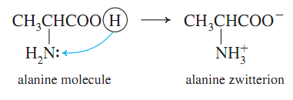
Electrophoresis
Method to separate compounds (AA) based on differences in
Charge (+/-)
Size (friction)
Gel Matrix (Sieve Like Material)
AA move due to electric field (or pH gradient)
SDS – separate on size only
Review “Zwitterions”
Can you:
How are AA separated
Terminology
Describe a Chromatography experiment
Read:
29.5 and 29.12
https://www.youtube.com/watch?v=bzR-uu-cIyg

Slide 12
Remember:
Opposites Attract
Electrophoresis - Example
Start:
++
+
-
+
- -
End:
++
+
-
+
- -
Can you:
Complete the experiment

Slide 13
Remember:
Opposites Attract
Electrophoresis – Example with AA
Ala
Glu
Lys
Start:
Ala
+
-
Glu
Lys
End:
Ala
+
-
Glu
Lys
Can you:
Complete the experiment

Slide 14
Remember:
Opposites Attract
Electrophoresis – You Try It!
HIS
Tyr
Asp
Start:
His
+
-
Tyr
Asp
End:
+
-
Can you:
Complete the experiment

Slide 15
Remember:
Opposites Attract
Electrophoresis – You Try It (Answer)!
HIS
Tyr
Asp
Start:
His
+
-
Tyr
Asp
End:
His
+
-
Tyr
Asp
Can you:
Complete the experiment

Slide 16
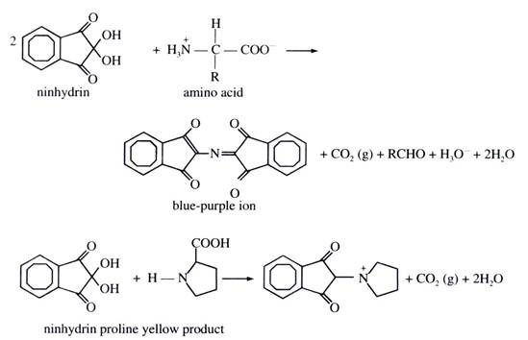
Diagnostic Test – Ninhydrin Reaction
Super sensitive (10⁻⁸g)
Clear → purple (yellow if Pro)
+ any AA
- other (carbohydrates/lipids

Slide 17
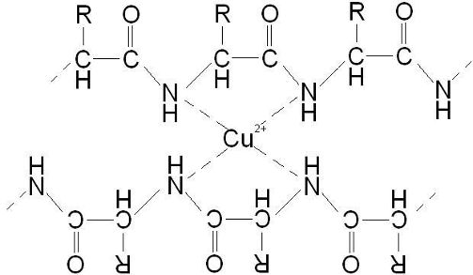
Diagnostic Test - Biuret
1
2
3
Clear → pastels (Easter eggs)
+ peptides with 3+ AA
- AA or dipeptides

Slide 18
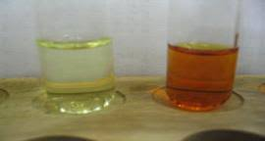
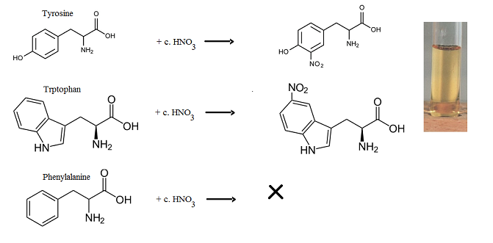
Diagnostic Tests - Xanthoproteic
Clear → yellow/orange
+ Benzene rings
- Other AA

