Slide 1
CHE 102 Spring 2020
Lecture 29b – Structure/Function Relationship
Overview/Topics
4 Levels of Protein Structure
Primary
Secondary
Tertiary
Quaternary
7 Functions of Proteins
Denaturation
Skills to Master
Recognize 3 types of Secondary Structure and how they are made
Draw/Sketch each type of interaction in Tertiary Structure
Hydrogen Bonds
Salt Bridges
Disulfide Bonds
Hydrophobic
Hydrophilic
Parts of Quaternary Structure
List 7 Functions of Proteins
List 7 ways to Denature Proteins
Read
Hein 10th Edition
Pages 802-819
Sections 29.6-29.10
Additional Useful Links
Libre Texts Sections 16.4

Slide 2
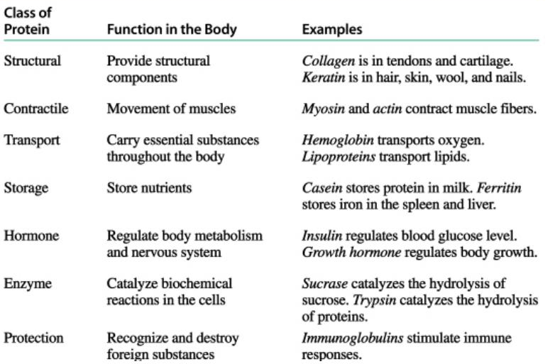
Protein – Functions (7)
Can you:
List 7 uses for proteins
Give 1 specific Example
Read:
Hein 29.8

Slide 3
Protein - Overview
Discovered partial structure 1954 – Linus Pauling/Robert Corey (Nobel Prize)
First Complete Structure 1958 – Fredrick Sanger (Nobel Prize)
Classification | Description | Examples
Primary | #, kind, type and sequence of AA
Secondary | Regular 3D structure, held together by H-bonds in backbone | α-helix β-pleated sheet triple helix
Tertiary | Distinct 3D structure due to interactions between R-groups | H-bonds Ionic bonds (Salt Bridges) Disulfide bonds Hydrophobic Hydrophilic
Quaternary | Complex proteins | Multiple units Non-protein parts Metal ions
Can you:
Differentiate between the different levels of structure

Slide 4
Protein – Primary Structure
#, kind, type, and sequence of AA
Fredrick Sanger (1958 Nobel Prize) Beef Insulin
Several years of work to sequence 51 AA
Hydrolyzed proteins into smaller fragments to analyze
Edman Degradation – split AA at N-Terminal End
Fragment 1:
Gly-Glu-Arg-Gly-Phe-Phe-
Fragment 2:
Gly-Phe-Phe-Tyr-Thr-Pro-Lys
Combined:
Gly-Glu-Arg-Gly-Phe-Phe-Tyr-Thr-Pro-Lys
Overlap
Can you:
Define Primary Structure
Used Sangers method to determine the sequence of a AA
Sangers Experiment
Read 29.12
More in Lab

Slide 5
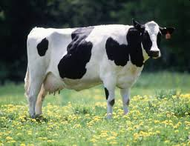
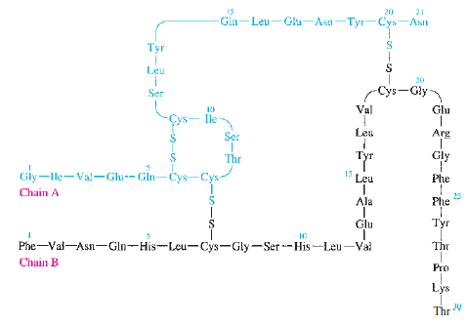
Protein – Primary Structure of Beef Insulin
Fredrick Sanger:
Solved structure of beef insulin (1955)
Nobel prize 1958
51 AA in two chains held together by disulfide bonds
DFNB + N-terminal end + hydrolysis to solve structure
“Paper shredder”

Slide 6
Protein – Secondary Structure
Determined by H-bonds between AA-backbone (between C=O on amide group and NH2 on another amide group
α-helix → AA 4 residues apart, R-groups towards outside
β-pleated sheet → AA far apart, R-groups face outwards
Collagen → Triple Helix (Ignore)
Can you:
Define Secondary Structure
Draw an example of the bonding
Differentiate between α-helix and β-pleated sheet

Slide 7
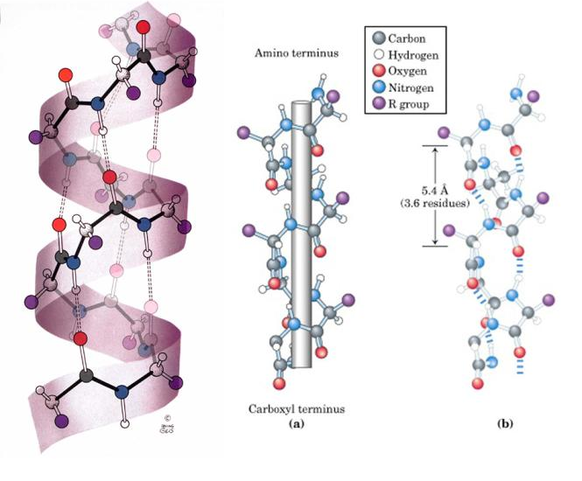
Protein – α-Helix
α-helix → AA 4 residues apart, R-groups towards outside

Slide 8
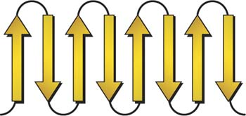
Protein – β-Pleated Sheet
β-pleated sheet → AA far apart, R-groups face outwards

Slide 9
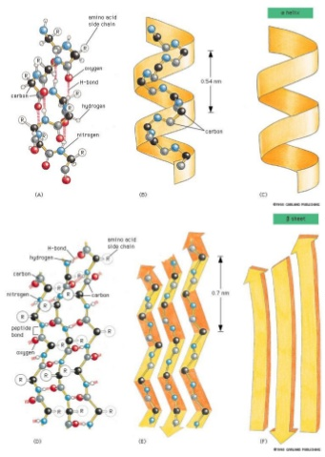
Protein – Different Ways to View Structures

Slide 10
Protein – Tertiary Structure
Determined by interactions between R-groups (5 Types)
H-bonds: -COOH and –OH
Ionic/Salt Bridges
Disulfide Bonds
Hydrophobic (form core of protein)
Hydrophilic (face outwards to interact with water)
Can you:
Define Tertiary Structure
Draw an example of each type
Given AA determine or draw the interaction

Slide 11
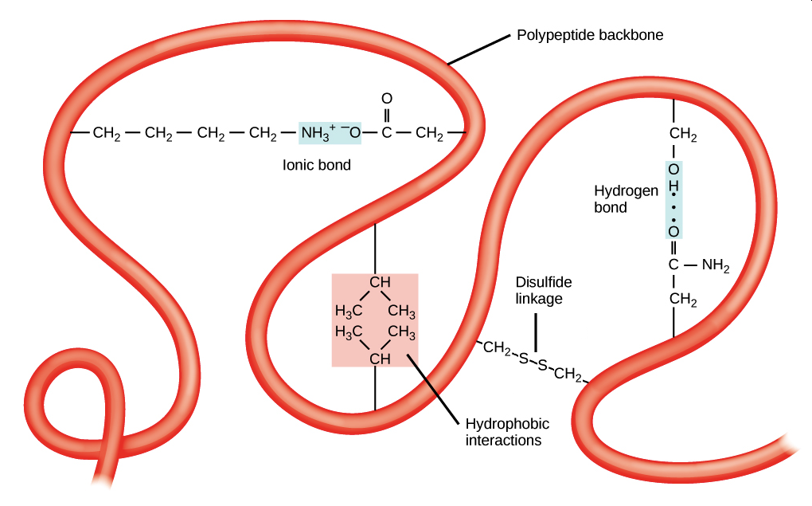
Protein – Tertiary Structure
Can you:
Label a diagram like this?

Slide 12
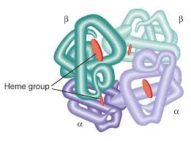
Protein – Quaternary Structure
Ex: Hemoglobin
4 subunits
Fe atoms
Multiple protein units
Non-protein parts
Metal ions
More Examples:
Read Hein 29.9 for more examples
Can you:
Define the different types of Quaternary Structure

Slide 13
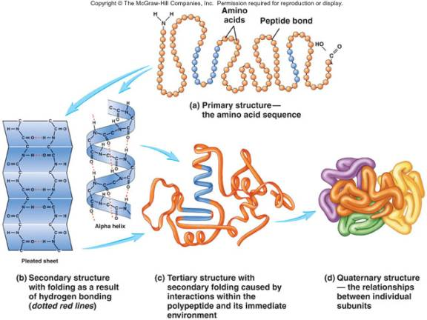
Protein Structure - “Overview”
Can you:
See the “Big” Picture

Slide 14
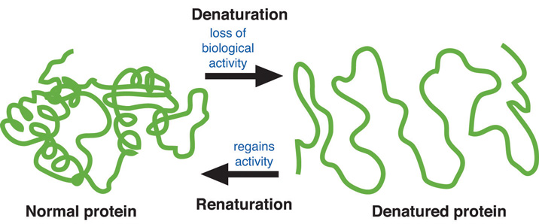
Denaturation
 | Cause | Example
1. | Heat | Cooking
2. | Acids/Base (pH) | Lactic Acid
3. | Organic Molecules | Ethanol/Isopropanol
4. | Heavy Metals | Pb, Hg
5. | Agitation | Stirring
6. | UV Light
7. | Enzymes | Digestion
8. | Salts | Water purification
Loss of 3D conformation in a protein
Disruption of 2°/3°/4° interactions
Does NOT break 1° structure (hydrolysis)
Loss of biological activity
Causes of Denaturation
Can you:
Define denaturation
Give examples

