Slide 1
CHE 102 Spring 2020
Lecture 29a – Amino Acid Basics
Overview/Topics
Definition/Why are they important
Structure of AA and Dipeptides
4 Types of Side Chains
Meaning of “Essential”
Zwitterions
Formation of Dipeptides
Skills to Master
Draw Examples/ID
D/L Isomer
Nonpolar/Polar/Acid/Basic AA
Zwitterions
Dipeptides
N-Terminal/C-Terminal
Peptide Linkage (Amide Bond)
Read
Hein 10th Edition
Pages 793-803
Sections 29.1-29.6
Additional Useful Links
Libre Texts Sections 16.1-16.3 - https://chem.libretexts.org/Courses/Sacramento_City_College/SCC%3A_Chem_309_-_General%2C_Organic_and_Biochemistry_(Bennett)/Text
Cheat Sheet: You will have Table 29.1 on all exams

Slide 2
Amino Acid - Background
Amino Acids (AA for shorthand)
Many functional uses
Structural Material
Enzymes/Catalysts (Ch. 31)
Nutritional – Growth and Maintenance (Ch. 32/35)
Some individually important (or converted to important molecules)
Gly, Glu, Tyr → neurotransmitters
Tyr → parent/precursor for epinephrine (adrenaline)
His → stomach secretes HCl, symptoms for inflammation, colds.
Building blocks for polypeptides and Proteins
Essential (10)
needed for normal health
not synthesized by the body
must be supplied by diet
Complete (animal) vs. Incomplete (vegetable) protein
Can you:
Many uses of AA/Proteins
Definitions – Essential, Complete, Incomplete

Slide 3
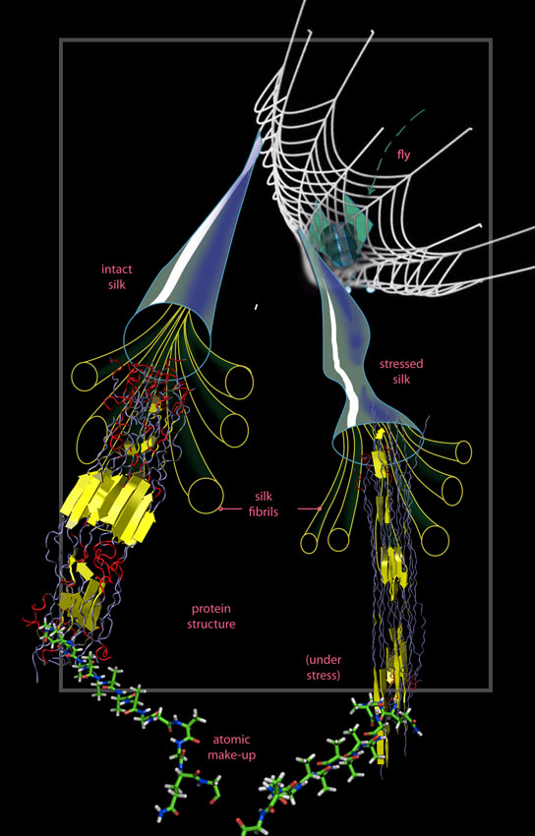
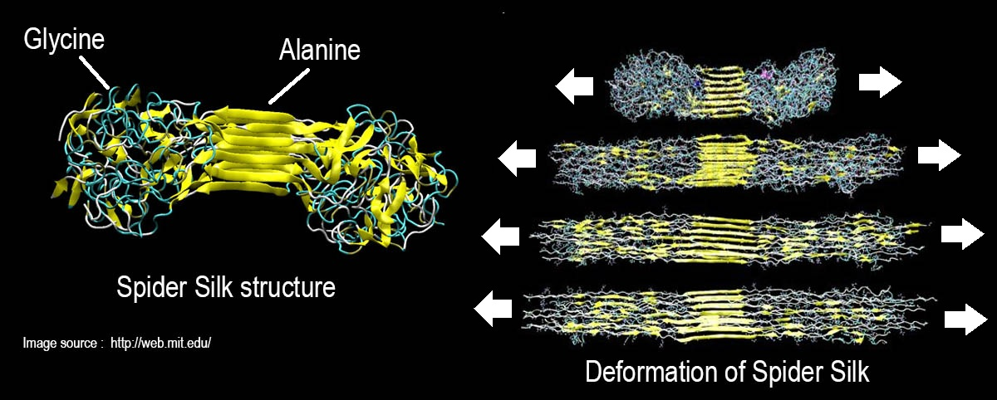
Structure to Function Relationship
Sequence of AA (structure) provides specific functionality.
Glycine and Alanine Rich regions provide large amounts of LDF
Makes spider silk “super strong”
Can you:
Relationship between Chemical Structure -> Physical Properties -> Biological Property

Slide 4
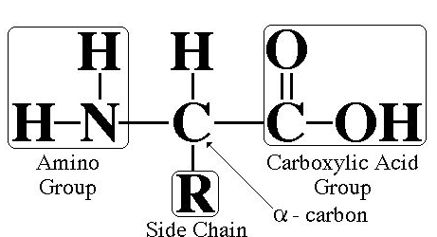
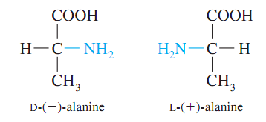
Amino Acid – Basic Structure
Amino Acid Structure:
Amide “amino” (N-terminal)
CA “acid” (C-terminal)
R-group (variable)
D/L Isomers
Can you:
Identify FG
Identify D and L Isomers

Slide 5
Amino Acid – Basic Structure
AA – Side Chains:
Side chains determine the functionality of the AA b/c the –COOH and –NH₂ groups react to form the backbone (More in Ch. 29.7)
3 letter abbreviations (given on cheat sheet)
Classification | Functional Group | Property
Nonpolar | -R (aliphatic or aromatic) | Hydrophobic
Polar | -COOH, -NH₂, -OH | Hydrophilic
Acidic | -COOH (extra) | Lose H → anion → Salt Bridges
Basic | -NH₂ (extra) | Gain H → cation → Salt Bridges
Cheat Sheet: You will have Table 29.1 on all exams
Can you:
Identify FG for each classification
Given an AA Characterize it using the classifications given

Slide 6
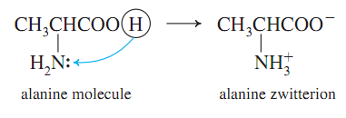
Zwitterions – physiological structure of AA
Zwitterion: dipolar form of AA, found at biological pH’s (internal acid/base Rxn)
Can you:
Draw a Zwitterion
*More later when we explore Electrophoresis (Ch. 29.11)

Slide 7
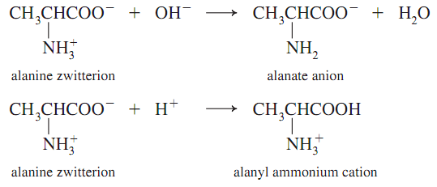
Amino Acid – Amphoterism
Amphoteric: molecules with properties of both acid and base
Remember
Opposites
Attract!
Can you:
Draw how an AA Zwitterion will react with an Acid or Base
*More later when we explore Electrophoresis (Ch. 29.11)

Slide 8
Formation of Polypeptides
Formation Reaction:
Dehydration reaction
CA + Amine → Amide
Amide structure/Peptide bond/Peptide linkage
C-Terminal Residue
-COOH or –COO⁻
N-Terminal Residue
-NH₂ or –NH₃⁺
Can you:
Given 2 AA can you draw the Dipeptide
Identify FG’s/Bonds/Type of Reaction
Cheat Sheet: You will have Table 29.1 on all exams

Slide 9
Formation of Polypeptides
“You try it”
Draw the Dipeptide Glu-Lys (Hit pause, try it yourself, then watch me do it)

Slide 10
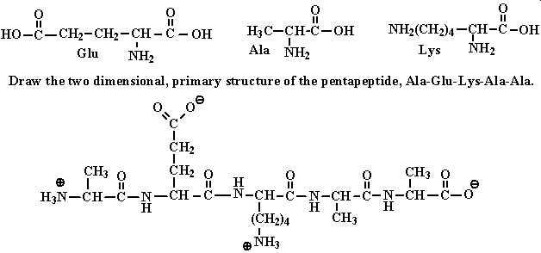
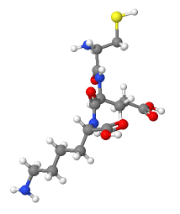
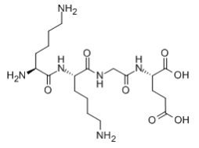
Variety of ways to draw the molecules.
Can you:
Be comfortable with the many different ways to draw/represent molecules?
LYS-LYS-GLY-GLU structure
Cys-Glu-Lys Structure

Slide 11
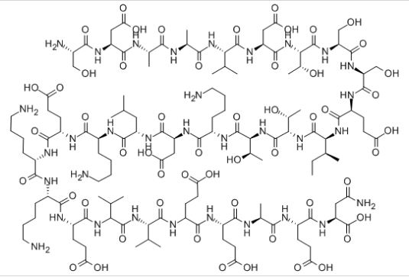
An “Excessive” Example
Can you:
Identify the various AA residues in the polypeptide?
H-SER-ASP-ALA-ALA-VAL-ASP-THR-SER-SER-GLU-ILE-THR-THR-LYS-ASP-LEU-LYS-GLU-LYS-LYS-GLU-VAL-VAL-GLU-GLU-ALA-GLU-ASN-OH

Slide 12
AA/Polypeptide Math
How many ways can you order AA?
# of AA | Possible Combinations | # of combinations (polypeptides)
2 | AB, BA | 2! = 1×2 = 2
3 | ABC, ACB, CAB BAC, BCA, CBA | 3! = 1×2×3 = 6
4 |  | 4! = 1×2×3×4 =24
10 |  | 3,528,800
15 |  | 1.3×10¹² (trillion)
30 |  | 2.65×10³² (???)
Many proteins are 100’s or 1000’s of AA long!
Can you:
Comprehend the shear number of possible polypeptides or proteins!

Slide 13
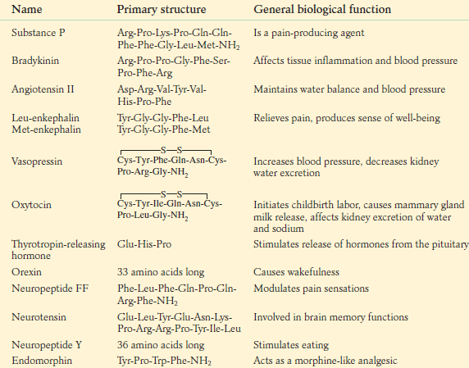
Polypeptides – Biological Properties
Polypeptides:
Small chains of AA (40-50 units)
Many ways to connect together (N!)
~30 biologically relevant ones
Read specific examples in Ch. 29.6
Hormones or Nerve transmitters
Small changes structure → HUGE changes in functionality
Can you:
Relationship between Chemical Structure -> Physical Properties -> Biological Property
Small change -> Big effect or…
Big change -> No effect

