Slide 1
CHE 102 Spring 2020
Lecture 28c – Biochemistry
Overview/Topics
Biological implications of structure
Biological Examples of Molecules
Biochemical Pathways
Specific Topics
Liposomes/Micelles
Atherosclerosis
Blood Group (Ch. 27 + 28)
Cell Membranes (Ch. 28 + 29)
Skills to Master
Vocabulary
Concept of Biochemical pathways
General Examples
Additional Useful Links
Libre Texts Sections 15.6
Read
Hein 10th Edition
Pages 776-781-770 and 755-756
Sections 28.7 and 27.15

Slide 2
Biological Pathways
General Information
Purpose of the pathway
Understand start/end
What occurs in an individual step
Regulation of pathways (biological and chemical)
Examples
Eicosanoids (Ch. 28.3)
Steroids (Ch. 28.6)
Atherosclerosis (Ch. 28.7)
Enzymes (Ch. 29/30)
DNA/RNA (Ch. 31)
Protein Synthesis (Ch. 31)
Metabolism (Ch. 33-35)
“A biological pathway is a series of actions among molecules in a cell that leads to a certain product or a change in the cell. It can trigger the assembly of new molecules, such as a fat or protein, turn genes on and off, or spur a cell to move.”
Start
End
A
B
C
D
Individual
Step
Individual
Step
Individual
Step
Can you:
Terminology
Focus on applying the general ideas for specific examples
https://www.genome.gov/about-genomics/fact-sheets/Biological-Pathways-Fact-Sheet

Slide 3
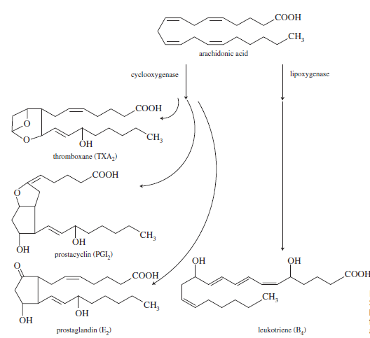
Eicosanoids – Immune Response
Start
Local Hormone Production due to Infection/Allergies/Tissue Damage
FA (Parent Molecules) released by cell are modified by enzymes into many molecule (Daughter Products) by many enzymes
Coordinate immune system response, blood clotting, attract WBC, vasodilation/restriction, body temperature, mucous
Ratio of ω-3 vs. ω-6 ratio important
ω-6 more potent/abnormal response
ω-3 mediate impacts
Drugs – used to control biochemical pathway
NSAIDS – inhibit cyclooxygenase (side-effect: stomach ulcers)
COX-2 – inhibit cyclooxygenase (side-effect: increased heart attacks)
ω-6
Individual
Steps
End
Can you:
Terminology
Understand the overall process
Ch. 28.3

Slide 4
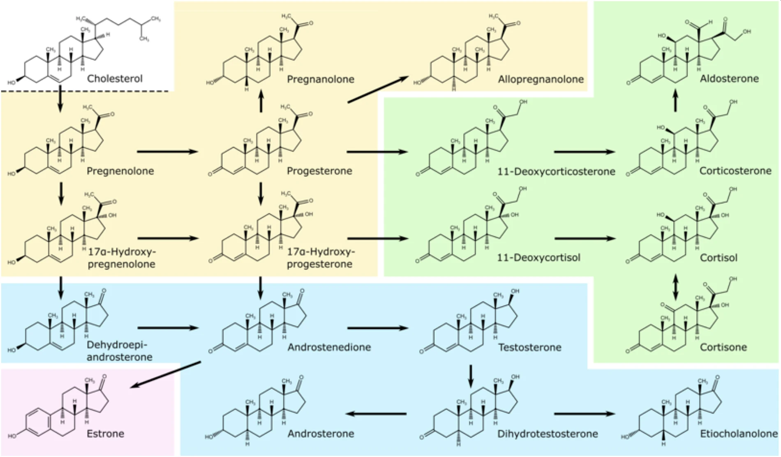
Ch. 28.6
Steroids – Chemical Modification
Parent molecule = cholesterol
Biologically/Chemically modified
Variety of daughter products
Vastly different properties
Can you:
Identify Functional Groups
Terminology

Slide 5
Self Assembly of Lipids
Micelles:
Formed from FA
Polar head
1 Non-Polar Tail
Single layer
Liposomes:
Formed from phospholipids etc.
Polar head
2 Non-polar tails
Double layer
Can you:
Identify and/or Draw a Micelle or Liposome?
ID the Hydrophobic or Hydrophilic parts
Hydrophilic
Hydrophobic
Hydrophilic
Hydrophobic
Nonpolar
Polar
Nonpolar
Polar
Hydrophilic
Surface
Hydrophilic
Surface
Hydrophobic
Core
Hydrophilic
Core
Ch. 28.7

Slide 6
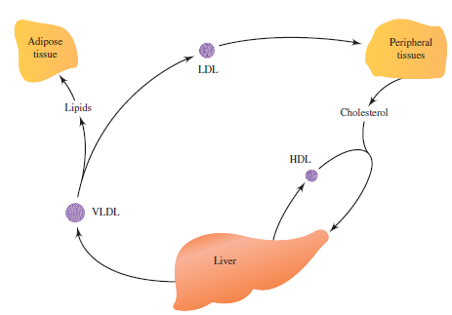
Biological Processes
Atherosclerosis:
Metabolic disease → deposits of lipids on artery walls → heart attack
Lipids naturally aggregate (hydrophobic)
Lipids trapped in artery walls (oxidized)
White cells (macrophages) scavenge lipids → bloated
Foam cells are stuck to arteries
Due to - improper transport of lipids
Lipid “cycle”
VLDL = Good – deliver lipids to cells
Adipose = Storage
LDL = BAD
Peripheral = Energy
HDL = GOOD – recycle
Drugs/Treatment
Low cholesterol diet
Decrease Triacylglycerol production
Inhibit metabolic synthesis of cholesterol
Increase excretion
Decrease absorption
Can you:
Answer questions about the process?
Understand the many methods to try and control biological process's
Ch. 28.7

