Slide 1
CHE 102 Spring 2020
Lecture 28b – Compound Lipids + Steroids
Overview/Topics
Phospholipids
Sphingolipids
Glycolipids
Steroids
Skills to Master
Draw Examples of all molecules given parts
ID Hydrophobic/Hydrophilic
Give an example of a use for each molecule
Read
Hein 10th Edition
Pages 771-776
Sections 28.4-28.6
Additional Useful Links
Libre Texts Sections 15.4-15.5

Slide 2
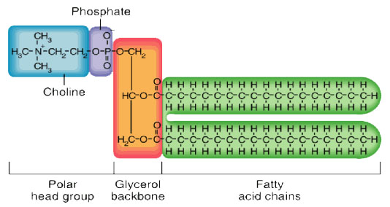
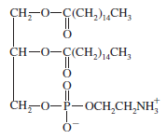
Phospholipids:
Structure:
○ Glycerol
○ 2 - FA
○ 1 - Phosphoric Acid
○ Amino-alcohol
Nerve tissue, brain matter, cell membranes (10-20%)
Used in foods as an emulsifier for chocolates and margarine
Hydrophobic vs. Hydrophilic parts
Formation reaction
Ester bond
Glycerol
Fatty acid
Fatty acid
PO₄
Nitrogen
Base
Can you
Draw Examples of all molecules given parts
ID Hydrophobic/Hydrophilic
Give an example of a use for each molecule
Cheat Sheet: You will have structure of Nitrogen Bases on exams

Slide 3
Formation Reaction
Dehydration (-H₂O)
Draw the phospholipid formed when glycerol, stearic acid, stearic acid, phosphate and ethanolamine react

Slide 4
Sphingolipids:
Structure:
○ Sphingosine
○ 1 - FA
○ 1 - Phosphoric Acid
○ Amino-alcohol
Membrane components, nerve sheath
Hydrophobic vs. Hydrophilic parts
Formation reaction
Amide bond
Sphingosine
Fatty acid
PO₄
Nitrogen
Base
Can you
Draw Examples of all molecules given parts
ID Hydrophobic/Hydrophilic
Give an example of a use for each molecule
Cheat Sheet: You will have structure of Sphingosine exams

Slide 5
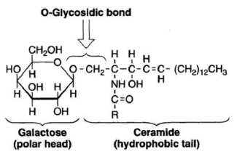
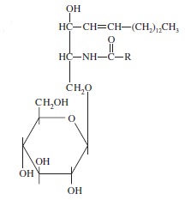
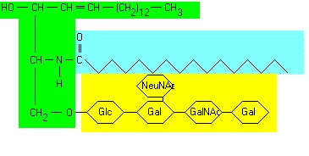
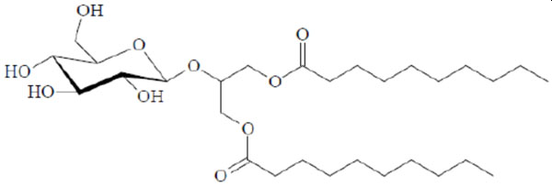
Glycolipids:
Structure:
○ Sphingosine
○ 1 - FA
○ Carbohydrate
Cerebrosides and gangliosides – cell membranes of nerve and brain tissue
Hydrophobic vs. Hydrophilic parts
Formation reaction
Amide bond
Sphingosine
Fatty acid
Carbohydrate
Can you
Draw Examples of all molecules given parts
ID Hydrophobic/Hydrophilic
Give an example of a use for each molecule
Cheat Sheet: You will have structure of Carbohydrates on exams

Slide 6
Try It
Draw the gycolipid that forms between spingosine, stearic acid, and β-D-Glucose

Slide 7
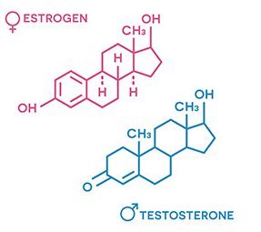
Steroids:
Parent Molecule → Daughter Molecules
Vary widely in function
Cholesterol - membrane component
Bile salts – digestion of fats
Ergosterol → Vitamin D
Digitalis – heart drug
Adrenal cortex hormones – metabolism
Sex hormones – characteristics and reproduction
Figure 28.5
Can you
Can you recognize Steroids/Cholesterol
Give an example of a use for each molecule
ID Functional Groups on Molecules
See it again:
Biochemical Pathways

