Slide 1
CHE 102 Spring 2020
Lecture 28a – Lipid Basics
Overview/Topics
Definition
Fatty Acids
Fat/Oils
Waxes
Triacylglycerol
Skills to Master
Draw Examples
FA (cis/trans/ω-3/ω-6
Waxes
Triacylglycerol's
ID Hydrophobic/Hydrophilic parts of molecules
General Properties of molecules
Read
Hein 10th Edition
Pages 763-770
Sections 28.1-28.3
Additional Useful Links
Libre Texts Sections 15.1-15.3
https://www.britannica.com/science/lipid

Slide 2
Definition: water insoluble, biochemical compounds that share no common chemical structure
Lipids
Fatty Acids
Giant CA
Simple Lipids
Waxes
Giant Esters
28 a
Fats and Oils
Esters of Glycerol + 3 FA
Glycerol + Phosphoric Acid + 2 FA + nitrogen/base
Phospholipids
28 b
Compound
Lipids
Sphingolipids
Sphingosine + Phosphoric Acid + 1 FA + nitrogen/base
Glycolipids
Sphingosine + 1 FA + carbohydrate
Steroids
Cholesterol
28 c
Misc. Steroids
Miscellaneous
Vitamins
32 - Skip
Lipoprotiens
Special Topic – Cell Membranes

Slide 3
Review of Solubility/IMF’s
What makes molecules water soluble (hydrophilic)?
Like dissolves like
Small
Similar IMF’s – Polar/H-bonds
Functional Groups that are generally water soluble:
What makes molecules water insoluble (hydrophobic)?
Oil and Water don’t mix”
Large molecules (R-groups)
Different IMF’s – Nonpolar
Functional Groups that are generally water insoluble:
Alcohols
Amines
Amides
Carboxylic
Acids
Alkane/ene/yne
Ether
Ester
Size Matters
HB/Hydrophilic
LDF/Hydrophobic
Can you:
Identify which FG are Hydrophobic and which are Hydrophilic?

Slide 4
Fatty Acids:
Giant Carboxylic Acids
Straight (unbranched) chains
Even number of carbons
Saturated vs. Unsaturated
Cis vs. Trans isomers
ω-3 vs. ω-6
Essential FA
Eicosands –
arachidonic acid, linolenic acid, linoleic acid
thromboxane, prostaglandin, prostacyclin, leukotriene
Ch. 35.2
CH₃(CH₂)₁₈COOH
Cheat Sheet: You will have Table 28.1 on all exams

Slide 5
Saturated FA
Unsaturated FA
Physical
No C=C
Mostly animals
(and higher plant cells)
Linear → LDF →Pack better
Generally Solid
Higher MP (b/c……)
Long shelf life
Used for Energy (28.4)
Form Micelles (28.7)
Physical
Contain C=C
Plants
Lower MP (liquids)
Spoil quickly
Cis/Trans Isomers (next slide)
Bonus Reaction: Use of Br₂ to detect presence.
Biological
Excess → atherosclerosis
heart diseases
Increase LDL (bad)
Decrease HDL (good)
Can block arteries easier
Biological
Good (better than Sat.)
Increase HDL (good)
Decrease LDL (bad)
Can you:
Identify and/or Draw a Saturated or Unsaturated FA?
Structure -> Physical Properties -> Biological Property

Slide 6
 | Saturated Fats | Unsaturated Fats
Recommended consumption: | Not more than 10% of total calories per day. | Not more than 30% of total calories per day
Health Effect: | Excessive consumption is not good because of their association with atherosclerosis and heart diseases. | Unsaturated fats are considered good to eat if you are watching your cholesterol.
Life: | These are long lasting and do not get spoiled quickly | These get spoiled quickly
Commonly found in: | Butter, coconut oil, whole milk, meat,peanut butter,margarine,cheese,vegetable oil or fish oil | Avocado, soybean oil, canola oil, olive oil
Cholesterol: | Saturated fats increase LDL (badcholesterol) and decrease the HDL | Unsaturated fats increase high-density lipoprotein ( HDL or good cholesterol) and decrease LDL (bad cholesterol)
Melting Point: | High | Low
Physical state at room temperature: | Solid | Liquid
Type of bonds: | Consist of SINGLE bond | Consist of at least 1 DOUBLE bond
Fatty Acids:
Saturated v.s. Unsaturate

Slide 7
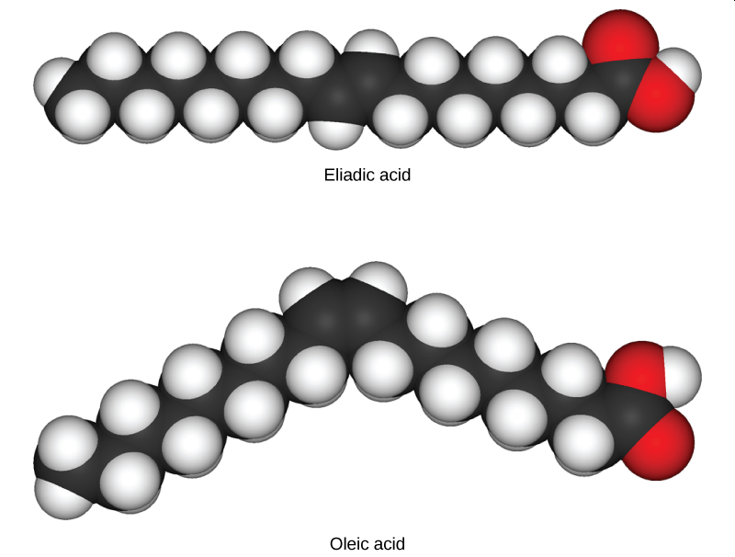
Cis-Isomer
Trans-Isomer
Physical
Contain C=C
Naturally occurring
Physical
Contain C=C
Rare in a nature
Man made through
Dehydrogenation Reaction
Linear → Packs tightly → High MP
Biological
GOOD
Decrease LDL (bad)
Increase HDL (good)
Biological
BAD
Increase LDL (bad)
Decrease HDL (good)
Increase risk of Heart Attack
Can you:
Identify and/or Draw a Cis or Trans FA?
Structure -> Physical Properties -> Biological Property

Slide 8
Greek letter Omega (ω) is the last letter in the Greek alphabet. It is used by biologist
(counting from the wrong end of the molecule!) to indicate the position of the first
C=C in an unsaturated fat.
ω-3 Fatty Acids
ω-6 Fatty Acids
Biological
GOOD
Precursor to molecules that produce
useful (less harmful) effects
Ex: Linolenic acid
Biological
BAD
Precursor to molecules that produce
harmful (exaggerated) effects
Ex: Arachidonic acid → Trigger for
Heart Attacks
Can you:
Identify and/or Draw a ω-3 or ω-6 FA?
Structure -> Physical Properties -> Biological Property
*More Information in 28 d
Biological Pathways and Eicosanoids

Slide 9
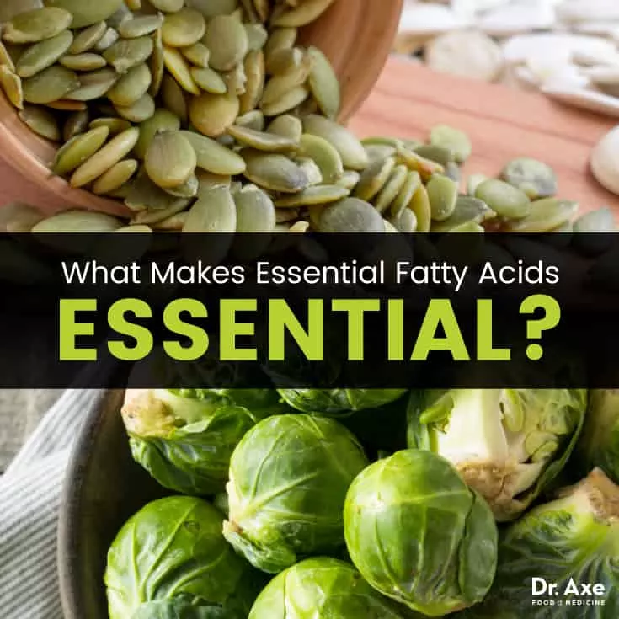
Essential Fatty Acids
Human can synthesis many FA
Lack enzyme to make specific ω-3 and ω-6 FA
Polyunsaturated Fatty Acids (PUFA)

Slide 10
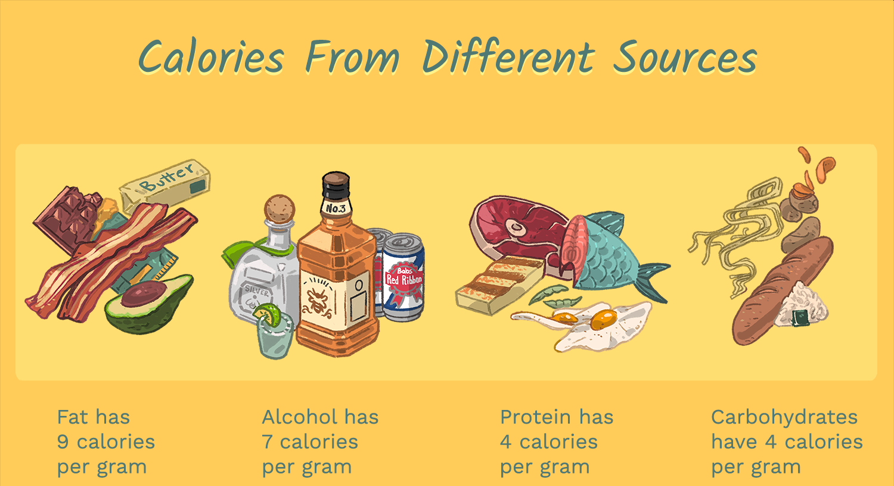
Preview – Metabolism
Oxidation Number = “Charge” an atom would have in a neutral molecule
Hydrogen always +1
Oxygen always -2
More Reduced (more -) = more energy stored
More oxidized (more +) = less energy stored
Carbohydrates
Fatty Acids
40% Carbon by mass
More oxidized
4 cal/g
75% Carbon by mass
More reduced
9.5 cal/g
Calc. Ox # for each molecule

Slide 11
Waxes:
Giant Ester (20-30 Carbons)
Dehydration Reaction (CA + Alc -> Ester)
Very hydrophobic
Used as protective layer on plant leaves, animal feathers, fur, cars, floors
Energy storage/buoyancy control in plankton
Industrial production of Lipstick, Eyeshadow, Car wax etc.
Can you:
Identify and/or Draw Wax?
Write a reaction showing the formation of a wax?

Slide 12
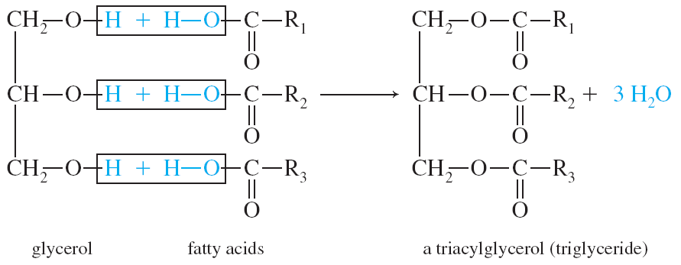
Fats and Oils:
Glycerol + 3 FA
Giant Esters
Dehydration Reaction
Ester Bonds
Triacylglycerol or Triglycerides
Hydrophobic
Glycerol
Fatty acid
Fatty acid
Fatty acid
-H₂O
Can you:
Identify and/or Draw a Triacylglycerol?
Write a reaction showing the formation of a wax?
Identify the Hydrophobic and Hydrophilic parts

Slide 13
Try It
Draw a triacylglycerol composed of glycerol, stearic acid, palmitoleic acid and buturic acid

