Slide 1
CHE 102 Spring 2021
Lecture 27e – Carbohydrate Reactions
Overview/Topics
Formation of cyclic structures
Formation of Diasaccharides
Redox Reactions – Generic
Mild oxidation
Strong oxidation
Reductions
Diagnostic Tests
Fehlings/Benedicts/Barfoeds
Reducing Sugars
Kiliani-Fischer synthesis (3 steps)
Addition/HCN (Ald → Cyanohydrin)
Hydrolysis/Oxidation to CA (CN → COOH)
Reduction (CA → Ald)
Skills to Master
27e
Read
Chapter 27

Slide 2
Review
Oxidation/Reduction
(Redox) Reactions
Plants reduce CO₂ and H₂O to store energy (in carbohydrates)
Humans oxidize carbohydrates to CO₂ and H₂O release energy
Ch. 33 – Bioenergetics
Ch. 34 – EMP/Glycolysis + CAC metabolism
Oxidation – Dfn/3 signs
Reduction – Dfn/3 signs

Slide 3
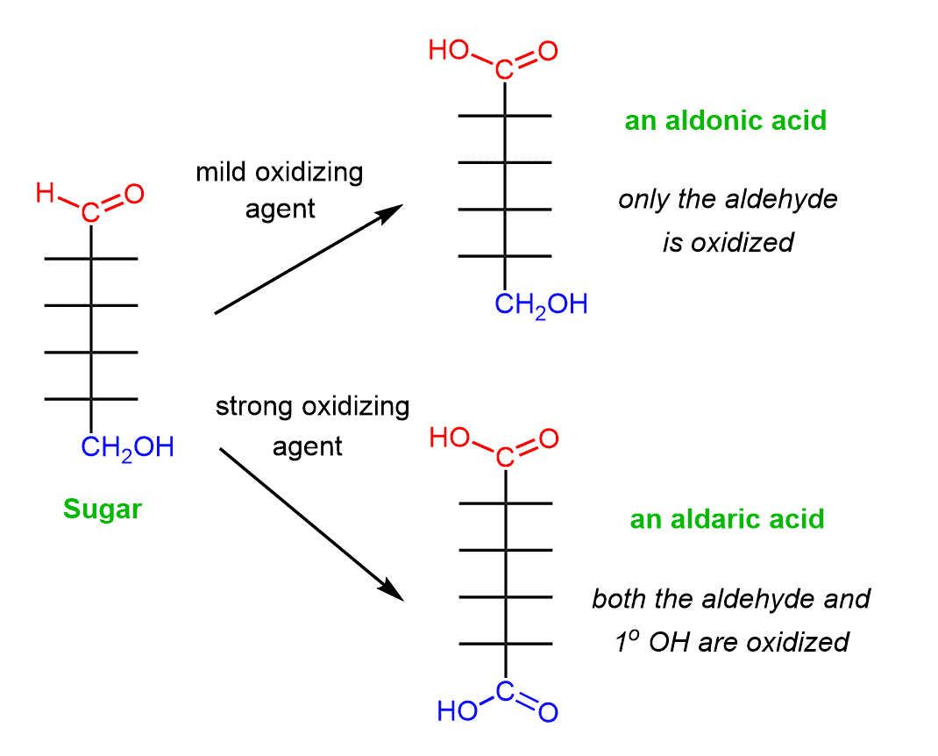
Oxidation
Lots of different oxidizing agents
Mild vs Strong oxidation
Glycolysis (Ch. 34) and CAC (Ch. 34)
[o]
Aldehyde
Alcohol
[o]
Carboxylic Acid
Carboxylic Acid
Aldehyde
Carboxylic Acid
or
strong
mild
-ose → onic acid
-ose → aric acid

Slide 4
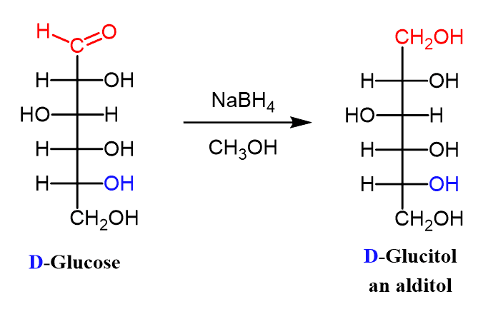
Reduction
Lots of different reducing agents
Mild vs Strong oxidation
[r]
H₂/Ni
H₂/Pt
Δ
generic
Ch. 23
Ch. 27
[r]
Aldehyde
Alcohol
“sugar alcohols”
Absorption in intestines partially blocked
½ calories
-ose → itol

Slide 5
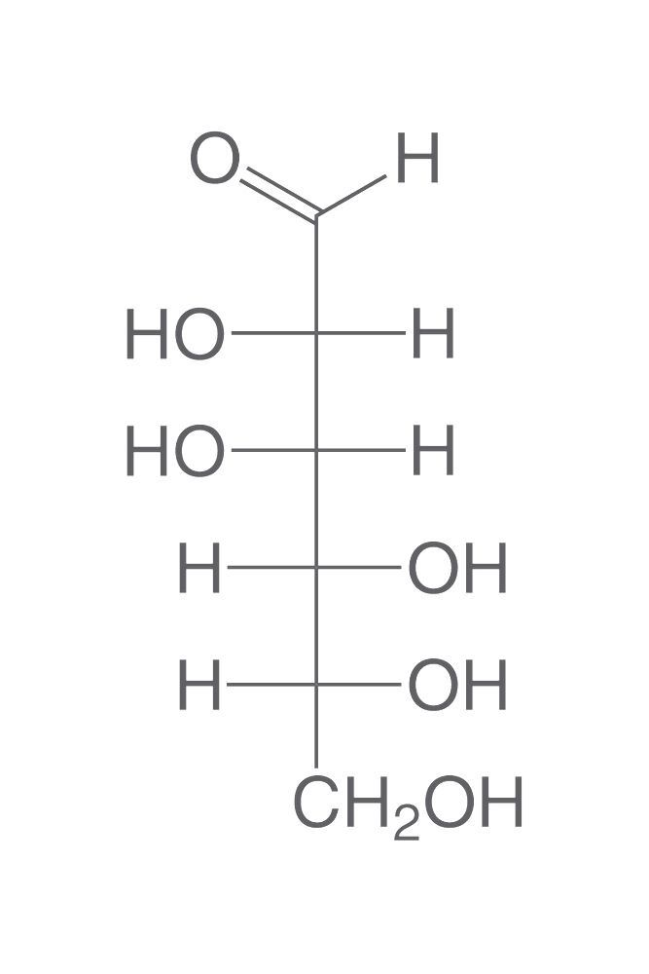
Lets Try It!
Write the products and names of the product for:
Mild oxidation
Strong oxidation
Reduction

Slide 6
Diagnostic Tests
“Reducing Sugars” (Sugar oxidized, Metal reduced)
3 Functional Groups (+)
Aldehydes
α-hydroxyketones
Hemiacetal
Many variations of the test – Tollens, Fehlings, Benedicts, Barfoed etc.
Glucose monitoring kits
Lab 28 (after break)
Key Negative is Sucrose
Very Inconsistent in Literature
Fehling/Benedict/Barfoed
[o]
Aldehyde + 2 Cu⁺² + 5 OH⁻
Carboxylic Acid Ion + Cu₂O + 3 H₂O
(blue)
Na⁺
brick red
ppt
Sometimes shown as CA Salt with Na
Tollens
[o]
Aldehyde + 2 Ag⁺¹
Carboxylic Acid Ion + 2 Ag (s) + 3 H₂O
Clear/Colorless
Silver Mirror/ppt

Slide 7
Lets try it: Write the reaction for glucose undergoing the Benedicts test and the Tollens test

Slide 8
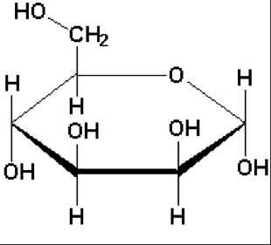
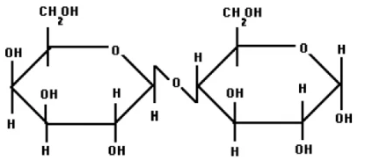
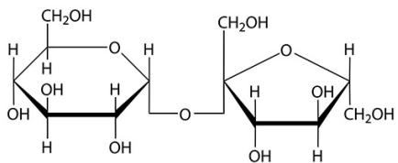
Lets Try It!
Which of the following will give a positive (+) Tollens (etc) test? Explain.
What is the visible evidence of positive (+) result?

Slide 9
Dehydration/Hydrolysis
[-H₂O]
[+H₂O]
Dehydration combines molecules together
Hydrolysis breaks molecules apart
[-H₂O]
Monosaccharide + Monosaccharide
Disaccharide
Polysaccharides (α-1,4)
[+H₂O]
Mono/Di-saccharides
[+H₂O]
Humans Lack Enzyme (NR)
Bacteria have
Polysaccharides (β-1,4)

Slide 10
Lets Try It!
Review
Draw they dehydration reaction between the cyclic forms of α-D-Glucose and β-D-Glucose.
Name the molecule
Draw and label an arrow pointing to hemiacetal/acetal/hemiketal/ketal

Slide 11
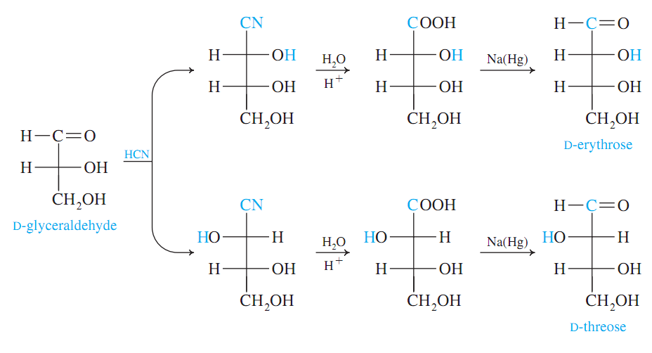
Review of Reactions:
Ch. 23 and 24
Kiliani-Fischer synthesis
3 Steps
Addition/HCN (Ald → Cyanohydrin)
Hydrolysis/Oxidation to CA (CN → COOH)
Reduction (CA → Ald)
Synthesis of all carbohydrates from smaller molecules
Aldehyde
Cyanohydrin
Carboxylic Acid
Aldehyde + 1
Cyanohydrin
Rxn
Hydrolysis
Rxn
Reduction
Rxn
Carbon Chain
Gains a Carbon
3C → 4C
Many Books Show Amide Formation

Slide 12
Starting with the proper D-Pentose show the reaction which would lead to the formation of D-Glucose. Only show the ½ the reaction leading to the desired product.
You Try It:

Slide 13
Kiliani-Fischer synthesis

