Slide 1
CHE 102 Spring 2021
Lecture 27 c,d – Disaccharides and Polysaccharides
Overview/Topics
3 Important Disaccharides
Formation Reaction
Disaccharide Structure
Draw
ID Hemiacetal, acetal, ketal, hemiketal
Glycosidic Bonds (ID, Label)
3 Important Polysaccharides
Structural differences
Functional differences
Draw/ID
Structure/Function Relationship
Skills to Master
HW 27 c,d
Read
Chapter 27
https://saylordotorg.github.io/text_the-basics-of-general-organic-and-biological-chemistry/s19-06-disaccharides.html

Slide 2
Formation of Disaccharides
Alcohol + Alcohol → Ether
α-1,4-Glycosidic Bond
“Ether Bond”
Dehydration
Reaction
Acetal
Hemiacetal
Maltose
Glucose + Glucose
Obtained from starchs
Fermented products
“Reducing Sugar”

Slide 3
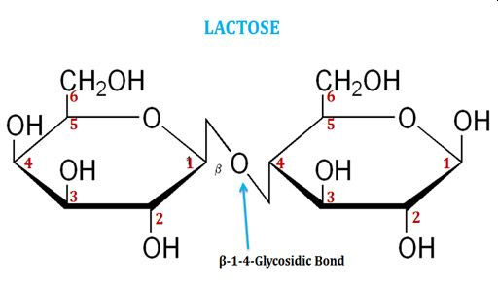
Lactose
Identify
Any hemiacetal, acetal, ketal, hemiketal
α and β
Carbon capable of mutarotation
Milk Sugar
Galactose + Glucose
Lactose Intolerance
“Reducing Sugar”
Carbon capable of mutaroation/hemiacetal
β-D-Galactopyranosyl-(1,4)-β-D-Glucopyranose

Slide 4
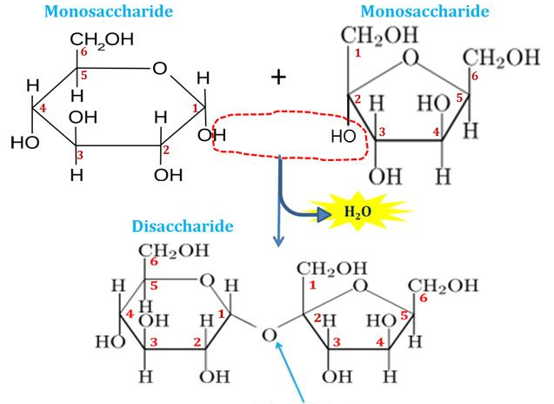
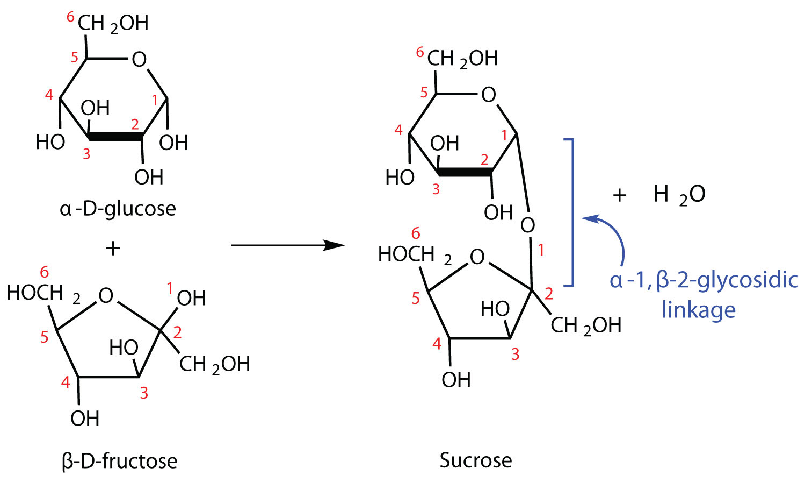
Sucrose
Identify
Any hemiacetal, acetal, ketal, hemiketal
α and β
Carbon capable of mutarotation
Sugar
Glucose + Fructose
NOT “reducing”
No carbon capable of mutarotation (acetal only)
Most abundant
Average consume 100 lbs/year
Alternative way to draw
Normal way to draw
Reversed direction of fructose
Reverse how α/β determined
α-D-glucopyranosyl-(1,2)-β-fructofuranose
Don’t do this!

Slide 5
Try It!
Draw the reaction resulting in β-D-Iodopyranosyl-1,2-α-D-Galactopyranose
Identify
Any hemiacetal, acetal, ketal, hemiketal
α and β
Carbon capable of mutarotation

Slide 6
Polysaccharides
Poly = many 10,000+
Nonreducing, not sweet, no mutarotation
Homo vs Hetero
Many uses (Energy/Structure etc)
4 Main Polysaccharides
What to Know
Starch
Amylose
Amylopectin
Glycogen
Cellulose
Won’t have to draw only “recognize” them
Type of Glycosidic Bond
Large scale structure
Physical/Chemical/Biological properties

Slide 7
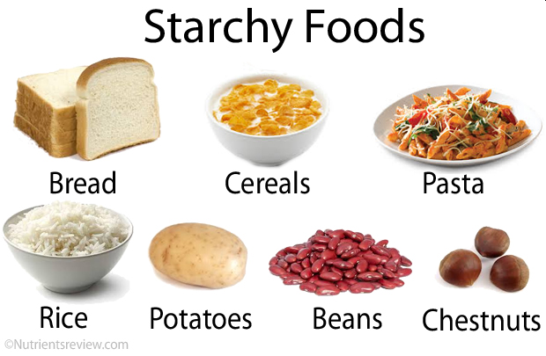
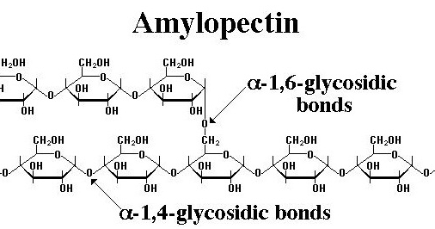
Starch
Mixture of Amylose (20%) and Amylopectin (80%)
“Storage” form of glucose
Easily Hydrolyzed (+ H₂O)
50% of average nutritional calories
Amylose
Amylopectin
α-D-glucose molecules
α-1,4 Glycosidic bonds
Every ~25 units α-1,6 glycosidic bond
250-1000+ units long
More dense
Tree like structure
α-D-glucose molecules
α-1,4 Glycosidic bonds
250-1000+ units long
Less dense
Coiled/Helix Structure due to HB

Slide 8
Amylose
Amylopectin

Slide 9
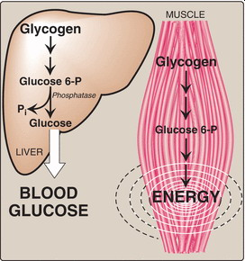
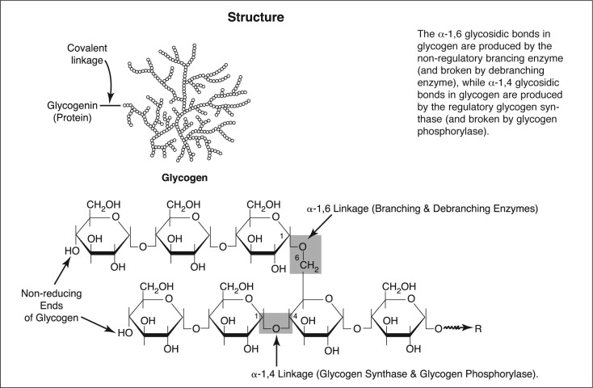
Glycogen
Animal Starch
Stored in Liver/Muscles
Similar to Amylopectin except more branched (10-15 units)
Easily Hydrolyzed

Slide 10
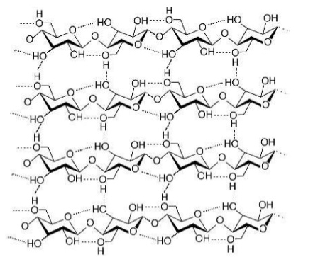
Cellulose
α-D-glucose
β-1,4-glycosidic bonds
Structural component plants/wood
Forms sheets held together by HB
Human can’t hydrolyze

Slide 11
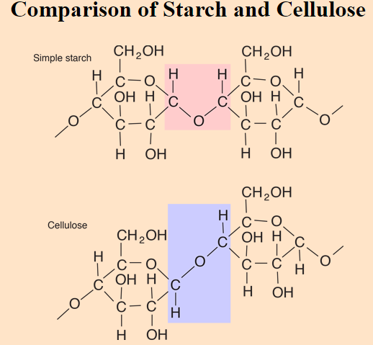

Slide 12
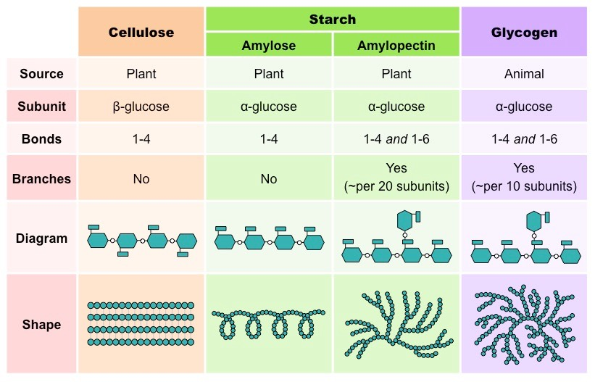
Can‘t Hydrolyze
Easy to Hydrolyze
Easy to Hydrolyze

Slide 13
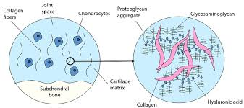
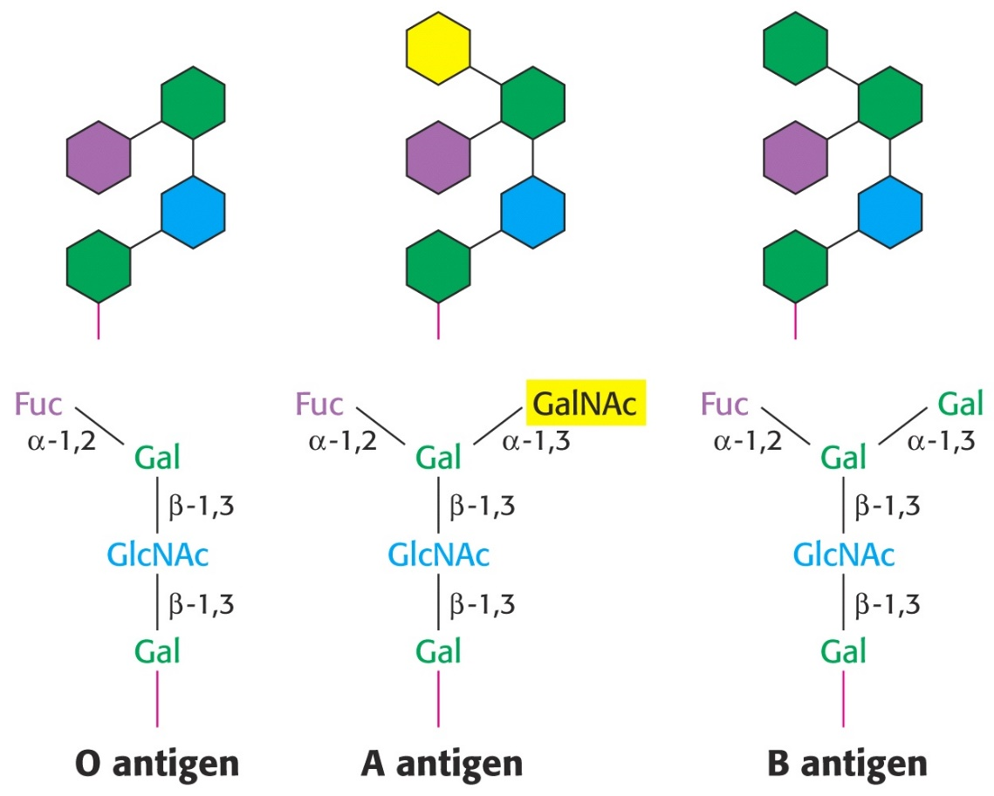
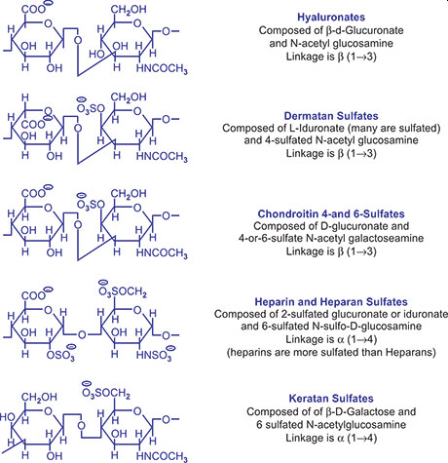
Many Other Uses for Carbohydrates
Glycoaminoglycans
Connective Tissue in Joints
Antigen/Bloodtyping

Slide 14
Try It!
Draw the reaction resulting in α-D-talopyranosyl-1,3-β-D-altropyranose

