Slide 1
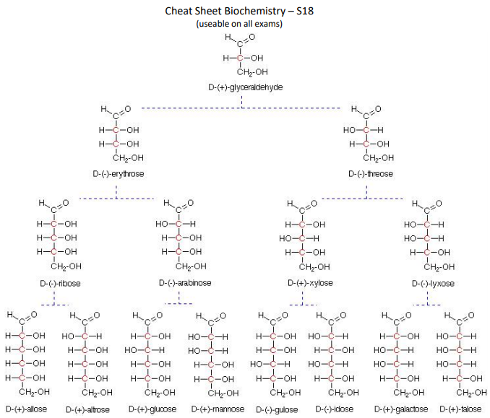
CHE 102 Spring 2021
Lecture 27 a,b – Carbohydrates
Overview/Topics
Nomenclature
Classifications
Mono, Di, Oligo, Poly
Triose, Tetrose, Pentose, Hexose…
Aldose, Ketose
D/L Isomers, +/- Isomer
Pyranose/Furanose ring
Importance of Carbohydrates (3)
Monosaccharides
Glucose
Galactose
Fructose
Cyclic Structure
Anomer, Epimer
Mutarotation
Hemiacetal/Acetal/Hemiketal/ketal
Chain vs Ring
Haworth Structures
Skills to Master
HW 27 a,b
Cheat Sheet
Read
Chapter 27.1-27.8
Cheat Sheet

Slide 2
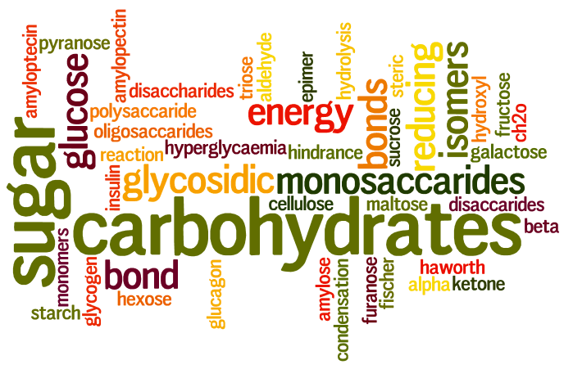
Carbohydrates
3 Important Functions
Ch. 34
Ch. 28, 29, 35
Carbon Hydrates – (C·H2O)_{n}
Polyhydroxy aldehyde or ketones
Energy Source (Fats/Proteins)
Easily transported (water soluble)
Structural Support (plant and animal cells)

Slide 3
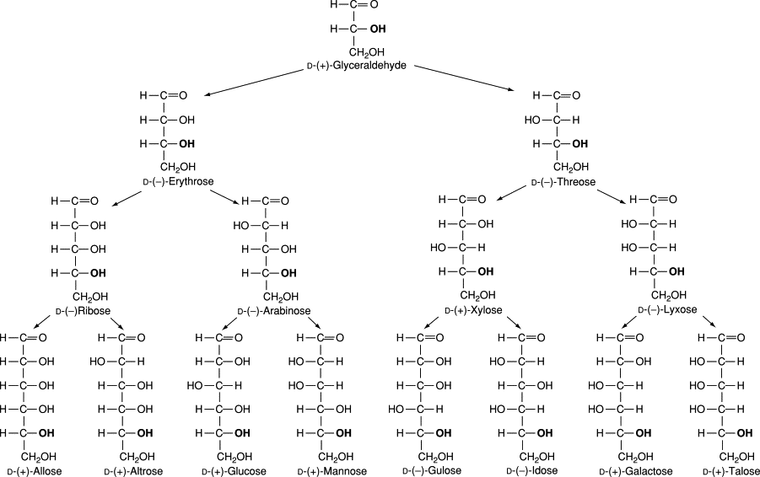
Number of Carbon Atoms
two monosaccharides that differ only in the configuration around a single carbon atom
Treose
Tetrose
Pentose
Hexose
Heptose
Epimers

Slide 4
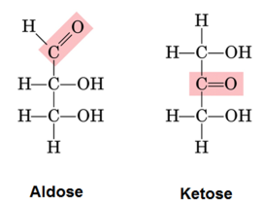
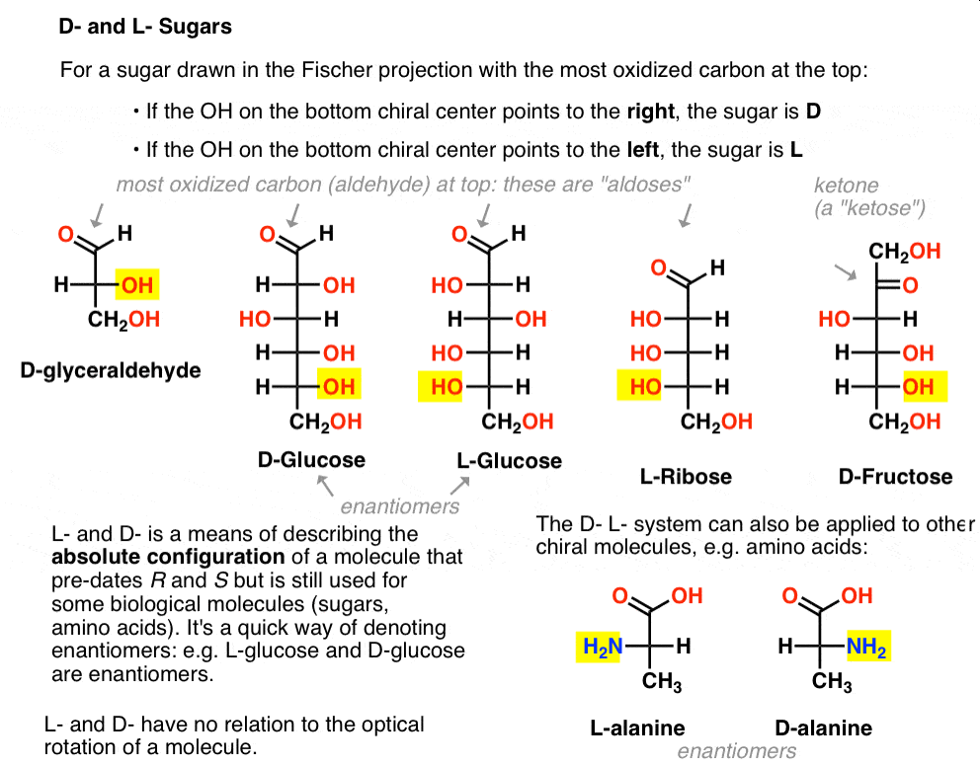
Functional Group
D or L Isomer
Aldose
Ketose
D – OH group on last chiral carbon (right)
L – OH group on the last chiral carbon (left)
+/- impossible to tell from structure

Slide 5
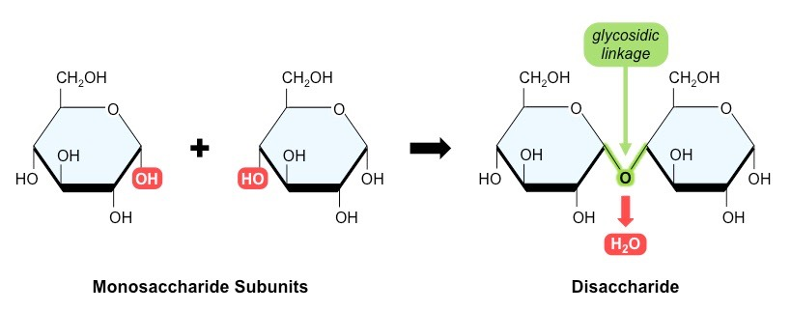
# of Carbohydrate Units
Monosaccharide
Disaccharide
Oligosaccharide
Polysaccharides

Slide 6
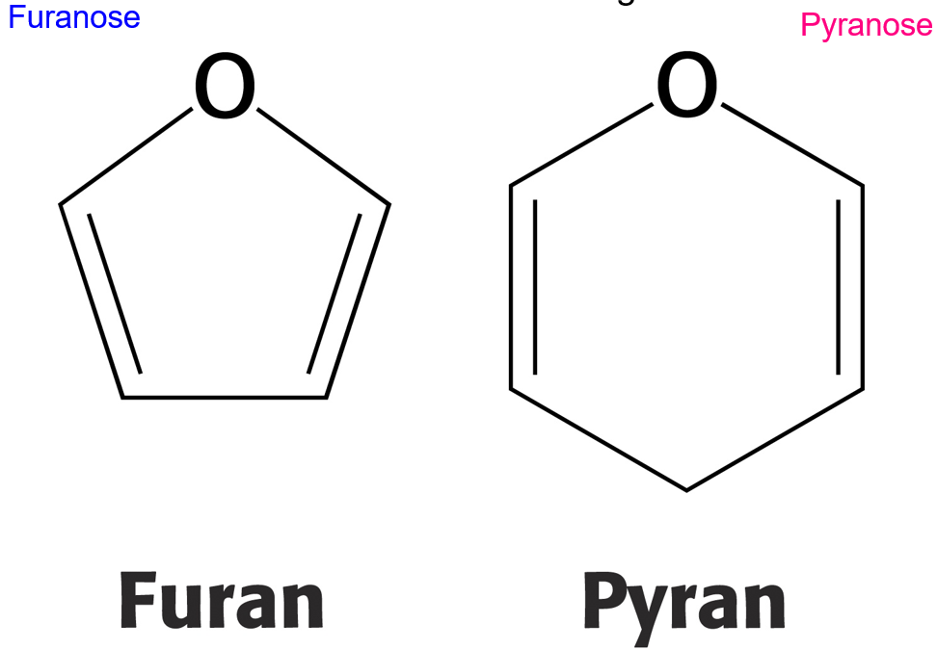
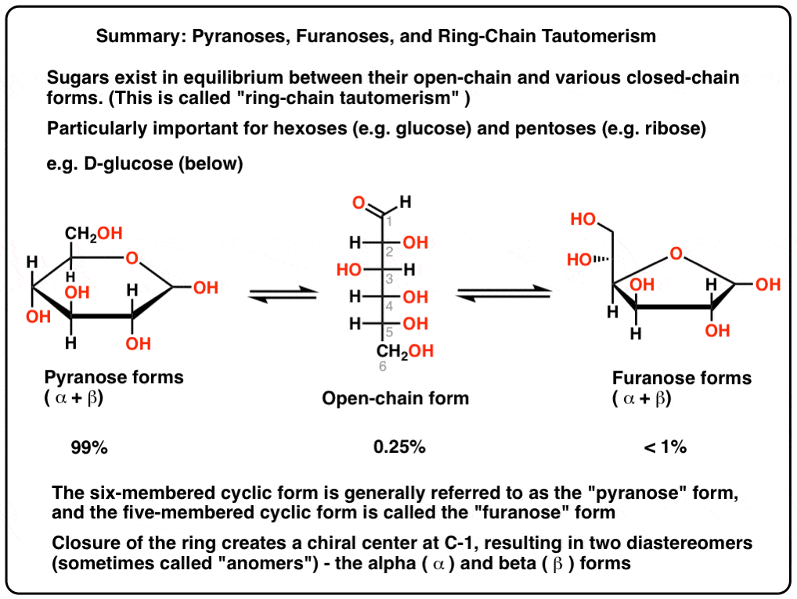
Size of Ring Formed
Anomers
BUDA
5 member ring = furanose
6 member ring = pyranose
Beta (β) = OH is up
Alpha (α) = OH is down

Slide 7
Classifications of Carbohydrates
Number of Carbon Atoms
Functional Group
# of Carbohydrate Units
Treose
Tetrose
Pentose
Hexose
Heptose
Aldose
Ketose
Monosaccharide
Disaccharide
Oligosaccharide
Polysaccharides
D or L Isomer
Size of Ring Formed
D – OH group on last chiral carbon (right)
L – OH group on the last chiral carbon (left)
+/- impossible to tell from structure
5 member ring = furanose
6 member ring = pyranose
Anomers
Beta (β) = OH is up
Alpha (α) = OH is down

Slide 8
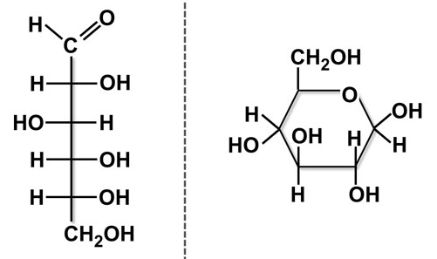
Categorize the following:
# carbons:
Functional Group:
# Units:
D/L:
+/-:
Ring Size:
α or β:

Slide 9
Categorize the following:
# carbons:
Functional Group:
# Units:
D/L:
+/-:
Ring Size:
α or β:

Slide 10
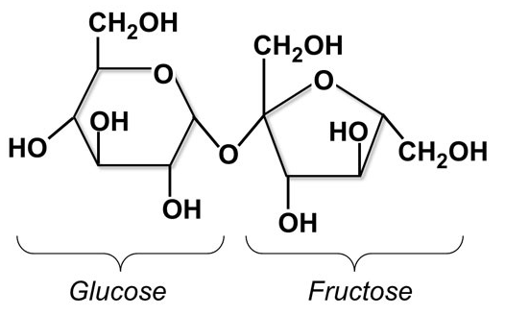
Categorize the following:
# carbons:
Functional Group:
# Units:
D/L:
+/-:
Ring Size:
α or β:

Slide 11
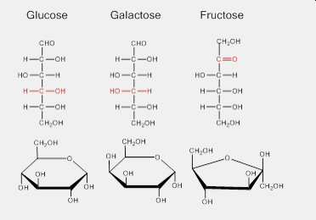
Don’t Memorize Structure
“Cheat” sheet
3+1 Important Monosaccharides
All have same formula C₆H₁₂O₆
Interconvertible (metabolic pathways)
Source of Energy
Building Blocks
Ch. 33/34
Chapter 31

Slide 12
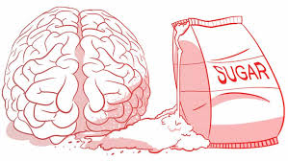
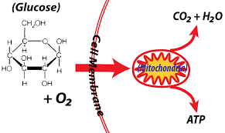
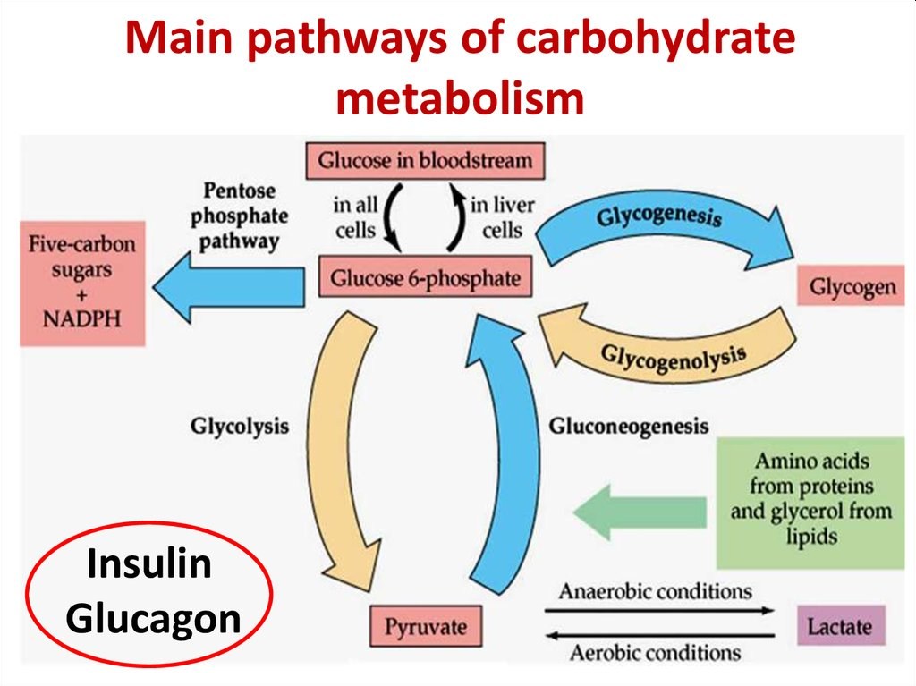
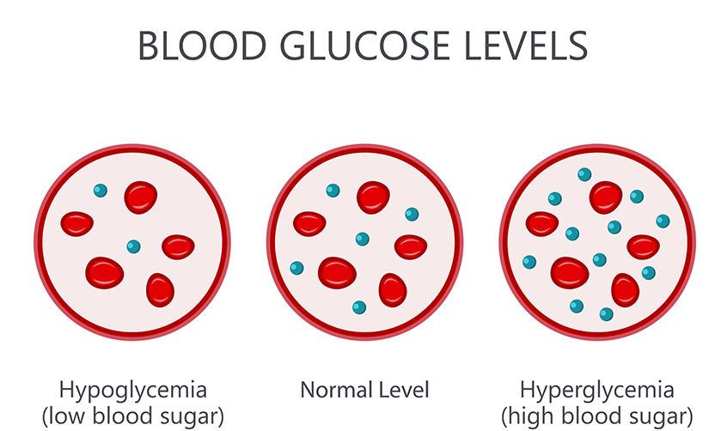
Glucose
Most common
Found in all disaccharides
Found in all Polysaccharides
“Dextrose or Blood Sugar”
Brain = Energy
Diabetes

Slide 13
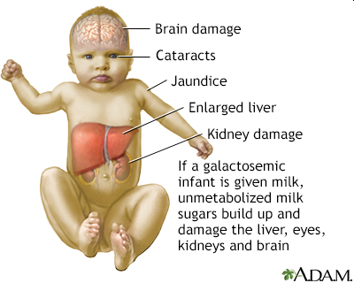
Galactose
½ of Lactose
Glycolipids/Cell Membranes
Galactosemia
Ch. 33/34

Slide 14
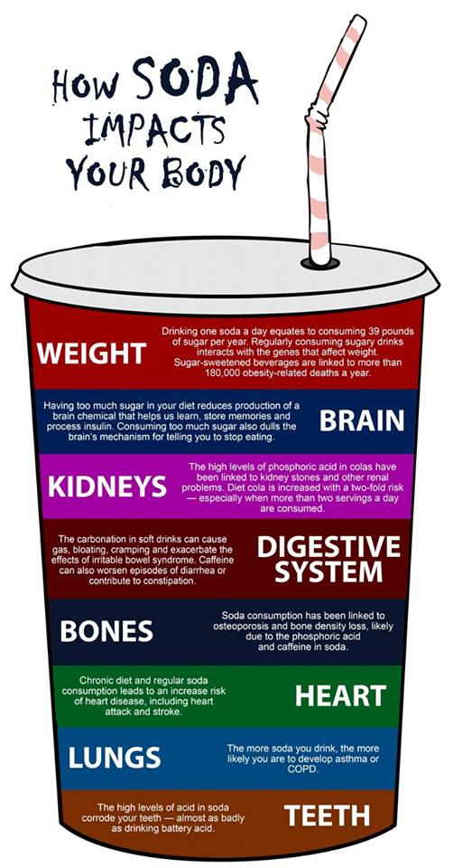
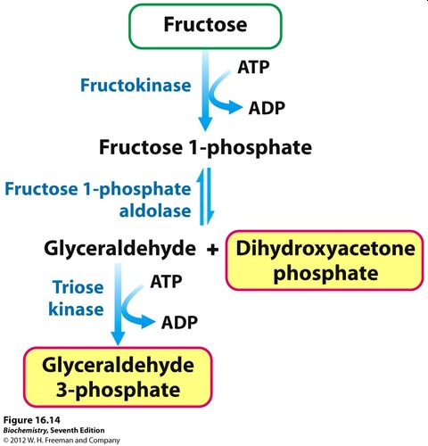
Fructose
Sweetest common carbohydrate
Most common sweetener
½ of Sucrose (table sugar)
High fructose corn syrup, Honey
Can be directly metabolized, but also converted to glucose

Slide 15
Cyclic Structure + Mutarotation
Next Lecture: Disaccharides
Aldehyde + Alcohol → Hemiacetal
Ketone + Alcohol → Hemiketal
Hemiacetal + Alcohol → Acetal
Hemiketal + Alcohol → Ketal
Review

Slide 16
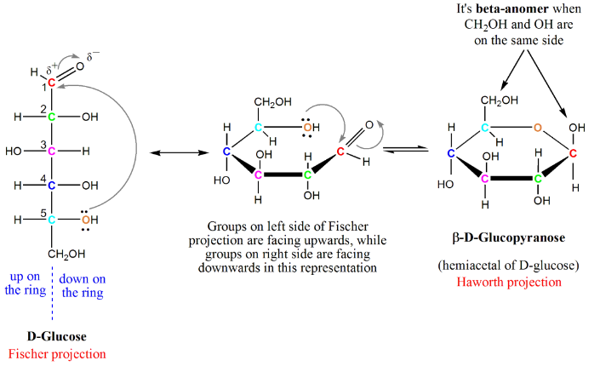
Cyclic Structure + Mutarotation
BUDA
Beta (β) = OH is up
Alpha (α) = OH is down
Anomer
Two cyclic isomers that differ in the orientation of the carbon involved in mutarotation
Mutarotation
Process by which anomers are interconverted
Occurs at the hemi-acetal carbon
D-isomer = always up
Name
Figure 27.3
https://www.khanacademy.org/test-prep/mcat/chemical-processes/aldehydes-and-ketones/a/cyclic-hemiacetals-and-hemiketals

Slide 17
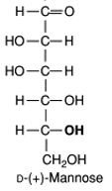
You Try It:
Draw α-D-Mannopyranose
Draw and Label an arrow pointing to the carbon the determine α/β
Draw and Label an arrow pointing to any hemiacetal, acetal, hemiketal, ketal

Slide 18
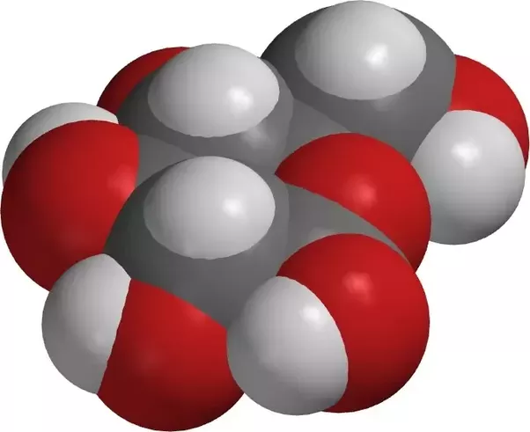
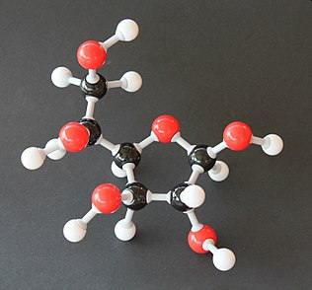
Glucose Models

Slide 19
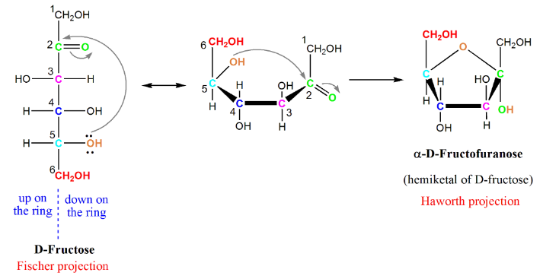
Fructose – Cyclic Form
Draw and Label an arrow pointing to the carbon the determine α/β
Draw and Label an arrow pointing to any hemiacetal, acetal, hemiketal, ketal

Slide 20
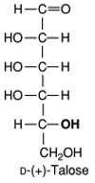
You Try It:
Draw Cyclic Structure
Name the Molecule
Did you draw the α or β anomer?
Draw and Label an arrow pointing to the carbon the determine α/β
Draw and Label an arrow pointing to any hemiacetal, acetal, hemiketal, ketal

