Slide 1
CHE 102 Spring 2021
Lecture 26a – Stereoisomers
Overview/Topics
Terminology
Optical Activity/Optical Rotation
Stereoisomers/Optical Isomers
Chiral/Achiral
Enantiomer
Diastereomer
Meso Compound
D/L, (+/-), R/S
Identify Chiral Carbons
Draw/ID Enantiomers, Diasteromers, Meso
Optical Rotation
S/F/G, P/C/B, O
Skills to Master
HW 26a
Read
Chapter 26
https://tophat.com/marketplace/science-&-math/chemistry/full-course/organic-chemistry-i-&-ii-steven-forsey/294/68270/

Slide 2
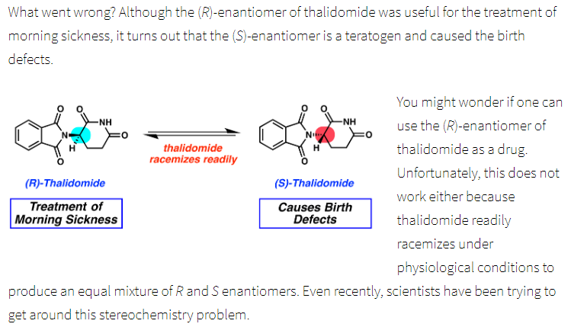
Children of Thalidomide
Cancer drug, sleep aid, morning sickness
1st stereoisomer = safe
2nd stereoisomer = birth defects
Phocomelia - resulted in shortened, absent, or flipper-like limbs.
https://helix.northwestern.edu/article/thalidomide-tragedy-lessons-drug-safety-and-regulation
https://en.wikipedia.org/wiki/Thalidomide

Slide 3
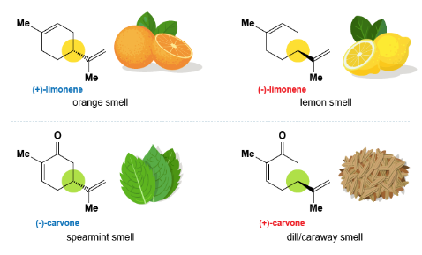
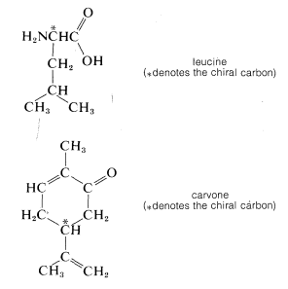
Importance of Stereoisomers
In a beaker (chemistry) = little difference (optical activity)
In a body (biochemistry) = can cause large differences
1st isomer = no headache
2nd isomer = headache
Different Tastes
1st isomer = sweet
2nd isomer = bitter
https://helix.northwestern.edu/article/thalidomide-tragedy-lessons-drug-safety-and-regulation
More examples in the future
Carbohydrates (Ch. 27) = D isomers
Amino Acids (Ch. 29) = L isomers
Enzyme Functionality (Ch. 30)
Metabolism (Ch. 34/35)
Different Smells
1st isomer = caraway
2nd isomer = spearmint
https://chem.libretexts.org/Bookshelves/Organic_Chemistry/Book%3A_Basic_Principles_of_Organic_Chemistry_(Roberts_and_Caserio)/05%3A_Stereoisomerism_of_Organic_Molecules

Slide 4
Isomers - Review
Same chemical Formula, Different Structure
How atoms connected
Orientation around C=C
Chirality
Ch. 19
Ch. 26
Ch. 20
https://www.compoundchem.com/2014/05/22/typesofisomerism/

Slide 5
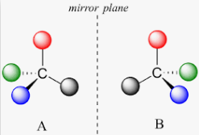
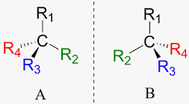
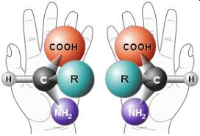
Stereoisomers
Representations
Wedge
Fischer Projection
Same Chemical Formula
Same Chemical Structure
Different Geometry around a “Chiral” carbon
3 Types
Enantiomers
Diastereomers
Meso
Requirements
4 Bonds (C, sometimes N)
4 different groups
No additional planes of symmetry
Effect on:
Physical
Chemical
Biological

Slide 6
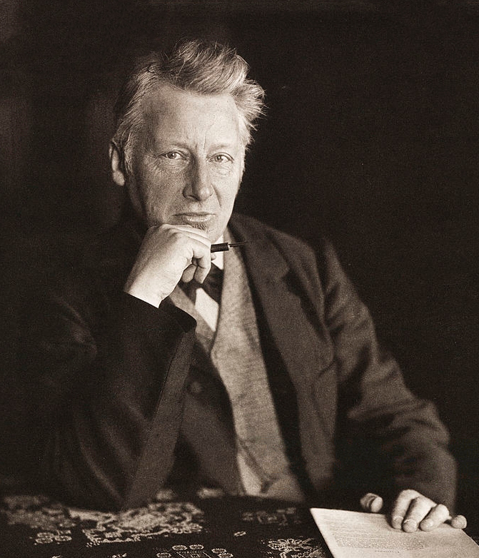
Identifying Chiral Molecules
“Asymmetric” Carbon Atom
Center of “Dissymmetry”
Requirements
4 Bonds (C, sometimes N)
4 different groups
No additional planes of symmetry or Not Superimposable
Lets Practice
J.H. van’t Hoff (1852-1911)
1901 – 1st Nobel Prize

Slide 7
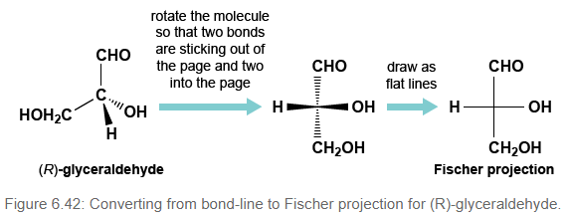
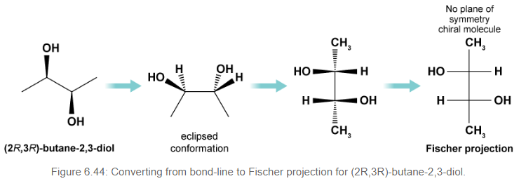
Drawing Stereoisomers
Sawhorse
Wedge Method
Fischer Projections
Most oxidized end up
Don’t change main change
https://www.mdpi.org/molecules/wedge/

Slide 8
Lets Practice

Slide 9
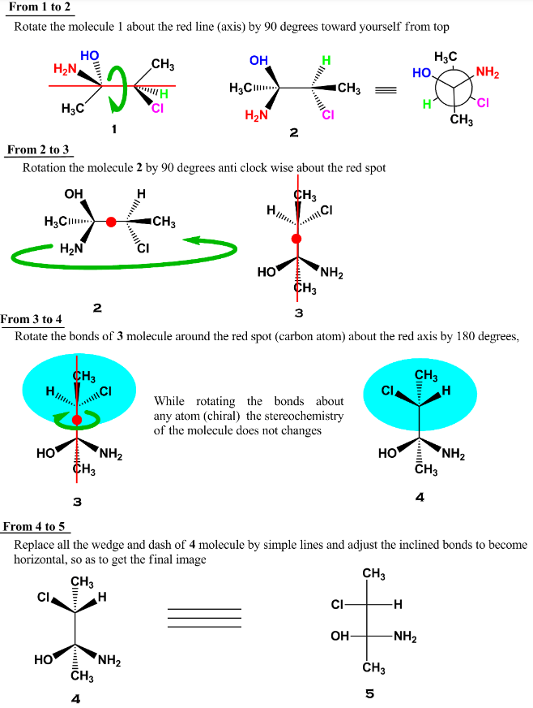
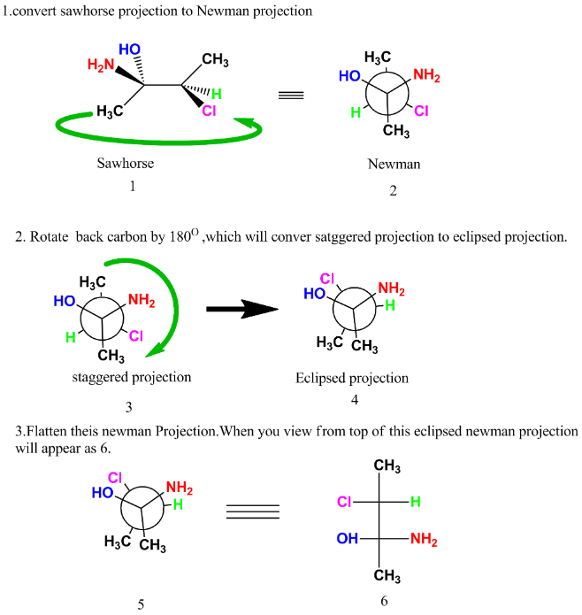
Drawing Stereoisomers
“a few other examples”

Slide 10
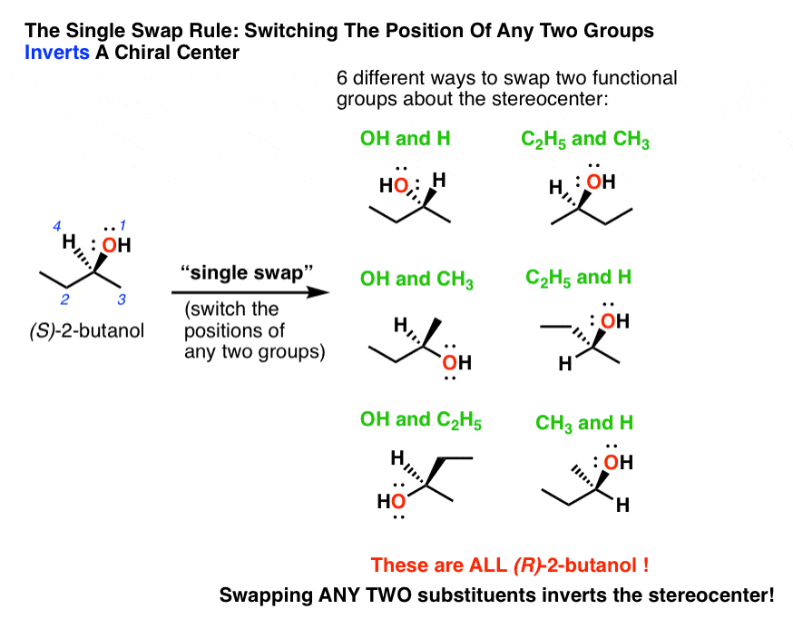
Same vs Different
2 Methods
Read Book – rotations, flip, flops
Swap/Exchange
Odd = different molecule
Even = same molecule
Examples

Slide 11
Lets Practice!

Slide 12
Molecules with Multiple Chiral Atoms
# stereoisomers = (# chiral atoms)²
Number of chiral atoms
# Stereoisomers

Slide 13
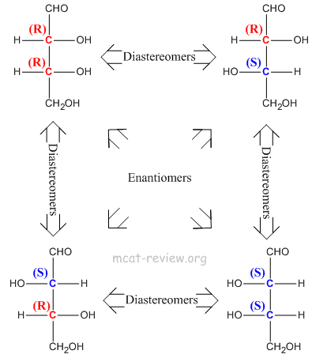
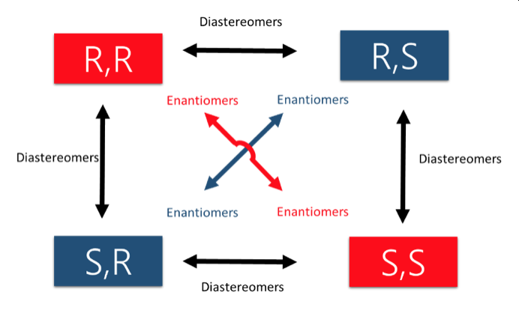
3 Types of Stereoisomers
Enantiomers
Stereoisomers that are mirror images
Same Formula, Structure, Diff Geometry
Same Physical/Chemical Properties
Different Biological Properties/Optical Rotation
Diastereomers
Stereoisomers that are not mirror images
Same Formula, Structure, Diff Geometry
Different Physical/Chemical Properties
Different Biological Properties/Optical Rotation
Meso
Stereoisomers with an additional plane of symmetry (not chiral)
Same Formula, Structure
Different Physical/Chemical Properties
Different Biological Properties/Optical Rotation

Slide 14
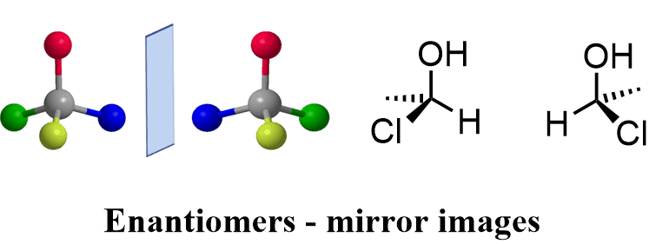
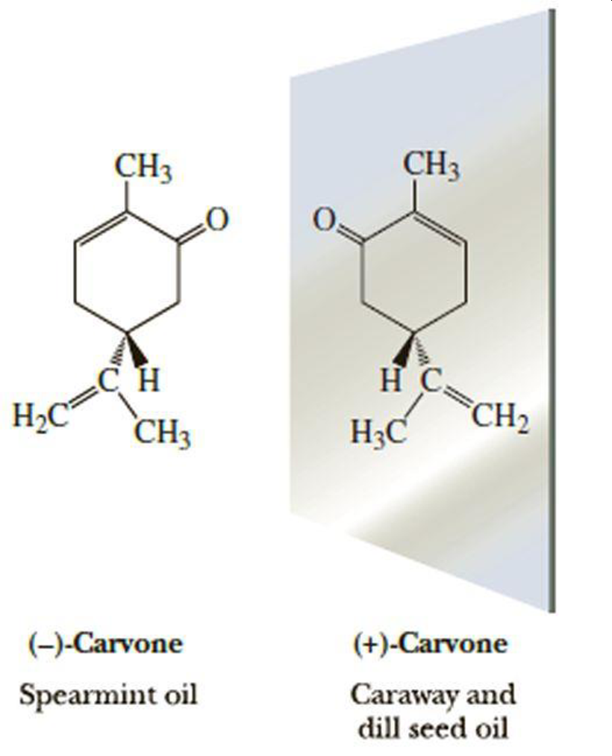
3 Types of Stereoisomers
Enantiomers
Stereoisomers that are mirror images
Same Formula, Structure
Same Physical/Chemical Properties
Different Biological Properties/Optical Rotation

Slide 15
3 Types of Stereoisomers
Diastereomers
Stereoisomers that are not mirror images
Same Formula, Structure
Different Physical/Chemical Properties
Different Biological Properties/Optical Rotation

Slide 16
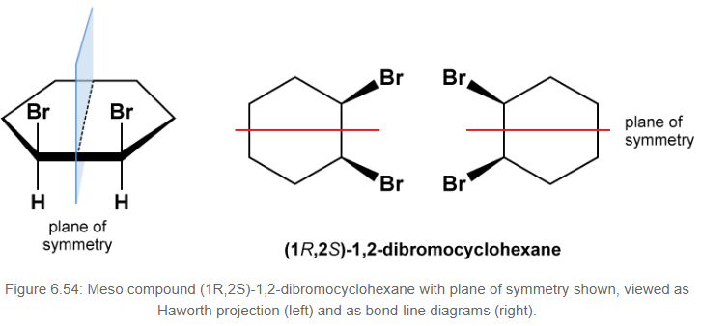
3 Types of Stereoisomers
Meso
Stereoisomers with an additional plane of symmetry (not chiral)
Same Formula, Structure
Different Physical/Chemical Properties
Different Biological Properties/Optical Rotation

Slide 17
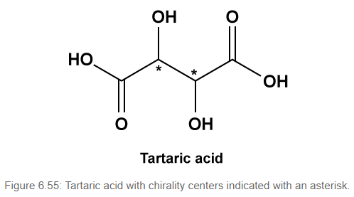
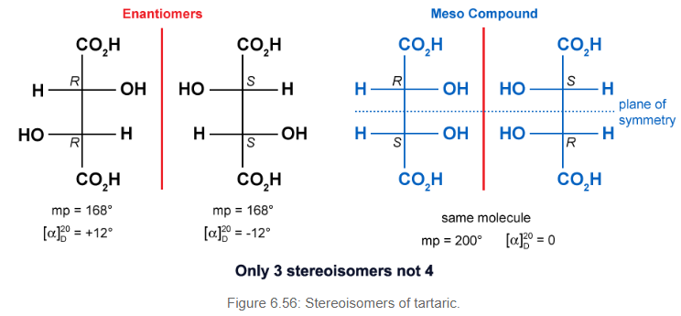

Slide 18
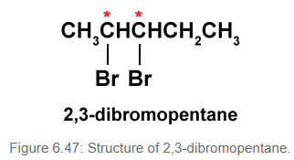
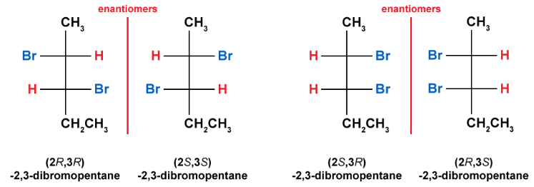
Identifying and Labeling - E,D,M

Slide 19
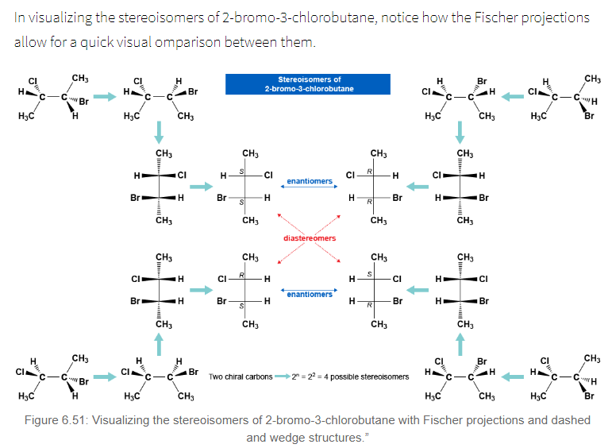
Identifying and Labeling - E,D,M

Slide 20
Lets Practice

Slide 21
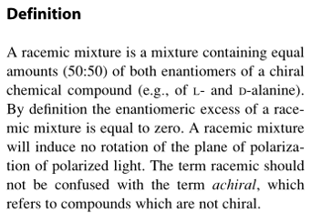
Racemic Mixture

Slide 22
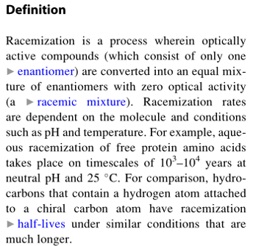
Racemization

Slide 23
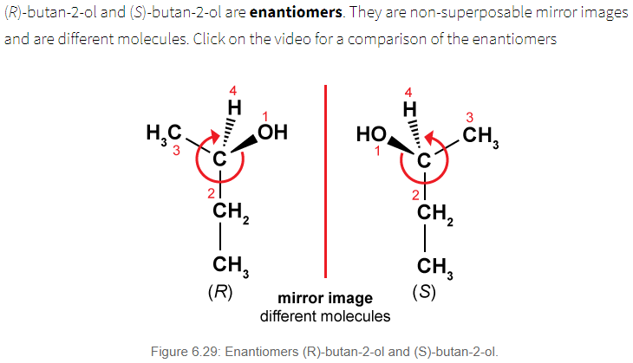
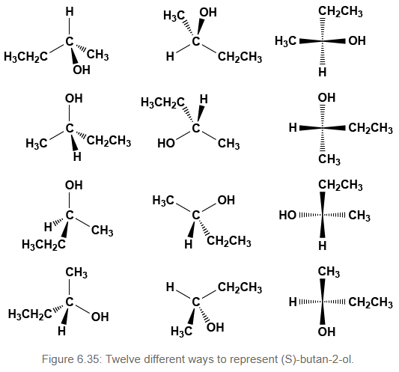
Stereoisomer Nomenclature
D/L: Dextrorotary and Levorotary: based on direction of optical rotation
+/- : based on direction of optical rotation
R/S : based on priority of group, clockwise (R), counterclockwise (S)
D/L : Orientation around last chiral carbon (Carbohydrates/Amino Acids)

Slide 24
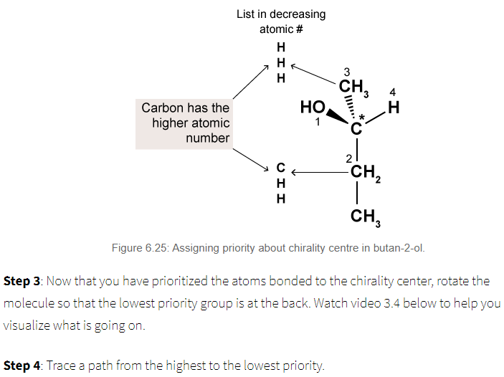
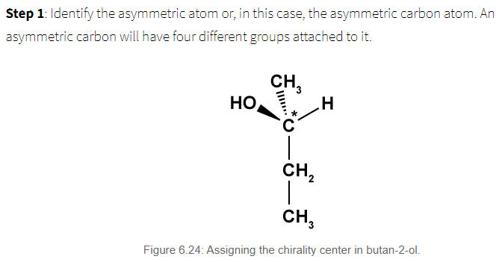
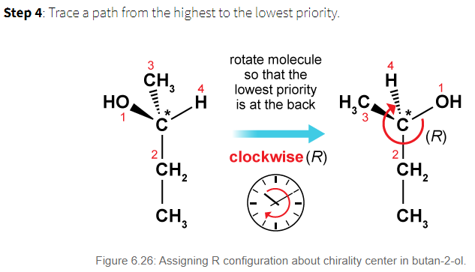
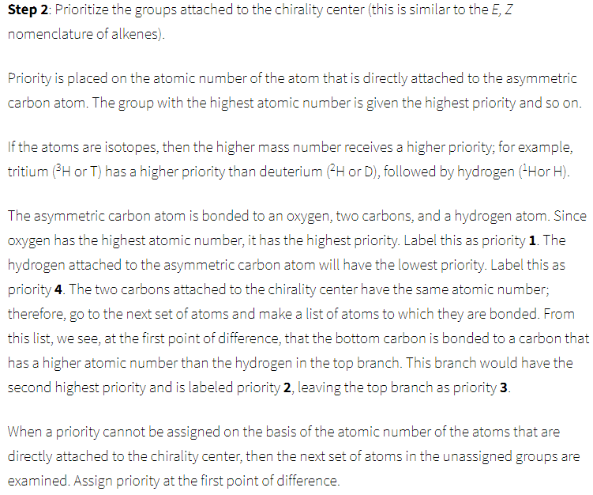
https://tophat.com/marketplace/science-&-math/chemistry/full-course/organic-chemistry-i-&-ii-steven-forsey/294/68270/

Slide 25
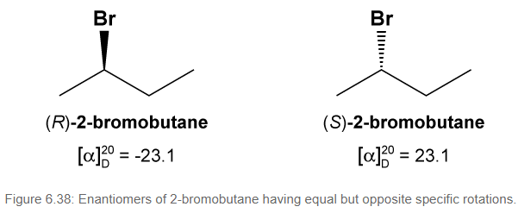
Optical Activity
Rotation
Almost only Physical property that can differentiate between enantiomers
D/L: Dextrorotary and Levorotary: based on direction of optical rotation
+/- : based on direction of optical rotation
Normal/Unpolarized Light
Polarized Light
Vibrates in all possible directions
Vibrates only in one direction

