Slide 1
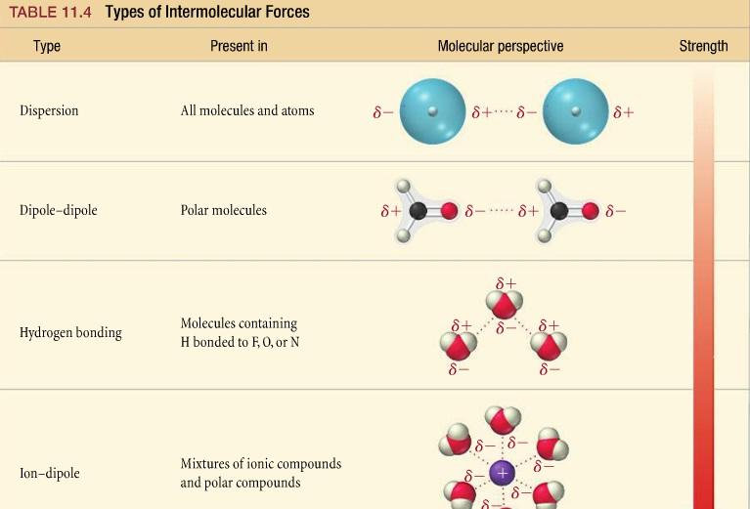
CHE 102 Spring 2021
Lecture 25a – Amines and Amides
Overview/Topics
New Functional Groups
R-NH₂ – Amine (-amine)
RCONH₂ – Amide (-amide)
Naming Rules
IMF and Physical Properties
Important Amines and Amides
Skills to Master
HW 25a
Draw Amines and Amides
Name Amines and Amides
IMF in Amines and Amides
Read
Chapter 25.

Slide 2
Amines
R-NH₂
Amides
RCONH₂
Shape:
Can you:
ID/Name FG
Geometry (Shape and Angle)
Important Use
Bond Angle:

Slide 3
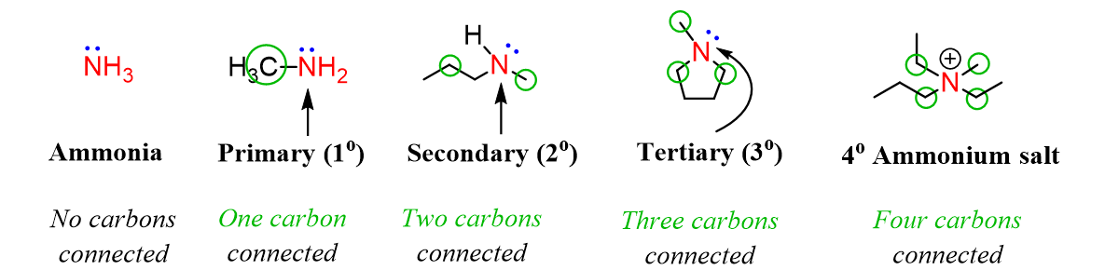
Types of Amines

Slide 4
Old UIPAC
New IUPAC
Naming Amines
Examples:
Longest Chain has FG
Ending = amine
FG = lowest #
*ignore # if redundant
Suffix = -amine
Location = Yes
Special SC = N-
= always 1st
Location Required
LC vs SC
N-methyl
Can you:
Name/Draw Molecules

Slide 5
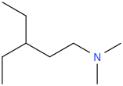
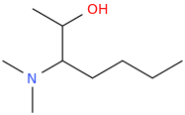
Lets Practice!:

Slide 6
Types of Amides

Slide 7
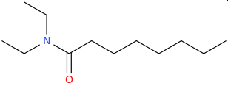
Naming Amides
Examples:
Longest Chain has C=O FG
FG = always #1
Suffix = -amide
Location = NO
Special SC = N-
= always 1st

Slide 8
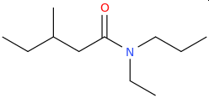
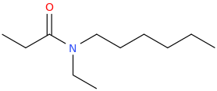
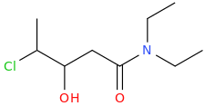
Lets Practice!:

Slide 9
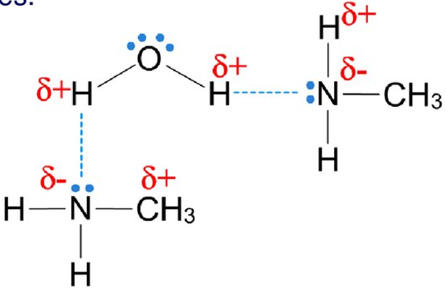
Intermolecular Forces
Amines
IMF = 0-3 HB (weak)
Can you:
Sketch IMF between 2 Amines
Sketch IMF between H₂O and Amine

Slide 10
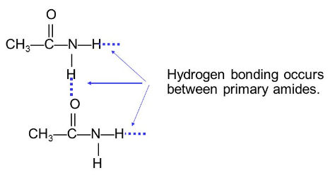
Intermolecular Forces
Amide
IMF = DD + 0-2 HB (strong)
Can you:
Sketch IMF between 2 Amides
Sketch IMF between H₂O and Amide

Slide 11
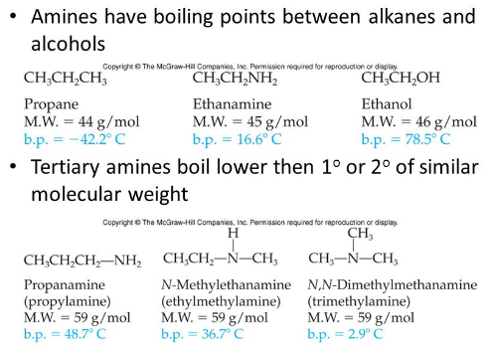
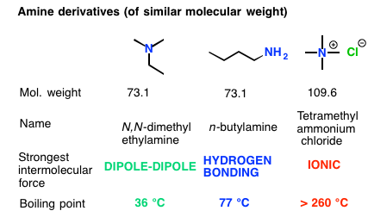
IMF’s – Boiling Points - Amines
Amines = weak HB
Between eth/ald/ket….alc
1° vs 2° vs 3° vs 4° (salt)

Slide 12
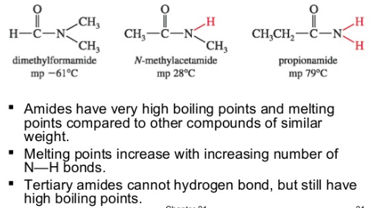
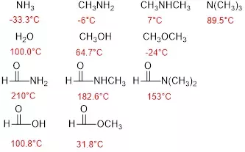
IMF’s – Boiling Points - Amides
Amides = strong HB
Bp > CA
1° vs 2° vs 3° vs 4° (salt)
Amines
Alc/Ether
Amides
CA and Ester

Slide 13
IMF’s – Boiling Points – All the FG’s
Compound | B_{p} (°C) | IMF
pentane | 36.0 | LDF
1-Pentene | 30.0 | LDF
1-Pentyne | 39.0 | LDF
1-ethoxypropane | 64 | DD – weak
ethoxy propanoate | 99 | DD
pentanal | 103 | DD
2-pentanone | 102 | DD
1-pentanamine | 94-110 | HB - weak
1-pentanol | 137 | HB
pentanoic acid | 185 | HB + DD
pentanamide | 225 | HB (strong) + DD
sodium penanoate | > 270 | HB + ID
ane/ene/yne < ether < ester/ald/ket < amines < alcohol < CA < Amides

Slide 14
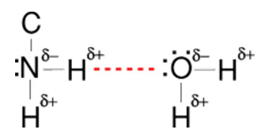
Solubility - Amines
Amines soluble < 5 C
Bigger Amines insoluble due to LDF
1° vs 2° vs 3° vs 4° (salt) matters
https://socratic.org/chemistry/intermolecular-bonding/polarity-of-bonds

Slide 15
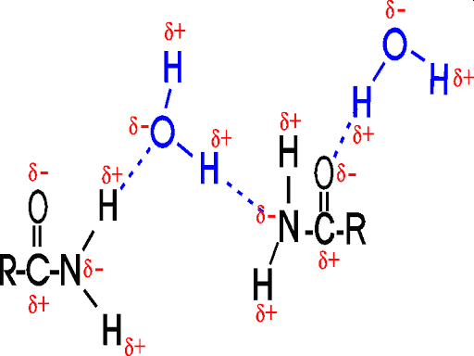
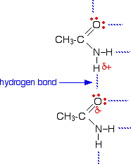
Solubility - Amides
Amides soluble < 5 C
Bigger Amides insoluble due to LDF
1° vs 2° vs 3° vs 4° (salt) matters
Can you:
Explain Solubility
Like Dissolved Like
Oil and Water don’t mix
https://www.chemguide.co.uk/organicprops/esters/background.html

Slide 16
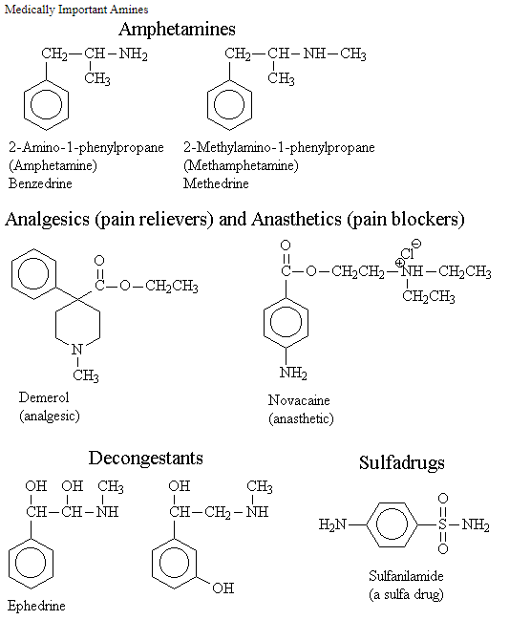
Important Amines
Stink!
Medical uses
Cadaverine

Slide 17
Important Amides
Medical Uses
Synthetic Intermediate
Nylon (other polymers)

Slide 18
https://mygaragestory.net/types-polyamides-and-applications/

Slide 19
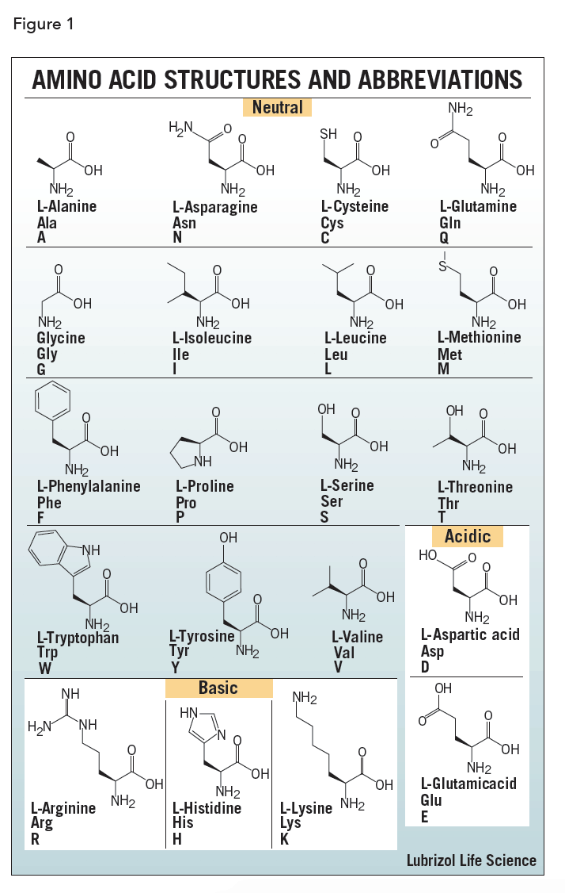
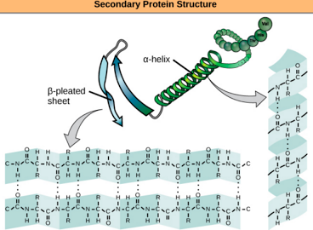
Amino Acids – Ch. 29
Component of Amino Acids
Amide bonds link AA into chains
Secondary structure – HB between amides

Slide 20
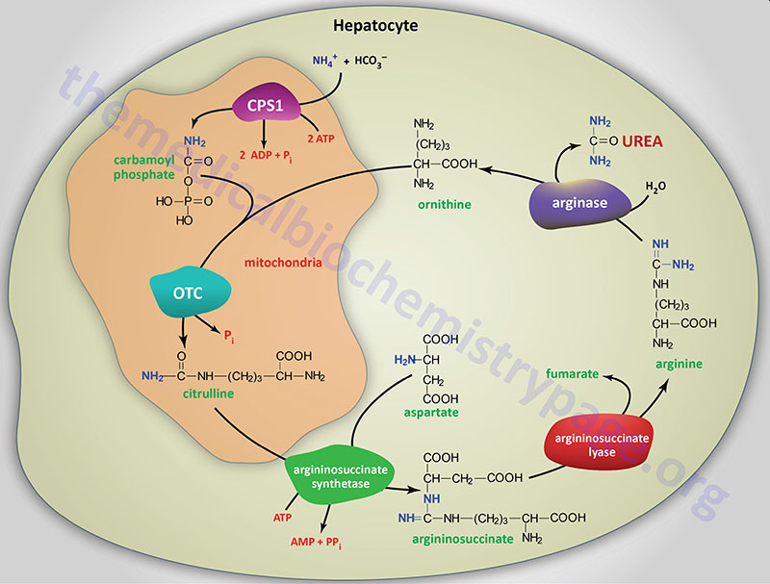
Urea Cycle – Ch. 35

Slide 21
Lets Practice!:

