Slide 1
CHE 102 Spring 2021
Lecture 24b – Reactions of CA/Esters
Overview/Topics
Reactions
Oxidation
Review: 1 alc → ald → CA
Review: Benzene → Benzoic Acid
Hydrolysis (+H₂O)
Acid - Niriles
Base (2 steps) – CA Salts
Acid - Esters
Base/Saponification - Esters
Dehydration (-H₂O)
CA + CA
Review: 1 alc + CA → Ester
Miscellaneous
Substitution: CA + SOCl₂
Aldol Condensation
Skills to Master
HW 24b
Read
Chapter 24.5-24.6 and 24.10-24.11
Note: S21 – Should add Decarboxylation Reactions

Slide 3
Review
Oxidation (Review)
[O]
Aldehyde Carboxylic Acid (CA)
Side Chain Oxidation (Ch. 20)
[NaMnO₄]
[NaOH + Δ]
Review
[O]
Benzene-R
Benzoic Acid + CA (R-1)

Slide 4
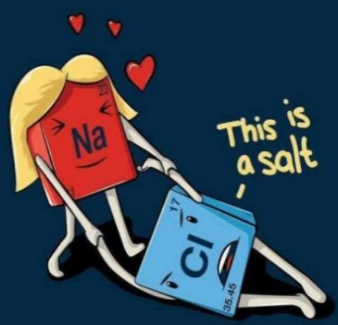
Sodium Loves Chlorine
“Review”
Carboxylic Acid Salt + Acid
Carboxylic Acid + Salt (NaCl)
HX
HCl

Slide 5
Hydrolysis or Hydration (+ H₂O)
Breaking molecules apart with water
Opposite of Dehydration (-H₂O)
Acid version (HCl)
Base version (NaOH)
Nitrile + 2 H₂O + HCl
Carboxylic Acid + Ammonium Chloride (NH₄Cl)
Nitrile + H₂O + NaOH
Carboxylic Acid Salt + Ammonia (NH₃)
Addition of H₂O across C≡N
[H⁺]
Reverse of Esterification
(CA + Alc → Ester + H₂O)
Ester + H₂O
Carboxylic Acid + Alcohol
Ester + NaOH
Carboxylic Acid Salt + Alcohol
Na Loves Cl

Slide 6
Nitrile + 2 H₂O + HCl
Carboxylic Acid + Ammonium Chloride (NH₄Cl)

Slide 7
Nitrile + H₂O + NaOH
Carboxylic Acid Salt + Ammonia (NH₃)

Slide 8
[H⁺]
Ester + H₂O
Carboxylic Acid + Alcohol

Slide 9
Ester + NaOH
Carboxylic Acid Salt + Alcohol

Slide 10
Dehydration
[-H₂O]
Carboxylic Acid + Alcohol
Ester + H₂O
Review - Esterification
[-H₂O]
*Multiple Products
“Find the Water”
CA + CA
Acid Anhydride + H₂O

Slide 11
[-H₂O]
*Multiple Products
“Find the Water”
CA + CA
Acid Anhydride + H₂O

Slide 12
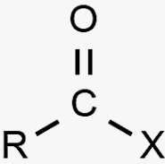
Miscellaneous - Substitution
Know Acid Halide + rearrange the stuff!
Carboxylic Acid + Thionyl Chloride (SOCl₂)
Acid Halide + HCl + SO₂ (g)

Slide 13
Na → CA Salts
Cl → Amine Salts
Na + Cl → Love!
Summary – Ch. 24
10 Reaction → 5 Reactions (it’s just ugly)
Some Review Though!
Reaction Type
Recognize
Mechanism
Misc
Aldehyde
Benzene Ring (SCO)
[O]
Review
Makes CA
Hydrolysis
Nitriles (C≡N)
Esters
Addition across C≡N
Break RCOOR bond
+ H₂O
Review
Dehydration
[-H₂O]
Find the Water
+H₂O
2 -OH
Substitution
SOCl₂
Acid Halide +
Rearrange stuff

Slide 14
You Try It:

Slide 15
You Try It:

Slide 16
You Try It:

