Slide 1
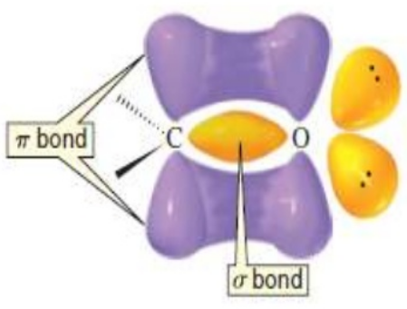
CHE 102 Spring 2021
Lecture 24a – Carboxylic Acids and Esters
Overview/Topics
New Functional Groups
RCOOH – Carboxylic Acid (CA) (-oic acid)
RCOOR – Ester (-oate)
Naming Rules
IMF and Physical Properties
Important CA/Esters
Skills to Master
HW 24a
Draw CA and Esters
Name CA and Esters
IMF in CA and Esters
Read
Chapter 24.1-24.4 and 24.7-24.24.9 and 24.11-24.13

Slide 2
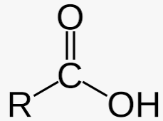
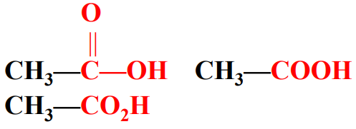
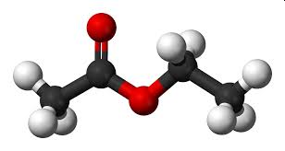
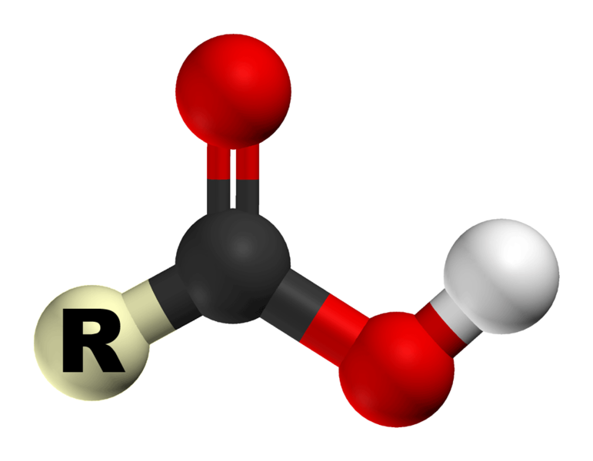
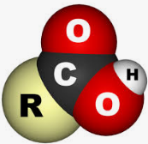
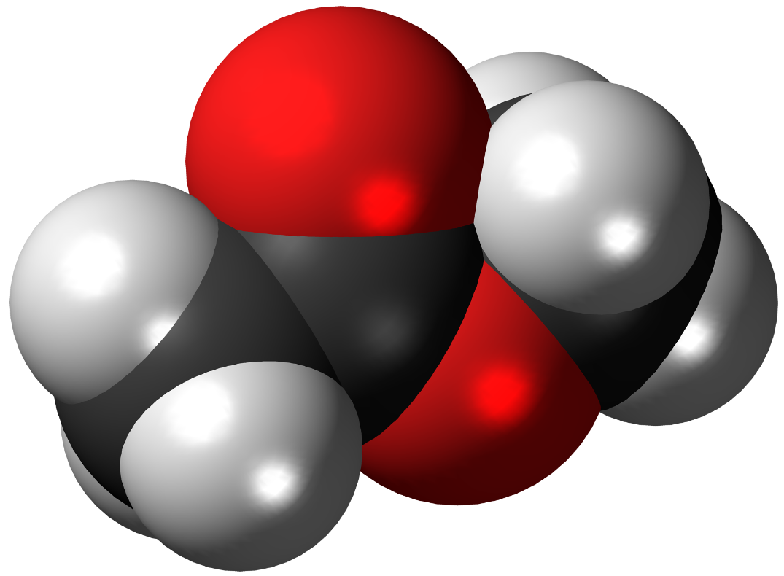
Carboxylic Acid
RCOOH
Ester
RCOOR
Shape:
Can you:
ID/Name FG
Geometry (Shape and Angle)
Important Use
Bond Angle:

Slide 3
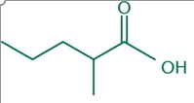
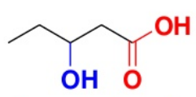
Naming Carboxylic Acids
Longest Chain has FG
FG = lowest #
Suffix = -oic acid
Location = NO
Examples:
Can you:
Name/Draw Molecules

Slide 4
Lets Practice!:

Slide 5
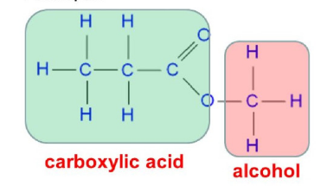
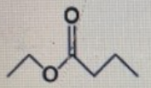
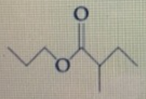
Naming Esters
Longest Chain has FG
FG = lowest #
Suffix = -oate
Prefix = alcohol part = SC
Location = sorta…
methyl propanoate
methyl_propanoate
Examples:

Slide 6
Lets Practice!:

Slide 7
Lets Practice!:

Slide 8
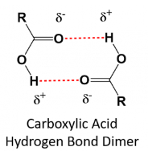
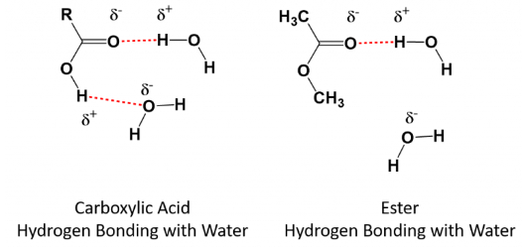
Intermolecular Forces
Carboxylic Acid
RCOOH
Ester
RCOOR
IMF = HB + DD
IMF = DD
Can you:
Sketch IMF between 2 CA/Esters
Sketch IMF between H₂O and CA/Ester

Slide 9
IMF’s – Boiling Points
Review
Analogies?
IMF = attractive force between molecules
KE = force responsible for motion
Bp/Mp is the energy required to separate molecules
Bp/Mp are Directly Proportional (DP) to strength of the attractive forces (IMF)
Strength of IMF: LDF < DD < HB < ID
Size matters because …
http://www.chemohollic.com/2016/07/3-trends-that-affect-boiling-points-of.html
https://www.masterorganicchemistry.com/2010/10/01/how-intermolecular-forces-affect-boiling-points/

Slide 10
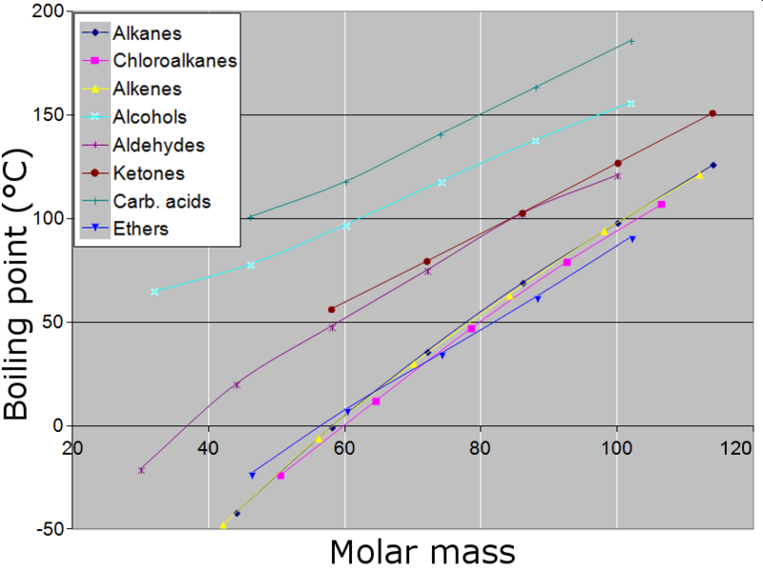
IMF’s – Boiling Points
Bp α IMF
Bp α Size
CA – HB, High Bp – often form dimers
Esters – DD, Low Bp
alkane/ene/yne < ether < ester/ald/ket < alcohol < CA

Slide 11
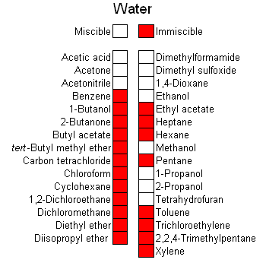
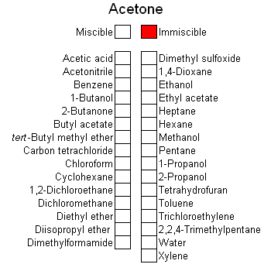
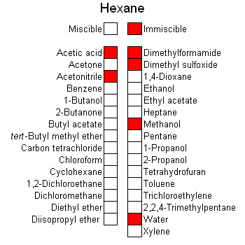
Solubility
Review
Like dissolves like and Oil and water don’t mix
Molecules must interact (via IMF’s) in order to dissolve/mix/soluble/miscible etc
Polar vs Nonpolar solvents
Size matters…
https://socratic.org/chemistry/intermolecular-bonding/polarity-of-bonds

Slide 12
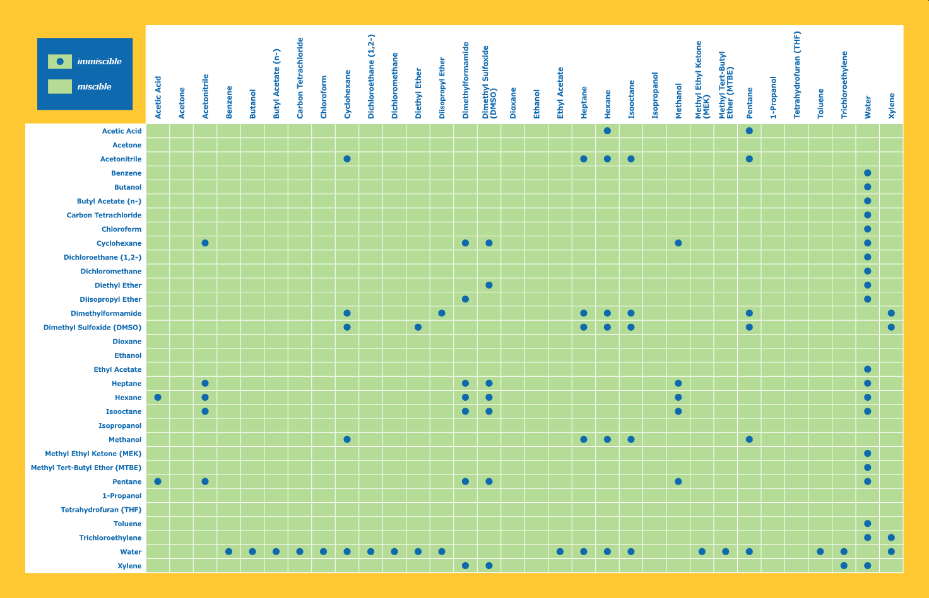
Acetone
H₂O

Slide 13
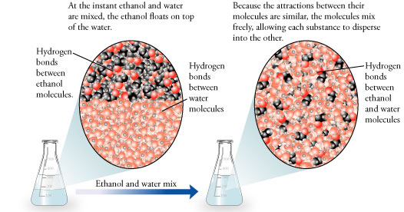

Slide 14
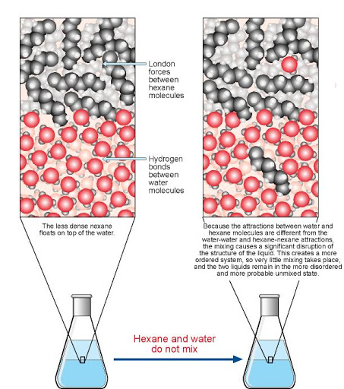

Slide 15
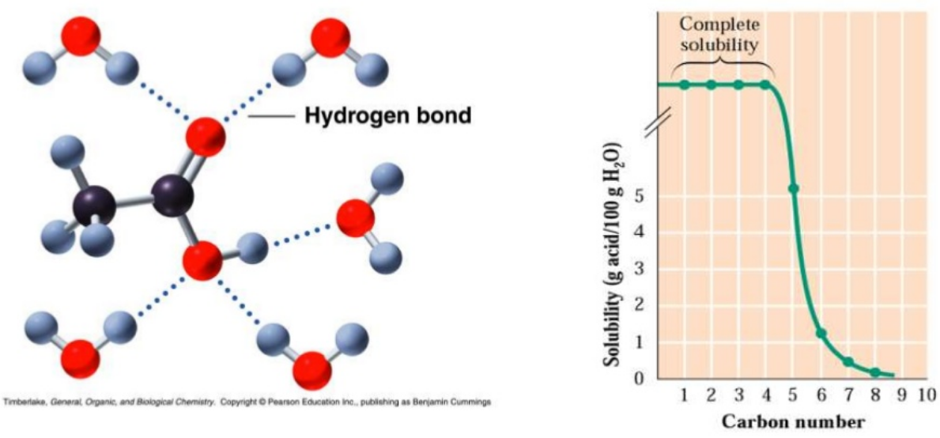
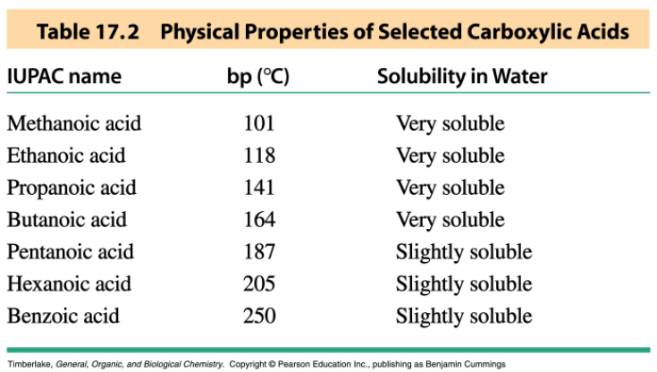
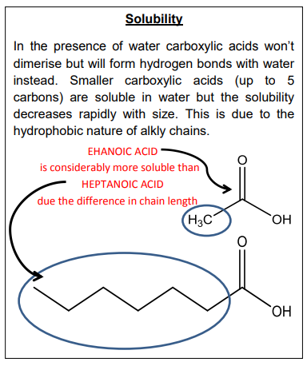
Solubility - CA
CA soluble < 5 C
Bigger CA insoluble due to LDF

Slide 16
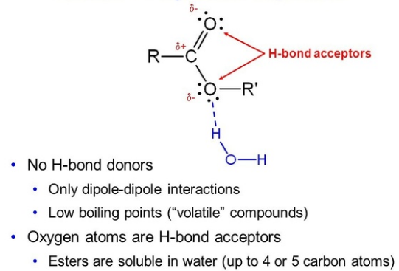
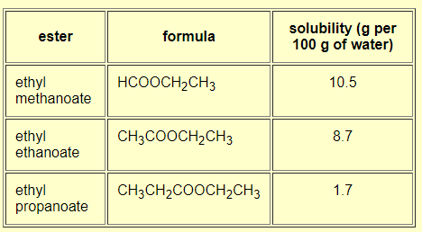
Solubility -Ester
Esters soluble < 5 C
Bigger Esters insoluble due to LDF
Why do Esters and CA solubility's, but such different Boiling Points?
Can you:
Explain Solubility
Like Dissolved Like
Oil and Water don’t mix
https://www.chemguide.co.uk/organicprops/esters/background.html

Slide 17
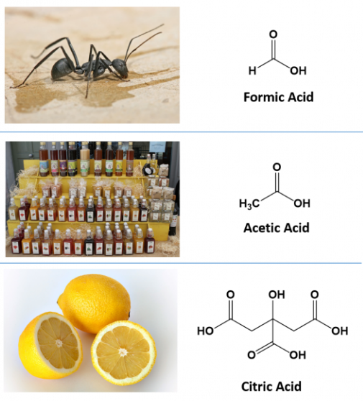
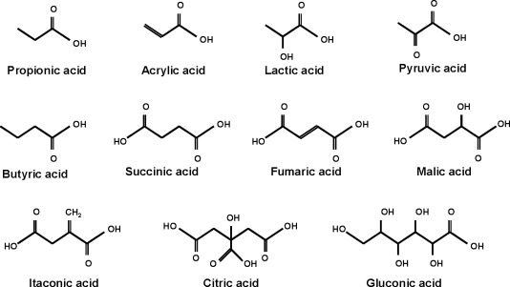
Important Carboxylic Acids
Acids
Lipids (Ch. 28) Fatty Acids = Big CA
Triacylglycerols
Lipid Membranes
Amino Acids (Ch. 30)
Citric Acid Cycle (Ch. 34)
Many “Categories”
Regular CA
Saturated vs Unsaturated
Aromatics
Hydroxy Acids
Dicarboxylic Acids
More info CA (smells, importance etc)
https://www.wikidoc.org/index.php/Carboxylic_acid

Slide 18
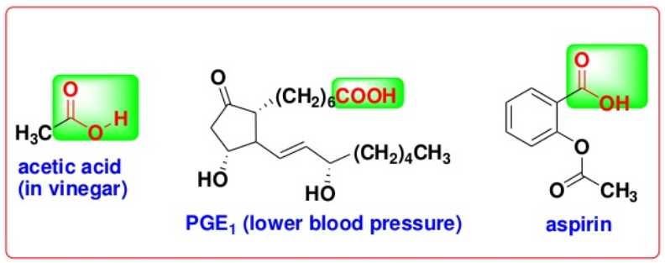
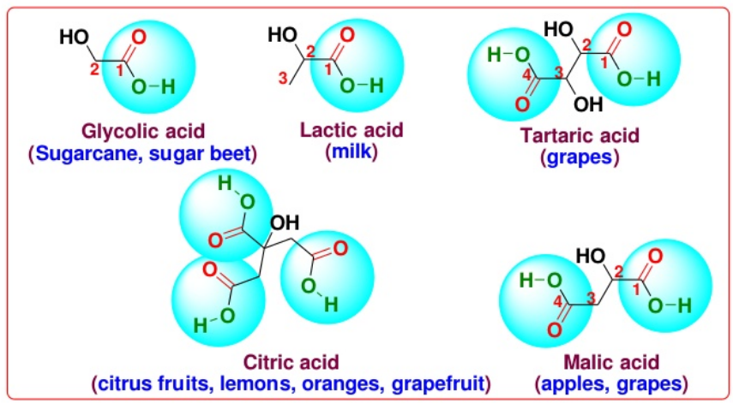
More Important Carboxylic Acids

Slide 19
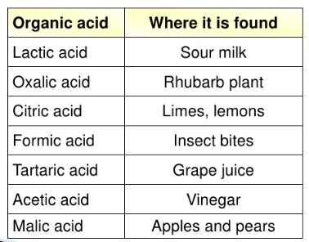
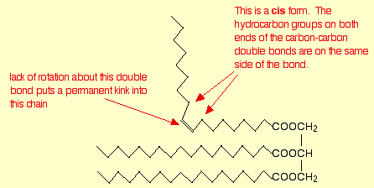
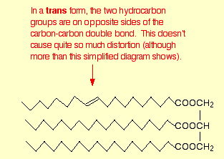
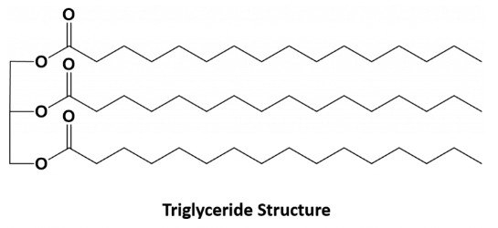
More Important Carboxylic Acids

Slide 20
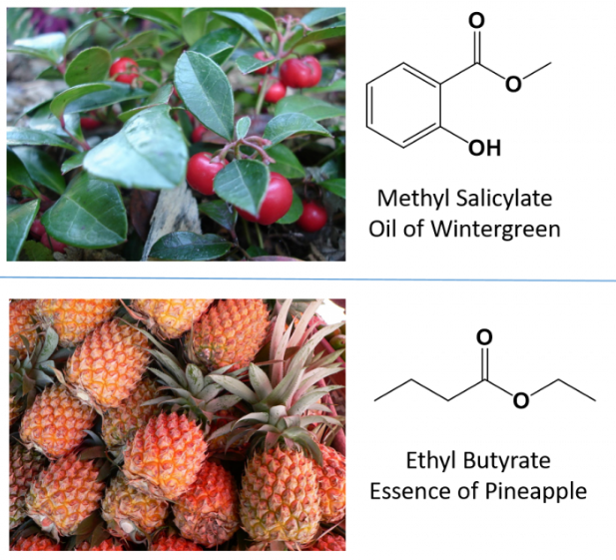
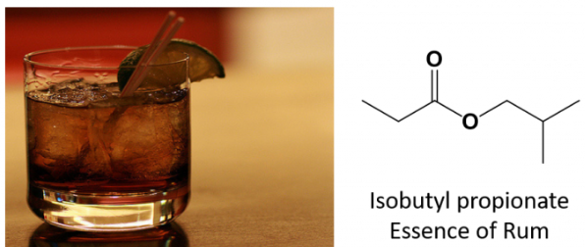
Important Esters
Smell – good!
Good Solvents (Like Acetone)
Polyester Fabrics (Dacron etc)
Lipids (Ch 28) – Waxes = Giant Esters
Triacyl glycerols
Lipid Membranes
Esters smell good!
https://www.wikidoc.org/index.php/Ester

Slide 21
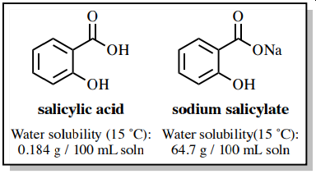
Carboxylic Acid Salts
Products in Tollen’s and Fehling/Benedicts Tests
Greatly increases solubility
Saponification/Soaps
Some Important Uses
Sodium Hexanoate

Slide 22
Lets Practice!:

