Slide 1
CHE 102 Spring 2021
Lecture 23b – Reactions of Ald/Ket
Overview/Topics
ID
Aldehyde
Ketone
Alcohol
Ether
Carboxylic Acid
Hemiacetal/Acetal/Hemiketal/Ketal
Reactions!
Additions Reactions
Reduction/Hydrogenation (+ H₂)
Cyanohydrin (+ HCN)
Hemiacetal/Hemiketal (+ Alc)
Dehydration (-H₂O)
Oxidation/Diagnostic Tests
Aldol Condensation
Skills to Master
HW 23b
Read
Chapter 23.4

Slide 2
Review – Functional Groups
Aldehyde
Ketone
Carboxylic Acid (CA)
Carboxylic Acid Salt

Slide 3
Review – Functional Groups
Hemiacetal
Hemiketal
Acetal
Ketal

Slide 4
Review
Oxidation (Review) Diagnostic Tests
[O]
Aldehyde Carboxylic Acid (CA)
[O]
Ketone No Reaction (NR)

Slide 5
What is oxidized?
What is reduced?
Tollens Reactions
“Silver Mirror Test”
Positive (+) for aldehydes
Negative (-) for ketones
[O]
Aldehyde + 2 Ag⁺ (aq) + NH₃ (aq)
Carboxylic Acid Salt + 2 Ag (s)
Visible Change: Clear to “Silver Mirror”
[O]
Ketone + 2 Ag⁺ (aq) + NH₃ (aq)
NR

Slide 6
Positive (+) for aldehydes
Negative (-) for ketones
What is oxidized?
What is reduced?
Fehlings/Benidicts
[O]
Aldehyde + 2 Cu⁺² (aq) + NaOH (aq)
Carboxylic Acid Salt + 2 Cu₂O (s) + H₂O
Visible Change: blue to “brick red ppt”
[O]
Ketone + 2 Cu⁺² (aq) + NaOH (aq)
NR

Slide 7
Examples:
Oxidation – Diagnostic Tests

Slide 8
Addition Reactions
[H₂/Ni]
Aldehyde Primary Alcohol
Reduction – gain bonds to H
Hydrogenation
Δ
[H₂/Ni]
Ketone Secondary Alcohol
Δ
[OH-]
Ald/Ket + HCN Cyanohydrin
[H⁺]
Aldehyde + Alcohol
Hemiacetal
[H⁺]
Ketone + Alcohol
Hemiketal
Things to add:
H₂
HCN
R-OH

Slide 9
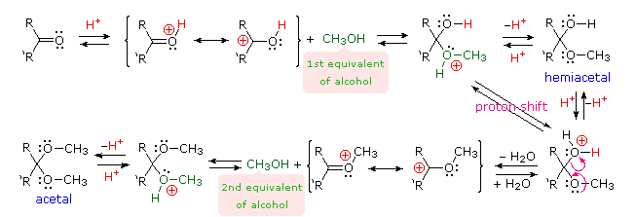
Reaction Mechanism – Yuck!

Slide 10
Examples:
[H₂/Ni]
Aldehyde Primary Alcohol
Reduction – gain bonds to H
Hydrogenation
Δ
[H₂/Ni]
Ketone Secondary Alcohol
Δ

Slide 11
Examples:
[OH-]
Ald/Ket + HCN Cyanohydrin

Slide 12
Examples:
[H⁺]
Aldehyde + Alcohol
Hemiacetal
[H⁺]
Ketone + Alcohol
Hemiketal

Slide 13
Dehydration Reactions
[dry HCl]
Hemiacetal + Alcohol
Acetal + H₂O
Play “Find the Water” again!
Hemiketal + Alcohol
[dry HCl]
Ketal + H₂O

Slide 14
Examples:

Slide 15
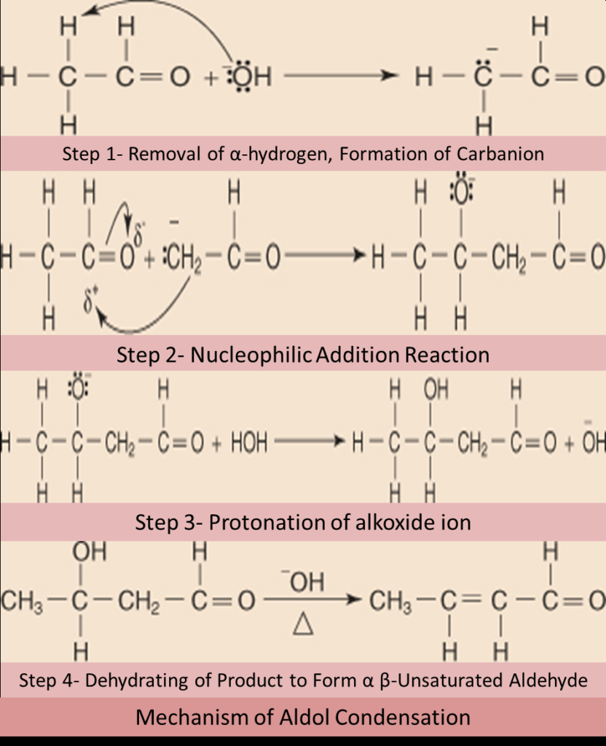
Yucky Mechanism
Aldol Condensation
“Self-Addition”
Condensation (Adding 2 molecules together)
α-hydrogen = most reactive
Product = Aldol = β-hydroxy ald/ket
Aldehyde + Aldehyde
[dilute NaOH]
Aldehyde + Ketone
Aldol (β-hydroxy ald/ket)
Ketone + Ketone
Multiple products if…..
Unsymmetrical aldehyde or ketone
Aldehyde + Ketone

Slide 16
Examples:
[dilute NaOH]
Aldehyde + Aldehyde
Aldol (β-hydroxyl ald/ket)

Slide 17
Ketone + Ketone
[dilute NaOH]
Examples:
Aldol (β-hydroxyl ald/ket)

Slide 18
Examples:
[dilute NaOH]
Aldehyde + Ketone
Aldol (β-hydroxyl ald/ket)

Slide 19
Summary – Ch. 23
14 Reaction → 3 Reactions
Reaction Type
Recognize
Mechanism
Misc
[O]
Memorize
Gain Bond O
Silver Mirror
Tollens
Fehling/Benedict
Blue → Red (ppt)
CA Salts!
Misc Arrow
C=O + something
Break C=O add “something” to both sides
Addition
Single Product
[dry HCl]
Dehydration
Find the Water
+H₂O
2 -OH
Aldol
Condensation
α-hydrogen
Multiple Prod.
β-hydroxyl ald/ket
“Fancy” Addition

Slide 20
Summary – Ch. 22
14 Reaction → 3 Reactions
Reaction Type
Recognize
Mechanism
Misc
[O]
Memorize
Gain Bond O
Chromic Acid Test
Oxidation
[-H₂O]
Dehydration
Find the Water
2 Reactants
(not Oxid or Dehyd)
Na loves Cl
Lucas Test
Substitution
Swap

Slide 21
You Try It:

Slide 22
You Try It:

Slide 23
You Try It:

