Slide 1
CHE 102 Spring 2021
Lecture 23a – Aldehydes and Alcohols
Overview/Topics
New Functional Groups
RHO - Aldehyde (-al)
R-CO-R – Ether (-one)
Hemiacetals, Hemiketal, Acetal, Ketal
Naming Rules
IMF and Physical Properties
Important Ald/Ketones
Skills to Master
HW 23a
Draw Aldehydes and Ketones
Name Aldehydes and Ketones
IMF and Aldehydes and Ketones
Read
Chapter 23.1-22.3 and 23.5

Slide 2
Aldehyde
RCHO
Ketone
RCOR
Shape:
Can you:
ID/Name FG
Geometry (Shape and Angle)
Important Use
Bond Angle:

Slide 3
Intermolecular Forces
IMF = Dipole-Dipole (DD)
Can you:
Sketch DD between 2 ald/ket
Sketch HB between H₂O and ald/ket

Slide 4
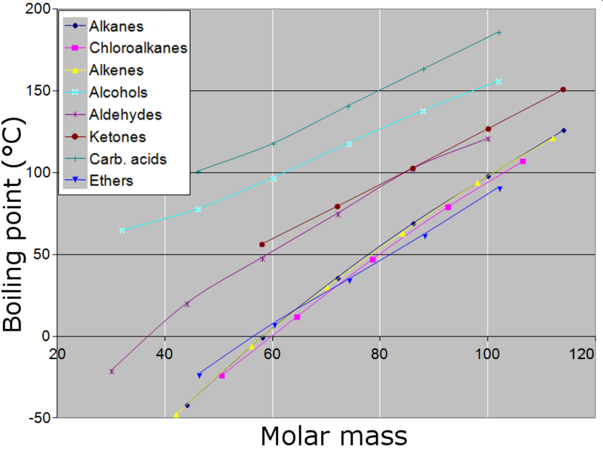
IMF’s – Boiling Points
Bp α IMF
Bp α Size
Alkane/ene/yne < ether <ald/ket < alcohol
Can you:
Explain Bp/Mp

Slide 5
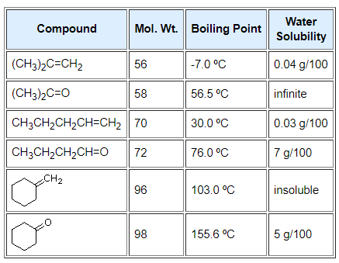
Solubility
Can you:
Explain Solubility
Like Dissolved Like
Oil and Water don’t mix

Slide 6
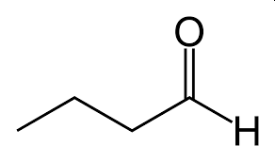
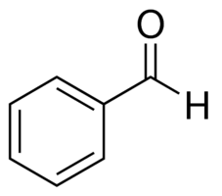
Naming Aldehydes
Naming Ketones
Longest Chain has FG
Longest Chain has FG
FG = lowest #
FG = lowest #
Suffix = -one
Suffix = -al
Location = YES
Location = NO
Always #1 (don’t include – redundant)
Examples:
vs
Can you:
Name/Draw Molecules

Slide 7
Examples:

Slide 8
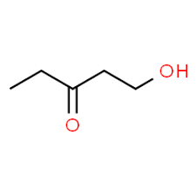
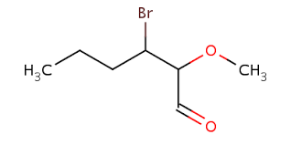
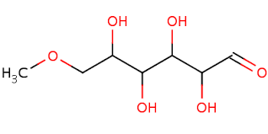
Examples:
-OH = hydroxy

Slide 9
Lets Practice!:

Slide 10
Lets Practice!:

Slide 11
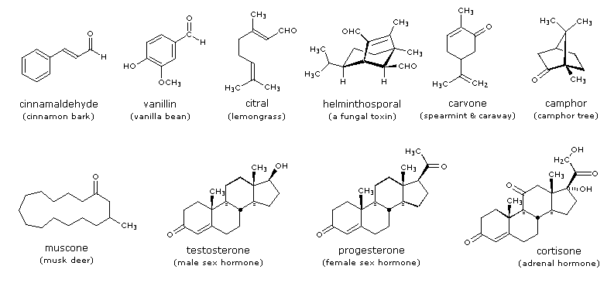
Important Aldehydes and Ketones
Smell
Small = bad smells
Larger = good smells
Component of Carbohydrates
Lipid Metabolism Intermediates

Slide 12
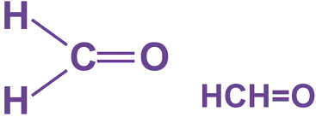
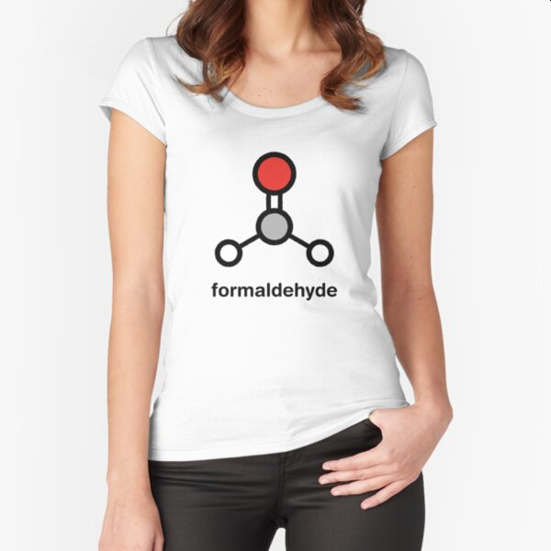
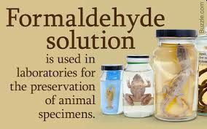
Methanal
“Formaldehyde”
Poisonous (irritation up to coma/death), irritating gas
Manufacturing of polymers
1.33x10⁹ kg/year
Preserve biological specimins

Slide 13
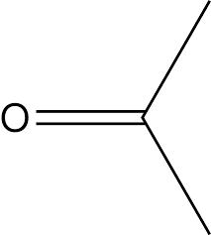
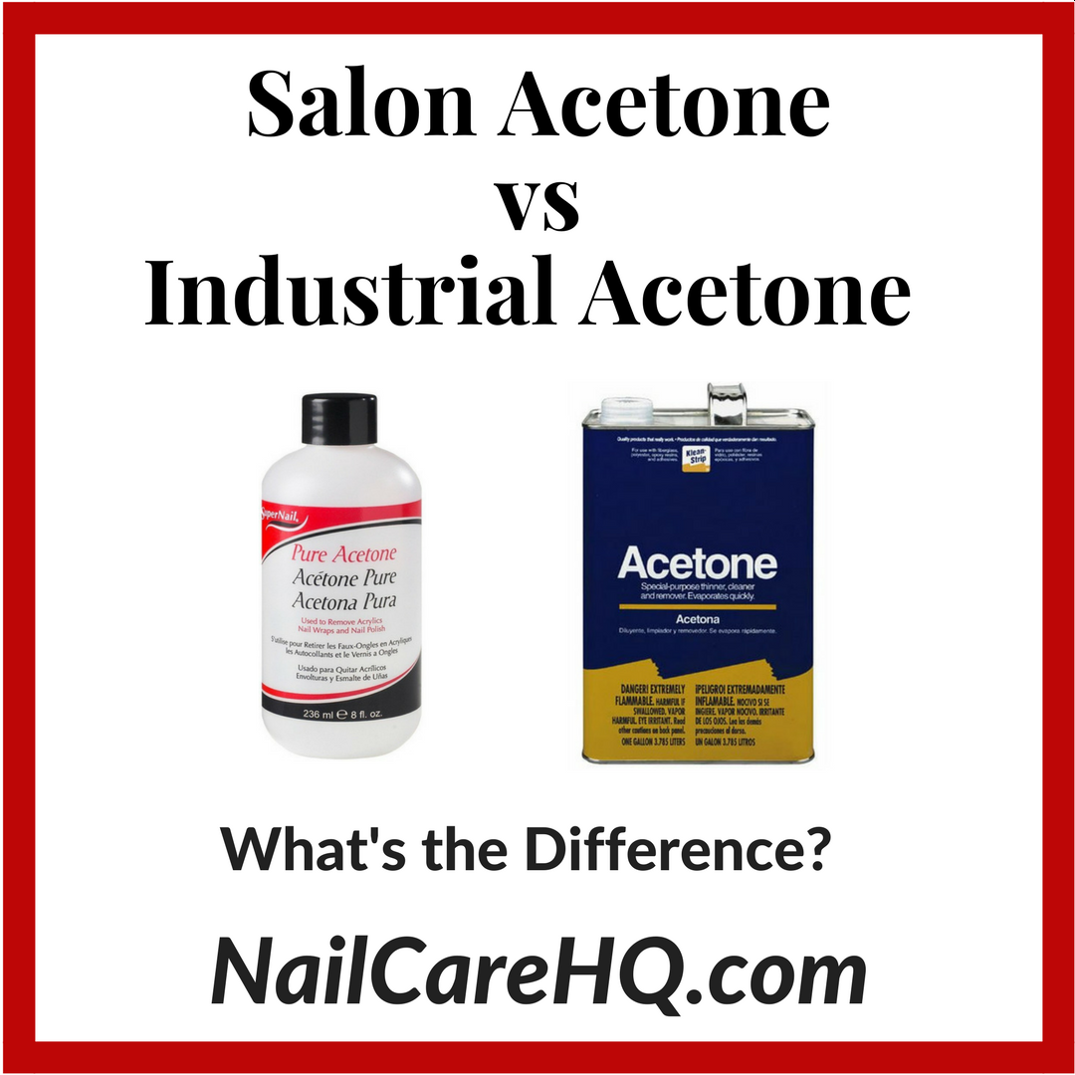
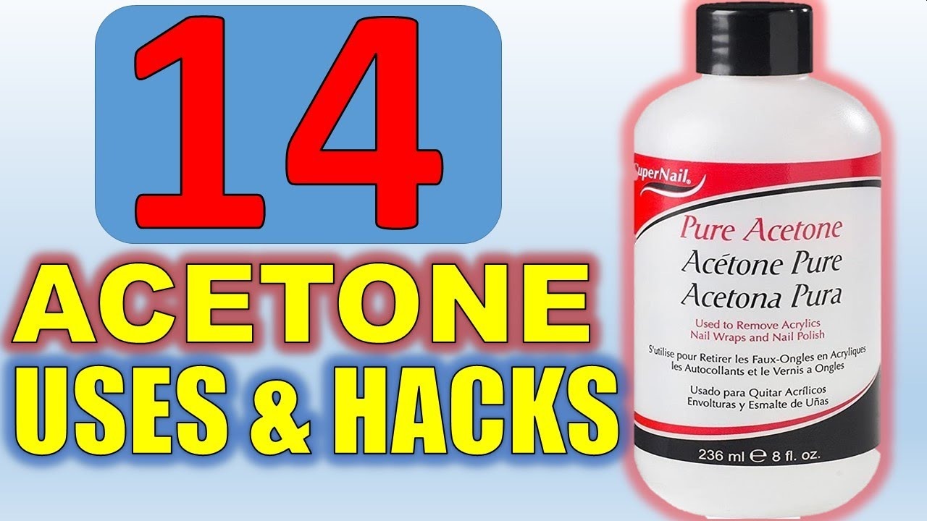
Butanone
“MEK or Methyl Ethyl Ketone”
Propanone
“Acetone”
Solvent (Fingernail polish remover)
Synthesis of explosives
Byproduct of Lipid Metabolism
1.26x10⁸ kg/year
Similar to Acetone but higher Bp/Lower Vp
Solvent
Dry erase markers
1.26x10⁸ kg/year
https://www.nailcarehq.com/ask-doug-purchase-acetone/

Slide 14
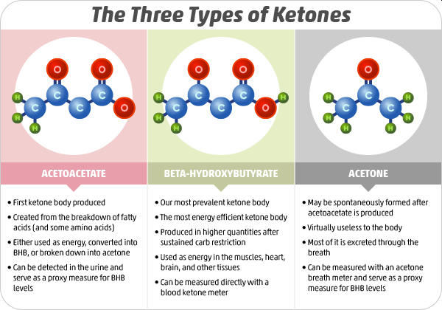
Health and Nutrition
“Ketone Bodies”

Slide 15
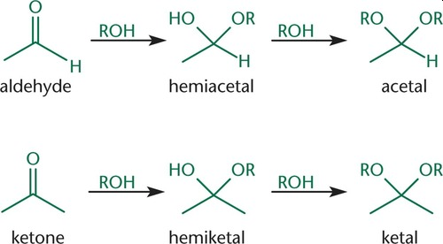
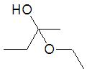
A few more “Structures” to memorize for reactions tomorrow
2-ether
2- R
1-ether
1-alcohol
1- H
1- R
1-ether
1-alcohol
2- R
2-ether
1 - H
1 - R
1-methoxy-1-propanol
2-ethoxy-2-butanol
1,1-diethoxyethane
2,2-diethoxy-3-methylbutane

Slide 16
Another View

Slide 17
Lets Practice!:
Alcohols, Ethers, Aldehydes, Ketones

