Slide 1
CHE 102 Spring 2021
Lecture 22b – Reactions of Alcohols and Ethers
Overview/Topics
ID 1°, 2°, and 3° alcohols
Reactions!
Oxidation
Dehydration
Esterification (Dehydration)
Alkaline Hydrolysis
Diagnostic Tests
Lucas Test
Chromic Acid Test
Skills to Master
HW 22b
Read
Chapter 22.5 and 22.10

Slide 2
Review Topics
Primary/Secondary/Tertiary Alcohols
Saytzeff’s Rule
Substitution Reactions
Elimination Reactions
Functional Groups (next slide)
Oxidation/Reduction (next slide)

Slide 3
Review – Functional Groups
Aldehyde
Ketone
Carboxylic Acid (CA)
Ester

Slide 4
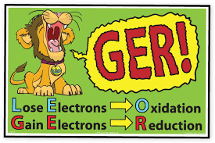
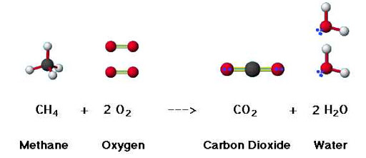
Oxidation-Reduction Reactions
“Redox”
[O]
Oxidation
Reduction
Lose Electrons
Lose bonds to H
Gain bonds to O
Molecule loses energy
Gain Electrons
Gain bonds to H
Lose bonds to O
Molecule gains energy
Future: Ch. 33-35

Slide 5
Oxidation Reactions
[O]
[O]
1° Alcohol Aldehyde + H₂O Carboxylic Acid (CA)
[O]
[O]
2° Alcohol Ketone + H₂O No Reaction (NR)
[O]
3° Alcohol NR

Slide 6
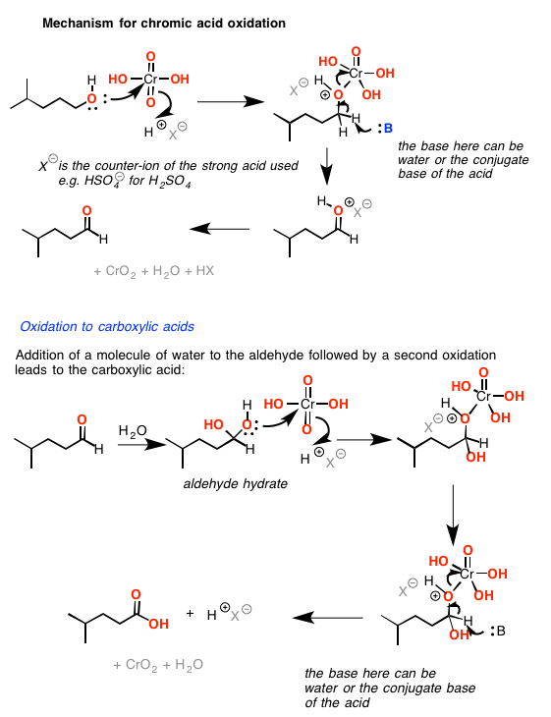
Reaction Mechanism – Yuck!

Slide 7
Examples:
Oxidation

Slide 8
You Try It:

Slide 9
Dehydration Reactions
[-H₂O]
1° Alcohol + 1° Alcohol Ether + H₂O
(Multiple Products Possible)
[-H₂O]
2 or 3° Alcohol Alkene + H₂O
(“Elimination” Saytzeff’s Rule)
[H⁺]
1° Alcohol + CA Ester + H₂O
[-H₂O]
(“Esterfication”)
1° Alcohol + CA Ester + H₂O

Slide 10
Examples:
Dehydration – 3 Types

Slide 11
Examples:
Dehydration – 3 types

Slide 12
You Try It:

Slide 13
Alkaline Hydrolysis
Alkyl Halide + Strong Base Alcohol + Salt
(Substitution or “Na loves Cl”)
Examples:
You Try It:

Slide 14
Review
Diagnostic Tests
Differentiate between Functional Groups
“Normal Reactions” associated with a visible change
Know what it tests for
Know what a + test looks like
Know what a – test looks like
Write an example reaction

Slide 15
Chromic Acid Test
K₂Cr₂O₇/H₂SO₄
Δ
Exactly the same as Oxidation Reactions
Positive Test (+) = 1°/2° Alcohol (color change: red/orange →blue/green)
Negative Test (-) = 3° Alcohol
K₂Cr₂O₇/H₂SO₄
Δ
1° Alcohol Aldehyde + H₂O
(Visible Change: orange/red → blue/green)
K₂Cr₂O₇/H₂SO₄
Δ
2° Alcohol Ketone + H₂O
(Visible Change: orange/red → blue/green)
K₂Cr₂O₇/H₂SO₄
Δ
3° Alcohol NR

Slide 16
Examples:

Slide 17
Lucas Test
Substitution Reactions
Rate of Reaction is Key – Formation of ppt
3° Alcohol = Fast < 1 min
2° Alcohol = Slow < 5-15 min
1° Alcohol = NR or > 30 min
[ZnCl₂]
Alcohol + HCl Alkyl Chloride (s) + H₂O
(Note the speed of formation)
Examples:

Slide 18
You Try It:
Diagnostic Tests

Slide 19
Summary
14 Reaction → 3 Reactions
Reaction Type
Recognize
Mechanism
Misc
[O]
Memorize
Gain Bond O
Chromic Acid Test
Oxidation
[-H₂O]
Dehydration
Find the Water
2 Reactants
(not Oxid or Dehyd)
Na loves Cl
Lucas Test
Substitution
Swap

Slide 20
Summary
14 Reaction → 3 Reactions

Slide 21
You Try It:

Slide 22
You Try It:

Slide 23
You Try It:

Slide 24
You Try It:

