Slide 1
CHE 102 Spring 2021
Lecture 22a – Alcohols and Ethers
Overview/Topics
New Functional Groups
R-OH - Alcohol (-ol)
R-O-R – Ether (-oxy, SC)
R-SH - Thiols
Naming Rules
IMF and Physical Properties
Skills to Master
HW 22a
Draw Alcohols and Ethers
Name Alcohols and Ethers
IMF and Alcohols and Ethers
Read
Chapter 22.1-22.4 and 22.7 and 22.10-22.13

Slide 2
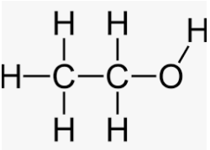
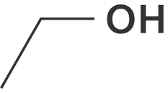
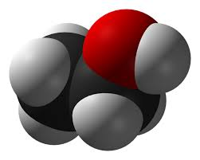
Alcohols
R-OH
Bond Angle:
Can you:
ID/Name FG
Geometry (Shape and Angle)
Important Use
Shape:

Slide 3
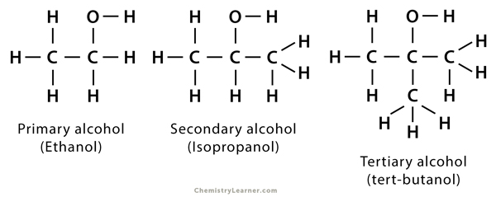
4 Classifications of Alcohols
1°
2°
3°
Important for Chemical Reactions (Tomorrow)
Can you:
ID/Label 1°, 2°, 3° alcohols

Slide 4
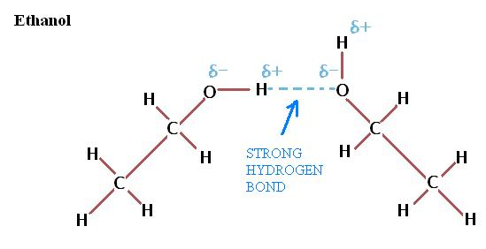
Intermolecular Forces
IMF = Hydrogen Bond (HB)
Can you:
Sketch HB between 2 alcohols
Sketch HB between alc and H₂O

Slide 5
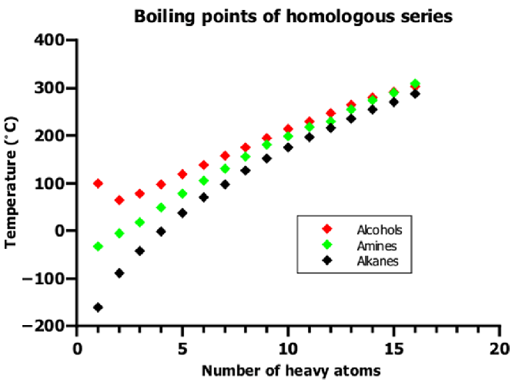
IMF’s – Boiling Points
Bp α Size
Can you:
Explain why BP is DP Size

Slide 6
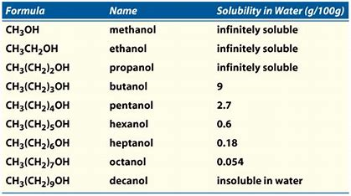
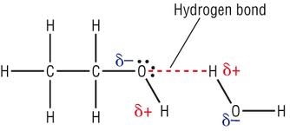
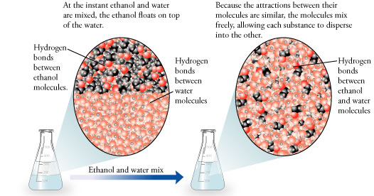
Solubility
Can you:
Explain Solubility
Like Dissolved Like
Oil and Water don’t mix

Slide 7
Solubility – Size Matters
VS
Can you:
Explain why Solubility DP Size

Slide 8
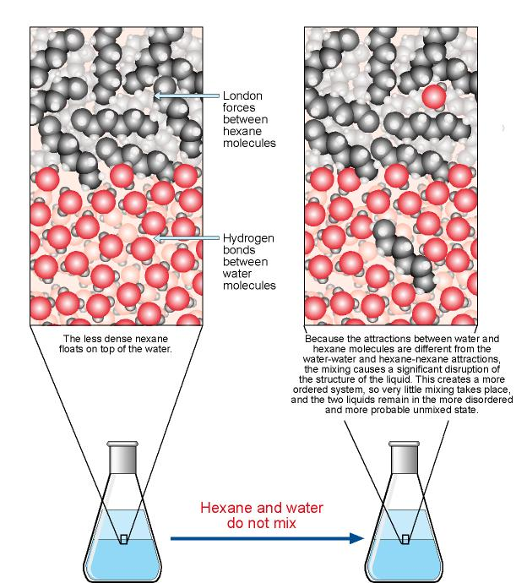

Slide 9
Naming Alcohols
Old vs. New IUPAC
-OH or HO-
Suffix = -ol
Longest Chain has FG
FG = lowest #
Examples:
OH
OH
HO
Future:
OH = sidechain
“hydroxy”
Can you:
Name/Draw Molecules

Slide 10
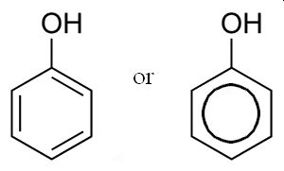
Examples:
HO
OH
Extra – not on exam, just be familiar with it
HO
HO

Slide 11
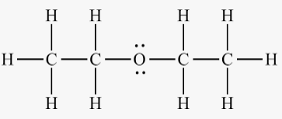
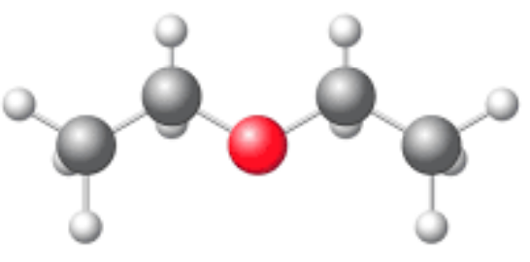
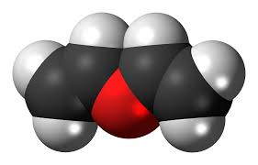
Ethers
R-O-R
Bond Angle:
Shape:

Slide 12
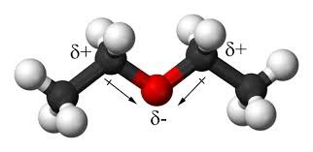
Ethers - IMF
Solubility – H₂O
Weak DD
Boiling Points
58.12
Butane
LDF
0° C

Slide 13
Naming Ethers
IUPAC vs Common
Common Name: SC SC “ether”
IUPAC: Named like SC – “oxy”
Examples:
Can you:
Structure ↔ Name
Draw Molecules

Slide 14
Examples:

Slide 15
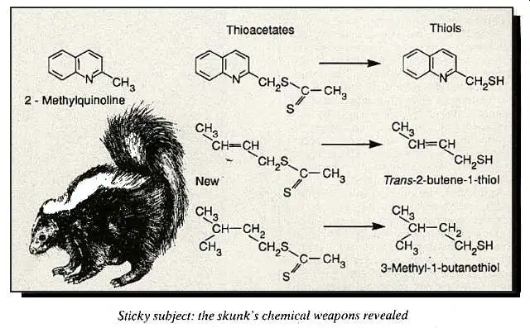
Thiols
Like alcohols except R-SH
Naming –thiol
DD
Form Disulfide Bonds (Protein Structure)
Stink! (skunks)

Slide 16
Lets Practice!:

Slide 17
Lets Practice!:

Slide 18
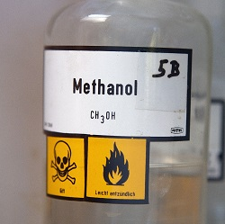
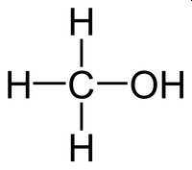
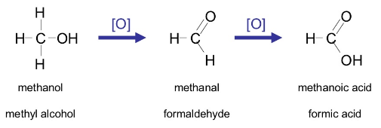
Important Alcohols
Methanol
Volatile, highly flammable and explosive vapors
5.1x10⁹ kg/year produced
Starting product many other compounds
Solvent
Denaturing alcohol
Deadly (1 tsp = blindness, 2-3 Tbsp = death)
More tomorrow!

Slide 19
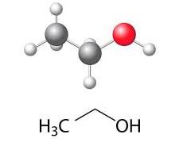
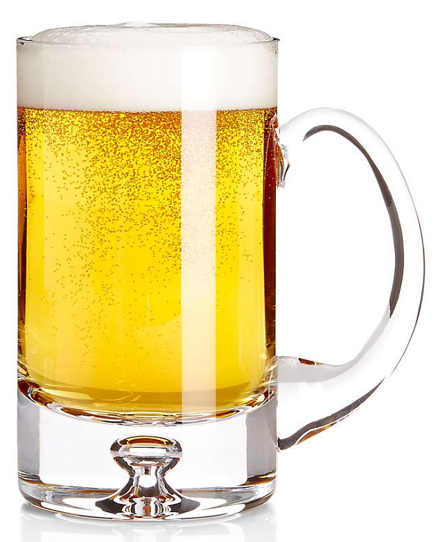
Ethanol
5.9x10⁸ kg/year produced
Beer!
Starting product
Solvent
Fuel (Gasoline additive)
Breathalyzer
Reddish-Orange
Greenish
More tomorrow!

Slide 20
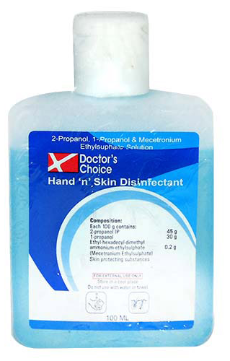
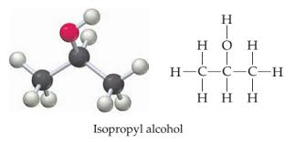
2-Propanol
6.3x10⁸ kg/year produced
Starting product (acetone)
Solvent
Disinfectant
Less toxic than methanol/ethanol

Slide 21
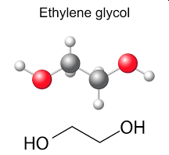
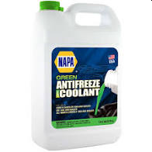
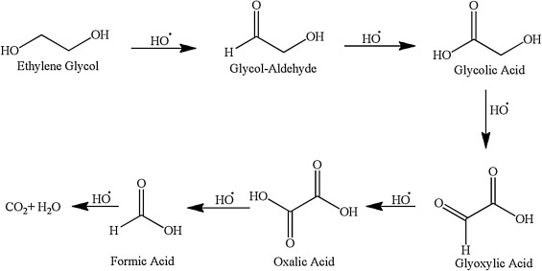
1,2-ethandiol
2.4x10⁹ kg/year produced
Starting product (polyesters, dacron, mylar)
Solvent
Anti-freeze
Extremely toxic when ingested
More tomorrow!

Slide 22
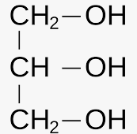
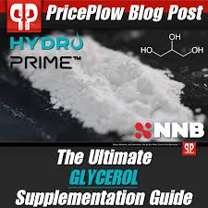
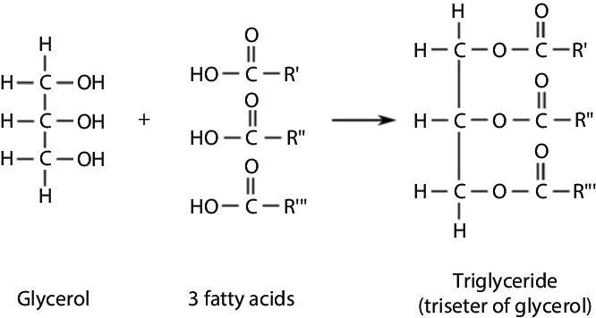
1,2,3-propanetriol
Starting product (polymers, explosives)
Solvent - cosmetics
Sweetener
Biochemistry
Glycerol
More in Chapter 28 - Lipids

Slide 23
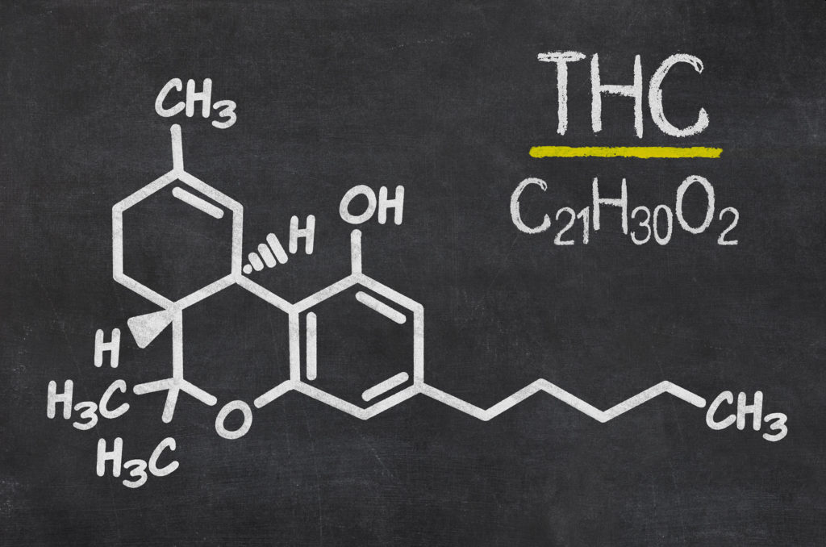
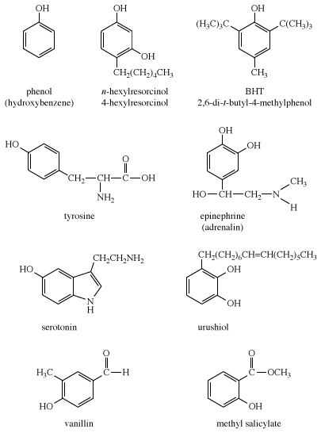
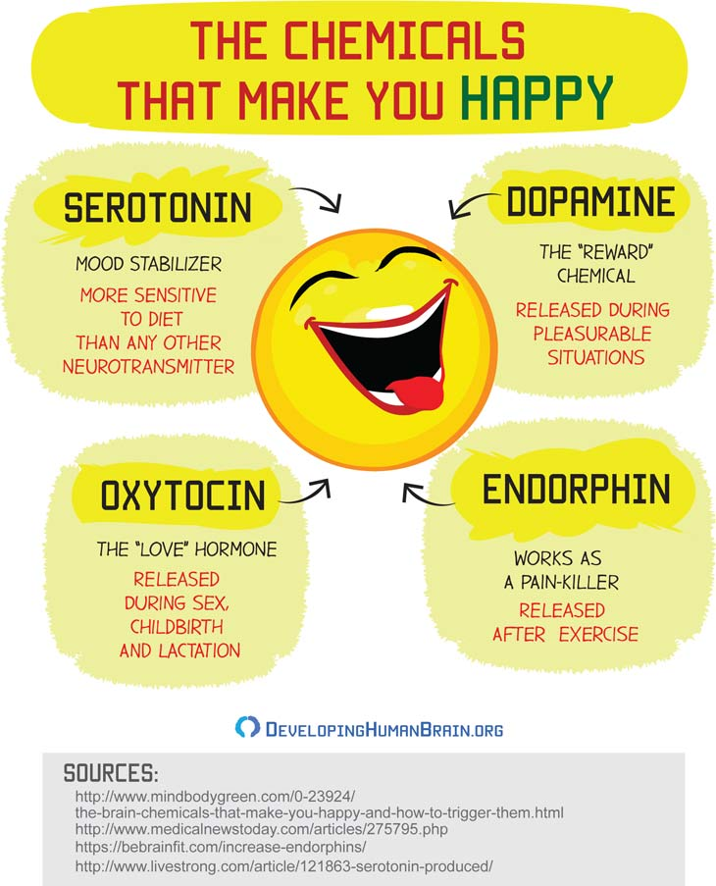
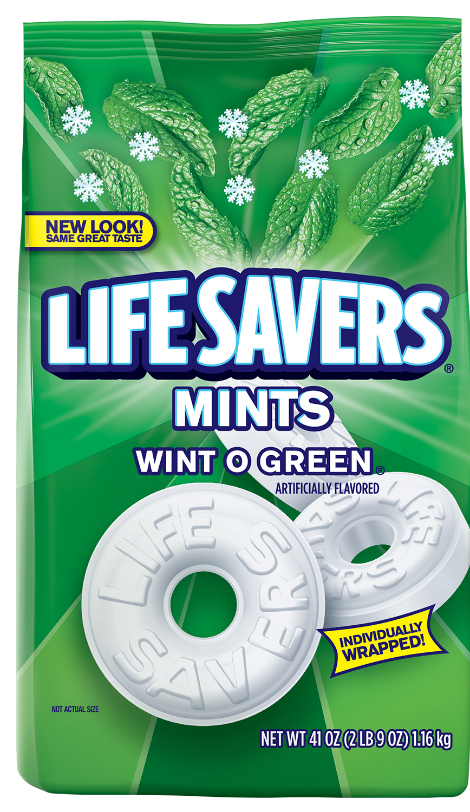
Phenols

Slide 24
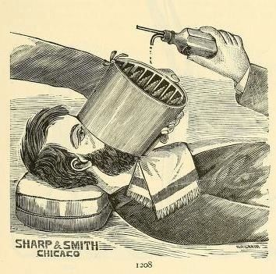
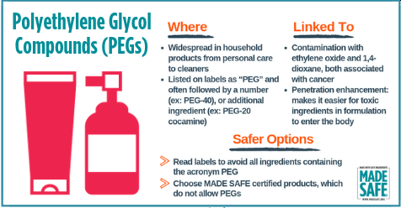
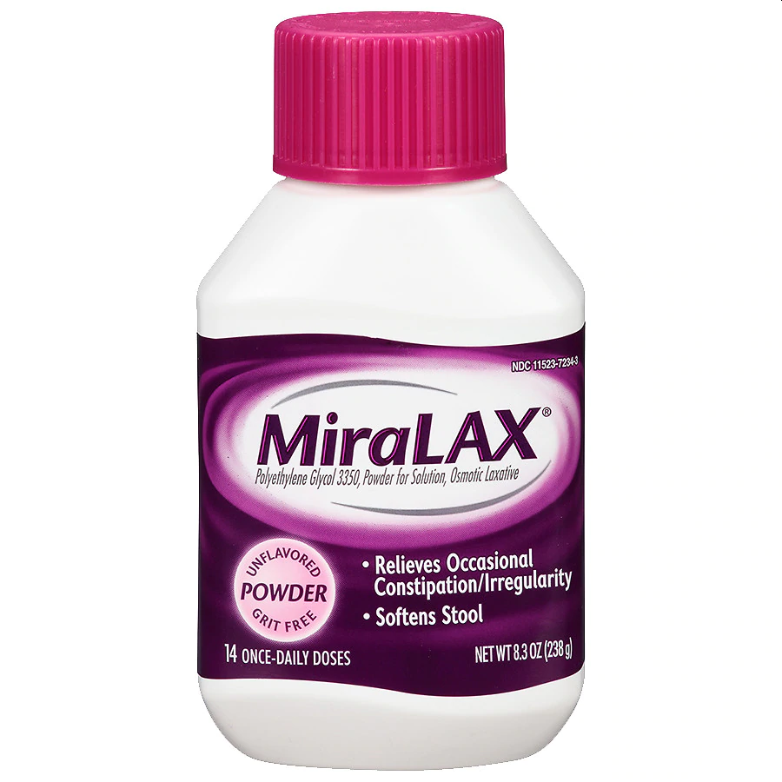
Important Ethers
Anesthesia, Laxative
Explosive
Solvent
nonpolar enough for alkanes
Polar enough for alcohols/water
Non-reactive
Plastics – PEG (Polyethylene Glycol)

