Slide 1
CHE 102 Spring 2021
Lecture 20c – VBT and Review of IMF’s
Overview/Topics
Valence Bond Theory (VBT)
Energy Level Diagrams
Promotion
Hybridization
sp³, sp² and sp hybridization
Sigma (σ) and Pi (π) bonds
Free Rotation
Skills to Master
HW 20 c
Read
Chapter 19 pages 474-475
Chapter 20 pages 506-508
Review Chapter 10.4 and 11

Slide 2
Lewis Theory – the Good
Flaws in Lewis Theory
Predicts which molecules are likely to form
Predicts single, double, triple bonds
Predicts shapes
Predicts Nonpolar or Dipolar
Developed before QM based on observations
Fails to predict bond lengths
Fails to predict bond strengths
Molecule | Bond Strength (kJ/mol) | Bond Length (pm)
H-H | 436 | 74
H-F | 568 | 142
F-F | 156.9 | 92

Slide 3
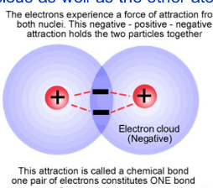
Valence Bond Theory (VBT)
Coulomb's Law
Based on QM
Key Idea’s
overlap of ½ filled atomic orbitals with opposite spins
e⁻ form an electron pair, that are shared by both atoms
Bond strength/energy α amount of overlap, energy minimum determines bond strength and length

Slide 4
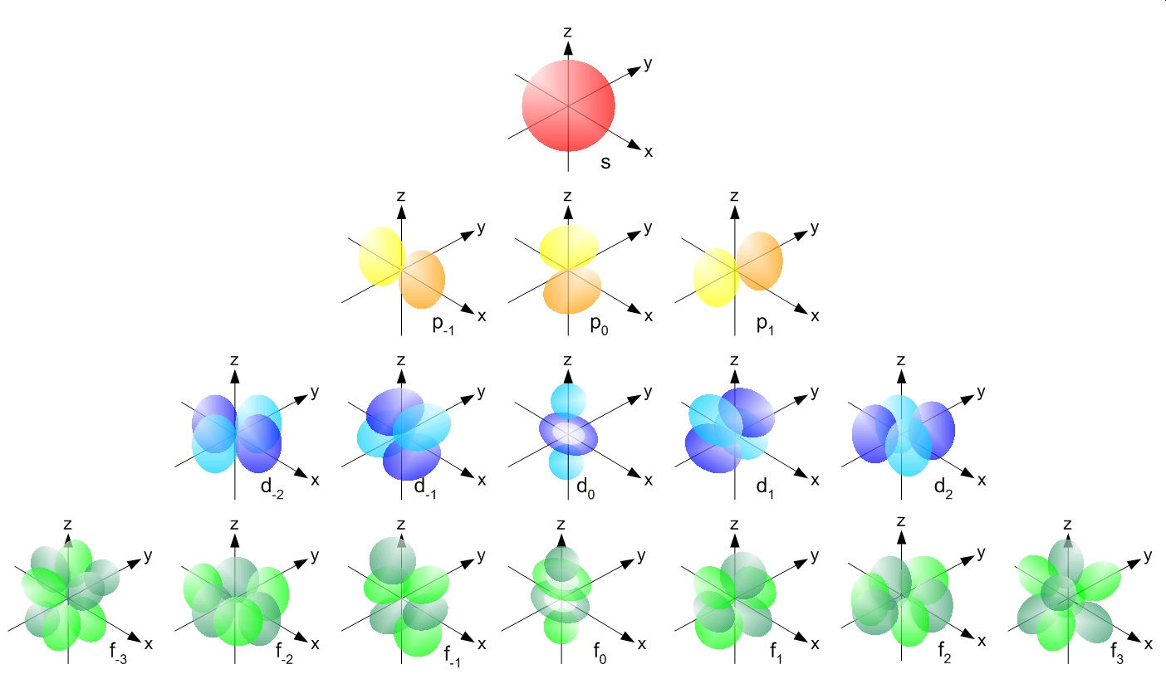
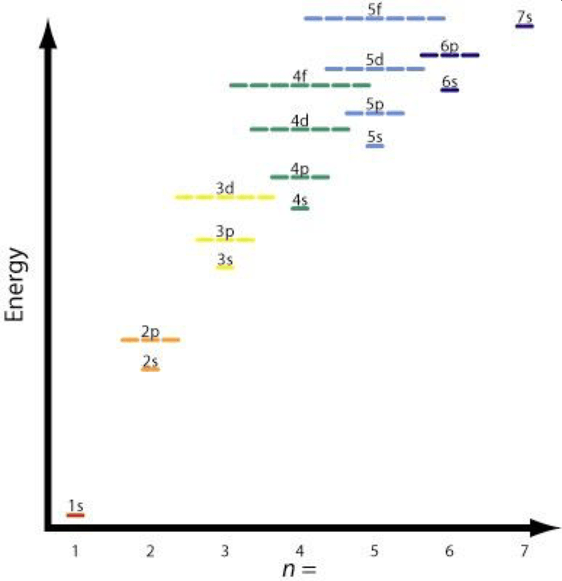
Review of QM
4 Different Orbital Shapes
Energy Level Diagram + Filling Order
Review Ch. 10

Slide 5
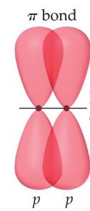
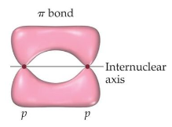
2 Types of Orbital Overlap
Sigma Bonds (σ bonds)
Pi Bonds (π bonds)
Overlap is end-to-end
e- density between atoms
“unreactive”
Overlap is side-by-side
e- density above and below atoms
“reactive”
H-H
H-F
or
F-F

Slide 6
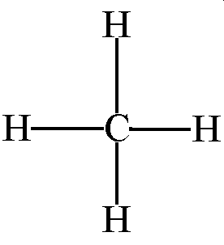
Lewis Structure
(and Experimentally)
QM/VBT – Not Great Yet…
“Basic” version doesn’t predict shapes!
Flaws
Not 4 unpaired electrons
Different Overlaps
Different Bond Angles
VS
Tetrahedral 109.5
4 equal length bonds
4 equal strength bonds
Energy
2p
1 bond is s-s
3 bonds are s-p
2s
1s
Carbon

Slide 7
VBT – 2 Improvements
Promotion – move an electron from a low energy orbital to high energy orbital
Hybridization – combine wave functions to produce new lower energy orbitals
Energy
Energy
2p
2p
Promotion
2s
2s
1s
1s
Carbon
Carbon

Slide 8
Hybridization – combine wave functions to produce new lower energy orbitals
Hybrid Orbitals
LCAO – Linear Combinations of atomic orbitals
Exist in molecules not isolated atoms
New shapes/orientations
Various combinations (3 total)
Lower in energy
Energy
Energy
2p
Hybridization
2s
sp³ hybrid
1s
1s
Carbon
Carbon

Slide 9
sp³ Hybridization
Energy
Energy
2p
Tetrahedral
109.5°
Hybridization
2s
sp³ hybrid
1s
1s
4 equal bonds
Tetrahedral 109.5

Slide 10
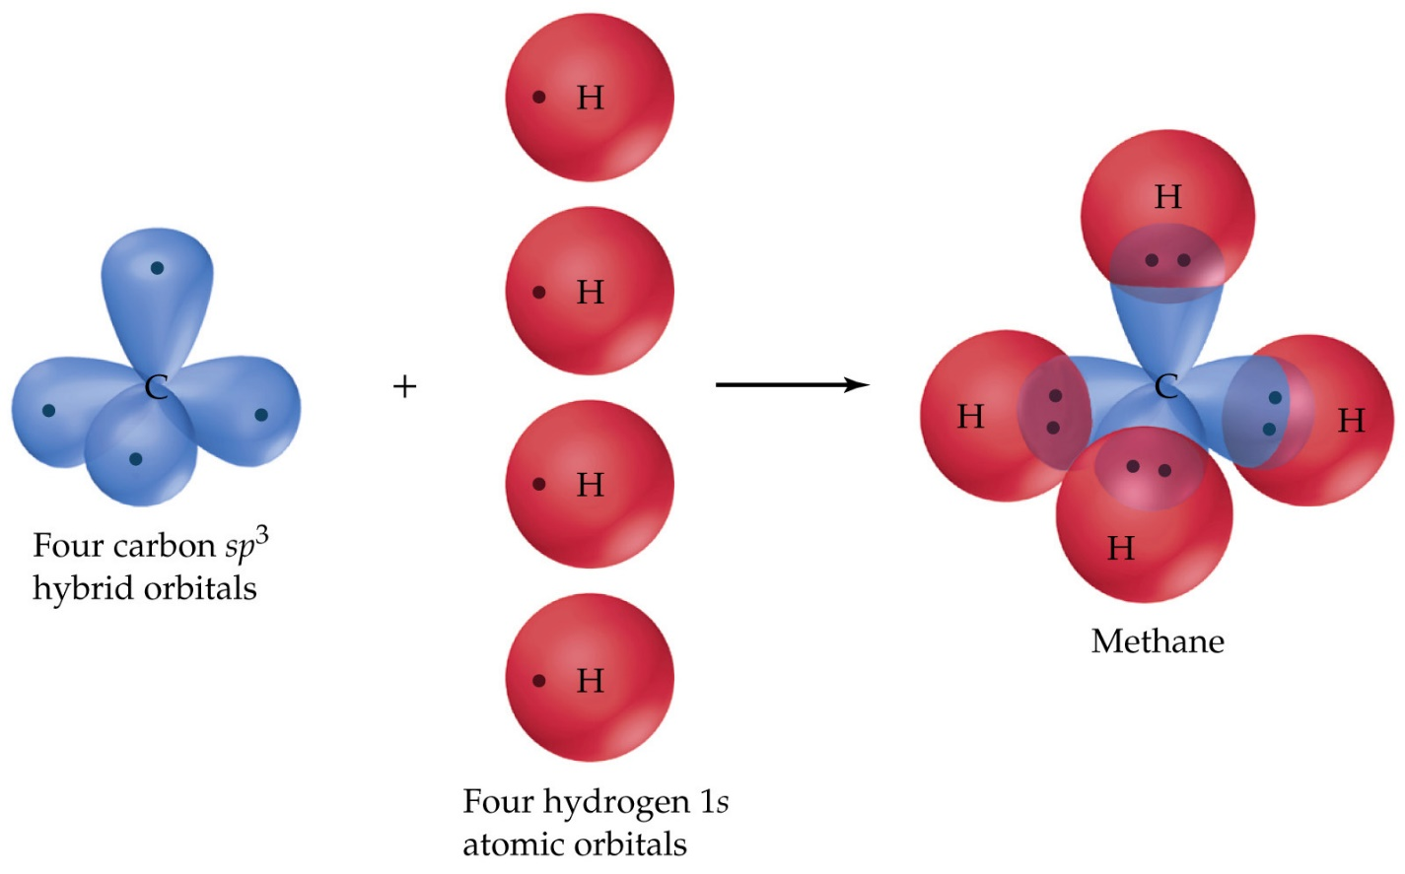
CH₄ – A Second Look (Full VBT)
Energy
Energy
Energy
2p
2p
Promotion
Hybridization
2s
2s
sp³ hybrid
1s
1s
1s
Carbon
4 hybridized (sp³) bonds to 4 hydrogen atoms

Slide 11
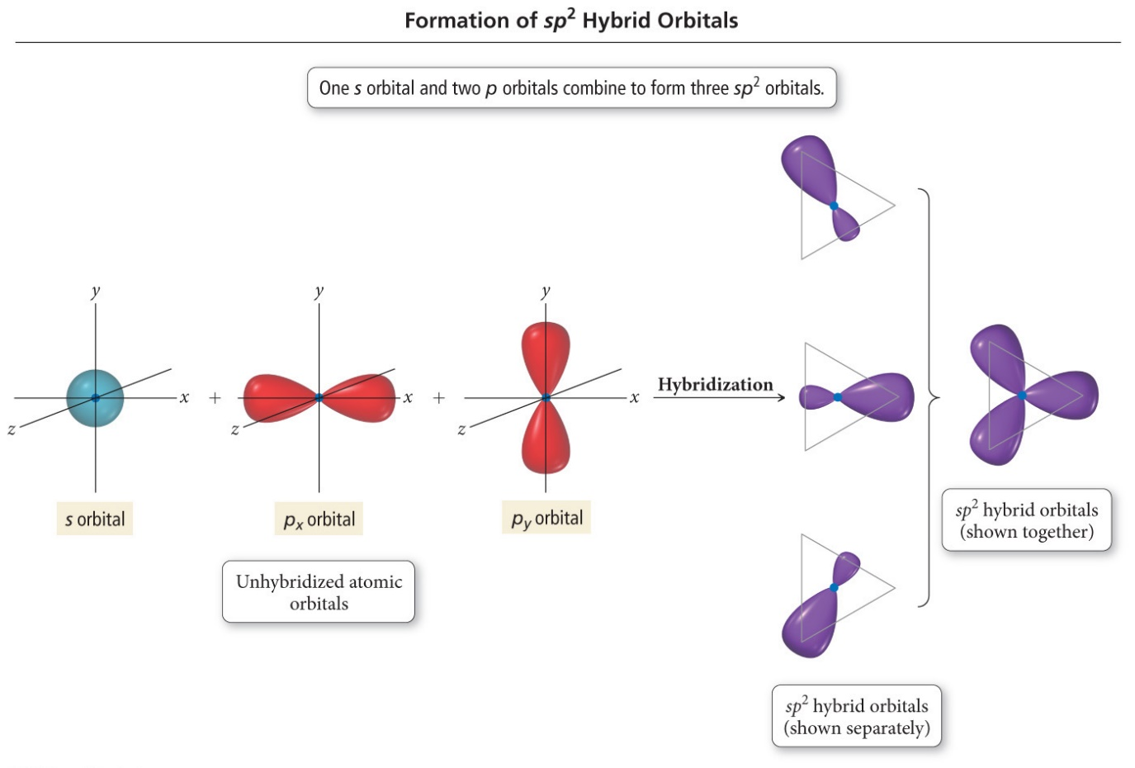
sp² Hybridization
Energy
Energy
2p
2p
Trigonal Planar
120°
Hybridization
sp² hybrid
2s
1s
1s
3 equal bonds
1 “double” bond
Trigonal Planar 120

Slide 12
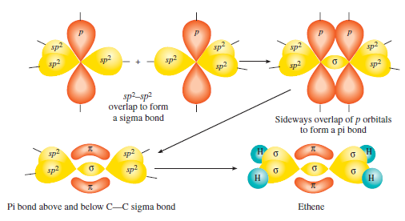
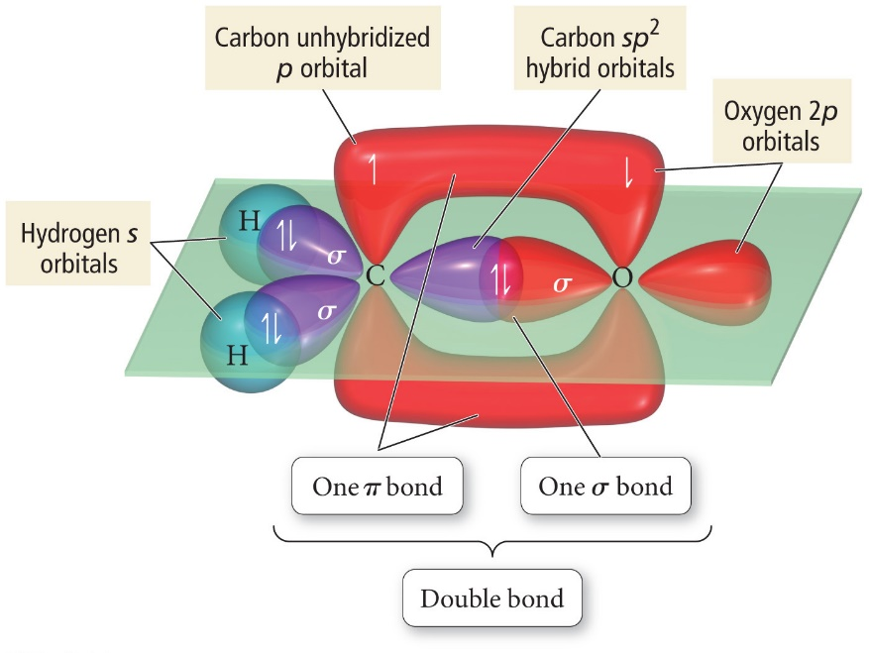
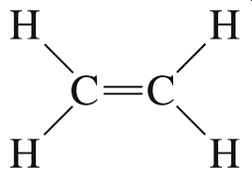
C₂H₄ – Example of sp² hybridization
C=C is made up of:
1 Sigma Bond +
1 Pi Bond

Slide 13
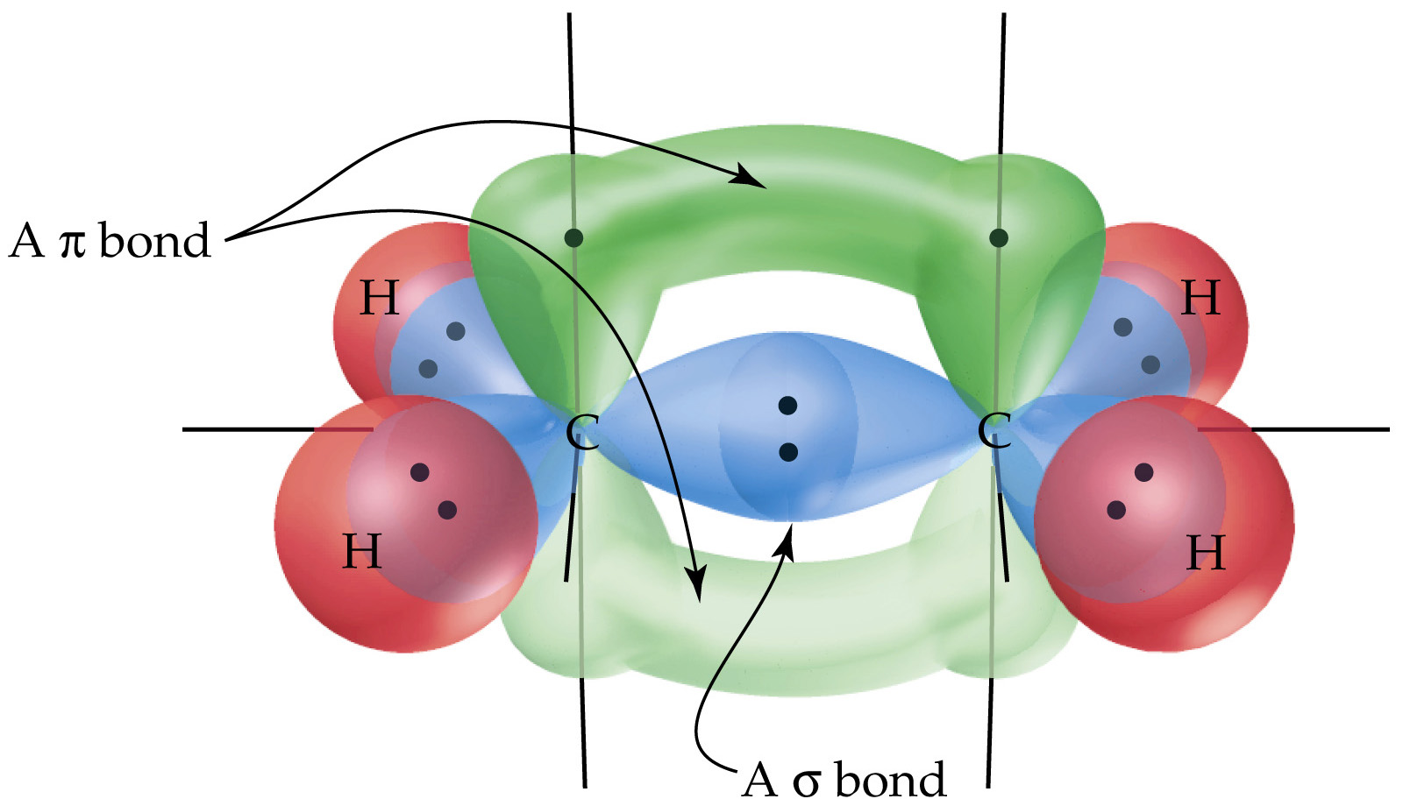

Slide 14
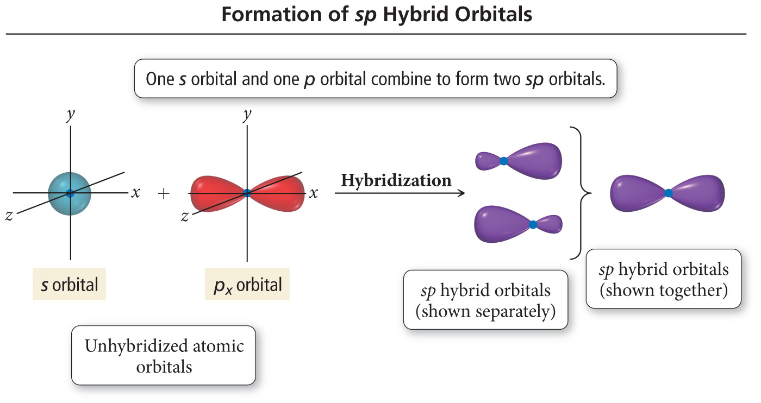
sp Hybridization
Energy
Energy
2p
2p
Linear
180°
Hybridization
2s
sp hybrid
1s
1s
2 equal bonds
2 “triple” bonds
Linear 180

Slide 15
C₂H₂ – Example of sp hybridization
C=C is made up of:
1 Sigma Bond +
2 Pi Bond

Slide 17
Single vs Double vs Triple Bonds
sp³ – hybridization
sp² – hybridization
sp – hybridization

Slide 18
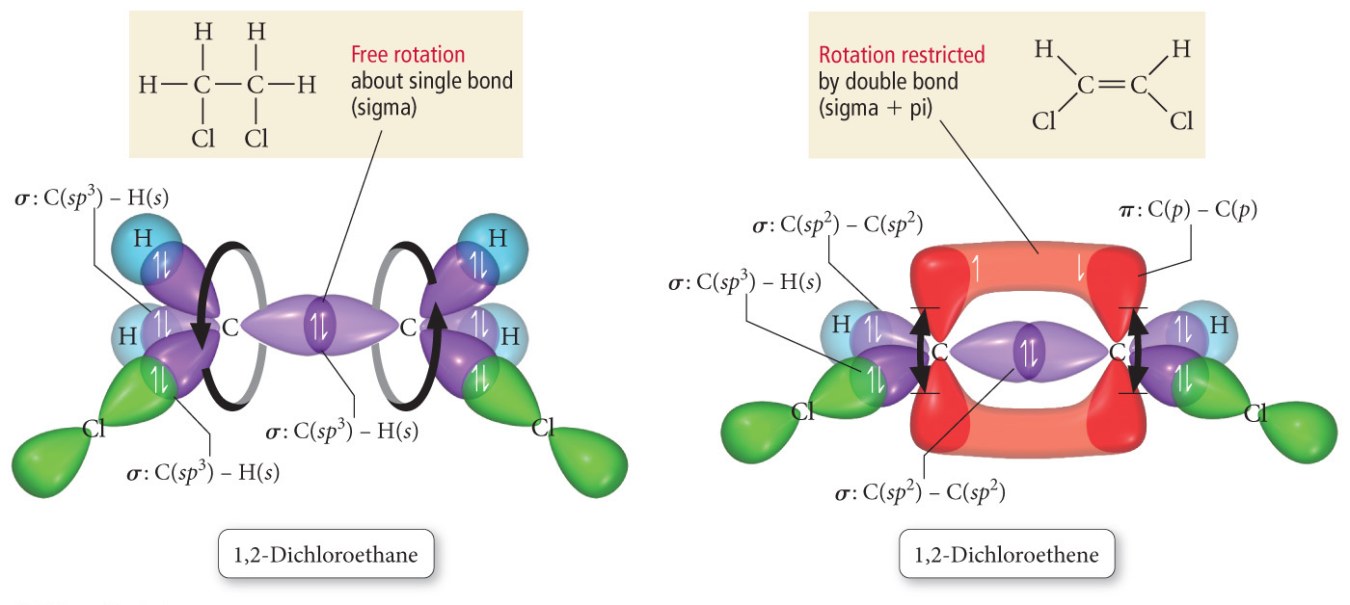
Miscellaneous – Free Rotation vs Restricted Rotation

Slide 19
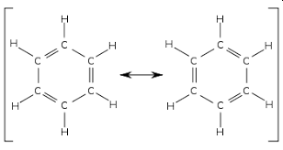
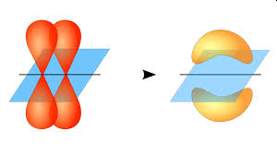
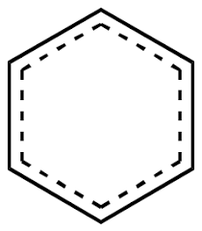
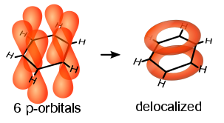
Aromatic Rings
Alternating C=C (conjugated)
Extra Stable, non-reactive
Reactions more like Alkanes (then –enes/ynes)
Resonance Structure
Delocalization of Pi Bonds

