Slide 1
CHE 102 Spring 2021
Lecture 20b – Addition Reactions
Overview/Topics
C=C Reactions
Addition Reactions
Baeyer Test (Oxid)
Markovnikovs Rule
Aromatic Reactions
Substitution
Side-Chain Oxidation
Skills to Master
HW 20b
Read
Chapter 20.5-20.6 and 20.13
https://www.masterorganicchemistry.com/2011/10/03/introduction-to-addition-reactions/

Slide 2
Addition Reactions
Aromatic Reactions
Must have C=C or C≡C
Electrons exposed and highly reactive
Small molecules added across C=C bond
X₂ , HX, HOH or H₂
Markovnikov’s Rule – When adding an unsymmetrical molecule (HX or HOH), the H goes to the carbon atom with the greater number of H’s already attached.
Circle the favored product
Diagnostic Test – Baeyer Test
Aromatic Ring – conjugated, “extra” stable
React like Alkanes (Substitution)
Circle the favored product
Side Chain Oxidation
Can you:
Recognize the type of reaction
Apply the reaction mechanism
Apply the selection rule
Complete the reaction
Additional Reading
https://www.masterorganicchemistry.com/2011/10/03/introduction-to-addition-reactions/

Slide 3
Addition Reactions
(a)
Words:
Alkene
+ H₂
Alkane
(b)
Condensed:
R-CH=CH₂ + H₂
R-CH-CH₂
H
H
Addition of H
Across C=C
H
H
H
H
H
H
(c)
Lewis:
C C
H
C
C
H
C
C
+
H
H
H
H
H
H
New Bonds
Formed
H
H
Free Radicals
Formed
H
H
(d)
Line:
+
H
H

Slide 4
Markovnikov’s Rule
When adding an unsymmetrical molecule (HX or HOH) across a C=C (or C≡C) add the H to the Carbon with the most H.
1 H
H
Cl
+
H
Cl
+
2 H
Cl
H
(a)
(b)
Make it “Harder”
Bigger molecule?
C≡C
1 or 2 products
Sometimes you don’t apply the rule
Sometimes both molecules equally favored

Slide 5
Examples
+ H₂
+ Cl₂
+ HCl
+ HOH

Slide 6
Examples
+ HCl
+ HCl

Slide 7
Examples
+ HCl

Slide 8
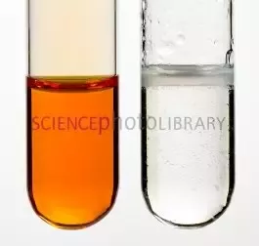
Diagnostic Tests
Used to determine Functional Group in an unknown compound or aid in identification of unknown compounds
Generally “quick” and dirty
Bromine Test
Positive (+) – Alkenes/Alkynes: orange → clear (fast)
Negative (-) – Alkanes: NR or requires UV light
+ Br₂
+ Br₂

Slide 9
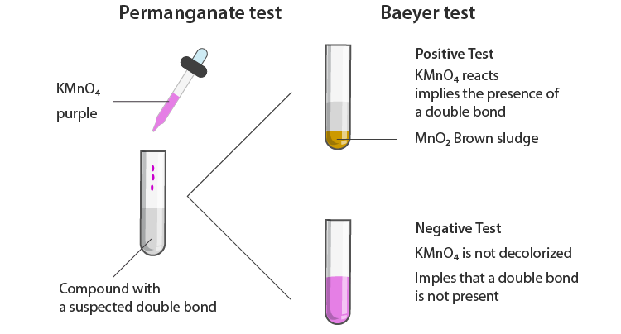
Baeyer (Potassium Permanganate – KMnO₄)
Positive (+) – Alkenes/Alkynes: purple → muddy brown ppt
Negative (-) – Alkanes: NR (stays purple)
Technically an “oxidation” but close enough to “addition”
C=C/C≡C + KMnO₄ + H₂O → Diol + MnO₂ + KOH
(purple)
(brownish ppt)
Alkane + KMnO₄ + H₂O → NR
(purple)
(purple)
(purple)
+ KMnO₄ + H₂O
(purple)
+ KMnO₄ + H₂O

Slide 10
Halogenation
Nitration
Alkylation (Friedel-Craft)
Reactions – Aromatic Compounds
Exceptionally stable
Reacts like Alkane
Substitution Reactions
X₂ , HX, HOH, HO-NO₂ RX
Example
+ Cl₂

Slide 11
Example
+ HBr
+ H₂O
+ H₂

Slide 12
AlCl₃
Example
Alkylation or Friedel-Craft reaction
+
F

Slide 13
Reactions – Aromatic Compounds
Oxidation
Lose Energy
Lose e⁻
Gain bonds to O
Lose Bonds to H
Side-Chain Oxidation
Generic Symbol [O]
Can be a diagnostic test (next chapter)
Requires: KMnO₄ or K₂Cr₂O₇/H₂SO₄ + heat (Δ)
Example
[O]

Slide 14
Example
[O]
[O]

Slide 15
Putting it all together – Ch. 19 + Ch. 20
Substitution
Elimination
Addition
Alkane + ??
Swap
Selection Rule
500 °C
Alkane
LG or Adj. H
Selection Rule
Alkene/yne + ??
Add across C=C
Selection Rule
Δ
Aromatics
Miscellaneous
Substitution
Alkylation
Side-Chain Oxidation
Combustion
Diagnostic Tests
Bromine
Baeyer (KMnO₄)

