Slide 1
CHE 102 Spring 2021
Lecture 20a – Naming, Drawing, and Isomers
Overview/Topics
New Functional Groups
C=C (-ene)
C=C (-yne)
Aromatics
Naming Rules
Geometric (Cis/Trans) Isomers
Skills to Master
HW 20a
Draw Alkenes, Alkynes and Aromatics
Name Alkenes, Alkynes and Aromatics
Identify Cis and Trans isomers
Read
Chapter 20.2-20.3 and 20.7-20.10

Slide 2
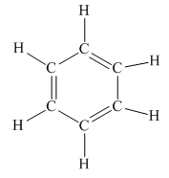
Alkenes
Alkynes
Aromatics
C=C
C≡C
Suffix = -ene
Suffix = -yne
Longest Chain has FG
FG = lowest #
Its complicated,
more later
ω-3 and ω-6 Fatty Acids
Trans-Fatty Acids
Retinol
Acetylene gas - welding
Carcinogen
TNT
Steroids, Hormone, Amino Acids, Membranes
Things we won’t do:
Multiple C=C or C≡C
Mixed FG
New IUPAC Rules
Can you:
ID/Name FG
Geometry (Shape and Angle)
Important Use

Slide 3
FG = lowest #
Give Location of FG
Old vs. New IUPAC
Examples:
Computer…
Can you:
Structure ↔ Name
Draw Molecules

Slide 4
FG = longest chain
FG = lowest #
Give Location of FG
Examples:

Slide 5
Multiple C=C or C≡C
Mixed FG
Not on Exam
Examples:
1,5-heptadiene
5-methyl-1-hexen-3-yne

Slide 6
Geometric or
Cis/Trans Isomers
a
x
C=C
C=C are rigid, no free rotation
Exhibit Geometric Isomerism
Same Formula, Same Structure, Different Geometry (and P/C)
Requirements:
C=C
2 different groups attached to each side (top and bottom of each side must be different)
b
y
CH₃
CH₃
CH₃
H
C=C
C=C
H
H
CH₃
H
Cis-2-butene
Trans-2-butene
Can you:
Define Requirement
ID Cis/Trans
“Name”
or

Slide 7
Identify if a molecule will have a cis/trans isomer:
(a) CH₃CHCH₂
(b) CH₃CH₂CH=CClCH₃
(c) CH₃C≡CCH₂CH₃
(d) CH₃CH₂CHO
(e) CH₃CH=CClCH₂CH₂CHCHCH₃

Slide 8
Aromatics
5 Different Naming Rules
6 special groups
1 side chain (normal rules)
Complicated Side Chains (Phenyl group)
2 side chains “o, m, p”
3+ side chains (use numbers)
Its messy!
Its not consistent.
Google may give you the wrong answer. Follow the rules given in the text book.

Slide 9
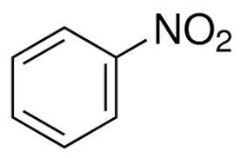
1
6 “Special” groups
(memorize)
These groups ALWAYS take priority when naming
Nitrobenzene

Slide 10
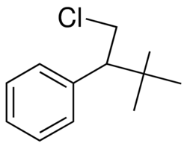
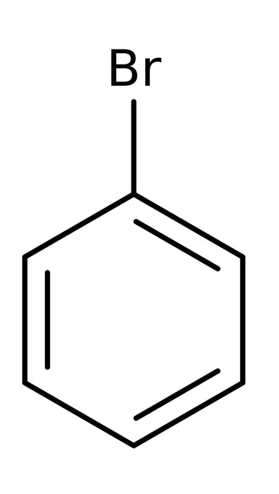
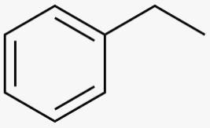
2
3
1 Side Chain
(normal rules)
Complex Side Chain
Aromatic is a SC
-Phenyl group
*no # needed because
It is redundant

Slide 11
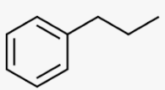
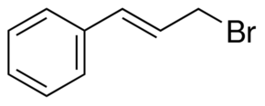
You Try It:

Slide 12
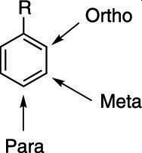
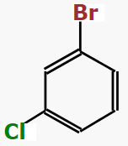
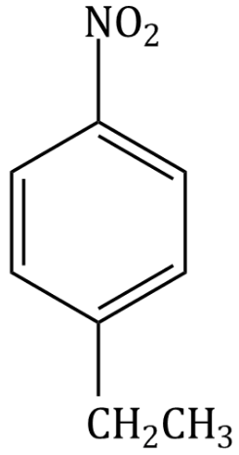
4
2 Side Chains
(o, m, p)
Examples:

Slide 13
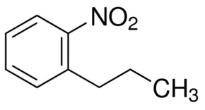
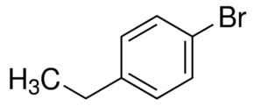
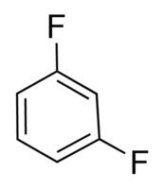
You Try It:

Slide 14
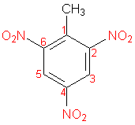
5
3 + Side Chains
(normal)
Number like normal
The 6 “special” groups are always #1
If no special group use lowest set of numbers
If there is a tie go alphabetical
2,4,6-trinitrotoluene “TNT”
Just be familiar with this
(i.e. not on exam)!

Slide 15
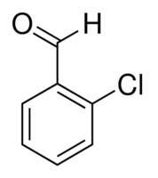
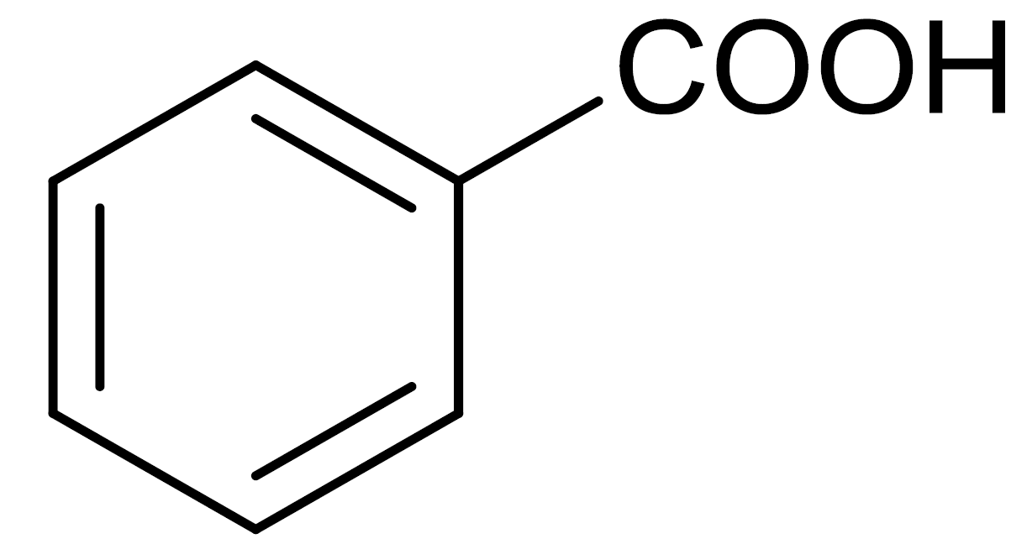
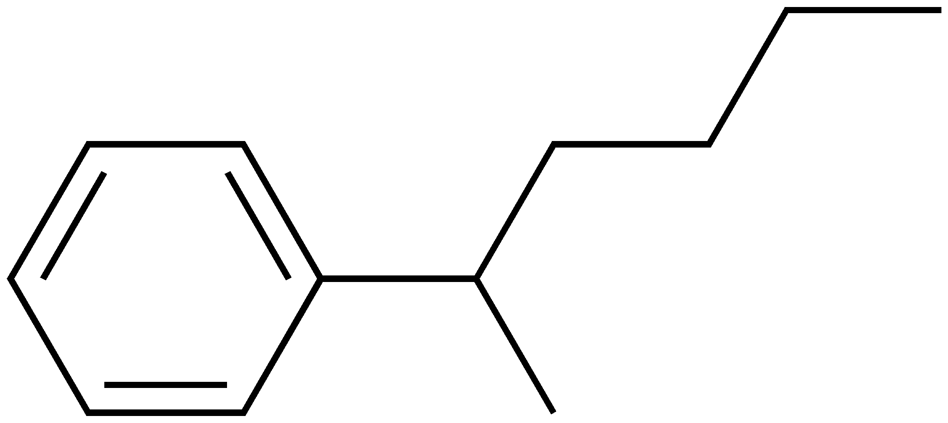
You Try It:

Slide 18
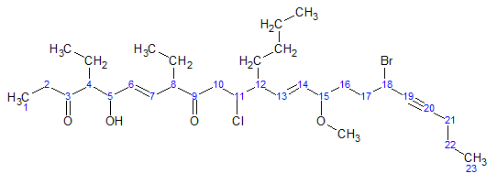
(6E,13E)-18-bromo-12-butyl-11-chloro-4,8-diethyl-5-hydroxy-15-methoxytricosa-6,13-dien-19-yne-3,9-dione
Can you:
Structure ↔ Name
For a mental break
http://www.chm.bris.ac.uk/sillymolecules/sillymols.htm

