Slide 1
CHE 102 Spring 2021
Lecture 19 c,d – Structure of Organic Compounds
Overview/Topics
Naming/Drawing Organic Molecules
Count 1-10
Main Chain/Side Chain (MC/SC)
Ending – MC vs SC
Rules for naming
Isomers
Skills to Master
Name/Draw molecules
Isomers
HW 19 c,d
Read
Chapter 19.8-19.9
Extra Handout on chemhaven.org – naming
Extra Handout on chemhaven.org – Review +
Extra Links on chemhaven.org

Slide 2
Highlight
Heading
Can you:
Memorize Table 19.1

Slide 3
Naming Organic Compounds
Goal = Unique Name
IUPAC Rules (old and new)
Main Chain/Longest Chain
MC/LC
Longest continuous chain of carbon atoms
Side Chain/Branch Chain
SC
All other carbon, not in MC

Slide 4
Table 19.4
Counting 1-10
Counting Side Chains
Halogens
1 - meth
2 - eth
3 – prop
4 - but
5 - pent
6 - hex
7 - hept
8 - oct
9 - non
10 - dec
1 –
2 – di
3 – tri
4 – tetra
5 – penta
F - Fluoro
Cl - Chloro
Br - Bromo
I - Iodo
Ending
Main Chain
Side Chain
Alkanes – ane
Alkenes – ene
Alkynes - yne
-yl
Can you:
Memorize Table 19.4 Left
Don’t memorize Right
Table 19.1 - ending

Slide 5
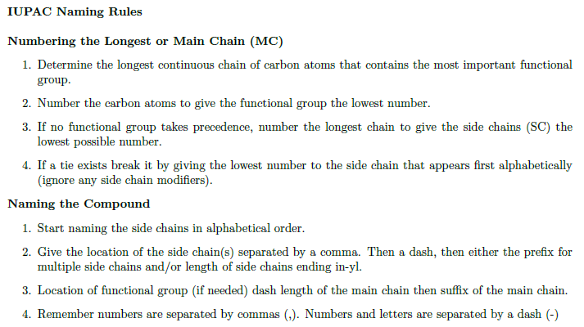
Rules for Naming Organic Molecules
Structure → Name
Name → Structure
LC
FG
SC
Alpha
#,#-prefix_SC_yl MC_ending

Slide 6
Example:
vs

Slide 7
Example:
Cl

Slide 8
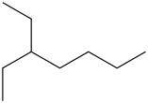
Example:

Slide 9
Example:

Slide 10
Example:

Slide 11
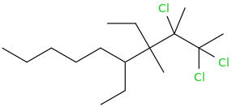
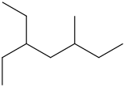
Example:

Slide 12
Name to Structure
“Easier”
Reverse Order
Example:
2-methyl-3-chlorohexane
3,4-diethyloctane

Slide 13
Things we will ignore!
SC on SC
Cyclic Compounds
Special Groups on SC (Table 19.4)
Common Mistakes
Forget di/tri/tetra
Lowest Number
Alphabetization
Forgetting dash/comma
Extra Practice
Online at www.chemhaven.org/che102
Printable Practice also
Practice Exams

Slide 14
Ch. 19
Ch. 20
Ch. 26
https://www.compoundchem.com/2014/05/22/typesofisomerism/

Slide 15
Isomers
Many different types
Ch. 19 – Constitutional
Ch. 20 – Geometric (Cis/Trans)
Ch. 26 – Stereoisomers (D/L)
Constitutional – same formula, different structure
different P and C properties
3 Different Types
Chain
Positional (of FG)
Functional Group (ex: alcohol/ether etc)
Example:
C₄H₁₀

Slide 16
General Rules for Drawing Constitutional Isomers
Move FG or Halogen to all unique positions
Remove 1C (shorten MC), move methyl group around
Rinse and repeat
Name molecules (double check uniqueness)
Example:
C₄H₁₀
Example:
C₄H₉Cl

Slide 17
You Try It:
All isomers of hexane (C₆H₁₄) – 5 Total

Slide 18
1.1 ×10¹⁸

Slide 19
Tuesday
Extra
Handout – Drawing Molec.
Handout – Review + Ch. 19
Links – Drawing Molec.
EP on Condensed/Lewis/Line
EP on Naming/Drawing
Read Lab 20 – Review of LS
Wednesday
Read 19.8-19.1
Memorize Table 19.9 (left side)
Due: HW 19 a,b
Thursday
Finish Lab 20
Due: Lab 20
Friday
No class
Due: HW 19 c,d

