Slide 1
CHE 102 Spring 2021
Lecture 19ab – Structure of Organic Compounds
Overview/Topics
Review Lewis Structures
Draw simple structures
Shapes and angles
Representations of Organic Compounds
Chemical Formula
Condensed Structure
Lewis Structure
Line Structures
Identify Functional Groups
Skills to Master
Memorize Functional Groups
Draw all types of organic molecules
HW 19 a,b
Read
Chapter 19.1-19.8
Extra Handout on chemhaven.org – Line drawing
Extra Handout on chemhave.org – Review +

Slide 2
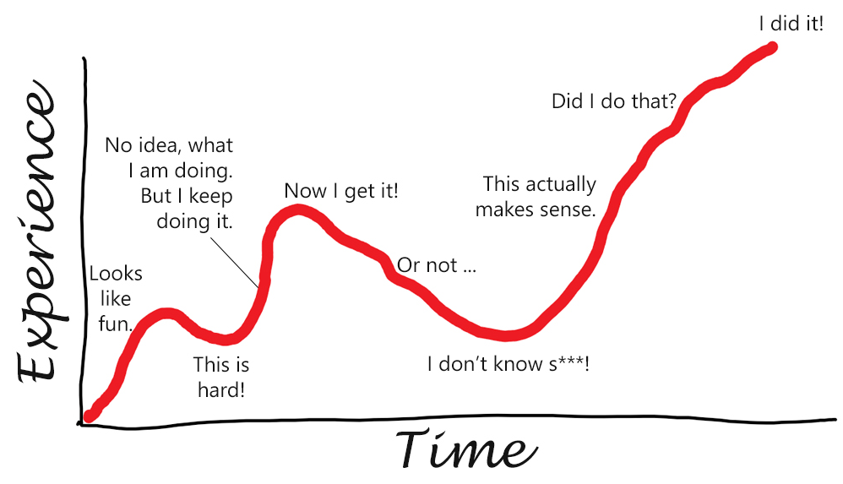
CHE 102 - Overview
Ch. 26
Stereoisomers
E4
E5
Chapter 19-25 Organic Chemistry
Draw Molecules
Name Molecules
Chemical Reactions
IMF and Physical Properties
Structure/Function Relationship
Misc.
Chapter 27-31 Macromolecules
Draw Molecules
Chemical Reactions
IMF and Physical Properties
Structure/Function Relationship
Functions in the Body
Misc.
E1
E2
E3
Ch. 32 - Nutrition
E6
Chapter 33-35 Biochemistry
Bioenergetics
Identify Chemical Reactions
Structure/Function Relationship
Functions in the Body
Misc.

Slide 3
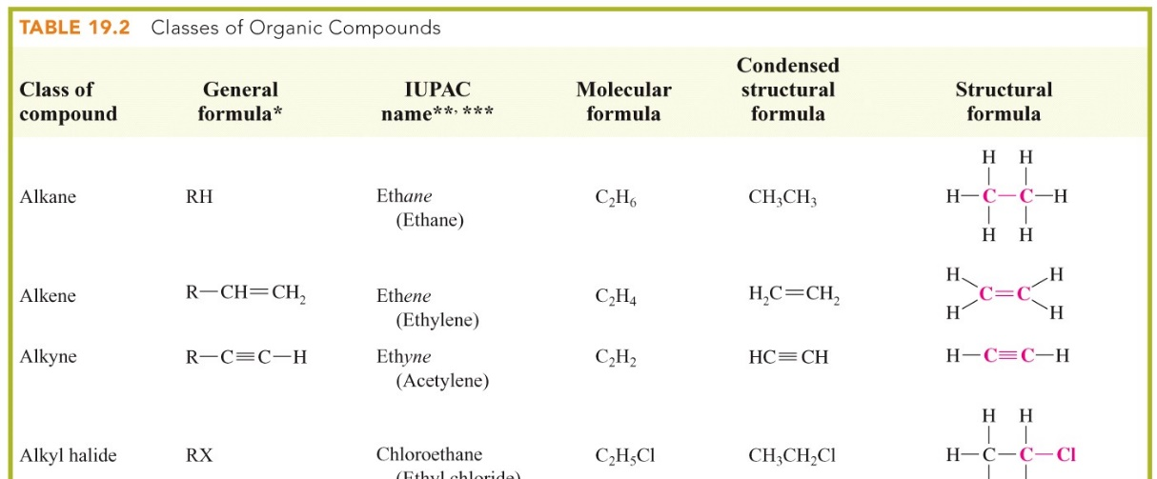
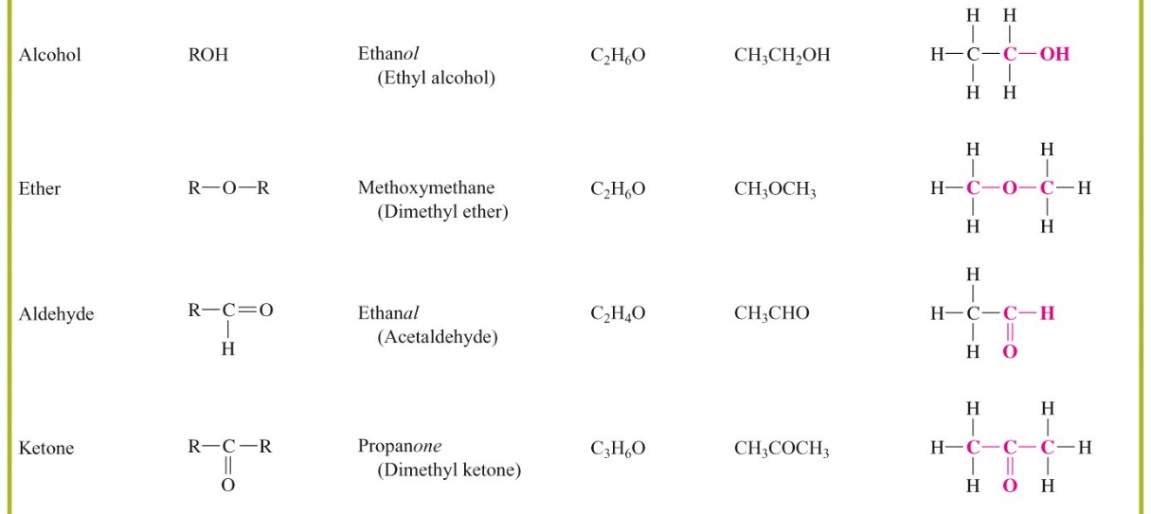
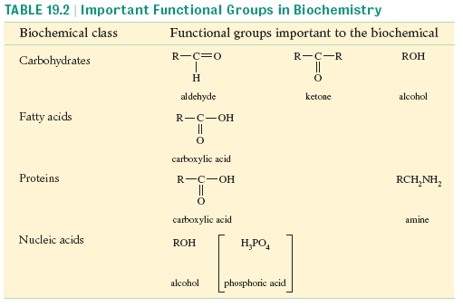
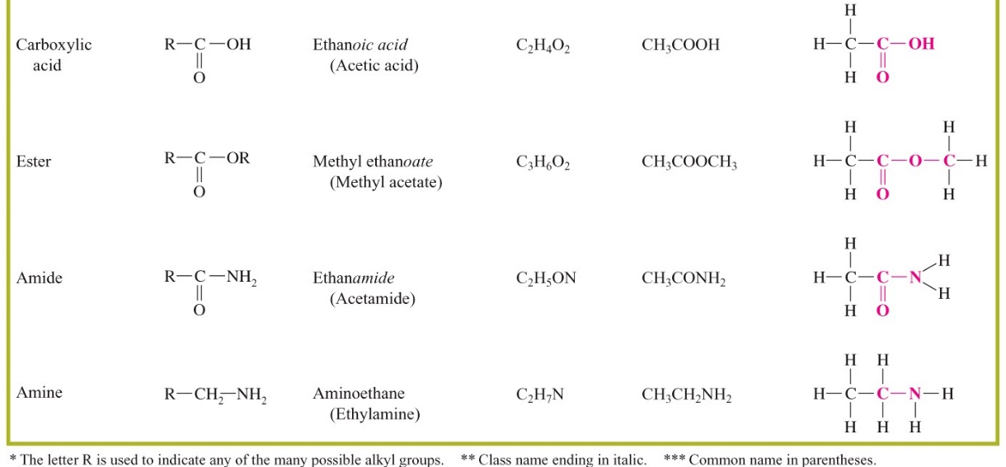
Organic Chemistry
Dfn: Study of compounds made of
C, H, O, N + a few others
Functional Group
Unique group, “common feature”, similar P and C properties 12 groups (2/chapter)
Can you:
Memorize Table 19.1
Macromolecules

Slide 4
Carbon
Hydrogen
EN = 2.1 (middle)
1s¹ = 1 valence e⁻
Exception to octet
C-H bonds = high energy
EN = 2 (middle)
1s²2s²2p² = 4 valence e⁻
Wants to make 4 bonds
Variety of bonding patterns
Stable Bonds
H
C
C
C
C
Oxygen
Nitrogen
EN = 3.0 (middle)
1s²2s²2p³ = 5 valence e⁻
Wants to make 3 bonds
Variety of bonding patterns
EN = 3.5
1s²2s²2p⁴ = 6 valence e⁻
Wants to make 2 bonds
C-O bonds = low energy
+1
O
O
N
N
N
N
Can you:
Draw Lewis Structures

Slide 5
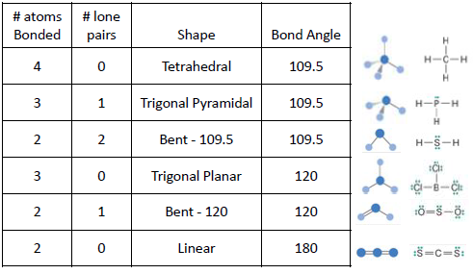
Review Lewis Structures
Hein – Ch. 11 Lab 11
OER – Ch. 1 Lab 21
Lewis Structure Review
# atoms
Bonded
# lone
pair e⁻
lone-pair electrons
F F O O N N
Single Bond
Double Bond
Triple Bond
2
+1
H
O
O C O
H
N
H
H
Polyatomic Ions
Can you:
Determine shape/angle

Slide 6
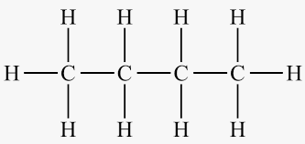
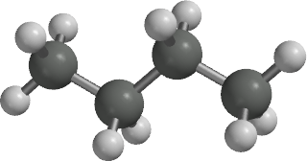
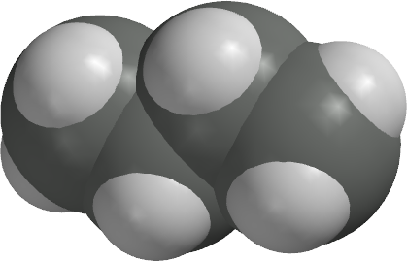
Representations of Organic Molecules
Type | Definition | Example
Molecular | Actual Composition No structure | C₄H₁₀
Empirical | Ratio Elements No structure | C_{n}H_{2n+2}
Condensed | Little structure | CH₃-CH₂-CH₂-CH₃
Modified Cond. | Little structure | CH₃(CH₂)₂CH₃
Lewis Structure | All Information! Takes forever
Ball and Stick, Space Filling, 3D | Awesome! Never gonna happen
Line Drawing | Fast, make assumptions
https://pubchem.ncbi.nlm.nih.gov/compound/Butane#section=3D-Conformer
Can you:
Be comfortable with multiple representations

Slide 7
Representations of Organic Molecules
Don’t need to know these!
SMILES
CCCCCCCC
IUPAC NAME
Octane
Tomorrow!
InChi
1S/C8H18/c1-3-5-7-8-6-4-2/h3-8H2,1-2H3
InChiKey
TVMXDCGIABBOFY-UHFFFAOYSA-N

Slide 8
Condensed Structures
Line Structures
Carbon grouped with atoms bonded to it
( ) = repeated group in main chain
( ) = side chain
Carbon = end/vertex
Don’t show H
Zig/Zag » Shape/Angle
CH₃(CH₂)₃CH(CH₃)CH₂CH₃
Tips/Tricks
Count to 4
“read L to R”
Practice!
Can you:
Lewis ↔ Cond. ↔ Line

Slide 9
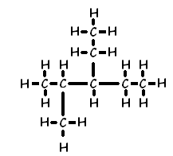
You Try It:
Lewis Structure
Cond. Structure
Line Structure

Slide 10
You Try It:
Lewis Structure
Cond. Structure
Line Structure
CH₃CHBr(CH₂)₂CH(CH₂CH₃)CH₂CH₃

Slide 11
You Try It:
Lewis Structure
Cond. Structure
Line Structure

Slide 12
More information about Table 19.1
Ch. 19
Ch. 20
Ch. 19
R = rest of molecule
X = any halogen
Ch. 22
Ch. 23
Ch. 24
Ch. 25

Slide 13
Condensed
Lewis
Line
Name
Alkanes
Alkyl Halide
Alkenes
Alkynes
Aromatic

Slide 14
Condensed
Lewis
Line
Name
Alcohols
Ethers
Aldehydes
Ketones

Slide 15
Condensed
Lewis
Line
Name
Carboxylic Acid
Ester
Amine
Amide

Slide 16
You Try It:
Lewis Structure
Cond. Structure
Line Structure

Slide 17
You Try It:
Lewis Structure
Cond. Structure
Line Structure

Slide 18
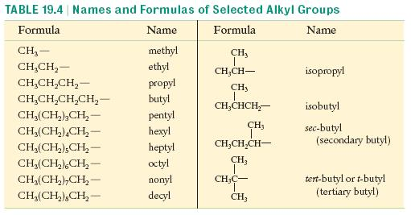
Tuesday
Extra
Handout – Drawing Molec.
Handout – Review + Ch. 19
Links – Drawing Molec.
EP on Condensed/Lewis/Line
EP on Naming
Read Lab 20 – Review of LS
Wednesday
Read 19.8-19.1
Memorize Table 19.9 (left side)
Due: HW 19 a,b
Thursday
Finish Lab 20
Due: Lab 20
Friday
No class
Due: HW 19 c,d

