Slide 1
CHE 101 Fall 2021
Lecture 9d – Concentration Units and Colligative Properties
Overview/Topics
Concentration Units (math!)
Mass Percent
PPM
Volume Percent
Mass-Volume Percent
Molarity
Molality
Dilutions (M₁V₁=M₂V₂)
Colligative Properties
Freezing Point Depression
Boiling Point Elevation
Vapor Pressure Lowering
Osmotic Pressure
Colligative Properties Calculations
Skills to Master
HW 9d
Read
Chapter 13

Slide 2
Review of Conversions
Q → A
Solution = Solute + Solvent
Metric System
1 unit → 1 unit
2 units → 2 units
List all the CF you know:
Conversion “Maps”CF

Slide 3
Review of Ch. 2, 6
Conversions!
Units of Concentration
Most often picked for “convenience”
Mass Percent (% m/m)
Parts per million (ppm)
Generally used by non-chemists or people that don’t care how many moles they have
Generally used for really really small quantitates
$$\frac{g solute}{g solution}×100$$
$$\frac{g solute}{g solution}×1,000,000$$
g solution = g solute + g solvent
Not on CS, use Table 14.4

Slide 4
Example:
Given a solution made by dissolving 10.00 grams of NaOH in 50.0 g of H₂O calculate:
Mass %
Convert Mass % to Molarity
Convert Molarity to Mass %

Slide 5
Example:
In lab you have a 12.5% m/m NaOH solution
(a) How many grams of NaOH are in 150 g of the solution?
(b) What is the Molarity of the solution?

Slide 6
Example:
What is the “Best” solution we can make in lab of NaOH?
Calculate the %m/m
Calculate the M
Calculate the ppm

Slide 7
Units of Concentration
Mass/volume Percent (% m/v)
Mass/volume Percent (% v/v)
Generally used by non-chemists or people that don’t care how many moles they have and its easier to measure volume than mass of one component
Generally used by non-chemists or people that don’t care how many moles they have and its easier to measure volume than mass of the components
$$\frac{g solute}{mL solution}×100$$
$$\frac{mL solute}{mL solution}×100$$

Slide 8
Example:
In lab you dissolve 20.0 g of NaOH in 100.0 mL of Water.
(a) Calculate the % m/v
(b) Calculate the M of the solution

Slide 9
Units of Concentration
Molarity (M)
Molality (m)
Used by chemists because we care about how many mols we have in a reaction!
Can measure volume easier
Used by chemists because we care about how many mols we have in a reaction!
Can measure mass easier
$$\frac{mol solute}{L solution}$$
$$\frac{mol solute}{Kg solvent}$$

Slide 10
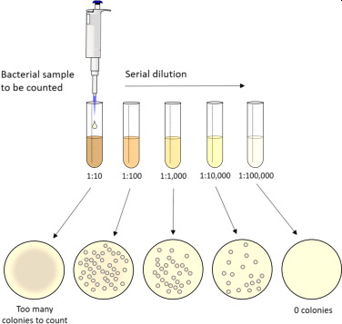
Dilutions
Take concentrated solution (High M) and add water to create a dilute solution (Low M)
Used to accurately and precisely make solutions that would be hard to measure
Used in Labs to make calibration curves
4 variables (know 3 solve for missing 1)
Similar to P₁V₁=P₂V₂
M₁V₁ = M₂V₂

Slide 11
Example:
What is the final concentration of a solution that is prepared by taking 1.00 mL of 15.0 M HCl and diluting it to a final volume of 200.0 mL?
Example:
You need to prepare a 1000.0 mL of a 0.01 M solution from a 2.5 M stock solution. How many mL of the stock solution should you dilute to make the solution?

Slide 12
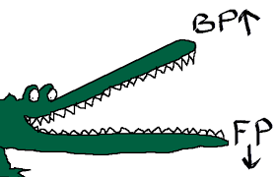
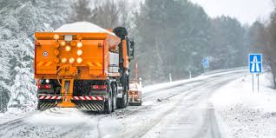
Colligative Properties
Properties that depend on the amount (# molecules or moles) of *solute molecules dissolved in the solution, not on their chemical identity
4 Examples
Freezing Point (Depression)
Boiling Point (Elevation)
Vapor Pressure (Lowering)
Osmotic Pressure
*Non-volatile solutes
*Unionized solutes

Slide 13
Vapor Pressure
Lowering
Non-volatile solute = less particles at surface, therefore less particles evaporate therefore the Lower the Vapor Pressure

Slide 14
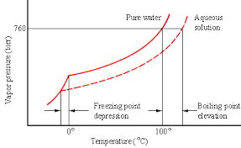
Boiling Point
Elevation
Boiling Point occurs when P_{v} = P_{atm}
If P_{v} is lowered then it takes more energy to get P_{v} = P_{atm}
Freezing Point
Depression
Opposite for Freezing
The line does not intersect until below the normal F_{p}
Harder for solvent particles to form a lattice (due to impurity)

Slide 15
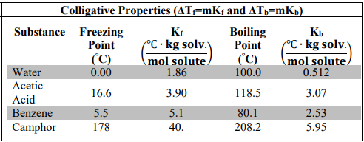
Cheat Sheet
Calculating B_{p} and F_{p} of Impure Solutions
ΔT = change in temperature (°C)
ΔT_{f} = mK_{f}
$$\frac{mols solute}{kg of solvent}$$
m = molality =
or
ΔT_{b} = mK_{b}
K_{f} = molal freezing point depression constant
K_{b} = molal boiling point elevation constant
$$\left(\frac{℃ ∙kg solvent}{mol solute}\right)$$
Depends on solvent

Slide 16
Example:
What is the freezing point of a radiator that is filled with 25% anti-freeze (ethylene glycol) and 75% water?

Slide 17
Example:
What is the boiling point of a solution in which 45.0 grams of Acetic Acid (CH₃COOH) is dissolved in 100.0 grams of Benzene (C₆H₆)?

Slide 18
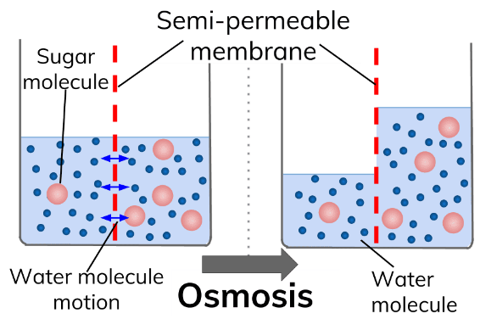
Allows small molecules (H₂O) through but stops larger molecules
Osmotic Pressure (π)
Osmotic Pressure is pressure required to equalize the water levels
Water flows from high concentration of water to low concentration of water to equalize the concentrations

Slide 19
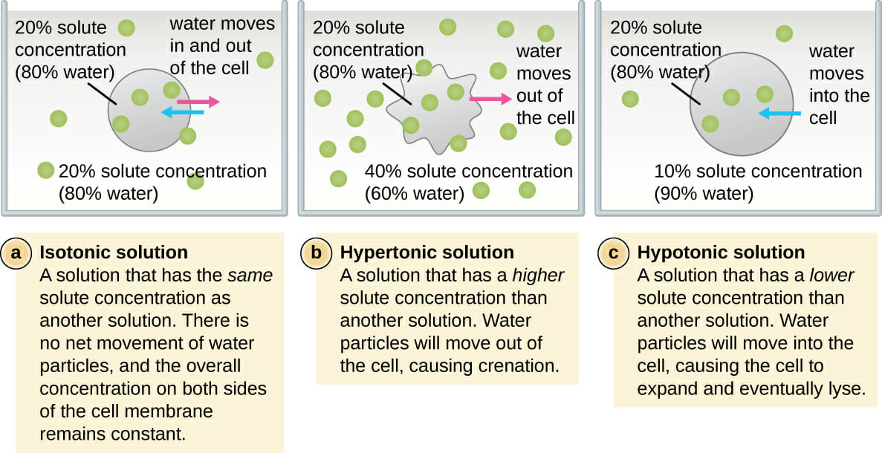
Osmotic Pressure (π)
Crenation
Hemolysis

Slide 20
Reverse Osmosis Desalinization
Expensive
Energy Intensive
Brine Waste

Slide 21
PPM + Dilutions + M
Example:
Make a 15 ppm solution of NaOH solution.

