Slide 1
CHE 101 Fall 2021
Lecture 9c – Properties of Solutions
Overview/Topics
Vocabulary
Solute, Solvent, Solution
Miscible, Immiscible
Soluble/Insoluble
Unsaturated, Saturated, Supersaturated
Solubility
Process, role of IMF’s
Effect of Temperature
Effect of Pressure
Ratio/Proportions
Dissolving Process/Rate
Particle size
Temperature
Concentration
Agitation/Stirring
Skills to Master
HW 9 c
Read
Chapter 14

Slide 2
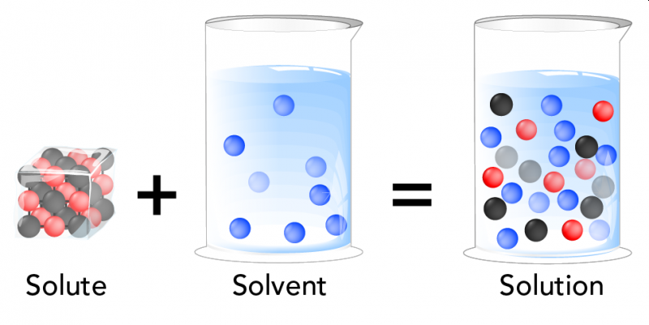
Solutions/Homogeneous Mixtures
Solution
One or more substances homogeneously mixed or dissolved in another substance
Solute
Component that is dissolved (least abundant)
Solvent
Dissolving agent (most abundant)
Solute
+
Solvent
=
Solution
Review Ch. 1

Slide 3
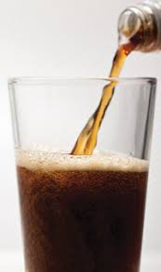
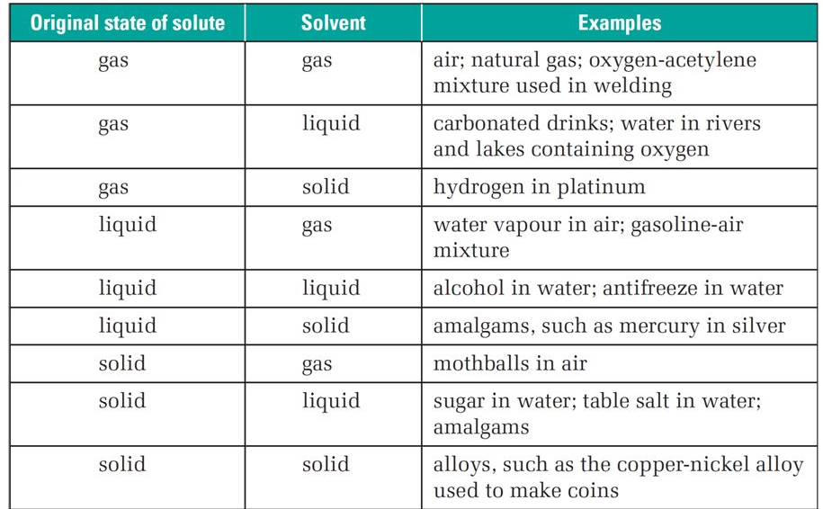
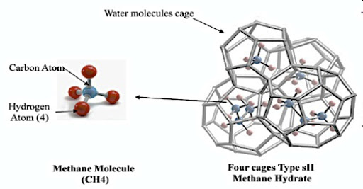
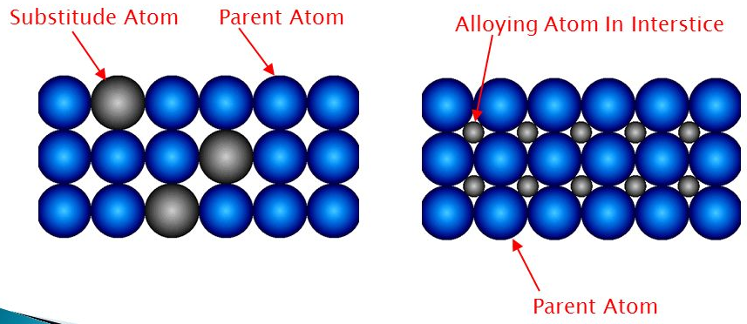
Different Types of Solutions

Slide 4
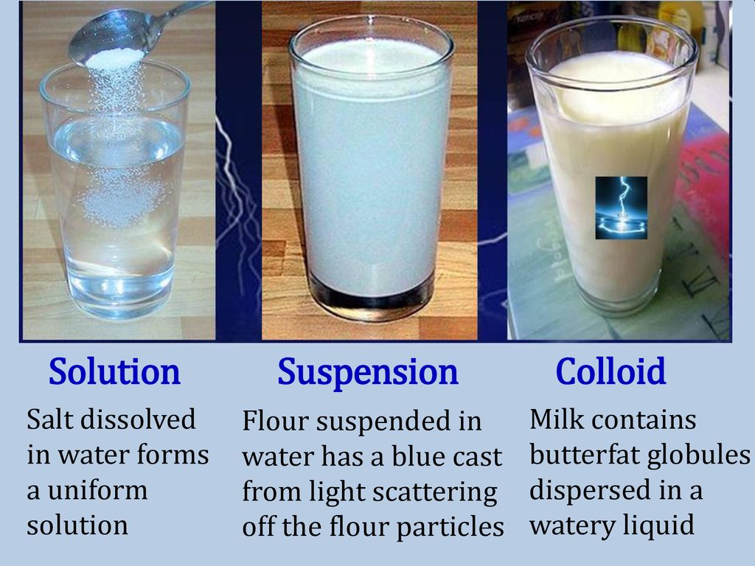
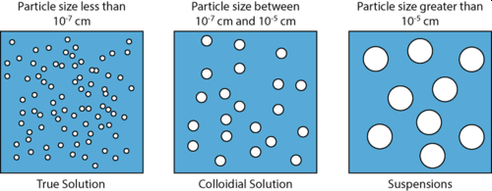
Review Ch. 1
General Properties of Solutions
Mixtures – Homogeneous, variable composition
Solute – generally molecular sized
Colored or colorless but usually transparent (liquids)
Solute is uniformly distributed (will not settle out)
Physically separable (ex: Evaporation)

Slide 5
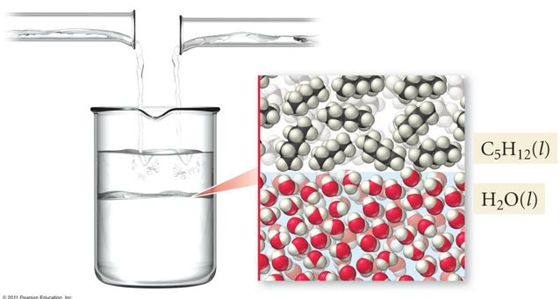
2 General Rules for Solutions
Like Dissolves Like
Oil and Water Don’t Mix
Substances with similar IMF will form solutions
Substances with different IMF will not form solutions
Phase Boundary
ID
HB
DD
LDF
Polar
Nonpolar
Substances are usually soluble +/- one category

Slide 6
Example
Water = polar forms DD/HB/ID
NaCl is soluble in water

Slide 7
Example
Water = polar forms DD/HB/ID
Sugar is soluble in water

Slide 8
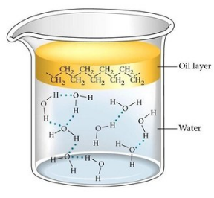
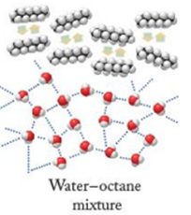
Water = polar forms DD/HB/ID
Hexane = nonpolar forms LDF
Oil and Water Don’t Mix
Example
Substances with different IMF will not form solutions
Phase Boundary
Oil Layer
H₂O Layer

Slide 9
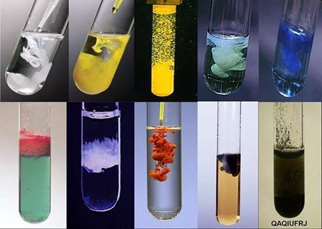
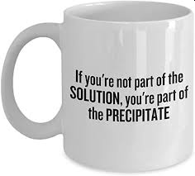
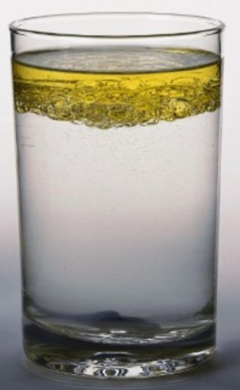
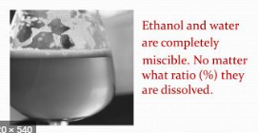
Solubility
Vocabulary
Soluble
dissolves in solution
Insoluble
Does not dissolve in solution
Liquids that mix homogeneously to form a solution
Miscible
Immiscible
Liquids that do not mix, form a phase boundary

Slide 10
Solubility
Vocabulary
Unsaturated (U)
Saturated (S)
Supersaturated (SS)
[Solute] < Max
Clear Solution
[Solute] = Max
Clear Solution + tiny amount solid
Equilibrium
[Solute] > Max
Clear Solution
Inherently unstable
or

Slide 11
Supersaturated (SS)
[Solute] > Max
Clear Solution
Inherently unstable
or

Slide 12
Example:
Cheat Sheet
Solubility of NaCl in H₂O at 20.0 °C is
36.0 g NaCl
100. g H₂O
Unsaturated (U)
[Solute] < Max
Clear Solution
Saturated (S)
[Solute] = Max
Clear Solution + tiny amount solid
Equilibrium
Supersaturated (SS)
SS – will ppt or grow crystals if disturbed o
[Solute] > Max
Clear Solution
Inherently unstable

Slide 13
Equilibrium
Unsaturated (U)
Rate of Dissolving < Rate of Precipitating
Saturated (S)
Rate of Dissolving = Rate of Precipitating
Dynamic Equilibrium

Slide 14
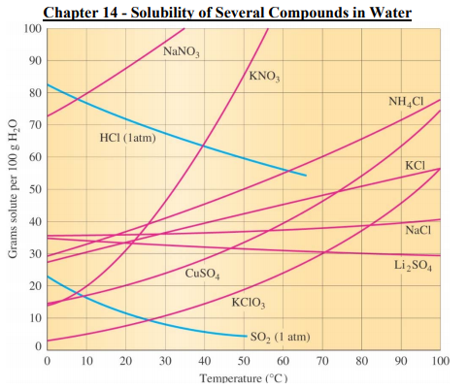
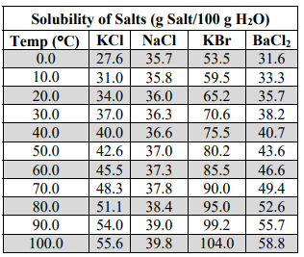
Cheat Sheet

Slide 15
Supersaturated (SS)
[Solute] > Max
ABOVE LINE
Saturated (S)
[Solute] = Max
Equilibrium
ON LINE
Unsaturated (U)
[Solute] < Max
BELOW LINE

Slide 16
Solubility Problems
Ratio’s and Proportions
Example:
What is the solubility of KClO₃ at 40 °C?
Example:
Is 25.0 grams of KClO₃ dissolved in 100 g of H₂O
U/S/SS at 70°C?
Example:
At what temperature(s) would a solution of 10.0 grams of KClO₃ dissolved in 100 g of H₂O be unsaturated?

Slide 17
Solubility Problems
Ratio’s and Proportions
Example:
Is 7.50 grams of KClO₃ dissolved in 35 g of water U/S/SS at 70 °C?
Example:
If you have a saturated solution of KClO₃ at 90 °C how much KClO₃ will precipitate out if the solution is cooled to 10 °C?

Slide 18
2 Factors that Affect Amount Dissolved
4 Factors that Affect Rate of Dissolving
Temperature
Solids generally DP
Gases its IP
Particle Size (IP)
Temperature (DP)
Concentration (IP)
Agitation/Stirring (DP)
vs.
Pressure
Solids Independent
Gases its DP

Slide 19
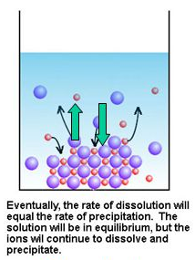
Temperature
Solids in Liquids
Gases in Liquids
Generally DP
Complicated due to IMF’s
More energy = more molecules can dissolve, therefore solubility increases
IP
More energy = more molecules can evaporate, therefore solubility decreases
KE >> IMF
KE << IMF
Dynamic Equilibrium

Slide 20
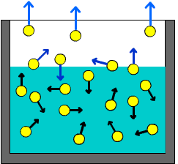
Pressure
Gases in Liquids
Solids in Liquids
Little or no effect
Liquids and Solids are incompressible
Pressure does not effect the equilibrium
DP
Gasses are very compressible
Increased pressure means more energy required to leave solution (break the IMF’s) therefore more gas in solution
↑ P has little effect
↑ P has large effect

Slide 21
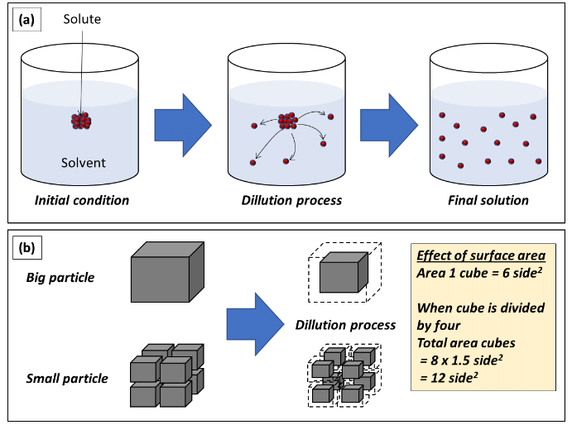
4 Factors that Affect Rate of Dissolving
Particle Size (IP)
Temperature (DP)
Concentration (IP)
Agitation/Stirring (DP)

Slide 22
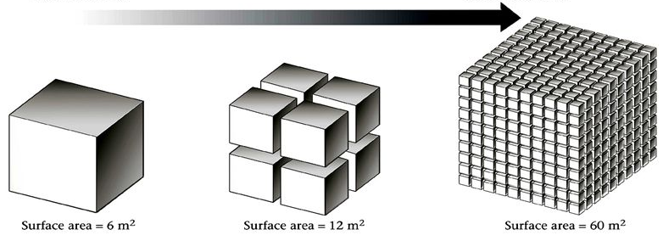
Effect of Particle Size (PS) or Surface Area (SA) on Rate of Dissolving
Rate is IP to Particle Size
Rate is DP to Surface Area
Surface Area is IP to Particle Size
Solute/Solvent must interact for dissolving to occur
More Surface Area = More Interactions

Slide 23
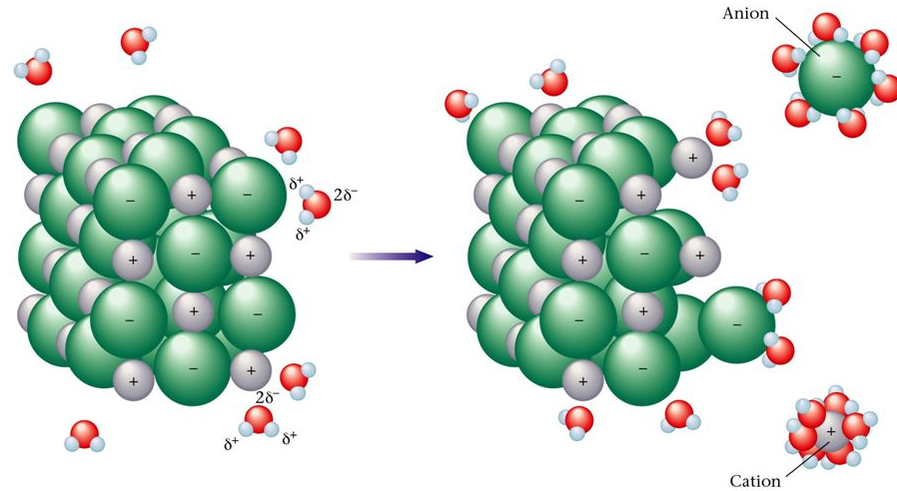
Effect of Temperature on Rate of Dissolving
Solvent molecules have more KE
Hit solid more often
Hit solid harder
Easier to break solute-solute IMF

Slide 24
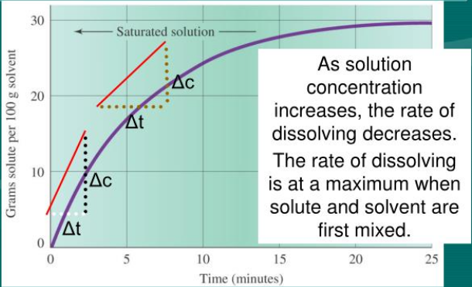
Effect of Concentration on Rate of Dissolving
Rate is IP to Concentration because particles must be near each other to interact/dissolve
Concentration Gradients slow dissolving
Decreased Solute-Solvent interaction

Slide 25
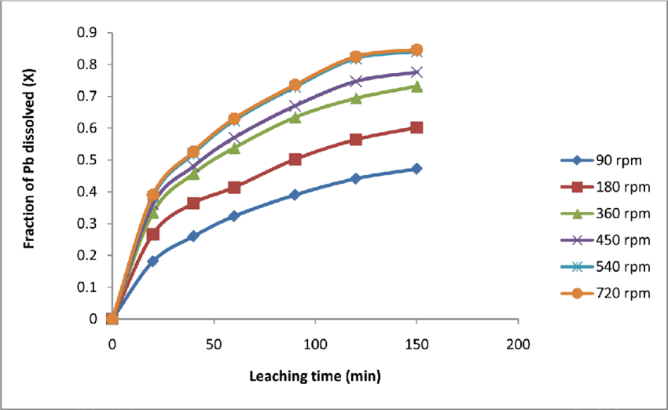
Effect of Agitation/Stirring on Rate of Dissolving
Breaks up Concentration Gradients
Increases Solute-Solvent Interaction
Increases # of collisions
No Stirring
With Stirring

