Slide 1
CHE 101 Fall 2021
Lecture 9 b – Properties of Liquids
Overview/Topics
Evaporation
Vapor Pressure
Boiling Point
Heating Curves
State Changes
Skills to Master
HW 9 b
Read
Chapter 13

Slide 2
Phase Changes
Process by which matter changes from one state to another
Physical Changes therefore IMF are important
Sublimation
Melting
Evaporation
Freezing
Condensation
Deposition
Exothermic
Endothermic
Low Energy
High Energy

Slide 3
Heating Curve

Slide 4
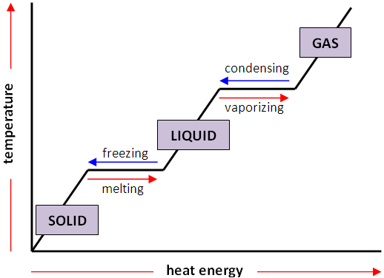
Heating Curve
q = mΔH_{vap}
q = msΔT
Liquid + Gas
q = mΔH_{fus}
q = msΔT
Solid + Liquid
q = msΔT

Slide 5
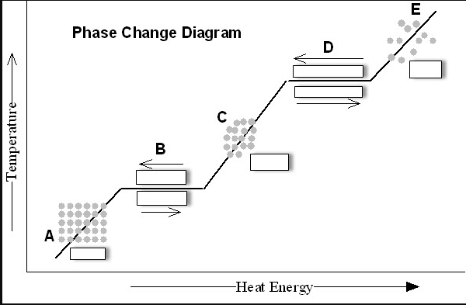
Heating Curve
q = mΔH_{vap}
Liquid + Gas
q = msΔT
q = mΔH_{fus}
Solid + Liquid
q = msΔT
q = msΔT

Slide 6
Heating Curve
2 Different Process’s
$$E∝\frac{q_{1}q_{2}}{r}$$
Heating a Substance
Phase Change
Add Energy
Molecules move faster (↑ KE)
Temperature Increases
Add Energy
Molecules move further apart
IMF is weakened
Temperature Stays Same
q = msΔT
q = mΔH_{vap}
q = mΔH_{fus}

Slide 7
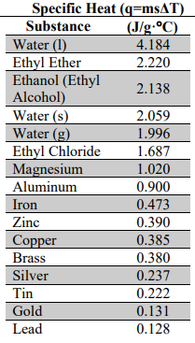
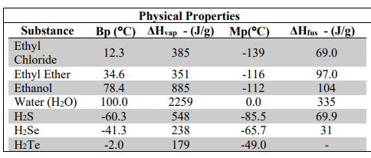
Heating Curve
Mathematics
Values on CS
q = msΔT
Change in energy required to heat a substance (s, l, g)
q = mΔH_{fus}
Change in energy required to melt/freeze a substance
q = mΔH_{vap}
Change in energy required to evaporate/condense a substance
ΔH_{sub} = ΔH_{fus} + ΔH_{vap}

Slide 8
Example:
How much energy does it take to transform 200.0 g of Ice at 0.0°C to Steam at 100°C?

Slide 9
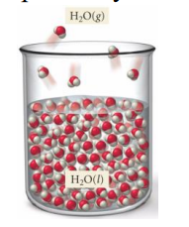
Evaporation
Process of turning a liquid into a gas (below the boiling point)
aka Vaporization
Evaporation: liquid → gas
Rate of Evaporation is DP to Temperature
Rate of Evaporation is IP to IMF
Rate of Evaporation is Independent of the amount of water
KE >> IMF
NOT Equilibrium
KE = IMF
Swamp Coolers

Slide 10
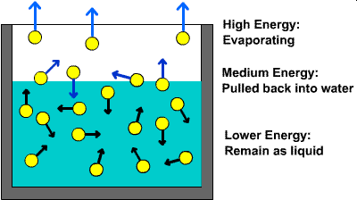
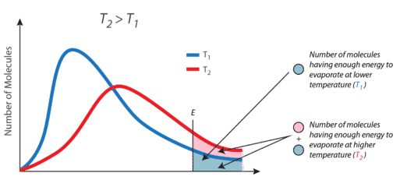
Temperature – KE Relationship
KE >> IMF
KE = IMF
KE << IMF
KE << IMF
KE = IMF
KE >> IMF

Slide 11
Vapor Pressure
The pressure exerted on a liquid by a vapor at equilibrium
(torr, mm Hg, Atm)
VP or P_{v}
Evaporation: liquid → gas
Condensation gas → liquid
Evaporation: liquid → gas
Time
NOT Equilibrium
Dynamic Equilibrium
Rate of Evaporation = Rate Condensation
Amount of Liquid ≠ Amount of Vapor

Slide 12
Dynamic Equilibrium
Dynamic Equilibrium
Dynamic
Equilibrium
constantly evaporating and condensing
rate is equal
Rate of Evaporation = Rate Condensation
Amount of Liquid ≠ Amount of Vapor
Evaporation: liquid → gas
Condensation gas → liquid
We see this again in Ch. 14

Slide 13
Vapor Pressure
Dependent on:
Independent of:
DP to Temperature
IP to IMF’s
Size/Shape of the Container
Amount of Liquid Present

Slide 14
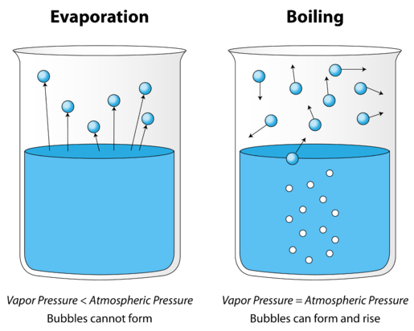
Boiling Point and Vapor Pressure
P_{vap} = P_{atm}
Review Ch. 8
Boiling point occurs when the vapor pressure of a liquid is equal to the external (atmospheric) pressure
Atmospheric Pressure is IP to Elevation

Slide 15
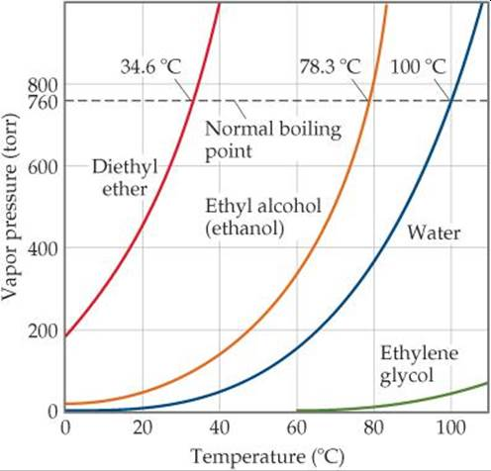
Vapor Pressure
Boiling Point
Intermolecular Forces
Boiling Point is DP IMF
Vapor Pressure is IP IMF
Graphs are Relationships
between Temperature and Vapor Pressure
If you know one you can find the other
Math equation (too complex, just use the graph!)
Similar Graph on CS

Slide 16
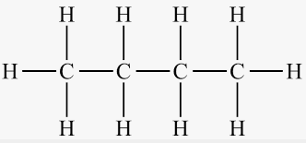
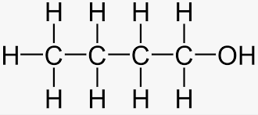
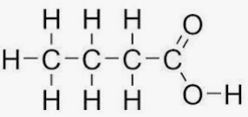
Example
Label all IMF in the following molecules
Order them from Lowest P_{v} to Highest P_{v}
(a)
(b)
(c)
(d)

