Slide 1
CHE 101 Fall 2021
Lecture 9a – Liquids (IMF’s)
Overview/Topics
General properties of liquids
Chemical Bond vs Intermolecular Forces (IMF)
Intermolecular Forces – Dfn, draw examples, identify molecules
LDF
DD
HB
ID
Effect of IMF on Physical Properties
Boiling Point and Melting Point
Viscosity
Surface Tension
Meniscus
Capillary Action
Skills to Master
HW 9 a
Read
Chapter 13

Slide 2
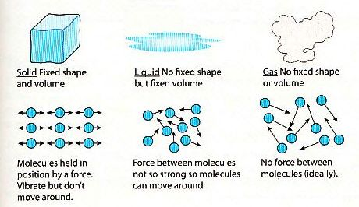
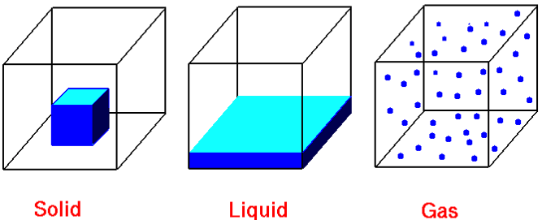
Review Ch. 2
General Properties of Gases
State | Shape | Volume | Particles | Compressibility | IMF/Energy
Solid | Def. | Def. | Ridged, clinging, tightly packed | Very Low | IMF >> Energy
Liquid | Indef. | Def. | Mobile, adhering | Low | IMF ≈ Energy
Gas | Indef. | Indef. | Independent, far apart | High | IMF << Energy

Slide 3
Chemical Bonds
Intermolecular Forces
Attractive force between atoms
Strong
2 Types
Ionic Bond (IB)
Covalent or Molecular
Determine Chemical Properties
Represented by:
Attractive force between molecules
Weak
4 Types
London Dispersion Forces (LDF)
Dipole-Dipole (DD)
Hydrogen Bond (HB)
Ion-Dipole (ID)
Determine *Physical Properties
Represented by:
*melting point, boiling point, vapor pressure, evaporation, viscosity, surface tension, and solubility

Slide 4
London Dispersion Forces (LDF)
aka – Dispersion forces, van Der Waals Forces
Attractive force between non-polar molecules due to temporary instantaneous dipoles
Occurs in all molecules
Weakest IMF
Proportional to size/# electrons/MW
NP molecules generally are symmetrical

Slide 5
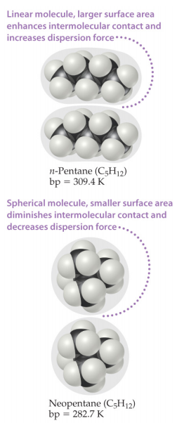
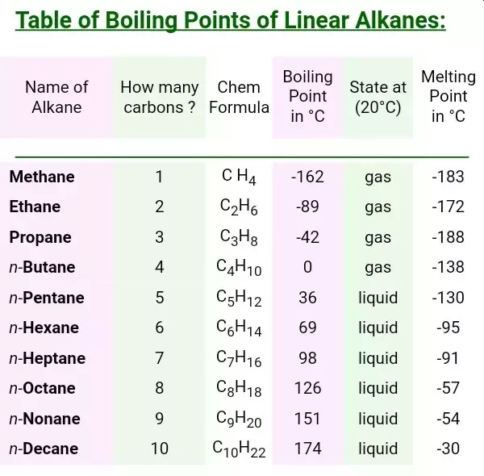
Shape/Size Matters
“Second Semester”
v.s.

Slide 6
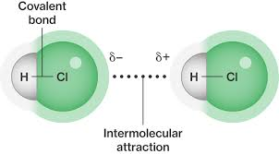
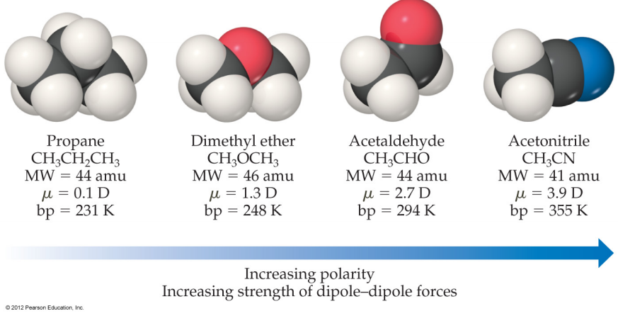
Dipole-Dipole Forces (DD)
Attractive force between polar molecules due to asymmetric distribution of electrons producing partial charges (δ⁺--- δ⁻) that attract two molecules together
Electrostatic Attraction (opposites attract)
2nd Weakest IMF
Proportional to size of the dipole (ΔEN)
DP molecules generally are unsymmetrical

Slide 7
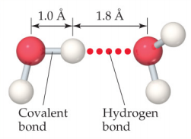
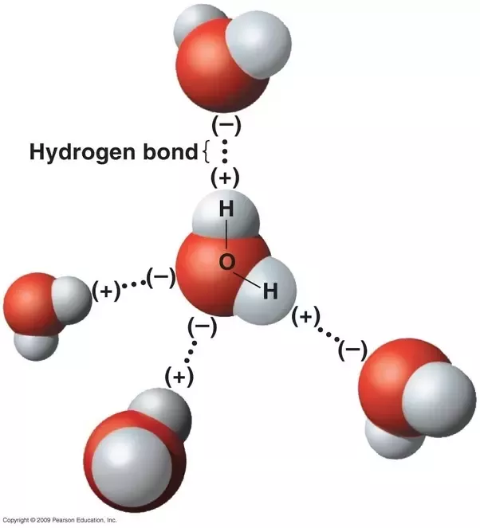
Hydrogen Bond (HB)
Special (stronger) case of DD interactions
H bonded to a small highly electronegative element (O,N,F) is attracted to a lone-pair of electrons or a δ⁻ charge on another molecule.
Hydrogen acts as δ⁺⁺ (stronger than normal partial charge)
Electrostatic Attraction (opposites attract)
2nd Strongest IMF
HB are IMF despite the poor word choice of “Bond”

Slide 8
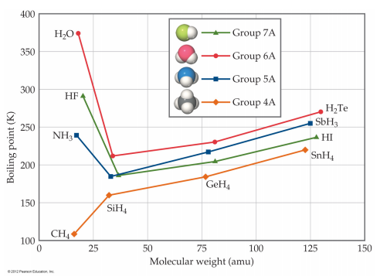
Importance of HB
w/o HB water would boil at -100 °C
Exceptionally large Heat of Fusion and Vaporization
Second Semester
Solubility
DNA structure
Protein Structure

Slide 9
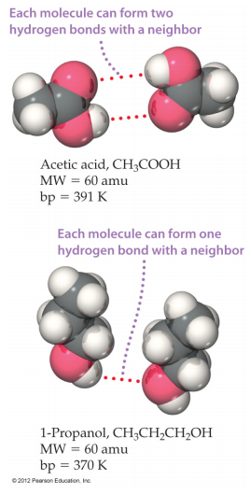
Shape/Size Matters
“Second Semester”
v.s.

Slide 10
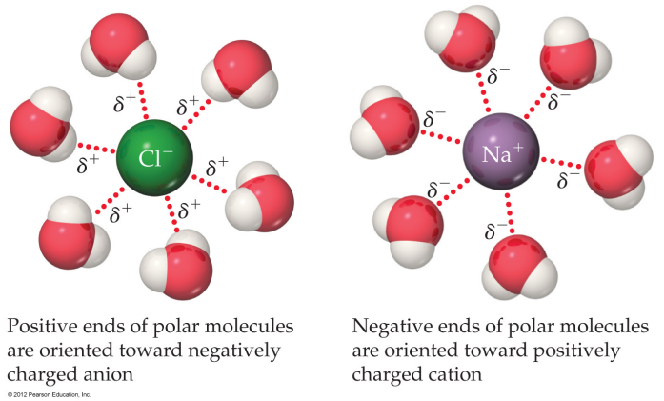
Ion Dipole (ID)
Attractive force between ions (full +/-) charges and a dipolar molecule (δ⁺/δ⁻ )
Electrostatic Attraction (opposites attract)
Strongest IMF
“Solvation Shell or Hydration Shell”

Slide 11
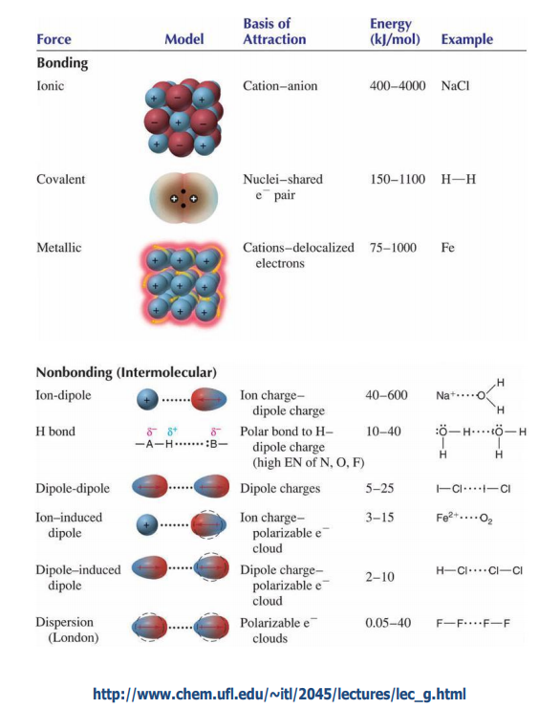
Relative Strength of Different Forces
Don’t memorize value, know relative strengths
Size Dependent

Slide 12
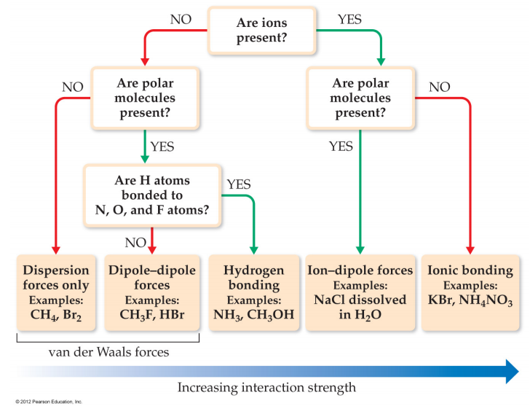
IMF Flowchart

Slide 13
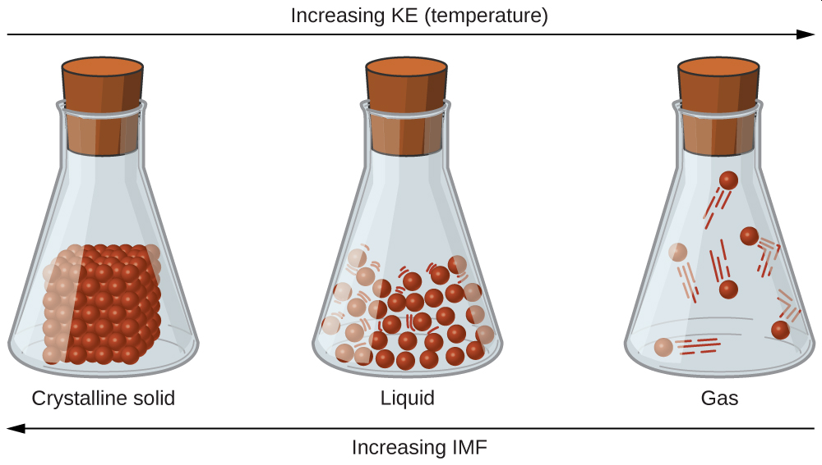
Effect on Physical Properties
Melting Point is Directly Proportional (DP) to IMF
Boiling Point is Directly Proportional (DP) to IMF

Slide 14
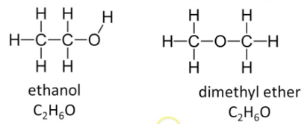
You Try It:
For each molecule indicate what IMF are present:
Which molecule will have the higher boiling point?

Slide 15
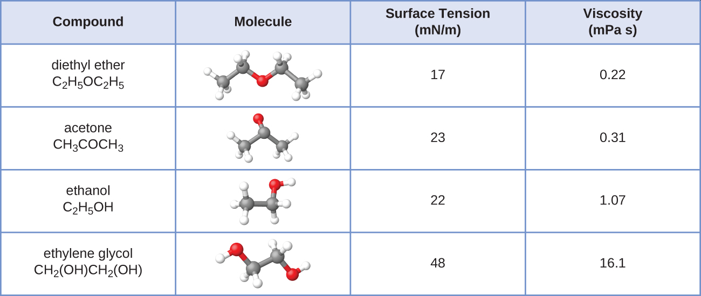
Viscosity
IMF’s
Resistance of a Liquid to Flow
DP to IMF
Size
You Try It:
Diethyl Ether
Acetone
Ethanol
Ethylene Glycol

Slide 16
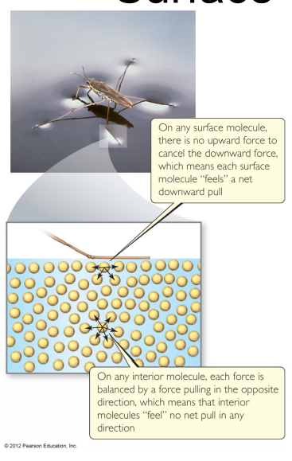
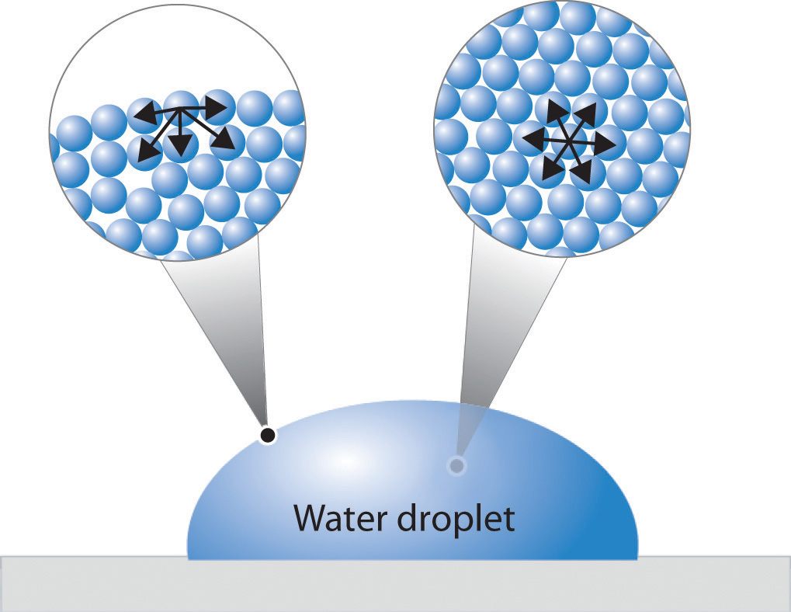
Surface Tension
Resistance of a liquid to an increase in surface area
ST DP IMF
H₂O/H₂O > H₂O/Surface

Slide 17
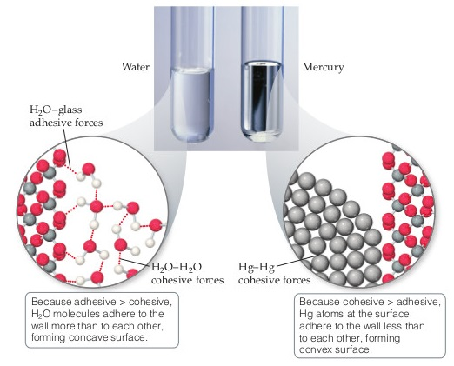
Meniscus
H₂O/H₂O < H₂O/Glass
Cohesive < Adhesive
Hg/Hg > Hg/Glass
Cohesive > Adhesive

Slide 18
You Try It:
For each molecule indicate what IMF are present:
Which molecule will have the higher boiling point?

Slide 19
You Try It:
For each molecule indicate what IMF are present:
Order the molecules from Lowest BP to Highest BP
(a)
(b)
(c)
(d)
(e)

