Slide 1
CHE 101 Fall 2021
Lecture 8b – Gases
Overview/Topics
Ideal Gas Law (PV=nRT)
Solving Problems
Ratio
PV=nRT
g A ↔ mol A ↔ mol B ↔ L B (gas)
Miscellaneous Topics
KM Theory of Gases
Diffusion and Effusion (Graham’s Law)
Daltons Law Partial Pressures
Skills to Master
HW 8 b
Read
Chapter 12

Slide 2
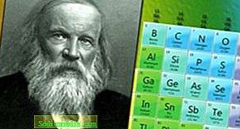
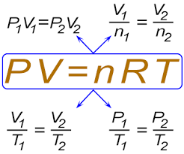
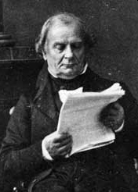
Ideal Gas Law
Combination of all 4 Individual Gas Law
Boyle’s Law (P and V)
Charles's Law (V and T)
Gay-Lussac’s Law or Amonton’s (P and T)
Avogadro's Law (V and n)
Dimitri Mendeleev
(1834-1907)
Benoît Paul Émile Clapeyron
(1799-1864)
Works well for High Temperature/Low Pressure

Slide 3
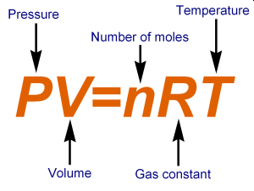
Cheat Sheet!
Ideal Gas Law
Equation Form
Standard Units
R = Gas Constant
P - Pressure (Atm)
V - Volume (L)
T - Temperature (K)
n - Amount (mols)
Standard Temperature and Pressure (STP)
Pressure = 1 Atm
Temperature = 273.15 K (0 °C)
Ratio Form
$$\frac{P_{1}V_{1}}{n_{1}T_{1}}=\frac{P_{2}V_{2}}{n_{2}T_{2}}$$

Slide 4
Ideal Gas Law Problems
3 Types of Problems
Equation Problems
One set of conditions
1 copy of each variable
PV=nRT
Ratio Problems
Two sets of conditions
2 copies of 1 or multiple variables
$$\frac{P_{1}V_{1}}{n_{1}T_{1}}=\frac{P_{2}V_{2}}{n_{2}T_{2}}$$
Stoichiometry Problems (Ch. 6)
Too Big to fit here, see next slide!
Includes a chemical equation (or you can write one)

Slide 5
Stoichiometry Problems (Ch. 6)
Includes a chemical equation (or you can write one)
A + B → C + D
R₁ + R₂ → P₁ + P₂
or
Use Reactants
Make Products
MW
mol/mol
MW
Grams A
Mol A
Mol B
Grams B
PV=NRT
Volume A
(Gas)
Volume B
(Gas)

Slide 6
Equation Problems
One set of conditions
1 copy of each variable
PV=nRT
Example:
A scuba tank is contains 80.0 L of air at 3000. PSI at room temperature of 20.0 °C.
How many mols of air are in the cylinder?

Slide 7
Ratio Problems
Two sets of conditions
2 copies of 1 or multiple variables
$$\frac{P_{1}V_{1}}{n_{1}T_{1}}=\frac{P_{2}V_{2}}{n_{2}T_{2}}$$
Example:
A scuba tank is contains 80.0 L of air at 3000. PSI at room temperature of 20.0 °C. If the scuba cylinder is heated to 100.0 °C what will the pressure in PSI be?

Slide 8
Stoichiometry Problems (Ch. 6)
Includes a chemical equation (or you can write one)
Example:
If you burn 227 g of Ethanol (C₂H₅OH) at 303 K and 1.0 Atm, how many Liters of O₂ gas will be consumed?
___ C₂H₅OH (s) + ___ O₂ (g) → ___ CO₂ (g) + ___ H₂O (g) + Heat

Slide 9
Example:
If in the previous reaction, you produced 2000.0 L of CO₂ (g) and H₂O (g), how many grams of Ethanol (C₂H₅OH) was combusted at 25.0 °C and 12.5 PSI?
___ C₂H₅OH (s) + ___ O₂ (g) → ___ CO₂ (g) + ___ H₂O (g) + Heat

Slide 10
You Try It:
A hot-air balloon at sea level holds 2000. L of air at 20.0 °C. If the balloon flies 1.5 miles high the pressure is 0.75 Atm and the balloons volume expands to 2500. L to keep it aloft. What is the temperature of the air inside the balloon?
270 K
You Try It:
How many grams of ethanol (C₂H₅OH) must be combusted to blow up a 50.0 L balloon at 1.00 atm and 20.0 °C using the following reaction.?
19.1 g C₂H₅OH
_1_ C₂H₅OH (s) + _3_ O₂ (g) → _2_ CO₂ (g) + _3_ H₂O (g) + Heat
You Try It:
A propane tank for your grill holds 250 mols of C₃H₈ gas in at 50.0 L tank at 20.0 °C. What is the pressure inside that tank in PSI?
1800 PSI
You Try It:
Hydrazine (N₂H₄) is used as a rocket fuel. If you burn 500.0 g of Hydrazine, how many Liters of gas will be produced at 700. mm Hg and 50.0 °C?
_1_ N₂H₄ (g) + _3_ O₂ (g) → _2_ NO₂ (g) + _2_ H₂O (g) + Heat
1.80x10³ L

Slide 11
You Try It:
A hot-air balloon at sea level holds 2000. L of air at 20.0 °C. If the balloon flies 1.5 miles high the pressure is 0.75 Atm and the balloons volume expands to 2500. L to keep it aloft. What is the temperature of the air inside the balloon?
270 K

Slide 12
You Try It:
How many grams of ethanol (C₂H₅OH) must be combusted to blow up a 50.0 L balloon at 1.00 atm and 20.0 °C using the following reaction.?
19.1 g C₂H₅OH
_1_ C₂H₅OH (s) + _3_ O₂ (g) → _2_ CO₂ (g) + _3_ H₂O (g) + Heat

Slide 13
You Try It:
A propane tank for your grill holds 250 mols of C₃H₈ gas in at 50.0 L tank at 20.0 °C. What is the pressure inside that tank in PSI?
1800 PSI

Slide 14
You Try It:
Hydrazine (N₂H₄) is used as a rocket fuel. If you burn 500.0 g of Hydrazine, how many Liters of gas will be produced at 700. mm Hg and 50.0 °C?
_1_ N₂H₄ (g) + _3_ O₂ (g) → _2_ NO₂ (g) + _2_ H₂O (g) + Heat
1.80x10³ L

Slide 15
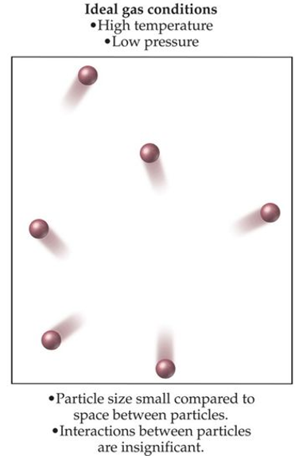
Kinetic-Molecular (KM)
Theory of Gases
“Ideal” Gas Theory
Empty Space
Gases behave like tiny particles
Distance between particles is large (volume is mostly empty space)
No attractive forces between particles
Move in straight lines, collide frequently
Collisions are elastic (no loss of energy)
Kinetic Energy (KE) is same for all gases and α Temperature (K)
No Attractive
Forces
$$KE=\frac{1}{2}mv^{2}$$
Elastic
Collisions
KE (E_{K}) = Kinetic Energy (J)
m = mass (Kg)
v = velocity (m/s)

Slide 16
Empty Space
Crowded
Attractive
Forces
No Attractive
Forces
Elastic
Collisions
Inelastic
Collisions

Slide 17
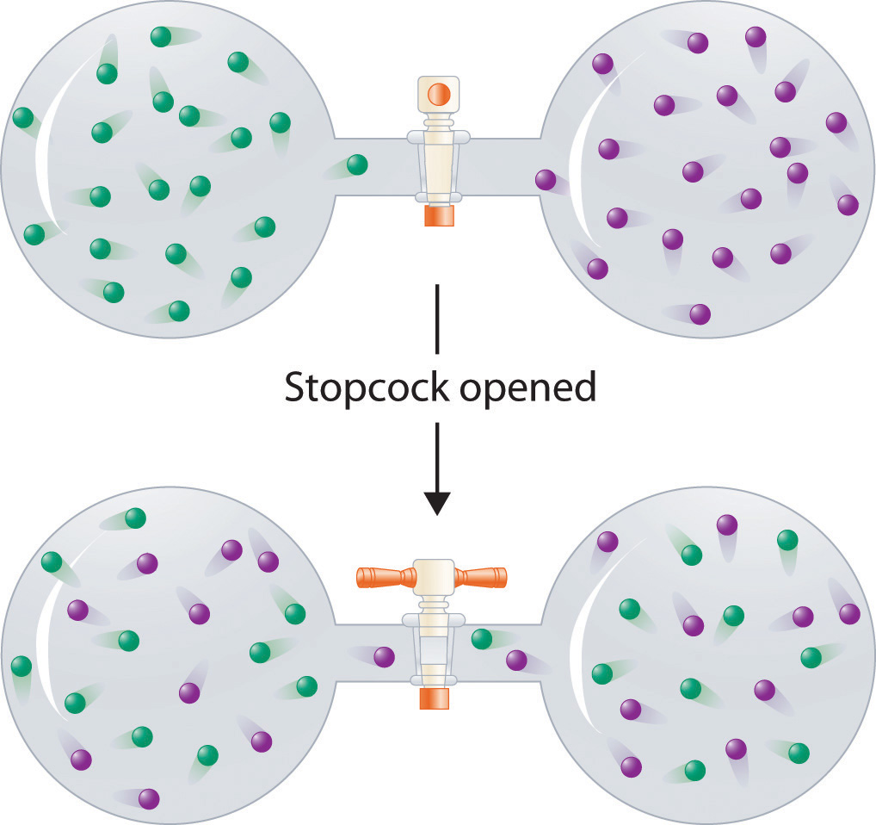
Diffusion
Gases mix spontaneously
Create an uniform mixture
Fill any space

Slide 18
Graham’s Law and Effusion
Gasses will flow (effuse) out a small hole from high pressure to low pressure
$$\frac{rate of effusion A}{rate of effusion B}=\sqrt{\frac{Density B}{Density A}}=\sqrt{\frac{MW B}{MW A}}$$
Rate of Effusion is Inversely Proportional (IP) to Mass
$$Rate ∝\frac{1}{Mass}$$

Slide 19
Dalton’s Law of Partial Pressure
Just Avogadro’s – All gases are the same
The total pressure of a mixture of gases is the sum of the partial pressures exerted by each of the individual gasses in the mixture
P_{total} = P₁ + P₂ + P₃ …
+
=
Example:
O₂ (g) + H₂O (g)

