Slide 1
CHE 101 Fall 2020
Lecture 8a – Gases
Overview/Topics
General properties of g, l, s (review Ch. 1)
Pressure and Pressure units
Four Variables (P, V, n, T)
Four Laws
Boyle’s
Charle’s
Guy-Lussac’s or Amontons’s
Avogadro’s
Directly vs Inversely Proportional (DP vs IP)
Solving Ratio problems
Skills to Master
HW 8 a
Read
Chapter 12

Slide 2
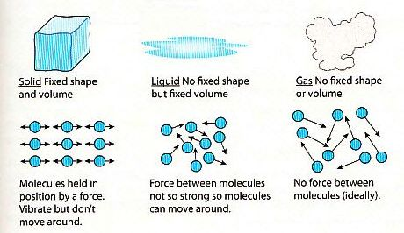
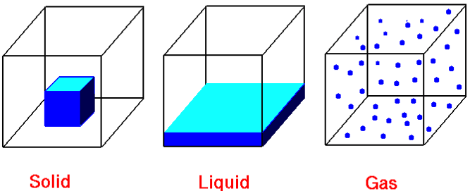
Review Ch. 1
General Properties of Gases
State | Shape | Volume | Particles | Compressibility | IMF/Energy
Solid | Def. | Def. | Ridged, clinging, tightly packed | Very Low | IMF >> Energy
Liquid | Indef. | Def. | Mobile, adhering | Low | IMF ≈ Energy
Gas | Indef. | Indef. | Independent, far apart | High | IMF << Energy

Slide 3
Gas Law’s
4 Variables Describe a Gas
4 Laws to Describe a Gas
P - Pressure (Atm)
V - Volume (mL or L)
T - Temperature (ALWAYS K)
n - Amount (mols)
Boyle’s Law (P and V)
Charles's Law (V and T)
Gay-Lussac’s Law or Amonton’s (P and T)
Avogadro's Law (V and n)
4 Ways to think about Gases
Pictures
Proportionalities (IP or DP)
Equations (Ratio’s)
Graphs (Lab)
K = °C + 273.15

Slide 4
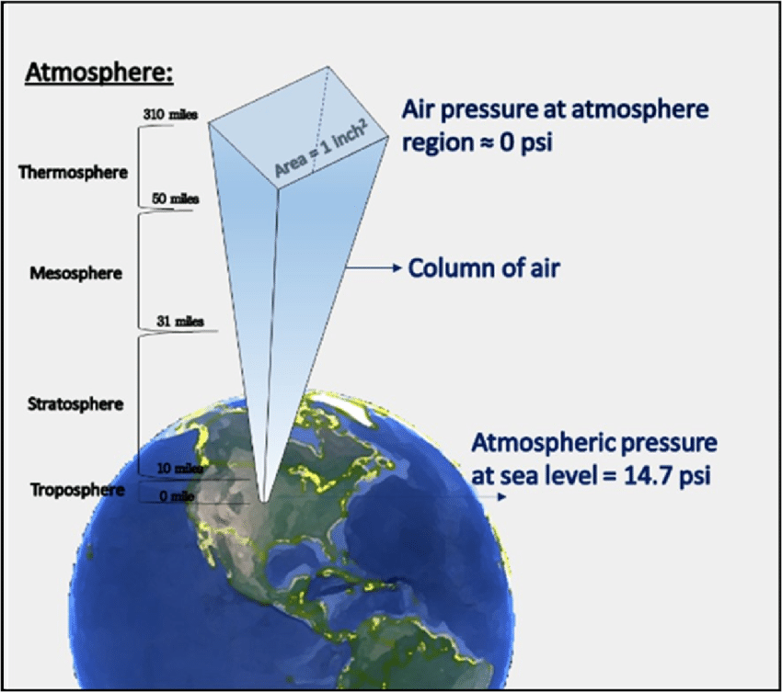
Pressure
P = $\frac{Force}{Area}=$
$$\frac{lb}{{in}^{2}}$$
or PSI
or
1 Atmosphere (Atm)
Pressure resulting from the force of the gas molecules in the atmosphere pushing downwards
Pressure resulting from the collision of gas molecules with the walls of the balloon.

Slide 5
Measuring Pressure
“Barometers”
E. Torricelli
Italian Physicist
(1643)
760 mm Hg
760 torr
Pressure Units (on CS)
(all values are equal)
1 Atm
760 mmHg
760 torr
101,325 Pa
14.7 lb/in² (PSI)
1013 mbar

Slide 6
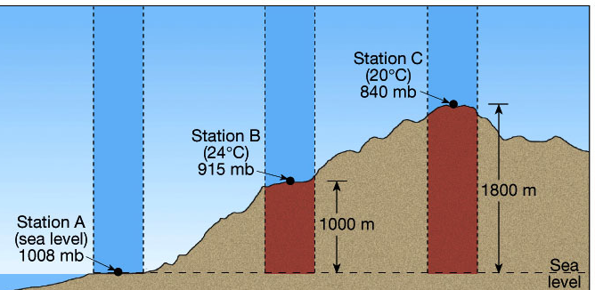
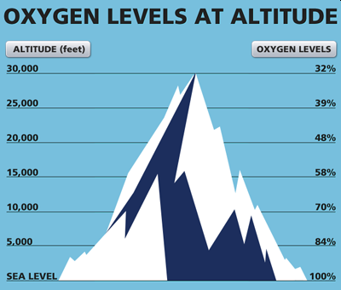
Pressure varies with Altitude
Altitude | P (Atm) | P (mm Hg)
Sea Level | 1.0 | 760
Rangely (5,280 ft.) | 0.83 | 629
14,000 ft. | 0.61 | 462
Mt Everest (29,000 ft.) | 0.36 | 277
Pressure is Inversely Proportional (IP) to Altitude
$$P∝\frac{1}{Alt}$$
Chapter 13 – Will examine Altitude and Boiling Points

Slide 7
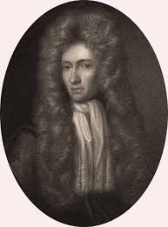
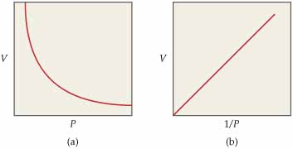
Boyle’s Law
(1627-1691)
Relationship between P and V
Temperature and Amount = Constant
$$V∝\frac{1}{P}$$
Pressure and Volume are
Inversely Proportional (IP)
P₁V₁ = P₂V₂
Balloon’s and Pistons

Slide 8
Example:
A balloon at sea level (1 Atm) has a volume of 1.0 L is transported to Denver (0.83 Atm).
Will the volume (I)ncrease or (D)ecrease?
What will the final volume of the balloon be?

Slide 9
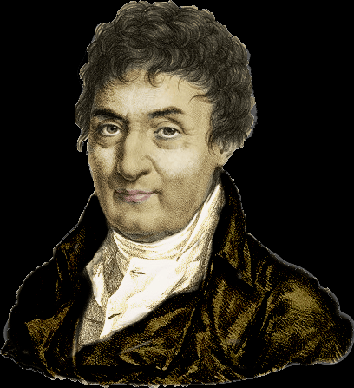
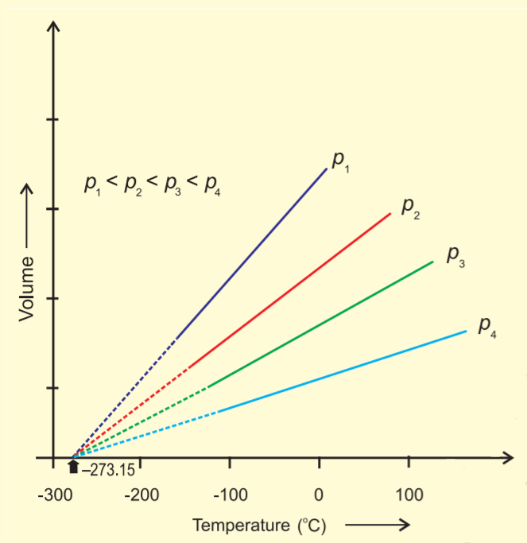
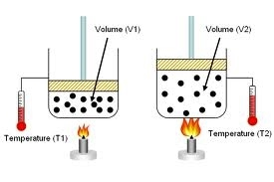
K = °C + 273.15
Charles’s Law
(1764-1823)
Relationship between T and V
Pressure and Amount = Constant
$$V∝T$$
Volume and Temperature are
Directly Proportional (DP)
$$\frac{V_{1}}{T_{1}}=\frac{V_{2}}{T_{2}}$$
Balloon’s and Pistons

Slide 10
K = °C + 273.15
Example:
A hot air balloon contains 100.0 L of air at 20.0 °C, if the air is heated to 100.0 °C
Will the volume (I)ncrease or (D)ecrease?
What will the final volume of the balloon be?
20.0 °C = 293.15 K
100.0 °C = 373.15 K

Slide 11
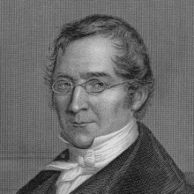
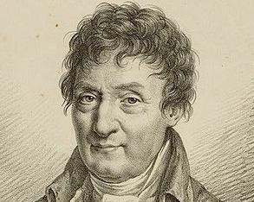
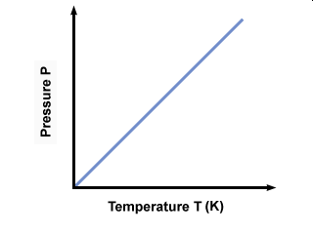
Joseph Louis Gay-Lussac
(1778-1850)
Guillaume Amontons
(1663-1705)
Relationship between P and T
Volume and Amount = Constant
$$P∝T$$
Pressure and Temperature are
Directly Proportional (DP)
$$\frac{P_{1}}{T_{1}}=\frac{P_{2}}{T_{2}}$$
Sealed Containers

Slide 12
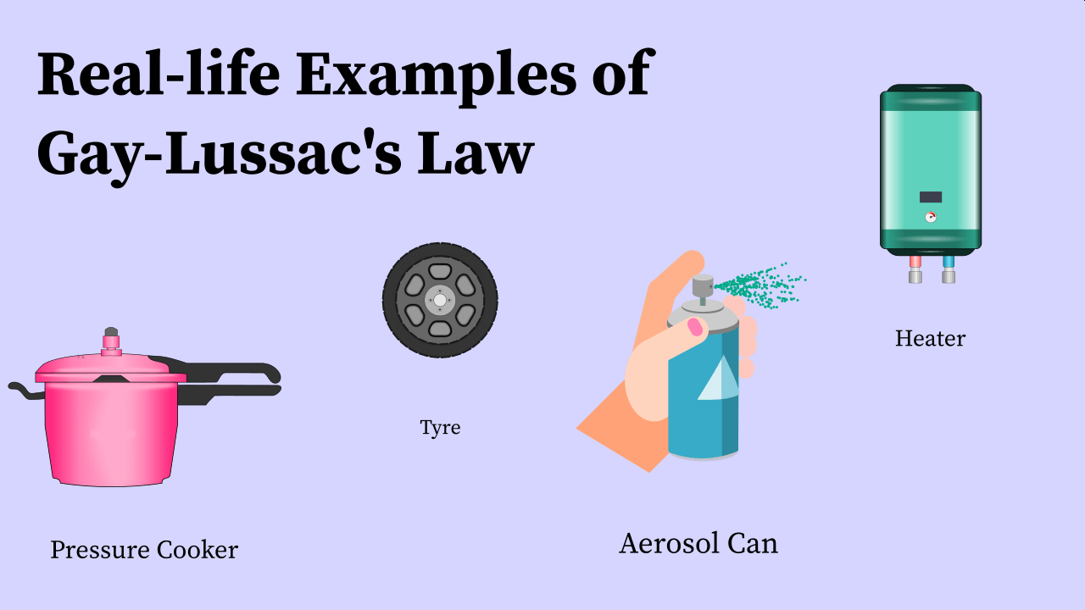
Example:
A pressure cooker starts out at 0.83 Atm at 20.0 °C is then pressurized to 2.00 Atm
Will the Temperature inside (I)ncrease or (D)ecrease?
What will be the final temperature in the pressure cooker?
20.0 °C = 293.15 K
= 68 °F

Slide 13
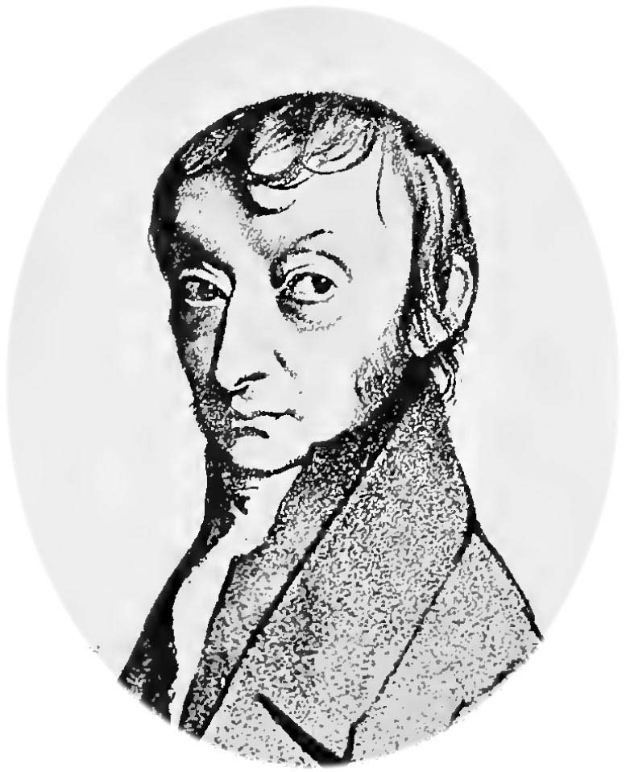
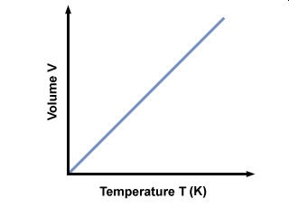
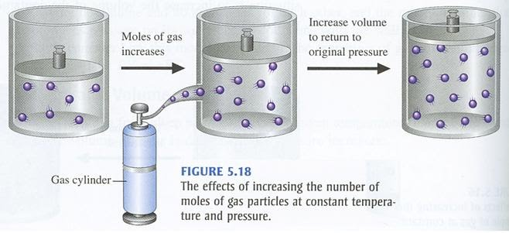
Amedo Avogadro
(1776-1856)
Relationship between V and n
Pressure and Temp = Constant
$$V∝n$$
Volume and Amount are
Directly Proportional (DP)
$$\frac{V_{1}}{n_{1}}=\frac{V_{2}}{n_{2}}$$
Balloons and Pistons

Slide 14
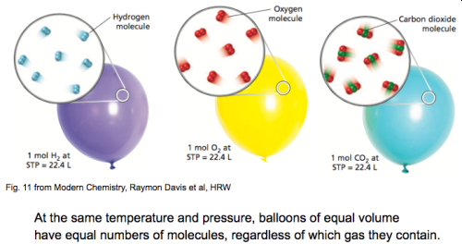
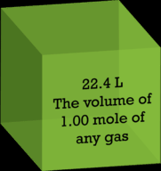
Avagadro’s Law
Part II
1 mol of
any gas
= 22.4 Liters

Slide 15
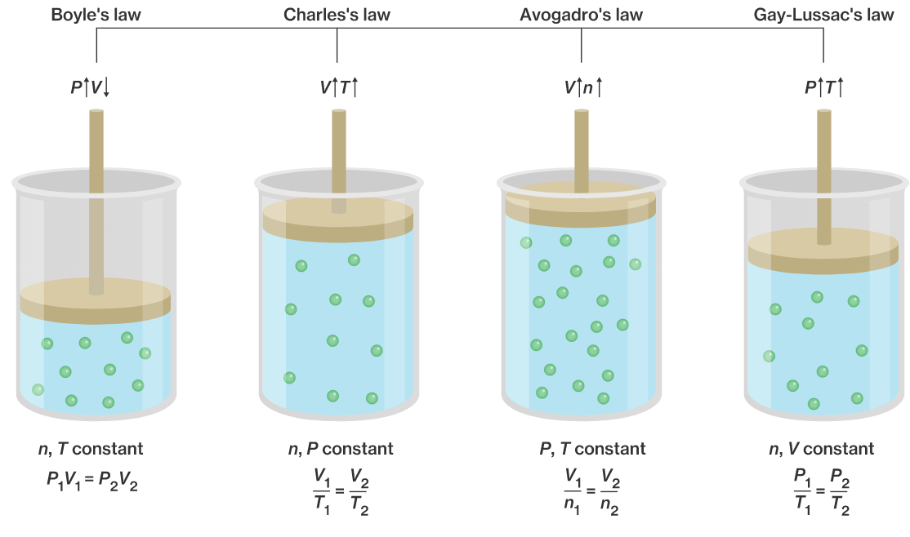
Gas Law Summary
4 Laws to Describe a Gas
Boyle’s Law (P and V)
Charles's Law (V and T)
Gay-Lussac’s Law or Amonton’s (P and T)
Avogadro's Law (V and n)
IP
DP
DP
DP

Slide 16
Temperature is
ALWAYS in K
You Try It:
For some odd reason you wish to increase the volume of gas in a balloon from 500.0 L at 25.0 °C to 750.0 L.
Who’s law is should you use?
Should you (I)ncrease or (D)ecrease the Temperature?
What will be the final temperature in °C?
25.0 °C = 298.15 K
You Try It:
A balloon at sea level (1 Atm) has a volume of 5.0 L is transported by a scuba diver to deep below the ocean where the pressure is 1500. mm Hg.
Who’s law is should you use?
Will the volume (I)ncrease or (D)ecrease?
What will the final volume of the balloon be?
You Try It:
A piston contains 2.5 mols of N₂ gas at a volume of 3.0 L. If 6.0 mols of F₂ gas is added at constant pressure
Who’s law is should you use?
Will the volume (I)ncrease or (D)ecrease?
What will the final volume of the piston be?
Units must match

Slide 17
You Try It:
For some odd reason you wish to increase the volume of gas in a balloon from 500.0 L at 25.0 °C to 750.0 L by changing the temperature.
Who’s law is should you use?
Should you (I)ncrease or (D)ecrease the Temperature?
What will be the final temperature in °C?
25.0 °C = 298.15 K
Charles Law
Increase b/c they are DP therefore ↑V = ↑ T
174 °C

Slide 18
You Try It:
A balloon at sea level (1 Atm) has a volume of 5.0 L is transported by a scuba diver to deep below the ocean where the pressure is 1500. mm Hg.
Who’s law is should you use?
Will the volume (I)ncrease or (D)ecrease?
What will the final volume of the balloon be?
Boyles Law
Decrease b/c they are IP therefore ↑P = ↓ V
2.5 L

Slide 19
You Try It:
A piston contains 2.5 mols of N₂ gas at a volume of 3.0 L. If 6.0 mols of F₂ gas is added at constant pressure
Who’s law is should you use?
Will the volume (I)ncrease or (D)ecrease?
What will the final volume of the piston be?
Avagadro Law
Increase b/c they are DP therefore ↑n = ↑ V
10. L

