Slide 1
CHE 101 Fall 2021
Lecture 7f – Misc + Periodic Trends
Overview/Topics
Periodic Trends – memorize and explain
Size of atoms
Ionization Energy
Size of Cations and Anions
Skills to Master
HW 7f
Read
Chapter 11.1

Slide 2
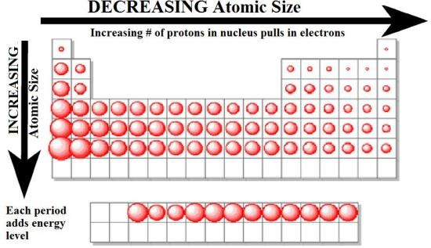
Atomic Size
Columns: Atoms get bigger as you go down a column
Principle QN (n)/size of orbital increases

Slide 3
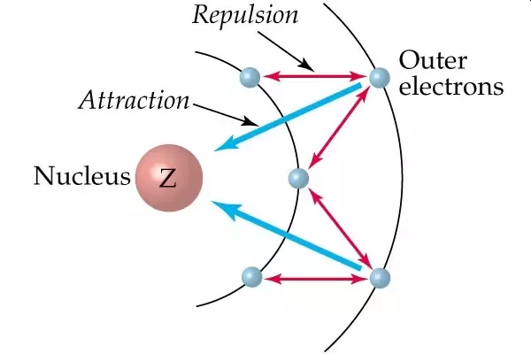
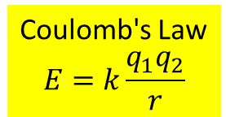
Atomic Size
Rows: Atoms get smaller as you go across a row
Same orbital ↑ protons ↑ attractions ∴ ↓ size
faster than ↑ electrons ↑ repulsions ∴ ↑ size
Z_{eff} = Z_{actual} - ES
Coulomb's Law
$$E=k\frac{q_{1}q_{2}}{r}$$

Slide 4
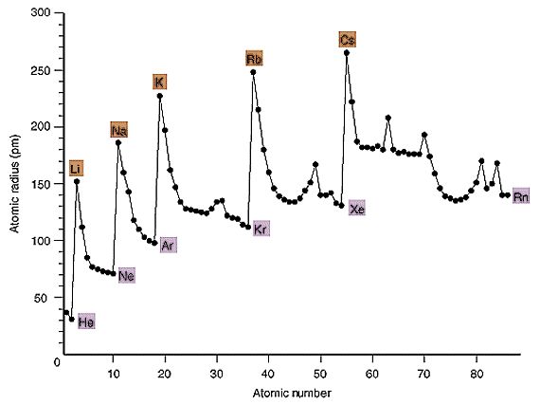
Atomic Size
Bigger Down a Column
Smaller across a row

Slide 5
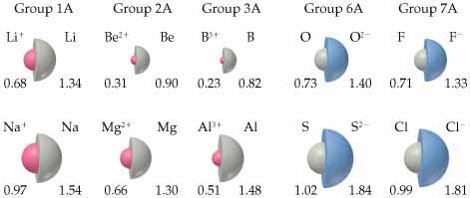
Cations and Anions
Cations get smaller
protons > electrons
Attractions > repulsions (Z_{eff} Increases)
Anions get BIGGER
protons < electrons
Attractions < repulsions (ES increases)

Slide 6
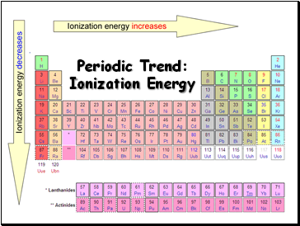
Ionization Energy (IE or E_{IE})
Process by which and electron is removed from an atom in the gas state
Na (g) + Ionization Energy → Na⁺ (g) + e⁻¹
Closer an electron is to the nucleus the greater the attractive force therefore greater E_{IE}
IE is always endothermic/+ because it takes energy to remove an electron from an atom due to the attractive forces between the protons in the nucleus and the electrons (opposites attract)
Opposite trend as size
Coulomb's Law
$$E=k\frac{q_{1}q_{2}}{r}$$
Across a row: Size ↓ Ionization Energy ↑
Down a column: Size ↑ Ionization Energy ↓

Slide 7
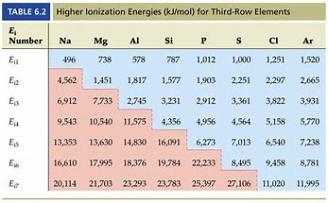
Ionization Energy (IE or E_{IE})
Can have multiple Ionization Energies if removing more than one electron
Noble Gases are very stable (full orbitals octets)
Extra large amount of energy to remove an e⁻ from a noble gas
Also e⁻ 1 orbital closer
Mg (g) + IE₁ → Mg⁺¹ (g) + e⁻¹
Mg⁺¹ (g) + IE₂→ Mg⁺² (g) + e⁻¹

Slide 8
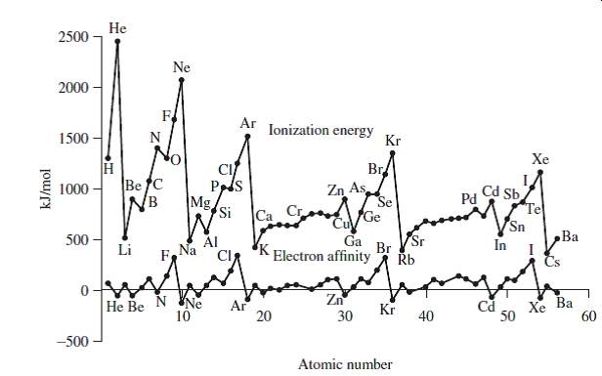
Increases across a row

