Slide 1
CHE 101 Fall 2021
Lecture 7e
Advance Lewis Structures
Overview/Topics
Lewis Structures
VSPER – Valence Shell Electron Pair Repulsion Theory
Shapes and Bond Angles of Molecules (6)
Polar vs Nonpolar Molecules
Skills to Master
Homework 7e
Use of Molecular Model Kits
Lab – Lewis Structures
Read
Chapter 11

Slide 2
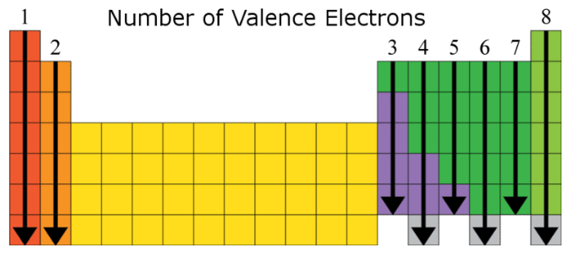
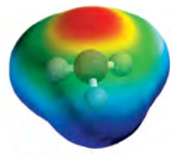
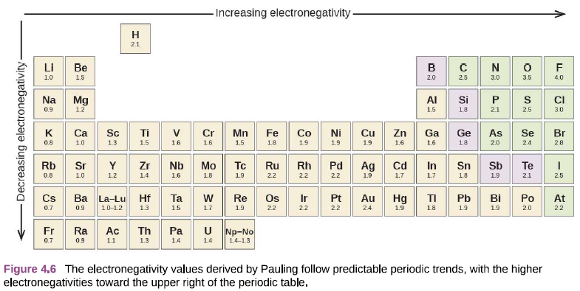
Review

Slide 4
6-10 Step Program for Drawing LS
Determine number of valence electrons
Cation – subtract one
Anions – add on
Draw a Trial Structure (1 bond only)
Least EN E in middle
Symmetrical
H + Halogens never in middle
Rarely (never) make O-O bonds
C – loves to make C-C bonds
Distribute remaining electrons as lone pairs to complete octets
Most EN E first
Outside to inside
If incomplete octets exist – share more
Outside to inside
If it doesn't work start over!
Determine Shape/Bond angle
Determine Polar or Nonpolar (Dipolar)

Slide 5
Example: CH₄

Slide 6
Example: SO₂

Slide 7
Example: CH₂ClCOO⁻¹

Slide 8
More Practice !
Examples in Book
Lab 11
Handout on chemhaven.org/che101
Flash cards on chemhaven.org/che101

Slide 9
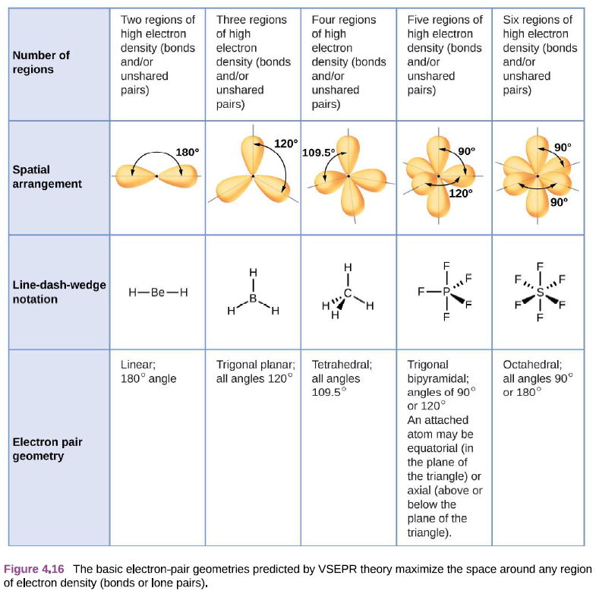
Molecular Structure
(VSEPR Theory)
VSPER – Valence Shell Electron Pair Repulsion Theory
Predicts molecular structure (shapes and bond angles) around a central atom
Lone pairs of e⁻ want to be as far apart as possible
Other things can effect shape/angle but for CHE 111 its good enough!
5 Main Shapes
3 obey octet rule
2 violate octet rule
Coulomb's Law
(again)

Slide 10
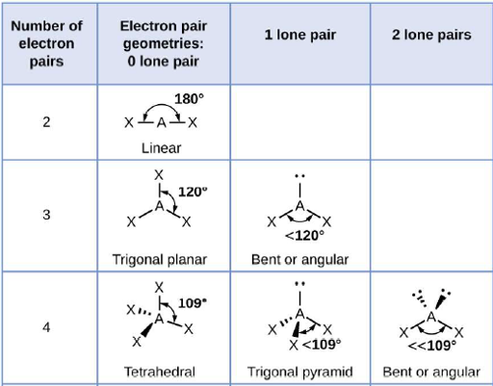
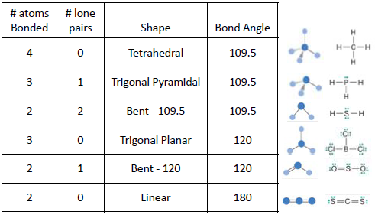
Molecular Shape and Bond Angles
(VSEPR Theory)
# atoms
Bonded
# lone
pair e⁻

Slide 11
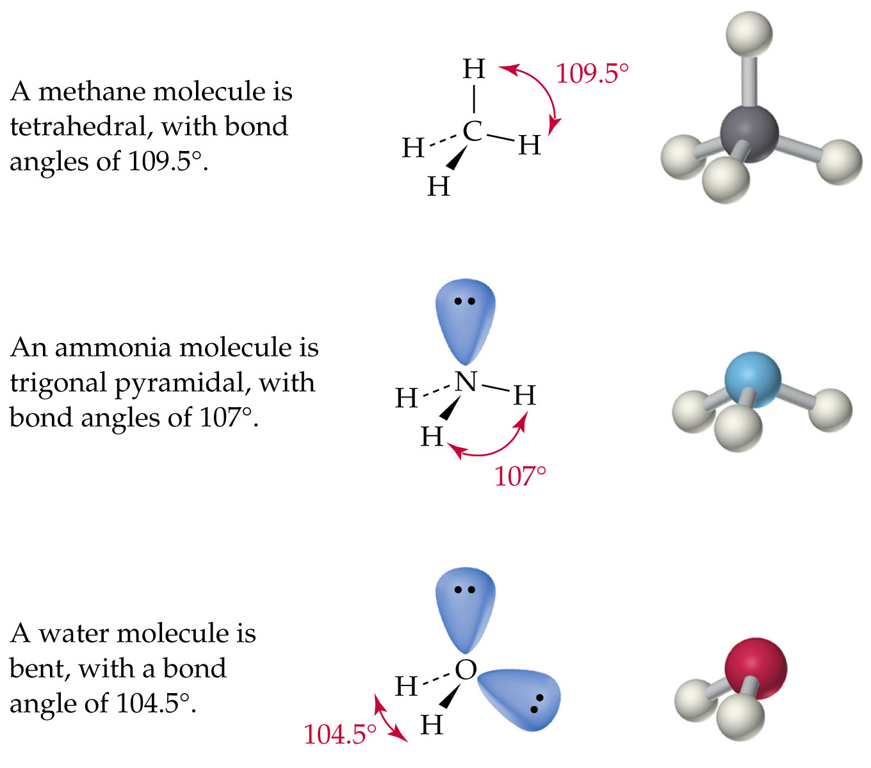
Four Charge Clouds
Tetrahedral
109.5°
(4,0)
Trigonal Pyramidal
109.5°
(3,1)
Bent – 109.5°
109.5°
(2,2)

Slide 12
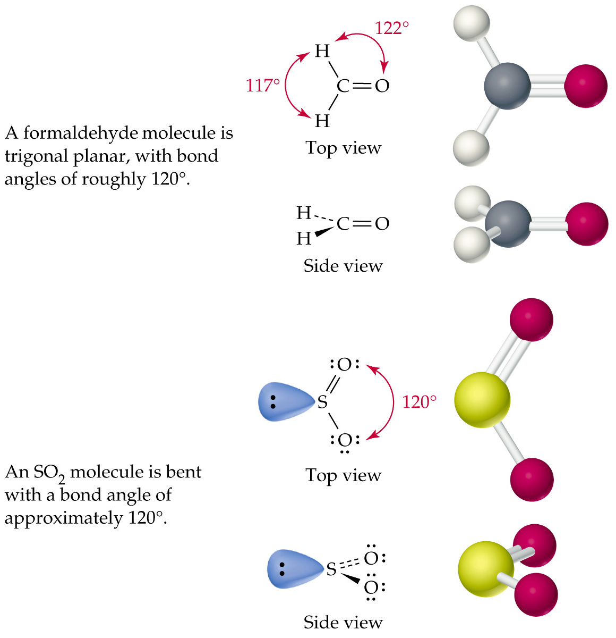
Three Charge Clouds
Trigonal Planar
120°
(3,0)
Bent - 120°
120°
(2,1)

Slide 13
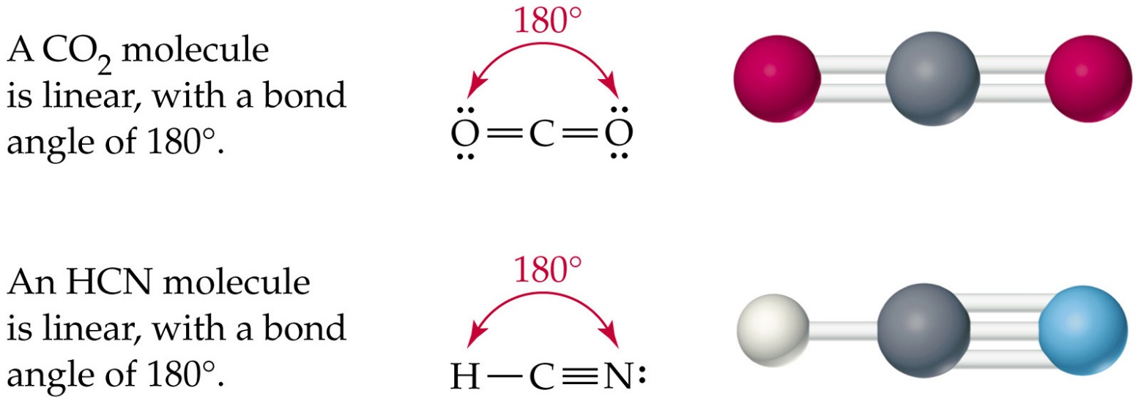
Two Charge Clouds
Linear
180°
(2,0)

Slide 14
Bond Polarity
Polar Covalent (PC) Bonds
Share e⁻ unequally
Bond Dipole Moment (μ)
Vector = magnitude + direction
EN > 0.5

Slide 15
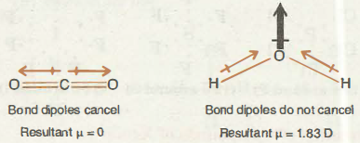
Molecular Polarity
Two Factors
ΔEN > 0.5 (ie PC Bond)
Shape (do vectors cancel)
Nonpolar (NP) Molecule
Dipolar (DP) Molecule
Symmetrical distribution of charge or e⁻
ΔEN = 0 (<0.5)
Vectors Cancel
Unsymmetrical distribution of charge or e⁻
ΔEN > 0 (0.5-1.8)
Vectors DO NOT Cancel

Slide 16
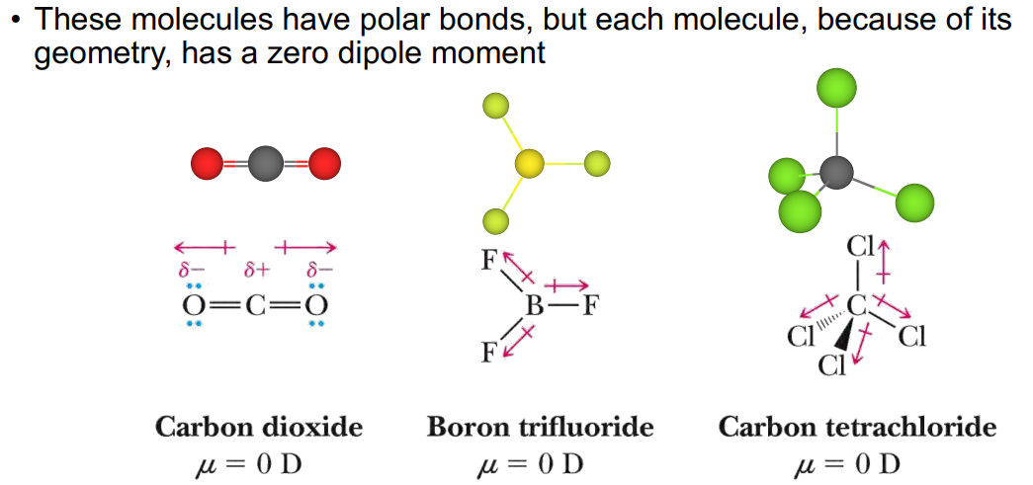
Examples: Nonpolar (NP) Molecule

Slide 17
Examples: Dipolar (DP) Molecule

Slide 18
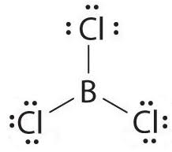
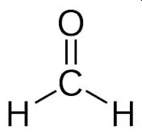
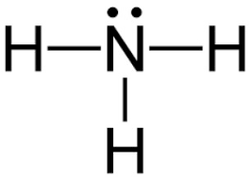
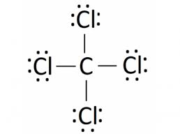
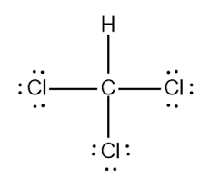
*Note: Violates Octet Rule
You Try It!
Molecule | NP or DP
HCl
BCl₃
CH₂O
NH₃
CCl₄
CHCl₃

Slide 19
Answers

Slide 20
Add a column NP/DP
Nonpolar or Dipolar?
General Rule –
Symmetrical shapes can be either NP or DP
Shapes with LP’s are always DP

Slide 21
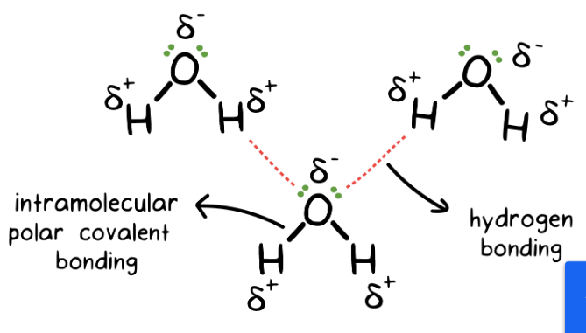
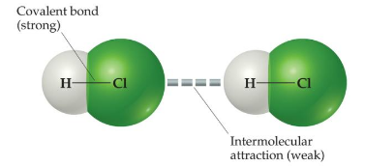
Properties of Polar Molecules
Polar Molecules behave like Magnets
Intermolecular Force (IMF)
Dipole-Dipole (DD) and Hydrogen Bond (HD)
Responsible for Physical Properties
Soluble in Water
Higher Mp and Bp
Lots more next week and 2nd Semester!

