Slide 1
CHE 101 Fall 2021
Lecture 7d– Lewis Structures Basics
Overview/Topics
GOAL = Understand where e⁻ are and how it effects chemical bonding (ionic and molecular)
Lewis Structure Basics
Formation of Cations, Anions and Ionic Bonds
Formation of Molecular Bonds
Covalent Bonds
Polar Covalent Bonds
Electronegativity
Label Molecules NPC/PC
Label δ⁺ δ⁻
Skills to Master
HW 7d
Read
Chapter 11

Slide 2
Review
Valence Electrons
Electrons in the highest energy levels (s and p electrons)
Outer most electrons in an element responsible for chemical reactions
Loss, gain or sharing of valence electrons are responsible for formation of chemical bonds
Octet Rule
Na: 1s²2s²2p⁶3s¹
1 Valence electron
s¹
s²
p¹
p²
etc

Slide 3
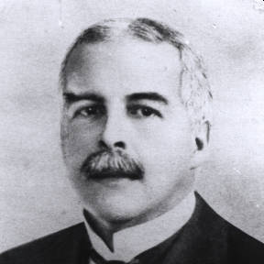
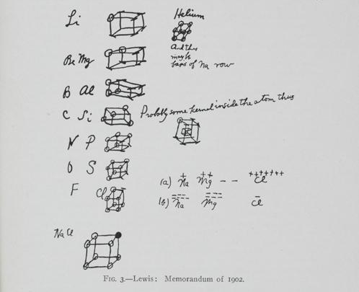
Invented Lewis Structures before QM fully discovered!
Lewis Symbols
Gilbert Newton Lewis
(1875-1946)
Developed Rules for Covalent Bonding
Acid/Base Chemistry
1902 – Chemistry Lecture
1916 – Paper
Nominated 41 times for Nobel Prize (never won)
https://en.wikipedia.org/wiki/Gilbert_N._Lewis
https://www.sciencehistory.org/historical-profile/gilbert-newton-lewis

Slide 4
Lewis Symbols
Lone Electron
Graphical representation of the valence electrons an element has
Shorthand for Electron Configurations
Lone “pair” Electrons
-
Shared Electrons (Covalent Bond)
[ ]
Ions
Li: 1s²2s¹ = 1 valence e⁻ =
You try it: Nitrogen
You try it: O⁻²

Slide 5
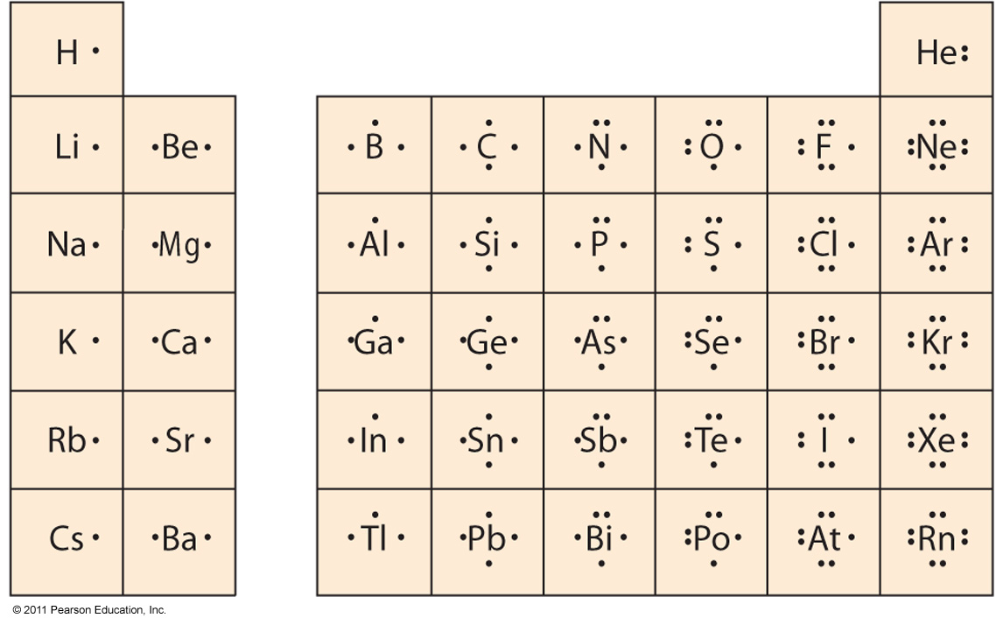
Lewis Symbols
This table is a bit of overkill because…….

Slide 6
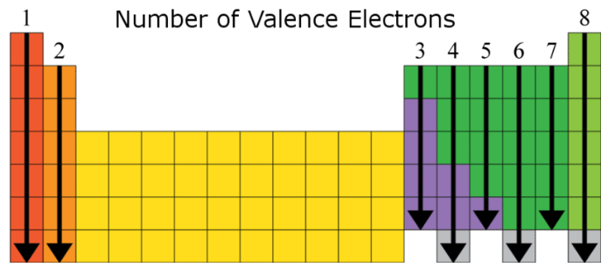
Octet Rule
Lewis noted that Noble Gases are unreactive
Lewis stated if positions on PT added to 8 a compound was formed
We know the “real” reason from QM
Elements with completely filled s and p orbitals are stable (s²p⁶)
8 electrons (octet) are stable
Exceptions to Octet Rule – H and He
Row 1 – Alkali Metal + Row 7 – Halogens = 8 (octet!)
s¹ + s²p⁵ = s²p⁶
NaF KF
NaCl KCl
NaBr KBr
1 + 7 = 8
Row 2 – Alkali Earth Metals + Row 6 – Chalcogens = 8 (octet!)
MgO CaO
MgS CaS
MgSe CaSe
s² + s²p⁴ = s²p⁶
2 + 6 = 8

Slide 7
Common Charges
QM predicts
Use your CS
Formation of Cations
Na
[Na]⁺
+
1s²2s²2p⁶3s¹
1s²2s²2p⁶
Formation of Anion
[
⁻¹
Cl
+
Cl
]
1s²2s²2p⁶3s²3p⁵
1s²2s²2p⁶3s²3p⁶

Slide 8
Ionic Compounds
Review Ch 3 and 6
Electrostatic attraction between cations and anions (opposites attract, Coulombs Law)
Form between metals (cations) and nonmetals (anions)
Gain or lose electrons to achieve an octet
Strong Attractive Force - Coulombs Law
High Melting and Boiling Points
Highly soluble in water
Conduct Electricity
Tend to form lattice structures
Silvery Metal
Very Combustible
Yellow-Green Gas
Very Toxic!
Clear/White Crystals
Very Tasty
[
⁻¹
Na
[Na]⁺
Cl
]
+
Cl
1s²2s²2p⁶3s¹
1s²2s²2p⁶3s²3p⁵
1s²2s²2p⁶
1s²2s²2p⁶3s²3p⁶
Sodium loses one electron, to chlorine to complete both octets, the resulting cation and anion form an ionic bond because opposite attract

Slide 9
Formation of Ionic Bonds
Cation + Anion
metal/nonmetal (m/nm)
Lose or gain electrons to reach an octet (8)
Electrostatic Attraction
Magnesium + Fluorine Magnesium Fluoride
+
MgF₂
Mg
2 F
+
1s²2s²2p⁶
1s²2s²2p⁶3s²
1s²2s²2p⁵
1s²2s²2p⁶
1s²2s²2p⁵
[ ]⁻¹
F
Mg
+
F
F
[Mg]⁺²
[ ]⁻¹
F
Magnesium loses two electrons, one to each fluorine to complete all three octets, the resulting cation and anion form an ionic bond because opposite attract

Slide 10
You try it: Mg + P →

Slide 11
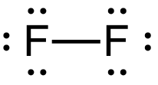
Ionic Bonds vs Molecular Bonds
Sometimes it is not possible to complete octets by gaining or losing e⁻
Sharing is the next best option
Example: F₂ = well known diatomic
Ionic Bond ≠ work
can’t gain/lose e-
[ ]
⁺¹
⁻¹
F
+
F
F
[ ]
F
1s²2s²2p⁵
1s²2s²2p⁵
1s²2s²2p⁴
1s²2s²2p⁶
Sharing e⁻ works better than nothing
Example: Lets try sharing now!
F
+
F
1s²2s²2p⁵
1s²2s²2p⁵
1s²2s²2p⁵⁺¹
1s²2s²2p⁵⁺¹

Slide 12
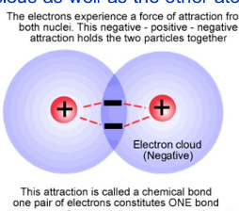
Covalent/Molecular Compounds
Form when gain/losing not possible therefore the share electrons
Form between nonmetals (nm) and nonmetals (nm)
Weak Attractive Force – (not full +/- charges)
Low Melting and Boiling Points
Solubility varies (Low)
Do Not Conduct Electricity
Tend to form discrete molecules
Coulombs Law – leads to lowering of energy

Slide 13
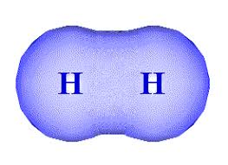
Another Example
-
H
+
H
H
H
1s¹
1s¹
1s¹⁺¹
1s¹⁺¹
Lewis Dot Structures use solid line to indicate shared electrons

Slide 14
You try it: O + O →
You try it: N + N →

Slide 15
Sharing is not always Equal
Non-Polar Covalent Bonds
Polar Covalent Bonds
Share e⁻ unequally
between different elements
Share e⁻ equally
between same Elements

Slide 16
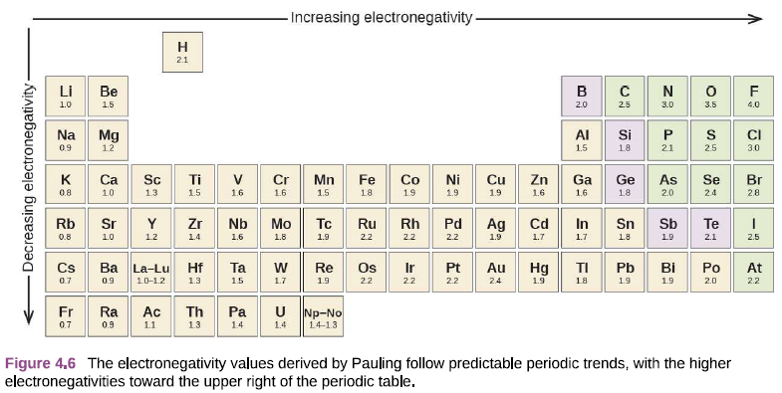
Electronegativity (EN)
Measure of the tendency of an atom to attract the electrons (electron density) in a covalent bond
Lowest = 0.7 (Fr)
Highest = 4.0 (F)
Assign δ⁺ to the least EN element
Assign δ⁻ to the most EN element

Slide 17
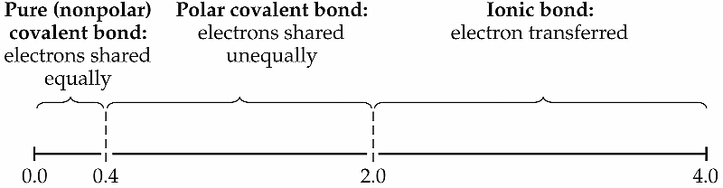
Using EN to Determine Bond Type
$∆EN=|{EN}_{Cation }−{EN}_{Anion}|$
Varies a little by book/web-site
General rule (lots of exceptions)
Best guide is nm/nm vs m/nm

Slide 18
You try it: Complete the following table
Bond/Molecule | ΔEN | NPC/PC/IB
KCl
NH₃
MgF₂
CO₂

Slide 19
Continuum of Bonding
Similar
nm/nm
Different
nm/nm
m/nm
No Electrostatic Attraction
Weak Electrostatic Attraction
Strong Electrostatic Attraction
Weak Bond
Strength
Medium Bond
Strength
Strong Bond
Strength

