Slide 1
CHE 101 Fall 2021
Lecture 7 c,d – QM Nuts and Bolts
Overview/Topics
GOAL = Understand where e⁻ are and how it effects chemical bonding (ionic and molecular)
Different “Views”
s,p,d,f orbital shapes
Energy level diagrams
Short hand notation
Box Diagrams
Write electron configurations for elements
Valence Electrons
Relationship between QM and PT
Skills to Master
HW 7 c,d
Read
Chapter 10

Slide 2
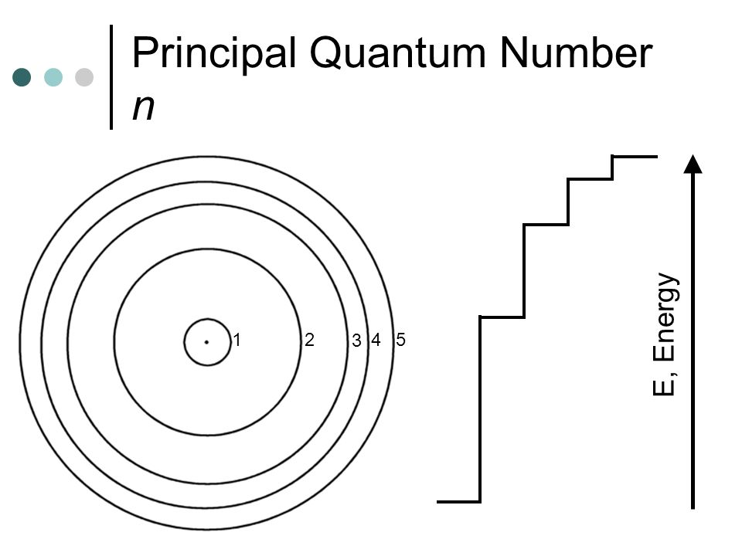
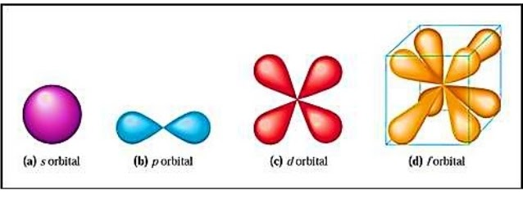
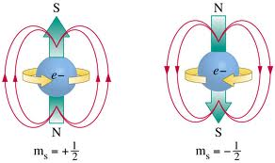
Review of Schrodinger Model of the Atom
4 Quantum Numbers
Principle (n) = distance from nucleus
Magnetic (m_{l}) = shape
Angular Momentum (l) = # orbitals + orientation
Electron Spin (m_{s})

Slide 3
Building the Atom

Slide 5
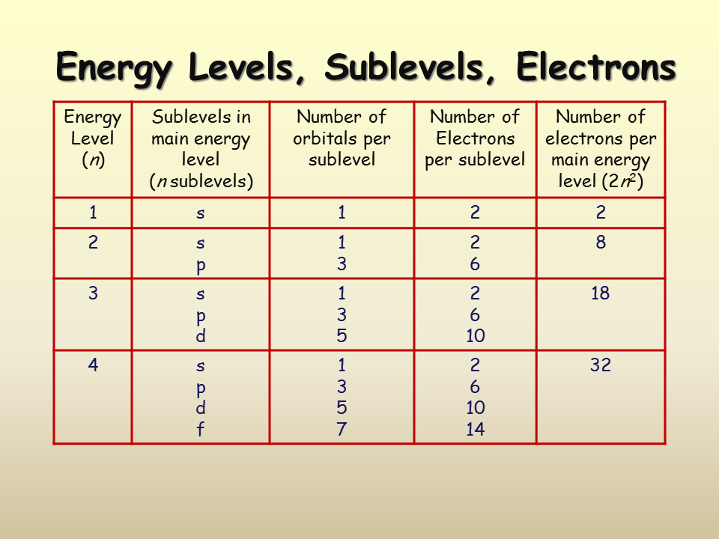

Slide 6
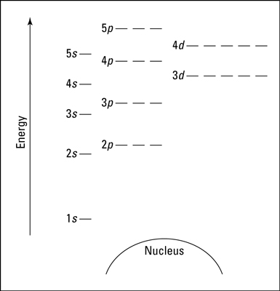
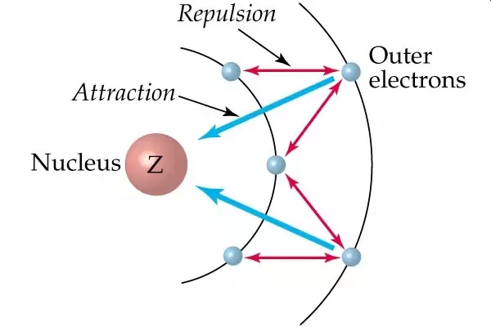
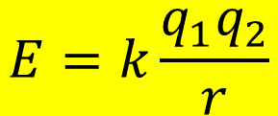
Coulomb's Law – Energy Levels of the Electron
Describes attractive and repulsive forces between charges (protons, electron, cation, anion etc)
DP – charges - Opposites attract, Likes repel
IP – distance between charges
Depends on shape of orbital
$$E=k\frac{q_{1}q_{2}}{r}$$
Review – Chapter 3

Slide 7
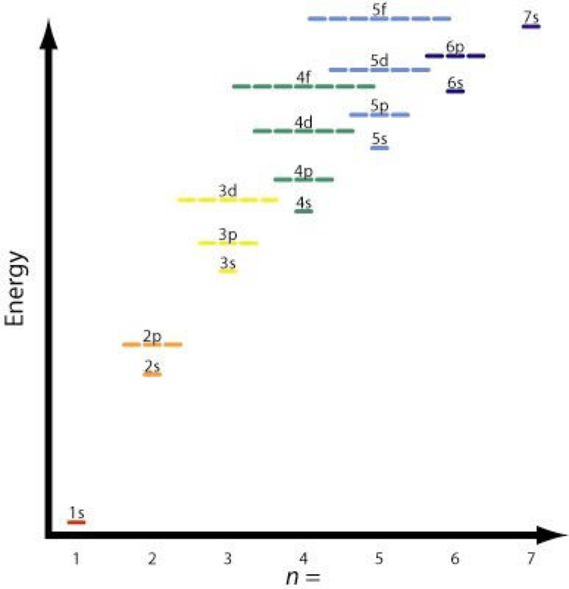
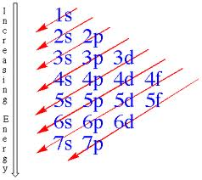
Energy Level Diagrams
1s², 2s², 2p⁶, 3s², 3p⁶, 4s², 3d¹⁰, 4p⁶, 5s², 4d¹⁰, 5p⁶, 6s², 4f¹⁴, 5d¹⁰, 6p⁶, 7s², 5f¹⁴, 6d¹⁰, 7p⁶,

Slide 8
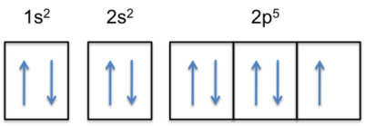
Electron Configurations
Too difficult to draw the diagram a lot
Use several abbreviated methods
1s²
# electrons in orbital
*Ignore Magnetic QN (m_{l})
*Ignore Electron Spin QN (m_{s})
Principle QN (n)
Distance from Nucleus
Angular Momentum QN (l)
Shape of Orbital
Box Diagrams
*Include Magnetic QN (m_{l})
*Include Electron Spin QN (m_{s})

Slide 9
Aufbau Principle's (rules for filling orbitals)
Rule 1 (*Pauli Exclusion Principle) – orbitals hold two electrons with opposite spins
(opposites attract)
Rule 2 (no special name) – fill orbitals from lowest energy level to highest energy level
(electrons are lazy!)
Rule 3 (Hund’s Rule) – each suborbital is occupied by a single electron before adding a second
(electrons don’t pair up until they have to)
*Pauli Exclusion Principle – no two electrons can have the same 4 Quantum Numbers

Slide 10
Don’t lose sight
of the “Goal”
Electron Shell Configurations for Several Elements
Li
Be
B
N

Slide 11
C
O
Fe
Au

Slide 12
Energy Levels of Electrons
Even easier, use the PT!
d’s lag by 1
f’s lag by 2
Remember the PT really looks like this

Slide 13
Valence Electrons
Electrons in the highest energy levels (s and p electrons)
Outer most electrons in an element responsible for chemical reactions
Loss, gain or sharing of valence electrons are responsible for formation of chemical bonds
Octet Rule
Na: 1s²2s²2p⁶3s¹
1 Valence electron
You try it: Carbon
You try it: Which element has 6 valence electrons?

Slide 14
Mendeleev’s Periodic Table
QM Periodic Table
Rows arranged by mass
Columns arranged by similar P and C properties
Rows arranged by # protons and orbital size (n)
Columns by similar outer shell e⁻ configurations
Width = type of orbital and # e⁻
s¹
s²
p¹
p²
etc
F: 1s²2s²2p⁵
Cl: 1s²2s²2p⁶3s²3p⁵
Li: 1s²2s¹
Na: 1s²2s²2p⁶3s¹

