Slide 1
CHE 101 Fall 2021
Lecture 7 ab – Properties of Light + Models of Atom
Overview/Topics
Appreciate the Scientific Process (success and flaws)
Properties of Light
Wavelength, Frequency, Amplitude
Constructive and Destructive Interference
5 Main Experiments/Models
Rutherford Model
Line Spectra
Bohr Model
DeBroglie Model
Quantum Mechanics/Schrodinger Equation
4 Quantum Numbers (what the describe)
Principal (n)
Angular Momentum (l)
Magnetic (m_{l})
Spin (m_{s})
Skills to Master
HW 7 a b
Read
Chapter 10
Don’t!
Memorize dates
Memorize trivia/flavor

Slide 2
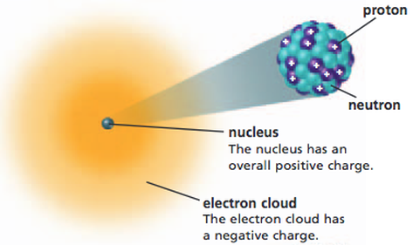
Why do we need to learn
Quantum Mechanics?
Review – Chapter 1 (Rutherford Model)
Ernst Rutherford (1911)
James Chadwich (1932)
Flaws in the Rutherford Model
Can’t explain line spectra
e⁻ cloud is “vague”
Doesn’t explain the PT
Doesn’t explain Ionic and Molecular Bonds
Advantages of QM
Describes the location of e⁻ around an atom
Explains line spectra
Explains shape of PT
Explains Ionic and Molecular Bonds
Used 2nd semester in organic chemistry

Slide 3
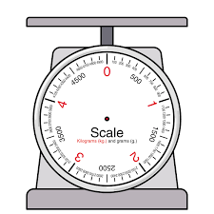
Properties of Particles
Properties of Waves
Mass
Size (localized)
Quantized
Kinetic Energy
Collide, bounce, stick together
No mass
No “size” (spread out)
Wavelength
Frequency
Amplitude
Continuous
Electromagnetic Energy
Add/Subtract
Atom

Slide 4
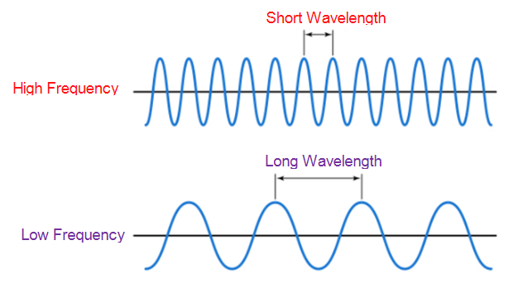
Properties of Waves (Electromagnetic Radiation)
Mathematically
Wavelength (λ) – distance between peaks or troughs
(meters, nm)
$$c= λν$$
Frequency (ν) – number of waves/sec passing a point
(waves/sec, 1/s, s⁻¹, or Hz)
c = speed of light (3.00x10⁸ m/s)
Inversely Proportional (IP)
Amplitude (A) – distance baseline to peak
(N/m²) (*we don’t use this)

Slide 5
Different Wavelength = Different Colors
Different Amplitudes = Different Brightness
Constructive and Destructive Interference

Slide 6
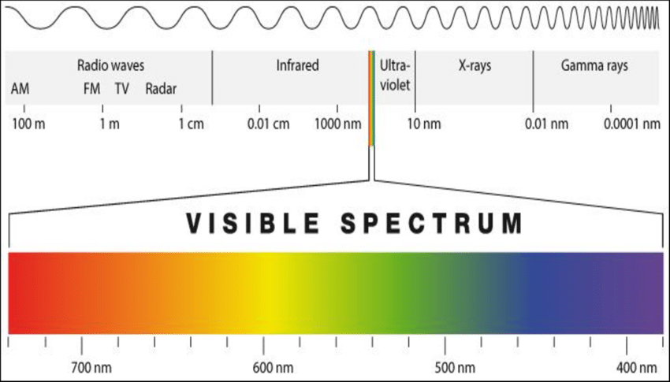
Visible Light Spectrum
Short Wavelength = low frequency = low energy
Long Wavelength = high frequency = high energy
Low Frequency
Low Energy
High Frequency
High Energy

Slide 7
Light – Wave Properties

Slide 8
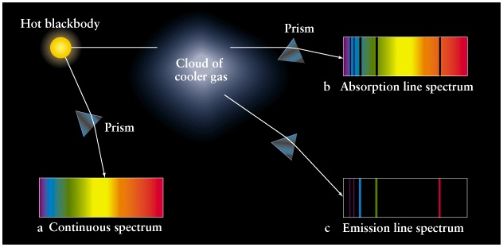
Line Spectra of the Elements
Interaction of Light (waves) and Atoms (particles)
1756 - Thomas Melvill – Flame Spectroscopy
1835 – Charles Wheatstone – ID Elements
1861 - Robert Bunsen + Gustav Kirchhoff – Discover Cs, Rb
1861 - William Crookes – Discovers Tl
1863 - Ferdinand Reich – Discovers In
Scientists not on test!

Slide 9
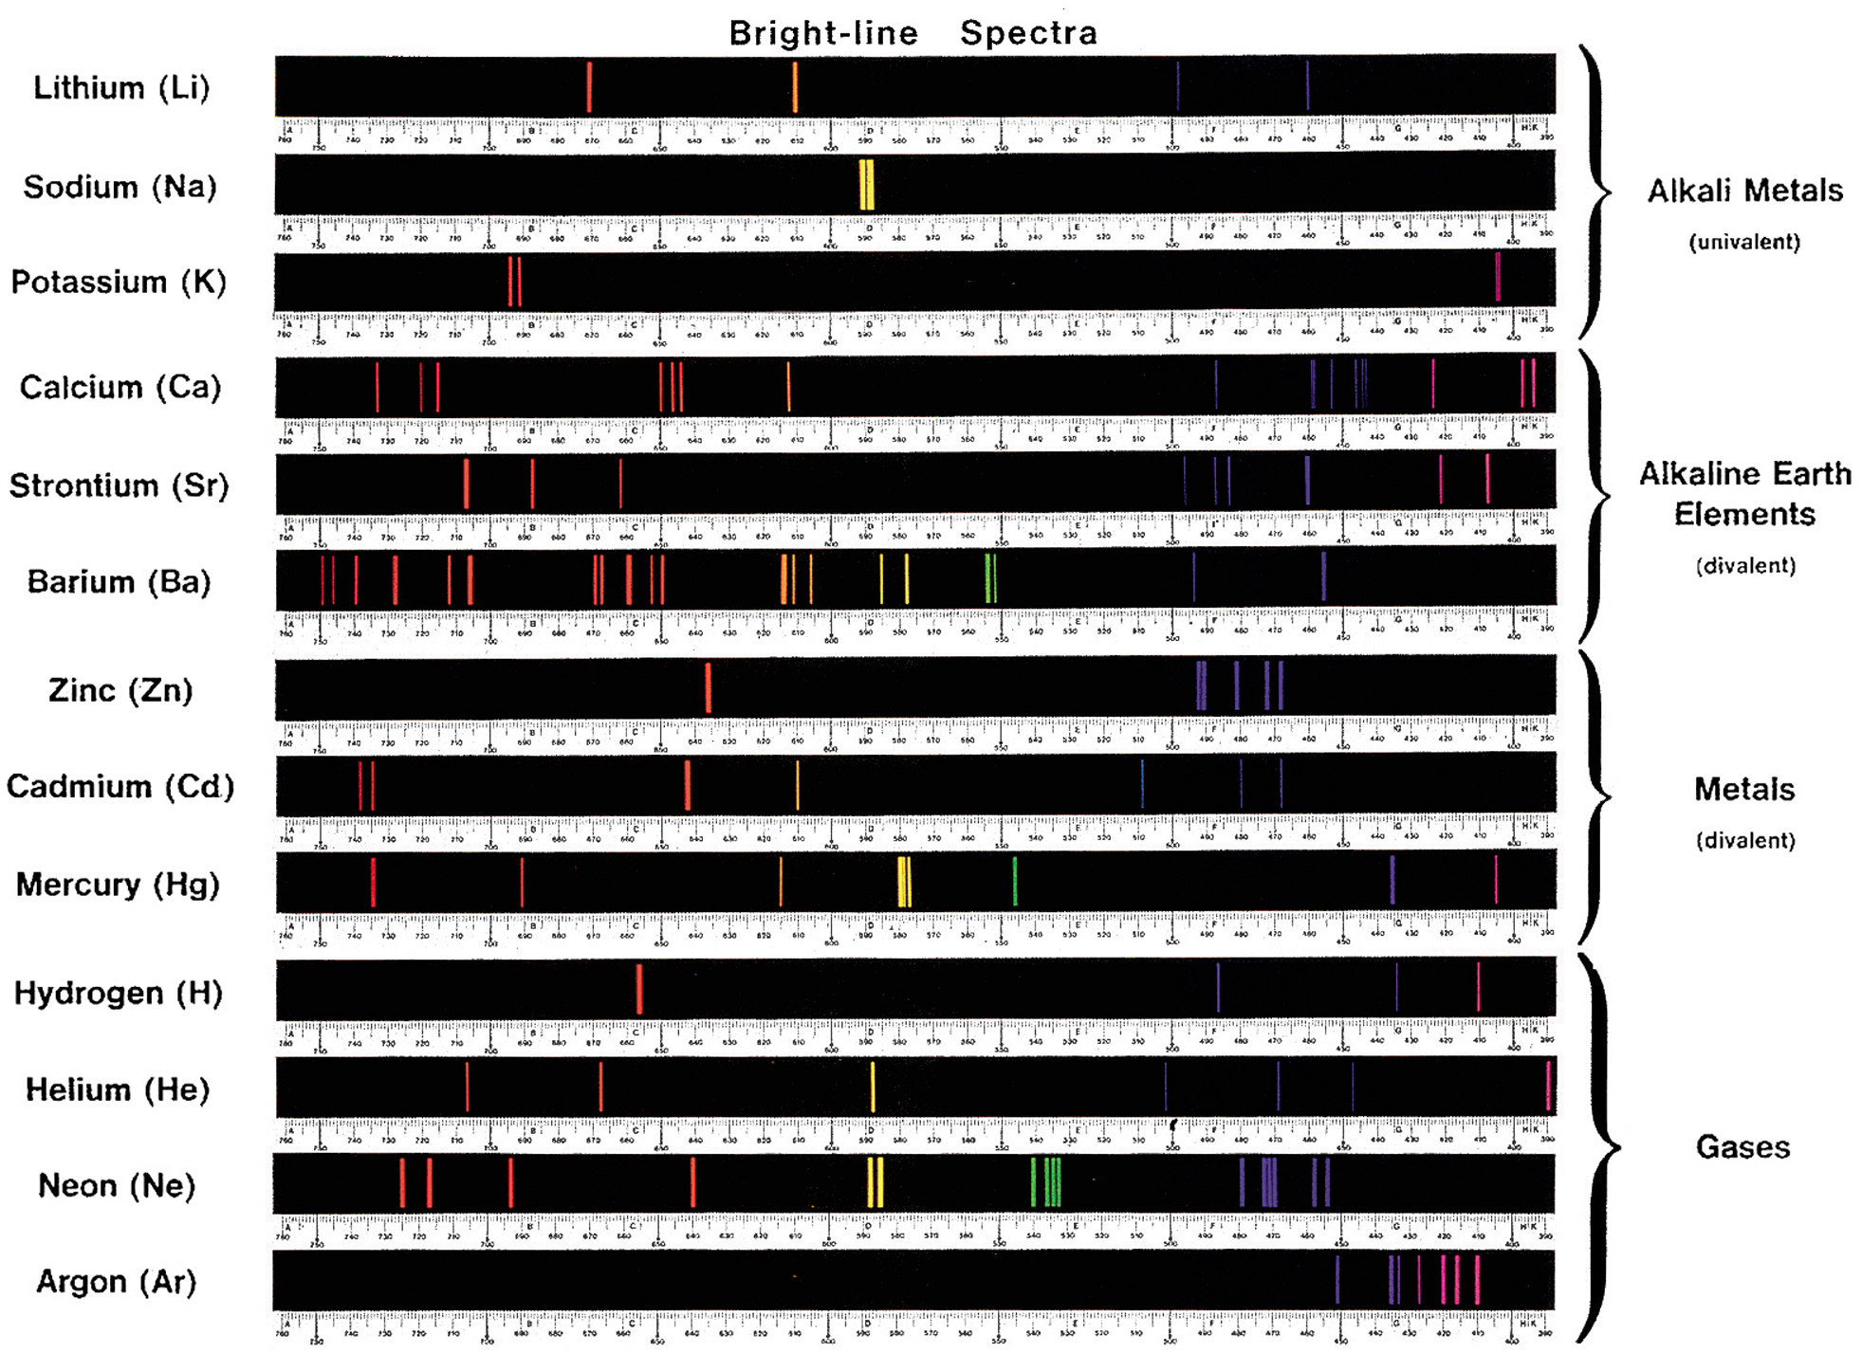

Slide 10
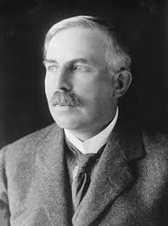
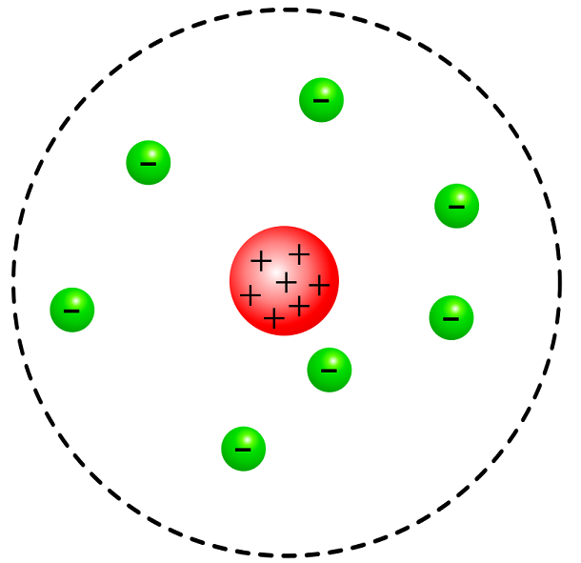
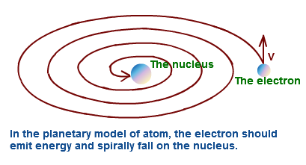
Failure of Rutherford Model
1) Fails to explain line spectra
2) If electrons orbit nucleolus they would lose energy/emit light and spiral into the nucleus
Since electrons can be any distance from the nucleus then they should be able to absorb or emit any color of light leading to either:
All colors of light are absorbed (black spectrum)
All colors of light are emitted (rainbow spectrum)
This is the exact opposite of what is observed!
Electrons can be any distance from the nucleus

Slide 11
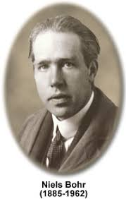
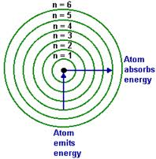
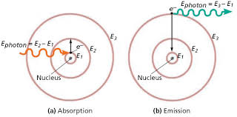
Bohr Model of the Atom
(1913)
Electrons are in quantized orbitals
Predicts line spectrum
Flaws (1) No reason its quantized
(2) Does not work for > 1 e
Explains line spectrum because only certain wavelengths (colors) of light can be absorbed or emitted because only certain orbitals are allowed.
Electrons are in Quantized Orbitals
Only some distances allowed
N = 1, 2, 3 …

Slide 12
How Line Spectra Work
Excited State
Ground State
Incoming light energy is absorbed as the electron moves from a low energy to high energy (close orbital to larger orbital) from the spectrum leaving black spaces at specific energy levels.
Energy is emitted as electrons fall from high energy to low energy level (far orbital to close orbital), resulting only in light of specific energy being emitted.

Slide 13
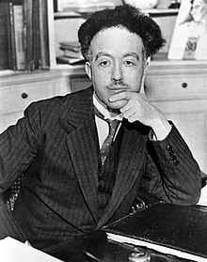
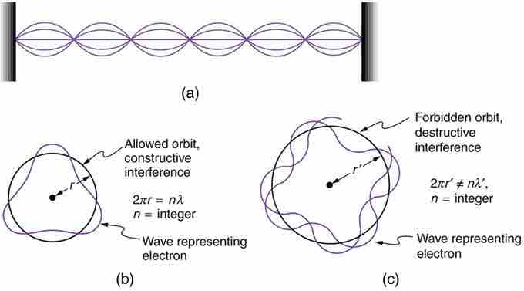
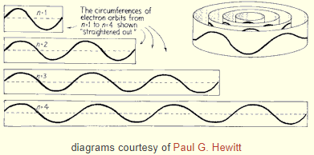
Louis De Broglie Model
“Wave Particle Duality”
If light can behave like a wave and a particle than an electron can behave like a particle and a wave.
Explained Quantization of Electron Orbitals therefore fixing Flaw (1).
Model still fails for > 1 e
Wave Particle Duality
Light is a wave and a particle
Electrons is a particle and a wave

Slide 14
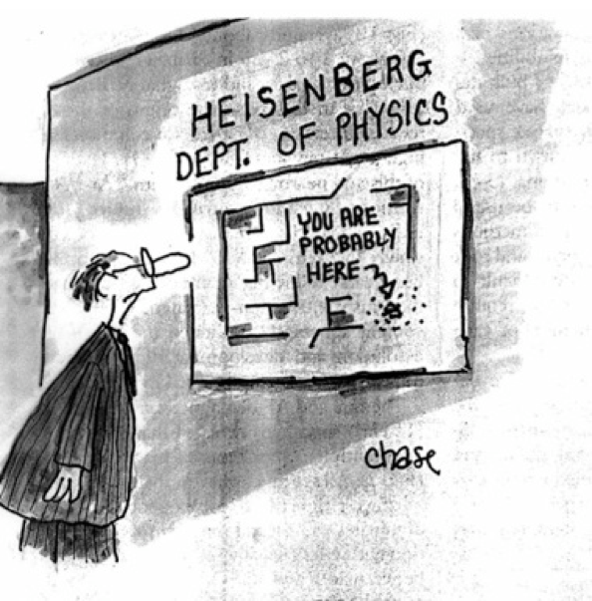
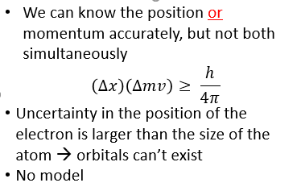
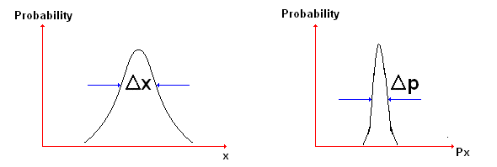
Heisenberg
Uncertainty Principle
(1926)
Uncertainty Principle
Error in e⁻ position is larger than the atom
https://steemit.com/science/@arrjey/the-principle-of-uncertainty-and-the-double-slit-experiment

Slide 15
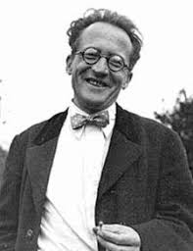
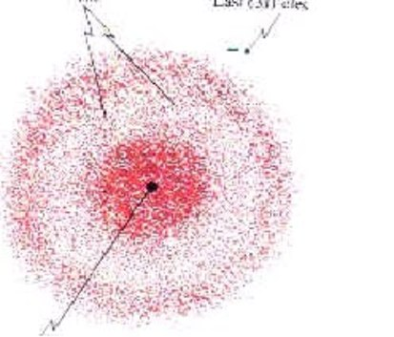
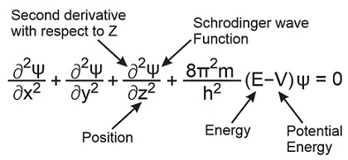
Schrodinger Equation
Statistical model using wave equations to describe the location of the electron.
$$Hφ=Eφ$$
Does not violate Heisenberg
4 Principle Quantum Numbers result
"Anyone who is not shocked by the quantum theory does not understand it." - Niels Bohr
Schrodinger Equation
Statistical Model (Ugly Math)
Gives the “correct” answer

Slide 16
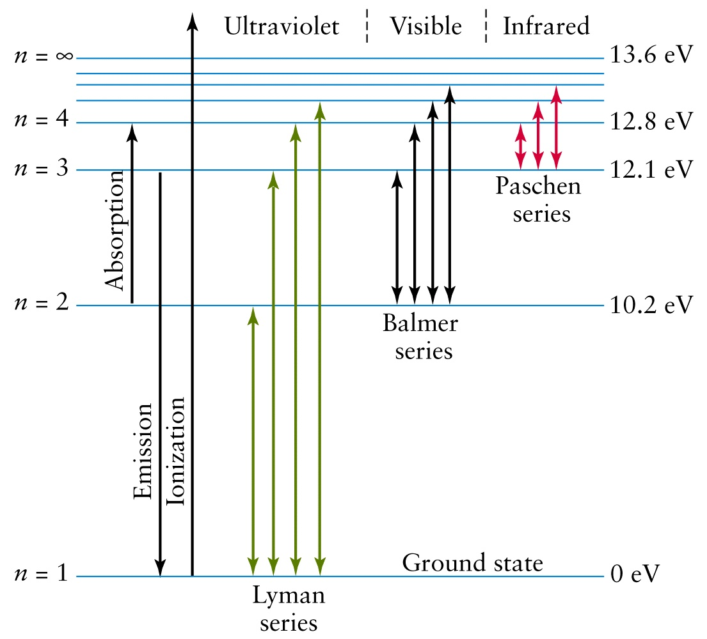
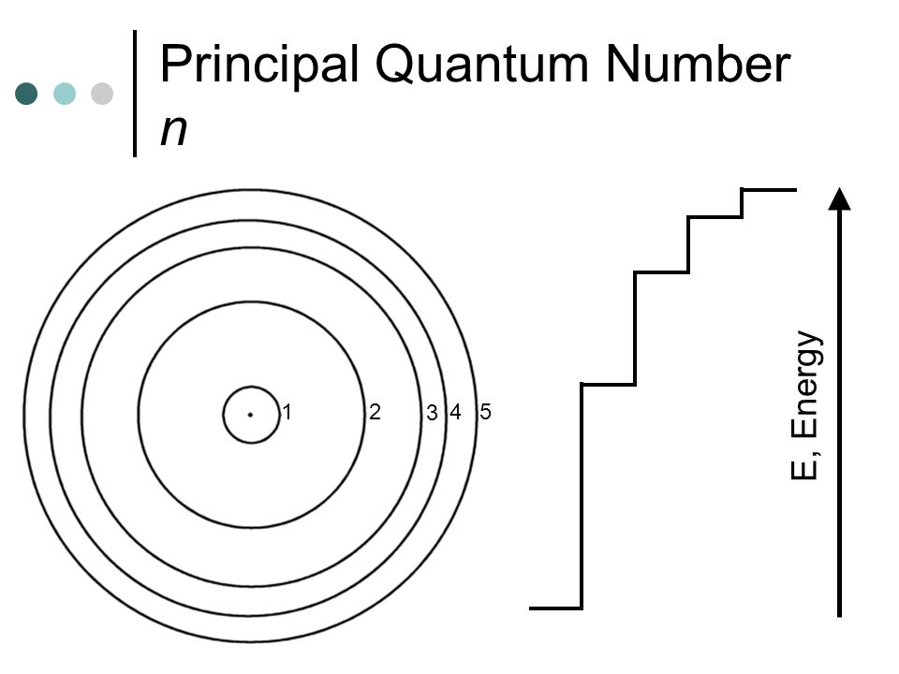
Coulomb's Law
Principle Quantum
Number (n)
$$E=k\frac{q_{1}q_{2}}{r}$$
Distance of an e⁻ from nucleus
Size of orbital
Allowed Values: 1,2,3 ….
“Shells”
High Energy
Distance from Nucleus
Low Energy

Slide 17
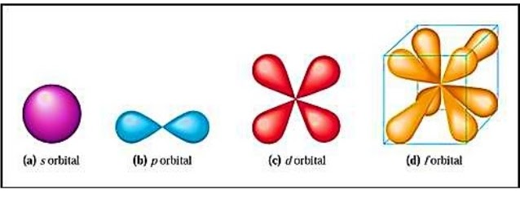
Angular Momentum
Quantum Number (l)
Allowed Values
n = 1 then l = 0
n = 2 then l = 0 and 1
n = 3 then l = 0, 1 and 2
Etc…
3D - shape of an orbital
Allowed Values: 0, 1, 2, 3 … (n-1)
4 shapes or sub-levels
Use letters since numbers are used for n
l =0
l =1
l =2
l =3
Shape of Orbitals

Slide 18
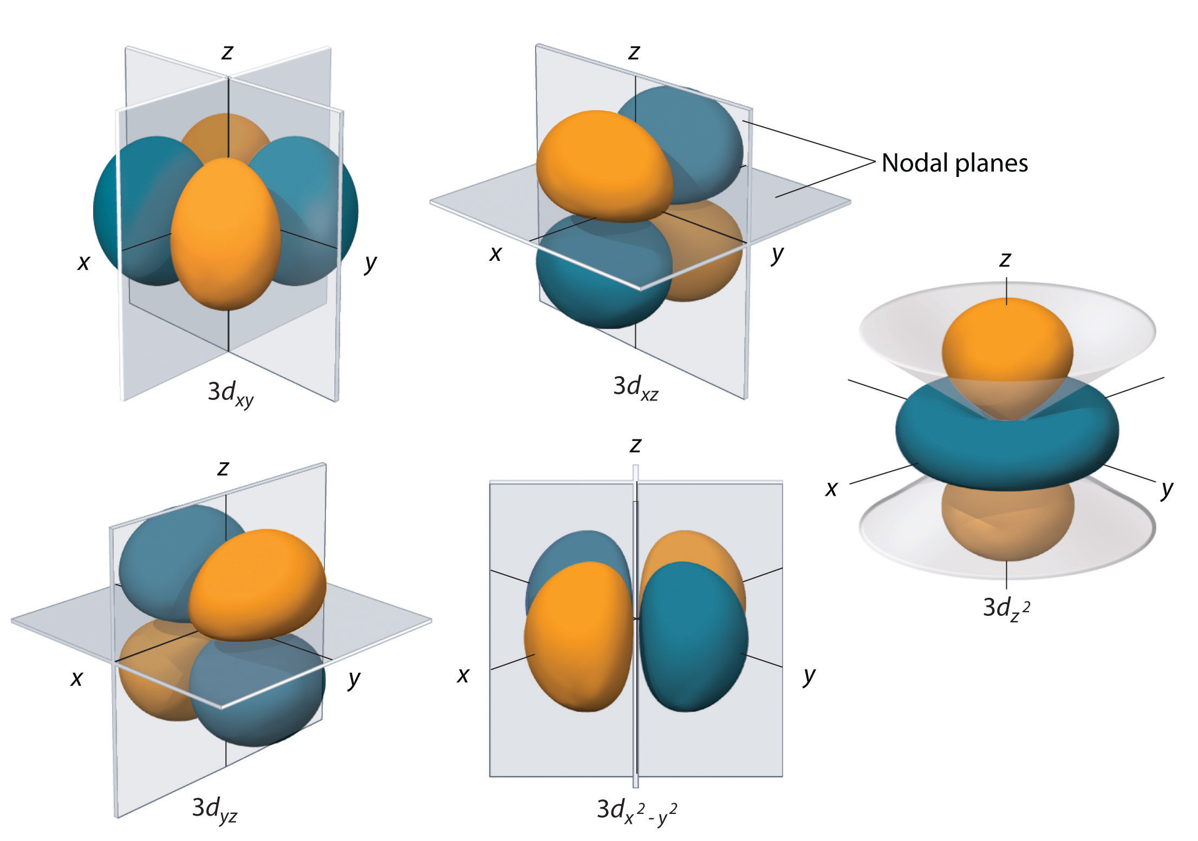
Magnetic Quantum
Number (m_{l})
p-orbitals (-1, 0, 1) = 3 orientations
Allowed Valued: $0, ±1, ±2 … ±$ l
Orientation of the orbital or sub-levels
# of orbitals
s = 1 orbital
p = 3 orbitals
d = 5 orbitals
f = 7 orbitals
Use subscripts (we will ignore)
d-orbitals (-2, -1, 0, 1, 2) = 5 orientations
Allowed Values
l = 0 m_{l} = 0 ∴ 1 orbital
l = 1 m_{l} = -1, 0, 1 ∴ 3 orbitals
l = 2 m_{l} = -2, -1, 0, 1, 2 ∴ 5 orbitals
l = 0 m_{l} = 0, ± 1, ± 2, ± 3 therefore 7 orbitals
Orientation + # of Orbitals

Slide 19
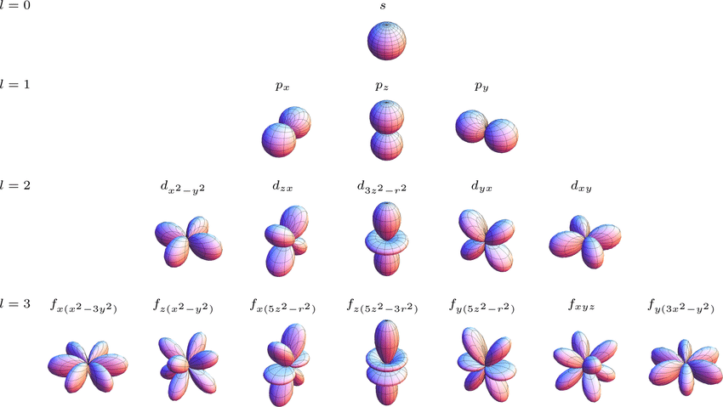

Slide 20
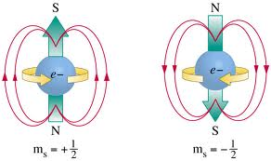
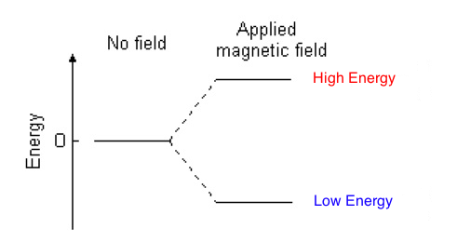
Electron Spin Quantum
Number (m_{s})
M_{s} = $±1/2$
Orbitals can hold 2 electrons $∴$
s = 2 electrons
p = 6 electrons
d = 10 electrons
f = 14 electrons
Leads to techniques like:
NMR – Nuclear Magnetic Resonance
MIR – Magnetic Imaging Resonance
Two e⁻ per orbital

Slide 21
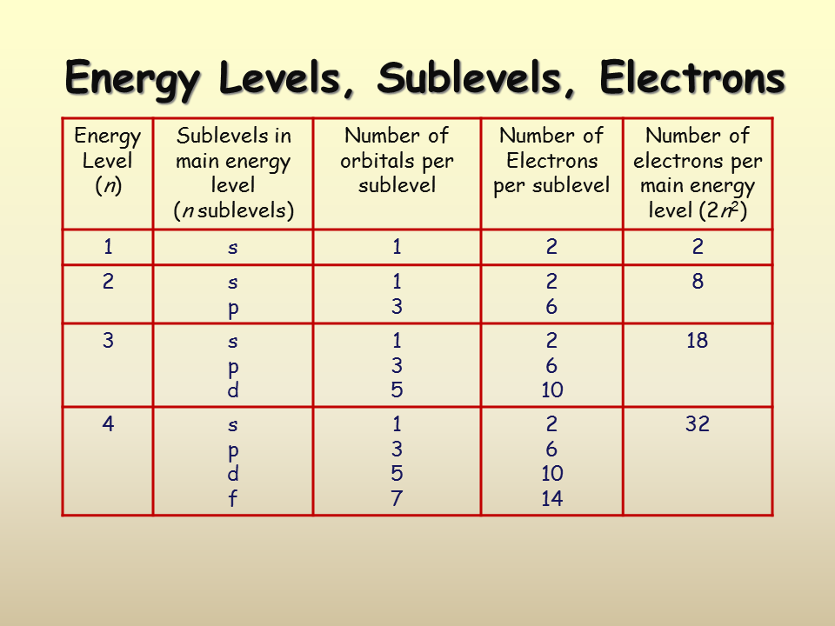

Slide 22
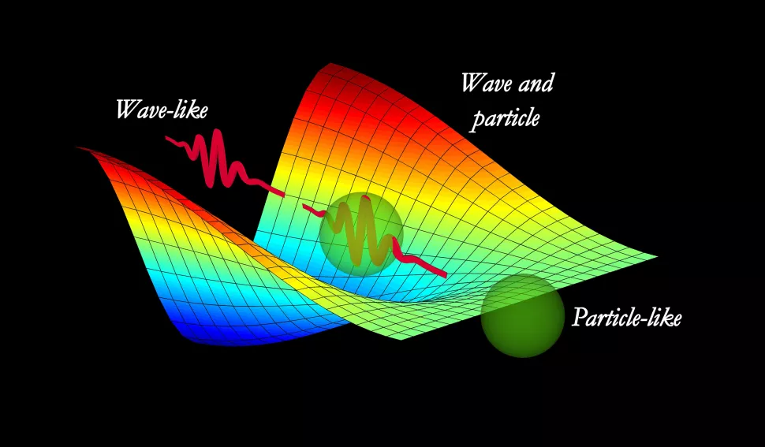
Classical Mechanics
Quantum Mechanics
Macroscopic Phenomenon
Wave or Particle
Continuous (all values allowed)
VS
Nanoscopic Phenomenon
Wave and Particle
Quantized (only some values allowed)
or
VS

