Slide 1
CHE 101 Fall 2021
Lecture 6 ab – Stoichiometry I
Overview/Topics
MW = new conversion factor
mol-mol ratio
G A → mol A → mol B → g B
Mix it all up!
Skills to Master
HW 6 ab
Read
Chapter 7 and 9

Slide 2
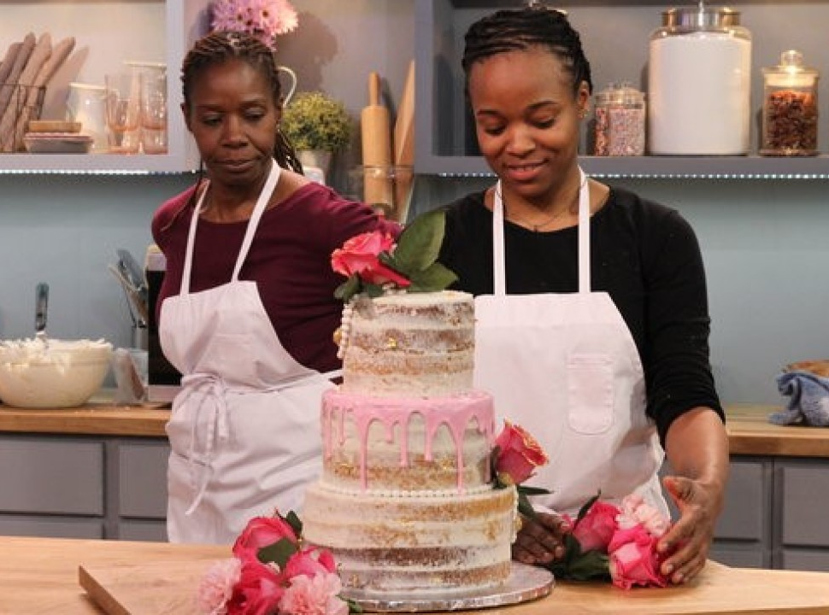
Baking = Chemistry
=
=

Slide 3
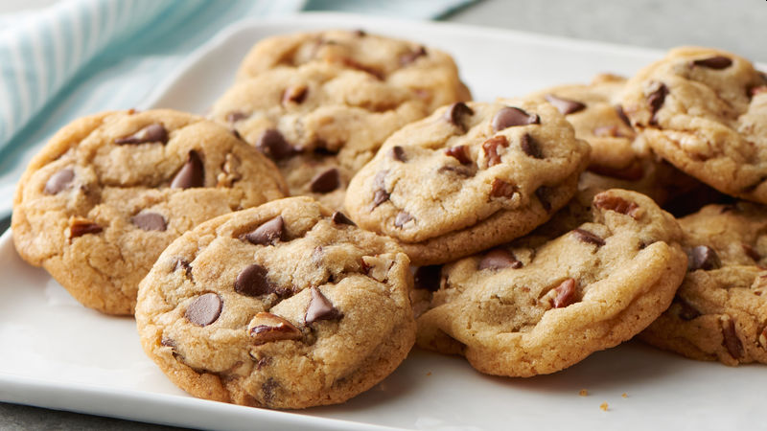
Baking Cookies!
Measurements by Amount
Measurements by Mass
3 cups Flour
2 cups Sugar
2 Eggs
1.5 teaspoons Baking Soda
CF
500.0 g Flour
200.0 g Sugar
120.0 g Eggs
2.5 g Baking Soda
3 cups F + 2 cups S + 2 eggs + 1.5 tsp BS
36 cookies
500.0 g F + 200.0 g S + 120.0 g eggs + 2.5 g BS
36 cookies

Slide 4
Baking Cakes and Cookies
_2_ cups Flour
+
_3_ cups Sugar
_1_ Cake
+
_6_ Cookies
Question: You have 10 cups of Flour, how many cakes can you make?
Question: I need to back 20 cookies. How much Sugar do I need?

Slide 5
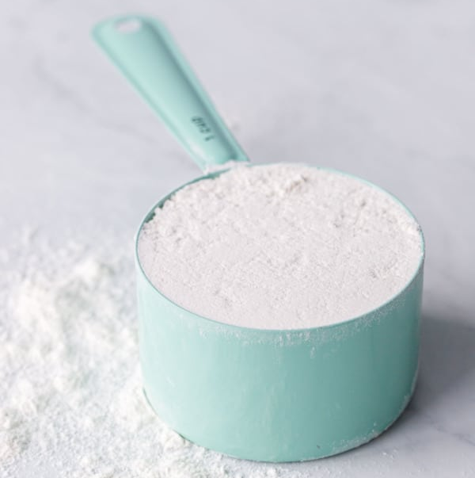
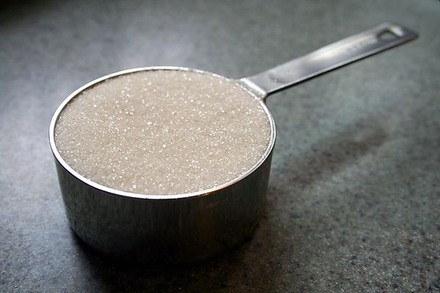
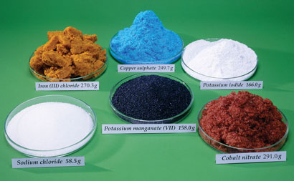
Baking and Chemistry!
Cups
“specks” of flour
Cups
“grains” of sugar
1 mole
6.02 x 10²³
Atoms

Slide 6
Chemical Reactions in a Lab
_2_ Al(OH)₃
+
_3_ H₂SO₄
+
_6_H₂O
_1_ Al₂(SO₄)₃
Question: You have 10 mols of Al(OH)₃, how much Al₂(SO₄)₃ can you make?
Question: I need to make 20 mols of H₂O. How many mols of H₂SO₄ do I need?

Slide 7
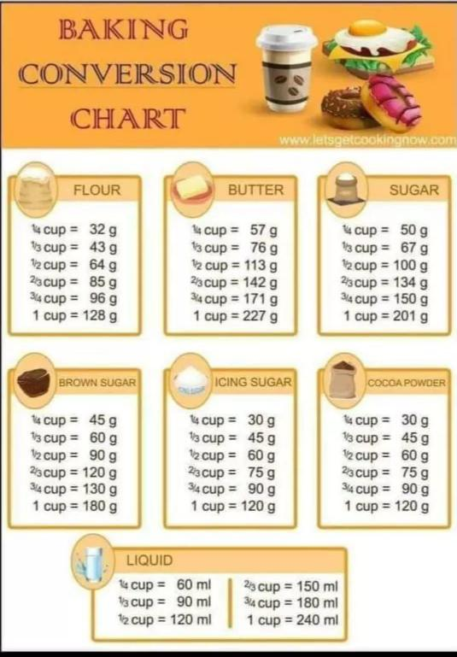
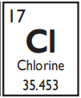
Baking and Chemistry!
From a Cookbook
Molecular Weight (MW)
Mass of 1 mole of an Element
Found on the PT
Units = g/mol
Grams Cups
Grams Moles
Avagadro’s Number
1 mole = 6.02 x 10²³

Slide 8
What is Avagadro’s Number?
It’s a lot like…
1 dozen eggs = 12 eggs
1 dozen donuts = 12 donuts
1 ream paper = 500 sheets
Avagadro’s Number
1 mole = 6.02 x 10²³ anything

Slide 9
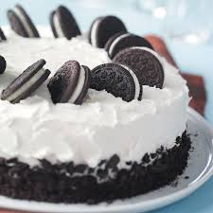
Baking by Mass
From a Cookbook
Grams Cups

Slide 10
Baking by Mass
_2_ cups Flour
+
_3_ cups Sugar
_1_ Cake
+
_6_ Cookies
0.3 lb/cup
0.5 lb/cup
1.5 lb/cake
0.1 lb/cookie
Question: You buy 5.0 lbs of Flour, how many pounds of cake can you make?
Question: You need to make 15.0 lbs of Cookies, how many pounds of sugar should you buy?

Slide 11
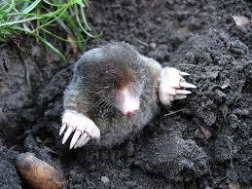
Mols and Grams
Atoms are super duper tiny!
Atoms don’t weigh much (1 H = 1.67 x 10⁻²⁷ kg)
Chemical Reactions are between atoms and molecules
In lab we measure things with scales (grams)
Molecular Weight = Conversion Factor between them
Chemical Reaction
MW
In Chemistry Lab
Na + Cl → NaCl
Na + Cl → NaCl
22.990 g
+
35.453 g
→
58.443 g
“1 atom of Na reacts with 1 atom of Cl to make 1 molecule of NaCl”
“22.990 g Na reacts with 35.453 g Cl to make 58.443 g NaCl”

Slide 12
Review – Dalton
Compounds are small whole number ratios
Chemical Reactions
_2_ Mg
+
_1_O₂
_2_ MgO
+
heat
2 Mg Atoms
+
1 O₂ Molecule
2 MgO Molecules
+
250 kJ
2 mols Mg
+
1 mol O₂
2 mols MgO
+
250 kJ
2 (24.305 g/mol)
+ 1 (31.998 g/mol)
2 (40.304 g/mol)
+
250 kJ
Review – Lavoisier
Conservation of Mass

Slide 13
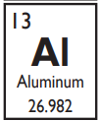
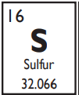
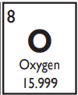
Molecular Weight (MW)
Molecular Weight (MW)
Mass of 1 mole of an Element
Found on the PT
Units = g/mol
Example:
Calculate the MW of Al₂(SO₄)₃
Grams Moles
2 (Al) = 2 × 26.982 = 53.964 g/mol
3 (S) = 3 x 32.066 = 96.198 g/mol
12 (O) = 12 x 15.999 = 191.988 g/mol
342.150 g/mol

Slide 14
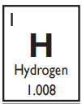
You Try It:
Calculate the MW of Al(OH)₃
Calculate the MW of H₂SO₄
Calculate the MW of H₂O

Slide 15
Chemical Reactions in a Lab
_2_ Al(OH)₃
+
_3_ H₂SO₄
+
_6_H₂O
_1_ Al₂(SO₄)₃
78.00 g/mol
98.08 g/mol
342.15 g/mol
18.02 g/mol
Question: You buy 500.0 g of Al(OH)₃, how many grams of Al₂(SO₄)₃ can you make?
Question: You need to make 250.0 grams of H₂O, how many grams of H₂SO₄ should you buy?

Slide 16
Roadmap to the Future!
_2_ A
+
_3_ B
_1_ C
+
_6_ D
MW
MW
mol/mol
Grams A
Mol A
Mol B
Grams B
Mol to Mol Ratio
from Balanced Eqn
Molecular Weight
g/mol
Molecular Weight
g/mol

Slide 17
You Try It
_3_ C
+
_1_ Fe₂O₃
_2_Fe
+
_3_CO
12.011 g/mol
159.687 g/mol
55.845 g/mol
28.01 g/mol
Question: I need to produce 500.0 g of Fe, how many grams of Fe₂O₃ do I need?
Question: You start with 45.50 g of C, how many grams of CO can you make?

Slide 18
You Try It
_2_ NH₄I
+
_1_ Cl₂
_2_NH₄Cl
+
_1_I₂
144.94 g/mol
70.906 g/mol
53.492 g/mol
253.808 g/mol
Question: I have 250.0 g of NH₄I, how many grams of Cl₂ will I need to finish the reaction?
Question: I you made 150.0 g of NH₄Cl, how many grams of I₂ would you also make?

