Slide 1
CHE 101 Fall 2021
Lecture 5d – SD and Combustion Reactions
Overview/Topics
Single Displacement Reactions
Cations
Anions
Combustion Reactions
Mix it all up!
Skills to Master
HW 5d + EP’s!
Read
Chapter 8 (old book)

Slide 2
Single Displacement (SD)
Determine type of Reaction
Does it occur
Mechanism
Balance Charges
Diatomics
States
Miscellaneous
Balance atoms (reaction)
AKA – Single Replacement, Oxidation/Reduction, Redox etc
2 Main Types
Cations
Anions
Recognize – E + C
Mechanism – Swap ONE Cation or Anion
Does it occur – Activity Series
The more active species will displace the less active species to make a compound
OR
If the more active species is in the compound nothing happens (NR)

Slide 3
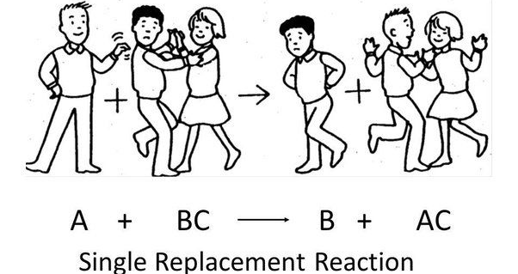
Swap Cations
E + CA → EA + C
E
+
Cation
Anion
+
Cation
Anion
E
Activity Series
Analogy

Slide 4
Examples
___ Mg (s) + ___ HCl (aq)
___ H₂ (g) + ___ MgCl₂ (aq)

Slide 5
You Try It:
___ Zn(NO₃)₂ (aq) + ___ Na (s)
___ Pb(C₂H₃O₂)₃ (aq) + ___ Mg (s)

Slide 6
You Try It:
___ Mg (s) + ___ Li₂CO₃ (aq)
___ Ba(NO₃)₂ (aq) + ___ K (s)

Slide 7
Swap Anions
E + CA → CE + A
E
+
Cation
Anion
+
Cation
Anion
E
___ F₂ (g) + ___ AlCl₃ (aq)

Slide 8
You Try It:
___ MgCl₂ (aq) + ___ Br₂ (l)
___ Cl₂ (g) + ___ ZnI₂ (aq)

Slide 9
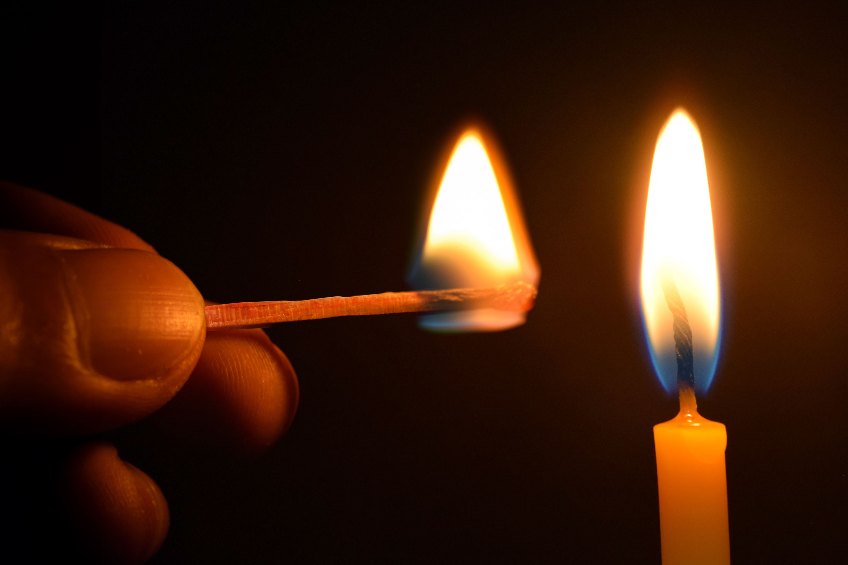
Combustion Reactions
Always Occur
Always Exothermic
Organic Compounds (C,H,O) always combust
Complete vs Incomplete Combustion
Any C,H,O + ___O₂ (g)
___CO₂ (g) + ___ H₂O (g) + Heat

Slide 10
Examples
___ CH₄ (g) + ___ O₂ (g)
___ C₄H₁₀ (l) + ___ O₂ (g)

Slide 11
You Try It:
___ CH₃OH (l) + ___ O₂ (g)

Slide 12
You Try It – All mixed up!
___ F₂ (g) + ___ NaCl (aq)
___ O₂ (g) + ___ CH₃COOH (aq)
___ FeCl₂ (aq) + ___ Al (s)
___ Mg(C₂H₃O₂)₂ (aq) + ___ H₃PO₄ (aq)
___ H₂ (g) + ___ ZnCl₂ (aq)

Slide 13
You Try It – Answers!
1
2
2
1
___ F₂ (g) + ___ NaCl (aq)
___ NaF (aq) + ___ Cl₂ (g)
2
1
2
2
___ O₂ (g) + ___ CH₃COOH (aq)
___ CO₂ (g) + ___ H₂O (g) + Heat
3
2
2
3
___ FeCl₂ (aq) + ___ Al (s)
___ AlCl₃ (aq) + ___ Fe (s)
3
2
1
6
___ Mg(C₂H₃O₂)₂ (aq) + ___ H₃PO₄ (aq)
___ Mg₃(PO₄)₂ (s) + ___ HC₂H₃O₂ (aq)
___ H₂ (g) + ___ ZnCl₂ (aq)
NR

