Slide 1
CHE 101 Fall 2021
Lecture 5c – DD Reactions
Overview/Topics
Review 5 a/b material to remember
Understand Double Displacement Reactions
Standard (ppt)
Formation of gas
Acid/Base (Exothermic)
Skills to Master
HW 5c
Write complete chemical reactions
Read
Chapter 8 (old book)

Slide 2
Review of Ch. 5 ab
Things to Memorize
7 Diatomic Elements
11 Elements found as gases
2 Elements found as liquids
10 Acids
8 common molecular gases
CO, CO₂
SO₂, SO₃
NO, NO₂, N₂O₄
NH₃ (Ammonium Gas)

Slide 3
Things to Memorize
7 Metalloids
Ionic vs Molecular
Review – Subscripts, Superscripts, Coefficients
Superscripts = charges (e⁻)
2
+2
-1
___ Ca(NO₃)₂
Coefficients = # atoms, molecules or moles
(Balance atoms)
Subscripts = # atoms in a polyatomic ion or molecule

Slide 4
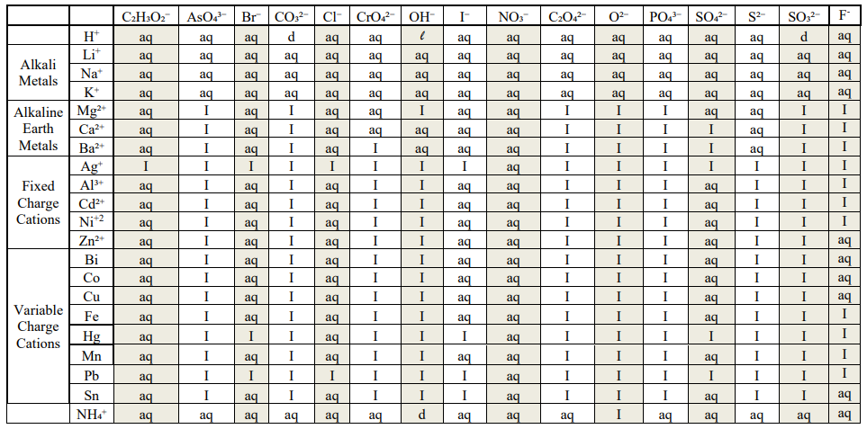
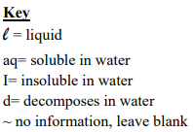
Solubility Tables
Insoluble (I) = (s) in reactions

Slide 5
Double Displacement Reactions (DD)
Sometimes called Double Replacement, PPT, Gas, Acid/Base etc
3 main Types
Formation of Precipitate
Formation of Gas
Formation of Heat
Generally occur between ionic compounds
Driving force – lower energy of the atoms (formation of ppt/gas/water)
Recognize – C + C
Mechanism – Swap ONE COPY of Cations and Anions
C = cations (+)
A = anions (-)
AB (aq) + CD (aq)
CB (aq) + AD (s)
Reaction occurs if:
Formation of ppt
Formation of gas
Formation of heat
Formation of water
A and B might “Swap” Places
if it results in lower energy
If No Reaction occurs write NR

Slide 6
A⁺
B⁻
+
C⁺
D⁻
C⁺
B⁻
+
A⁺
D⁻
(aq) = dissolved in water
form individual ions
(s) = is a solid water (ppt)
forms a compound
B⁻
B⁻
A⁺
B⁻
B⁻
D⁻
D⁻
C⁺
C⁺
A⁺
C⁺
C⁺
D⁻
D⁻
A⁺
A⁺
Reactants
Products

Slide 7
Silly Analogy

Slide 8
8 steps for writing a reaction
DD - ppt/gas/heat/water
SD - Activity Series
DD, AB, SD, Comb
Determine type of Reaction
Does it occur
Mechanism
Balance Charges
Diatomics
States
Miscellaneous
Balance atoms (reaction)
DD – swap cations
SD – swap (c or a)
Comb - memorize
Ionic Only
Heat, Decomposition etc

Slide 9
Example:
___ AgNO₃ (aq) + ___ MgCl₂ (aq)

Slide 10
Example:
___ AlCl₃ (aq) + ___ Na₂CO₃ (aq)

Slide 11
Example:
___ NaNO₃ (aq) + ___ Mg(C₂H₃O₂)₂ (aq)

Slide 12
You Try It:
___ (NH₄)₂SO₄ (aq) + ___ CaCrO₄ (aq)
NH₄ = +1
SO₄ = -2
Ca = +2
CrO₄ = -2

Slide 13
You Try It:
___ Na₃PO₄ (aq) + ___ Mg(NO₃)₂ (aq)
Na = +1
PO₄ = -3
Mg = +2
NO₃ = -1

Slide 14
Acid/Base (AB) Reactions
Just a DD reaction
Acid + Base → Ionic Salt + Water (HOH) + heat
Always occurs, always exothermic
Review
H__ = Acid
__OH = Base
___ NaOH (aq) + ___ H₂SO₄ (aq)

Slide 15
You Try It:
___ HClO₄ (aq) + ___ Ca(OH)₂ (aq)

Slide 16
You Try It:
___ Ba(OH)₂ (aq) + ___ H₃PO₄ (aq)

Slide 17
DD + Gas/Decomposition
Just a normal DD reaction except…
Product decomposes (d) into a gas + water
H₂CO₃ (d) → H₂O (l) + CO₂ (g)
NH₄OH (d) → H₂O (l) + NH₃ (g)
H₂SO₃ (d) → H₂O (l) + SO₂ (g)
Inflammable, Acidic in water
Inflammable, Basic in water
Inflammable, Acidic in water
___ NH₄Cl (aq) + ___ NaOH (aq)

Slide 18
You Try It:
___ H₂SO₄ (aq) + ___ Na₂CO₃ (aq)

Slide 19
You Try It – All mixed up!
___ Zn(C₂H₃O₂)₂ (aq) + ___ AgNO₃ (aq)
___ Ca(OH)₂ (aq) + ___ NaCl (aq)
___ K₂SO₃ (aq) + ___ HCl (aq)
___ KOH (aq) + ___ H₂CO₃ (aq)

Slide 20
You Try It – Solutions!
1
2
2
1
___ Zn(C₂H₃O₂)₂ (aq) + ___ AgNO₃ (aq)
___ AgC₂H₃O₂ (s) + ___ Zn(NO₃)₂ (aq)
NR
___ Ca(OH)₂ (aq) + ___ NaCl (aq)
___ CaCl₂ (aq) + ___ NaOH (aq)
1
1
___ H₂O (l) + ___ SO₂ (g)
1
2
2
___ K₂SO₃ (aq) + ___ HCl (aq)
___ KCl (aq) + ___ H₂SO₃ (d)
2
1
1
2
___ KOH (aq) + ___ H₂CO₃ (aq)
___ K₂CO₃ (aq) + ___ H₂O (aq) + Heat

Slide 21
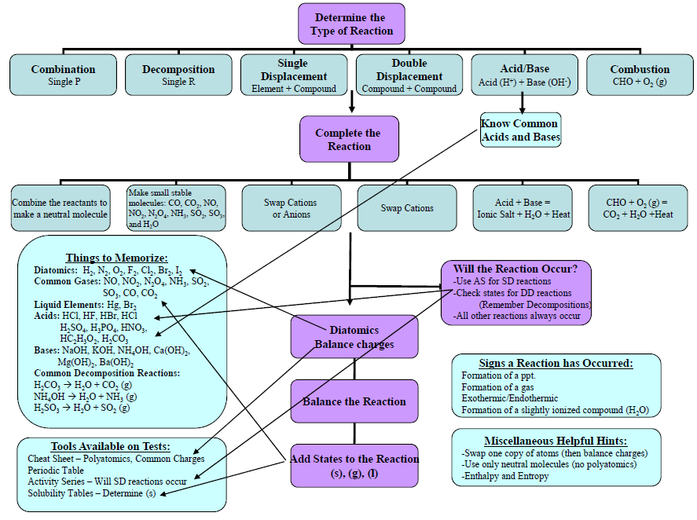
Additional Tools
(download at www.chemhaven.org)

