Slide 1
CHE 101 Fall 2021
Lecture 5 ab – Writing and Balancing Reactions
Overview/Topics
Balance Reactions (Lavoisier)
How to tell if a reaction occurs (paper)
Review/Things to Memorize
Solubility Tables
Writing Chemical Reactions
Skills to Master
HW 5 ab
Read
Chapter 8 (old book)

Slide 2
Chemical Reaction Review
Reactants
Products
Δ
___ Al (s) + ___ Fe₂O₃ (s)
___ Fe (s) + ___ Al₂O₃ (l)
Δ H = -345 kJ/mol
Lavoisier
Balance Atoms and Molecules
States
(s) = solid
(g) = gas
(l) = liquid
(aq) = aqueous
Miscellaneous Information
Δ = heat
250 °C = temperature
hν = light
Heat
Endothermic
Exothermic

Slide 3
Basic Rules
ONLY change the coefficients
Single E before multiple E
Balance polyatomic ions as a whole
H₂O or HOH?
Even/Odd rule
Smallest Whole Number Ratio
Double Check!
Balancing Chemical Reactions
We gotta obey Lavoisier!
Trial and Error Method (RP Method)
Algebraic Method
Some tricks
___ Fe (s) + ___ O₂ (g) → ___ Fe₂O₃ (s)
_______
Atom | Reactants | Products

Slide 4
Group Polyatomic Ions
___ H₃PO₄ (aq) + ___ NaCN (aq) → ___ HCN (aq) + ___ Na₃PO₄ (aq)

Slide 5
You Try It:
___ V(NO₃)₂ (aq) + ___ Al₂(SO₄)₃ (aq) → ___ VSO₄ (s) + ___ Al(NO₃)₃ (aq)

Slide 6
H₂O or HOH?
You Try It:
___ Mg(OH)₂ (aq) + ___ H₃PO₄ (aq) → ___ Mg₃(PO₄)₂ (s) + ___ H₂O (l)

Slide 7
You Try It:
Even/Odd Rule
___ C₃H₈ (l) + ___ O₂ (g) → ___ CO₂ (g) + ___ H₂O (g)
___ C₄H₁₀ (l) + ___ O₂ (g) → ___ CO₂ (g) + ___ H₂O (g)

Slide 8
Ughh Math!
Algebraic Method
___ CH₃ (g) + ___ H₂O (l) → ___ CO₂ (g) + ___ H₂ (g)

Slide 9
Chemical Reaction Basics
In a chemical reaction the atoms in each compound rearrange to form new compounds with different physical and chemical properties.
Reactions occur for two reasons
Decrease Energy
Increase Entropy
Remember Lab 2!
4 Signs a chemical reaction occurs (in Lab)
4 Signs a chemical reaction occurs (on Paper)

Slide 10
Review of Ch. 2 + 4
Things to Memorize
7 Diatomic Elements
11 Elements found as gases
2 Elements found as liquids
10 Acids
8 common molecular gases
CO, CO₂
SO₂, SO₃
NO, NO₂, N₂O₄
NH₃ (Ammonium Gas)

Slide 11
Things to Memorize
7 Metalloids
Ionic vs Molecular

Slide 12
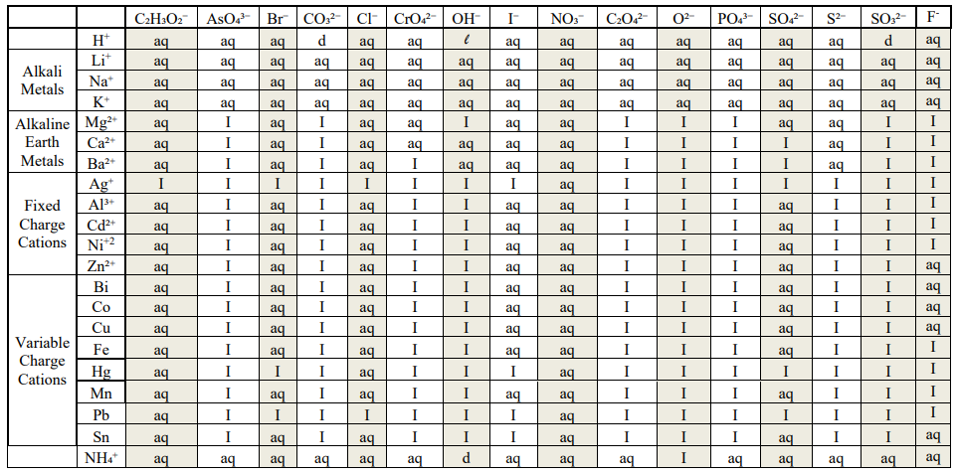
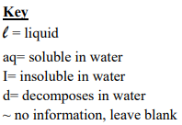
Solubility Tables
Insoluble (I) = (s) in reactions

Slide 13
You Try It:
Compound | State in a Reaction
Mg(C₂H₃O₂)₂
Ca₃(AsO₄)₂
NaOH
FeCO₃
K₂CO₃
Li₂S₂O₃
PbI₂

Slide 14
Writing Chemical Reactions
Translate words to formula’s
Molecular – done
Ionic – balance charges
Remember Diatomic’s
States when known
Balance the Reaction
Barium Nitrate + Sodium Acetate → Barium Acetate + Sodium Nitrate

Slide 15
You Try It
Iron + Chlorine → Iron (III) Chloride

Slide 16
You Try It
Magnesium Hydroxide + Sulfuric Acid →Magnesium Sulfate + Water

Slide 17
You Try It
Lead (II) Nitrate + Ammonium Phosphate → Lead (II) Phosphate + Ammonium Nitrate

