Slide 1
CHE 101 Fall 2021
Lecture 4 d,e – Naming Molecular Compounds and Acids
Overview/Topics
Use your Cheat Sheet!
Naming Molecular Compounds
Name → Formula
Formula → Name
Naming Acids
Name → Formula
Formula → Name
Putting it all together
Skills to Master
HW 4 d,e
Extra Practice Sheets on Chemhaven
Read
Chapter 6 (old book)

Slide 2
Naming Overview – 4 Categories
Type of Compound | Identify | Rules | Misc.
Ionic - Fixed | m/nm | Cation Anion | E – ide Poly - normal
Ionic - Variable | m/nm | Cation (charge) Anion | Charge uses Roman Numerals
Molecular | nm/nm | Prefix - 1st E – prefix – 2nd E | Know prefix’s
Acids | H_ | Memorize | Its only 10
Your CS may be helpful

Slide 3
Naming Acids
Ch. 15 is all about acids and bases
Acids always start with H_
No consistent rules
_ic Acid
Just memorize 10 most common
H
Anion or Polyatomics
H₂SO₄ = Sulfuric Acid
HNO₃ = Nitric Acid
H₂CO₃ = Carbonic Acid
H₃PO₄ = Phosphoric Acid
HClO₄ =Perchloric Acid
HC₂H₃O₂ = Acetic Acid
HF = Hydrofluoric Acid
HCl =Hydrochloric Acid
HBr = Hydrobromic Acid
HI = Hydroiodic Acid
Note – Just the Halogens
Note – charges do balance
- polyatomic on CS
Memorize them!

Slide 4
Ch. 15 is all about acids and bases
Naming Bases
Bases are always a metal + OH
Named like normal ionic compounds
Metal Atom
OH
NaOH
Mg(OH)₂
Sodium Hydroxide
Magnesium Hydroxide

Slide 5
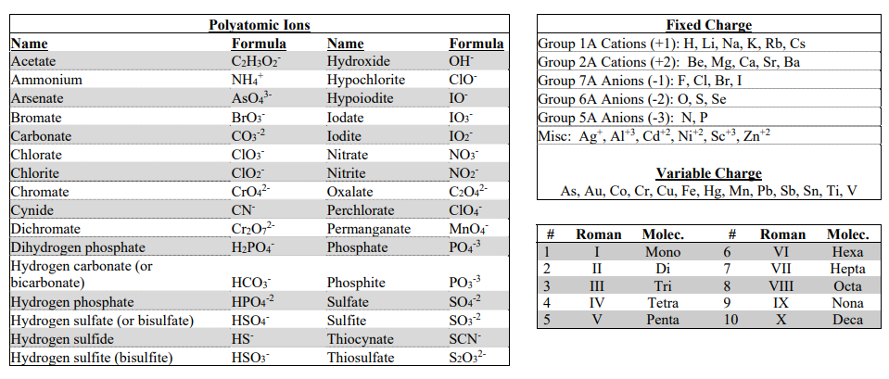
Using your Cheat Sheet
Never leave home without it
Provided on every exam
Fixed Charges
Variable Charges
Roman Numerals
and
Molec. Prefixs
Polyatomic Ions

Slide 6
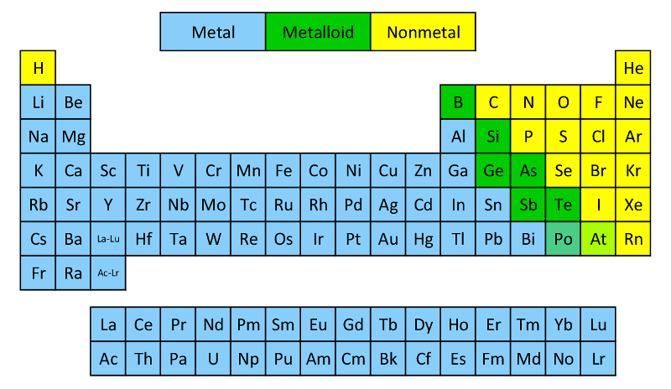
Review – Ch 3
Know the following:
Metalloids (7*) – B, Si, Ge, As, Sb, Te, Po/At
Metals (left)
Non-metals (right)
No consistent rule for metalloids
Nonmetals – B, Si,
Metals – Ge, As, Sb, Te

Slide 7
Compound: 2 or more E, chemically combined (bonded) in definite proportions
Review – Ch 3
 | Ionic | Covalent or Molecular
Formed by | Gain/lose electrons | Share electrons
Between | m/nm | nm/nm
Bond Strength | High | Low
Melting Point | High | Low
Solubility | High | Low
Conductivity | High | Low
Structure | Lattice | Discrete Molecules

Slide 8
Naming Molecular Compounds
1 = mono
2 = die
3 = tri
4 = tetra
5 = penta
6 = hexa
7 = hepta
8 = octa
9 = nona
10 = deca
nm/nm
Left most Element goes 1st.
Naming: Prefix – 1st Element – Prefix – 2nd Element (-ide ending)
Prefix
First Element
Prefix
Second Element
Never use mono
-ide ending
CO
CO₂
Carbon monoxide
Carbon dioxide
P₂S₅
S₃Br
Diphosphorus pentasulfide
Trisulfur monobromide

Slide 9
You try it: NO₂
You try it: B₂O₅
You try it: tetraphosphorus hexafluoride
You try it: dioxygen monochloride

Slide 10
Formula to Name
Acids – memorize them!
Prefix-Element Prefix-Element
Oh shit its test time… PANIC!
nm/nm
H_
*what the one exception?
m/nm
Fixed Charge
Variable Charge
Save until last they are the hardest!
Cation Anion (ide/poly)
Cation (charge) Anion (ide/poly)

Slide 11
You try it:
Na₂SO₄
V₂(SO₄)₃
H₂SO₄
SO₃

Slide 12
You try it:
PbPO₄
H₃PO₄
Ba₃(PO₄)₂
P₂O₅

Slide 13
Name to Formula
Acids – memorize them!
Prefix-Element Prefix-Element
-ic acid
Oh shit its test time… PANIC!
mono, di, tri (nm)
*what the one exception?
No ( )
m/nm
Look up charge
(charge on cation)
Balance Charges!
Save until last they are the hardest!

Slide 14
You try it:
Tin (VI) Oxalate
Sodium Oxalate
Dicarbon tetroxide
Carbonic Acid

Slide 15
You try it:
Calcium Acetate
Acetic Acid
Vanadium (III) Acetate
Silver Dihydrogen phophate

