Slide 1
CHE 101 Fall 2021
Lecture 4 bc – Naming Ionic Compounds I and II
Overview/Topics
Use your Cheat Sheet!
Review Balancing Charges (3 Methods)
Naming Fixed Charge Ionic Compounds
Name → Formula
Formula → Name
Naming Variable Charge Ionic Compounds
Name → Formula
Formula → Name
Skills to Master
HW 4 b,c
Extra Practice Sheets on Chemhaven
Read
Chapter 6 (old book)

Slide 2
Naming Overview – 4 Categories
Type of Compound | Identify | Rules | Misc.
Ionic - Fixed | m/nm | Cation Anion | E – ide Poly - normal
Ionic - Variable | m/nm | Cation (charge) Anion | Charge uses Roman Numerals
Molecular | nm/nm | Prefix - 1st E – prefix – 2nd E | Know prefix’s
Acids | H_ | Memorize | Its only 10
Your CS may be helpful

Slide 3
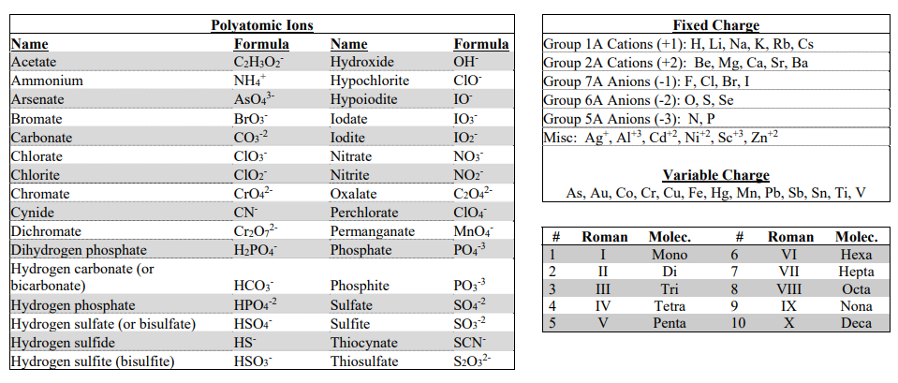
Using your Cheat Sheet
Never leave home without it
Provided on every exam
Fixed Charges
Variable Charges
Roman Numerals
and
Molec. Prefixs
Polyatomic Ions

Slide 4
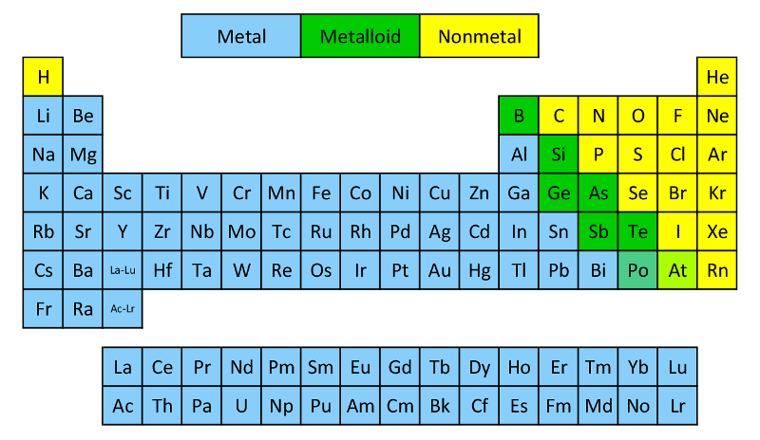
Review – Ch 3
Know the following:
Metalloids (7*) – B, Si, Ge, As, Sb, Te, Po/At
Metals (left)
Non-metals (right)

Slide 5
Compound: 2 or more E, chemically combined (bonded) in definite proportions
Review – Ch 3
 | Ionic | Covalent or Molecular
Formed by | Gain/lose electrons | Share electrons
Between | m/nm | nm/nm
Bond Strength | High | Low
Melting Point | High | Low
Solubility | High | Low
Conductivity | High | Low
Structure | Lattice | Discrete Molecules

Slide 6
Naming Fixed Charge
Ionic Compound
Metal
Anion
E - ide
Always write ionic compound: Cation – Anion (or m/nm)
Naming: Cation = metal name
Anion = element change ending to –ide
Polyatomic = name on CS
Writing Formula – Balance Charges
Poly = name
NaCl
NaNO₃
Sodium Chloride
Sodium Nitrate
MgCl₂
Mg₂(PO₄)₂
Magnesium Chloride
Magnesium Phosphate
Formula to Name

Slide 7
Review of 6a
3 Methods to Balance Charges
Atoms
Old School Math and CA method
Cross Method + Simplify
You try it: Compound formed between Ca and N
You try it: Compound formed between Na and SO₄
Charges are
on your CS!

Slide 8
You try it: Compound formed between Ca and PO₄
You try it: Compound formed between Al and SO₄
You try it: Compound formed between Na and SCN
You try it: Compound formed between Ag and HPO₄

Slide 9
Method 2 – Math + CA Method
You try it: Compound formed between Mg and P
You try it: Compound formed between K and CO₃

Slide 10
You try it: Compound formed between Ba and S
You try it: Compound formed between Al and CO₃
You try it: Compound formed between NH₄⁺ and NO₃
You try it: Compound formed between NH₄⁺ and PO₄

Slide 11
Naming Variable Charge
Ionic Compounds
Metal
(charge)
Anion
Always write ionic compound: Cation – Anion (or m/nm)
Naming: Cation = metal name
Charge in ( ) using roman numerals
Anion = element change ending to –ide
= Polyatomic name on CS
Variable Charge Listed on CS
Roman Numerals on CS
VCl₃
Fe₃(PO4)₂
Vanadium (III) Chloride
Iron (II) Phosphate
VCl₅
Fe₃PO₄
Vanadium (V) Chloride
Iron (I) Phosphate

Slide 12
Method 3 – Cross Multiply + Simplify
You try it: Compound formed between Sn⁺⁴ and O
You try it: Compound formed between Sn⁺² and CO₃
Compounds always form in the lowest whole number ratio

Slide 13
You try it: Formula for
Lead (IV) Sulfite
You try it: Formula for Chromium (III) Hydroxide
You try it: Name for
Au₂(S₂O₃)₃
You try it: Name for
Hg(SO4)₂

Slide 14
Mix it all up!
You try it: Formula for
Scandium Oxalate
You try it: Formula for Cobalt (II) Oxalate
You try it: Name for
Sb(MnO₄)₅
You try it: Name for
ZnCr₂O₇

