Slide 1
CHE 101 Fall 2021
Lecture 4a – Review
Cation/Anion and Ionic Compounds
Overview/Topics
Ionic Compounds (Ch. 2)
Formation Reaction for Cation (Ch. 2)
Formation Reaction for Anion (Ch. 2)
Polyatomic Ions
Balancing Charges in Ionic Compounds – 3 Methods
Skills to Master
HW 4a
Read
Chapter 6 (old book)

Slide 2
Formation of Ionic Compounds
Review – Ch. 2
Compound: 2 or more E, chemically combined (bonded) in definite proportions
 | Ionic | Covalent or Molecular
Formed by | Gain/lose electrons | Share electrons
Between | m/nm Cations/Anions | nm/nm
Bond Strength | High | Low
Melting Point | High | Low
Solubility | High | Low
Conductivity | High | Low
Structure | Lattice | Discrete Molecules

Slide 3
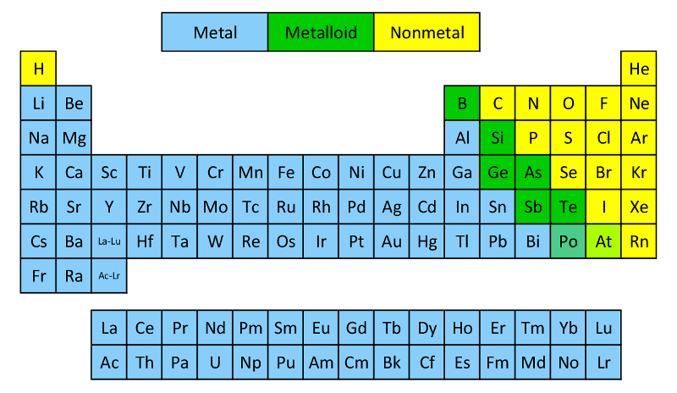
Review – Ch. 2
Know the following:
Metalloids (7*) – B, Si, Ge, As, Sb, Te, Po/At
Cations/Metals (left)
Anions/Non-metals (right)
Cations
Anions
Complicated
(more later!)

Slide 4
Formation Reaction for Cation (Ch. 3)
Review – Ch. 2
Example: Mg⁺²
You try it: Fe⁺³

Slide 5
Formation Reaction for Anions (Ch. 3)
Review – Ch. 2
Example: O⁺²
You try it: N⁻³

Slide 6
More Examples?

Slide 7
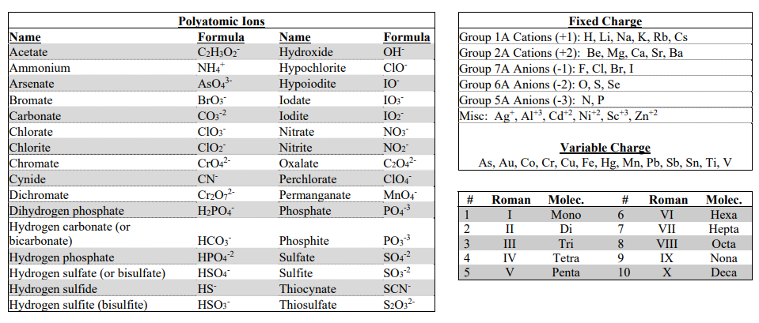
Charges of Common Ions
Use your cheat sheet!
Never leave home without it
Provided on every exam
Variable Charges
(more tomorrow)
Fixed Charges
Roman Numeral and
Molec. Prefixs
(more next week)
Polyatomic Ions
(more next slide)

Slide 8
Polyatomic Ions
Common Ionic Fragments
Use ( ) if more than 1
Poly = many (2+)
Atomic = atoms
Ions = charged

Slide 9
3 Methods to Balance Charges
Atoms
Old School Math and CA method
Cross Method + Simplify
Example: Compound formed between Ca and N
Example: Compound formed between Na and SO₄
Charges are
on your CS!

Slide 10
Method 2 – Math + CA Method
Example: Compound formed between Mg and P
Example: Compound formed between K and CO₃

Slide 11
Method 3 – Cross Multiple and Simplify
Example: Compound formed between Al and O
Example: Compound formed between Li and Cr₂O₇

Slide 12
You try it: Compound formed between Ca and PO₄
You try it: Compound formed between Al and SO₄
You try it: Compound formed between Na and SCN
You try it: Compound formed between Ag and HPO₄

Slide 13
More Examples?

