Slide 1
CHE 101 Fall 2021
Lecture 3 h,i – Density and Specific Heat
Overview/Topics
Use of Density as a CF
Variables – M, V, D
Problem solving
Use of Specific Heat as a CF
Heat vs Temp (differences)
Variables – q, m, s ΔT
Problem Solving
Don’t forget SF!
Skills to Master
HW 3 h,i
Additional Useful Links
www.chemhaven.org/che101
Khan Academy
Google/You Tube
Read
Hein Chapter 2 and Chapter 4

Slide 2
Conversion – Density and Specific Heat
*Unique for each element
Useful for identifying unknowns
Can you:
Solve Density Problems (Lab 7)
Solve Specific Heat Problems (Lab 9)

Slide 3
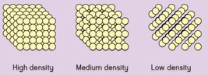
Conversions – Density
Ratio of the mass of an object to its volume
Measure of how closely packed the atoms are in a substance
$$D=\frac{M}{V}$$
M = Mass (g)
V = Volume (mL)
D = Density (g/mL)

Slide 4
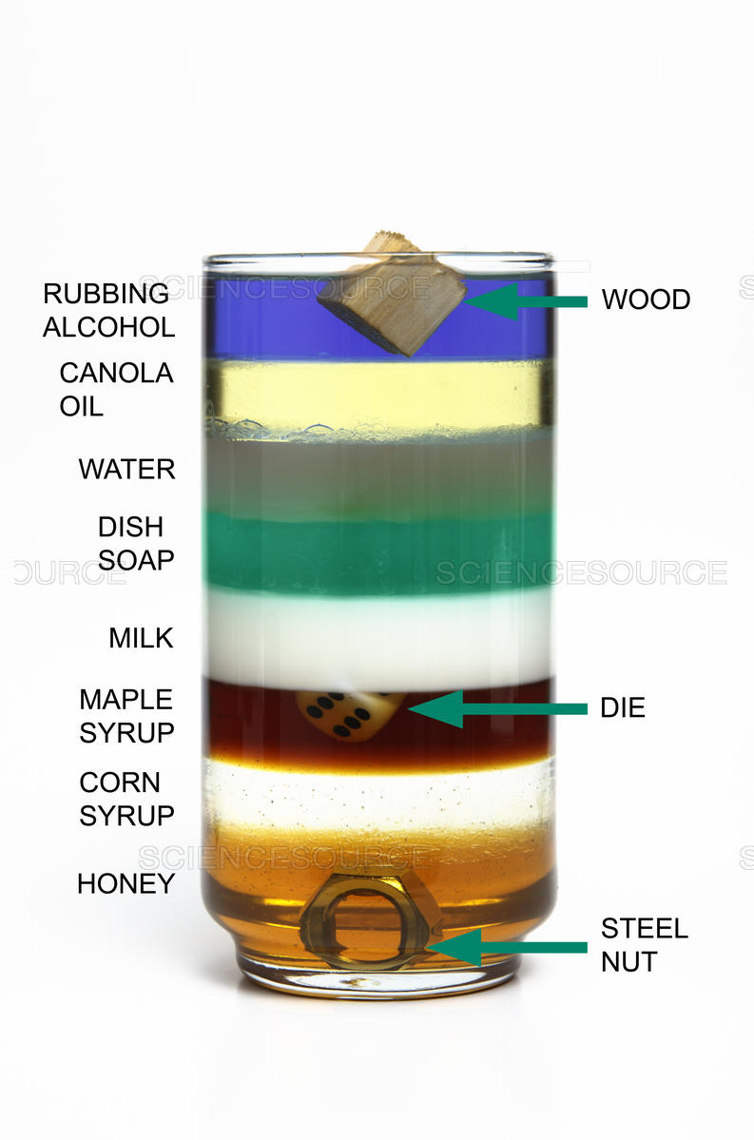
Conversion – Density Columns
Lowest Density
Highest Density

Slide 5
Solving Density Problems

Slide 6
Solving Density Problems (CF Method!)
Density has 2 units (g/ml OR ml/g) therefore it is just a CF like 1 ft = 12 in
Example: What is the volume (in L) of 25.0 kg of gold (Au)?
Can you:
Solve for D, M or V
Order Liquids
What are some other CF?
KISSS: Density is Just a Conversion Factor!

Slide 7
Solving Density Problems (CF Method!)
Density has 2 units (g/ml OR ml/g) therefore it is just a CF like 1 ft = 12 in
Example: What is the mass of 100. mL of gold (Au)?
Can you:
Solve for D, M or V
Order Liquids
What are some other CF?
KISSS: Density is Just a Conversion Factor!

Slide 8
You Try It:
What is the mass in pounds of 250 mL of mercury (Hg)?
You plan to steal a 500.0 lb silver (Ag) block. What is its volume in gallons?

Slide 9
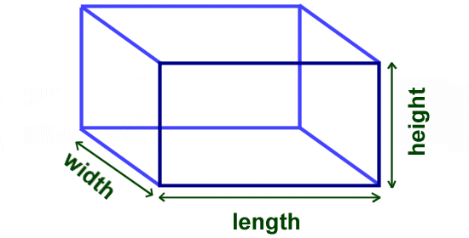
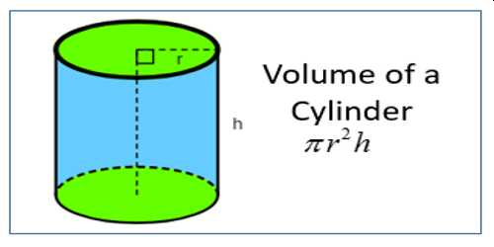
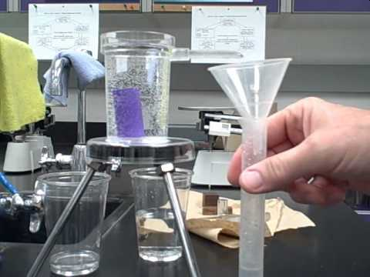
Experimentally Determining Density (2 Methods)
Use a scale
$$D=\frac{M}{V}$$
V = L x W x H
or
Archimedes Principle
Water Displacement

Slide 10
Example: You are given a gold necklace by your significant other. Being the chemist that you are (or may become) you decide to test if its real gold. You go into your chemistry lab and the necklace weighs 150 grams and when placed in a graduated cylinder the level of water changes from 55.0 mL to 66.6 mL. Is the necklace pure gold?

Slide 11
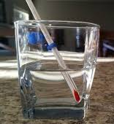
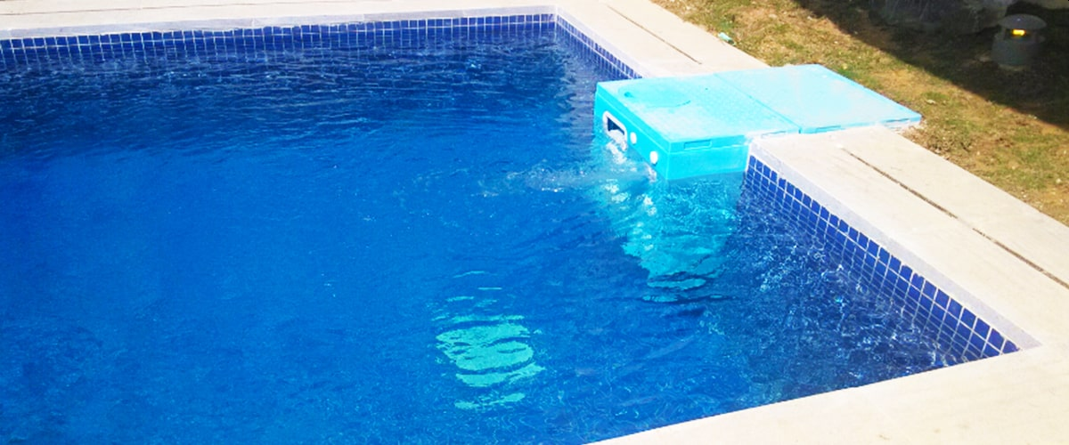
Heat (Thermal Energy)
Temperature
A measure of the average KE in a system (motion of molecules)
A form of energy
High Temperature – particles move faster
Low Temperature – particles move slower
Heat can be transferred between objects
Units – Joules or Calories
Units – °C, °F, or K
Extensive – depends on sample size
Intensive – independent on sample size
Same Temperature
Different Heat

Slide 12
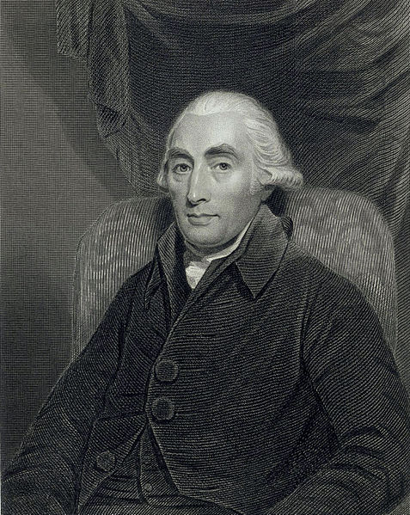
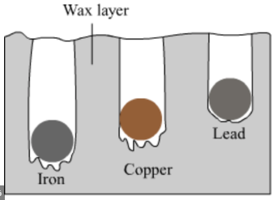
Heat - Quantitative Measurements
Joseph Black (1728-1799)
https://en.wikipedia.org/wiki/Joseph_Black
Analytical Scale
Properties of CO₂
Specific Heat
Metal Spoon = HOT!
Wood Spoon = Cool

Slide 13
Heat - Quantitative Measurements
Different substance store/absorb/transmit heat at different rates
How the atoms/molecules in a substance respond to heat is different
m - mass
g (kg, lbs. etc.)
ΔT - change in temperature
ΔT = T_{f} – T_{i}
°C (K or °F)
q = m s ΔT
Sign Conventions
+ = system absorbs energy
- = system loses energy
q - heat
J or cal
s - specific heat (c)
*Unique for each substance
Amount of heat required to
raise 1 gram of substance 1 °C
Units = J /g °C

Slide 14
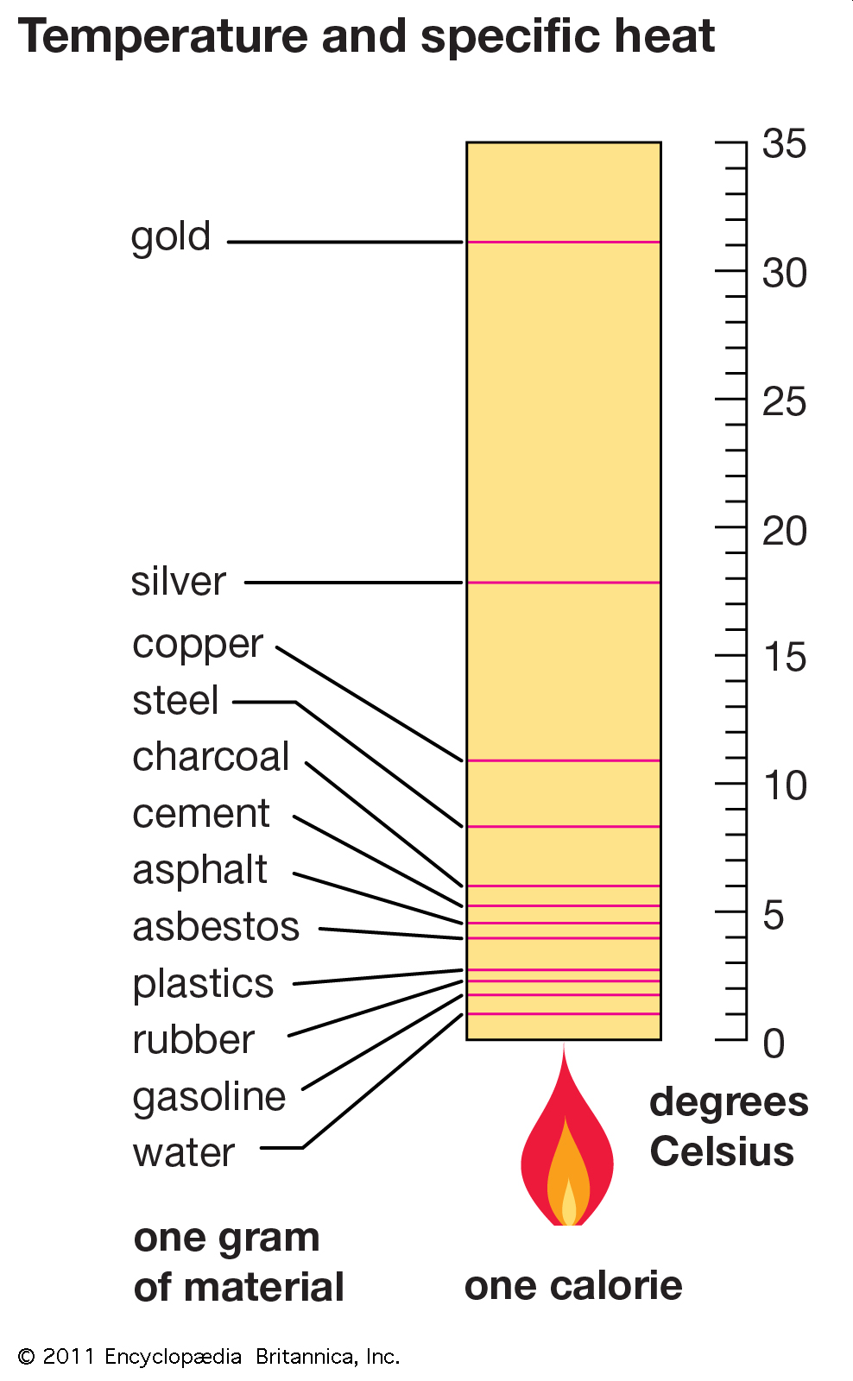
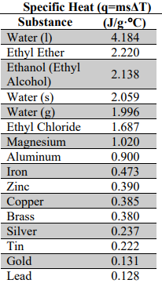
Specific Heat Values
*Unique for each substance
*On your CS!

Slide 15
How to Solve Problems
Q → A
Identify and List all values (based on units)
Identify additional CF needed
Rearrange the equation to solve for a given value
Try!
Types of Problems “Tricks”
Non Standard Units
Energy –
Mass –
Temperature –
Density ??
Extra Steps
Solving for Different Variables
Do the opposite
Do it to both sides
Don’t forget to!
Check/Cancel Units
Keep track of SF
Use SN if needed
Get help if you need it!

Slide 16
Example: Calculate the amount of heat (in J) required to boil a cup of water containing 150 mL from 20. °C to 90.°

Slide 17
Example: What amount of heat is required to boil 100.0 mL beaker of ethanol if the sample starts at 19.5 °C and the boiling point of ethanol is 78.4 °C

Slide 18
Example: What mass of Lead (Pb), in grams, can be heated with 250 kJ of energy from 50.0 °C to 150.°

Slide 19
Example: What is the specific heat of an unknown metal that required 250 kJ to heat 2.5 lbs of metal from 250. °C to 716.°C?

Slide 20
Example: A student supplies 2.50x10⁴ J of energy to a 500.0 grams sample of Silver (Ag). If the sample starts out at 25 °C what is the final temperature of the sample?

Slide 21
Example: A wood stove provides 650 J/min of heat. If you are trying to boil a cup of water that has a volume of 500.0 mL at 25.0 °C, how long (in hours) will it take to boil the water?

Slide 22
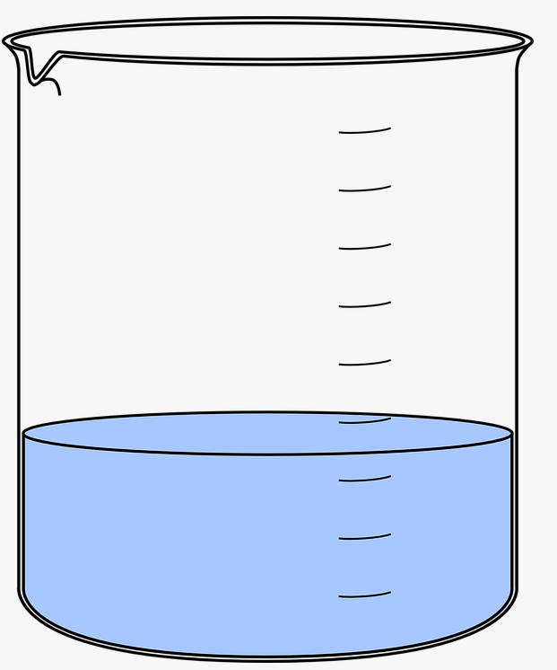
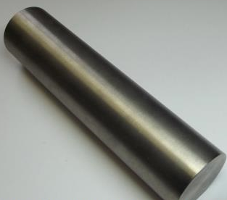
Linked Systems
Take a known system and “link” it to an unknown system to determine the missing value
Example: What is the specific heat of the unknown metal?
q_{metal} = msΔT
q_{water} = msΔT
Boiling Water = 95.0 °C
Water = 175.0 mL
Mass Unknown = 250.0 g
Water bath start = 20.8 °C
Water bath end = 26.0°C

Slide 25
Conversion – Energy and Pressure
Can you:
Remember it for the Future!

Slide 26
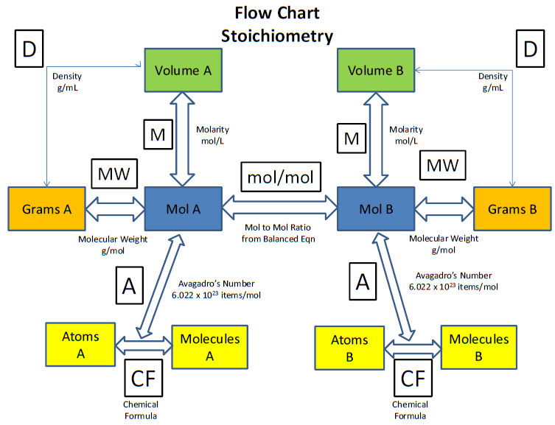
Conversion – Stoichiometry
Can you:
For the Future!

